Slide 1
Expression of Nuclear Receptors during Adipogenesis of 3T3-L1 Cells
COUP-TFI
COUP-TFII
PPARγ
VDR
GCNF
RORα
HNF4α
LXRα
LXRβ
RXRα
Nur77
REV-ERBα
REV-ERBβ

Slide 2
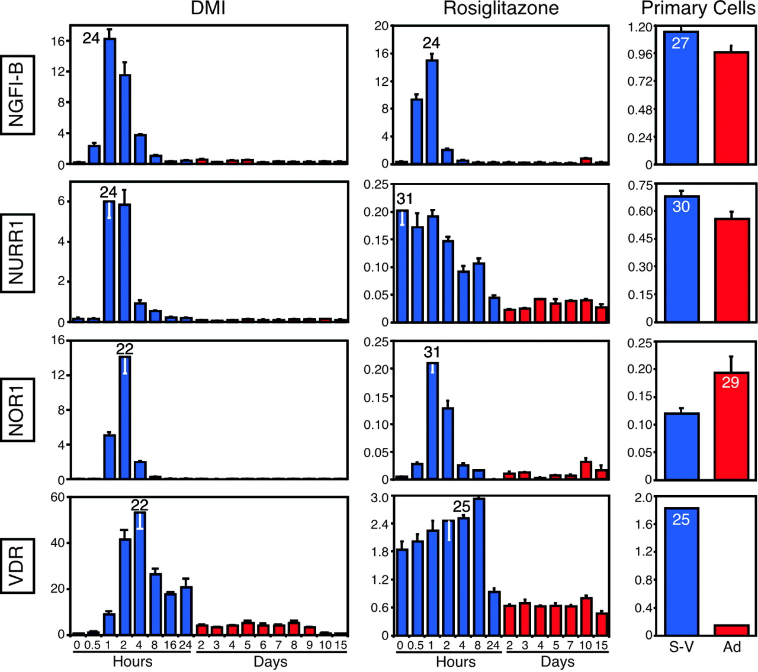
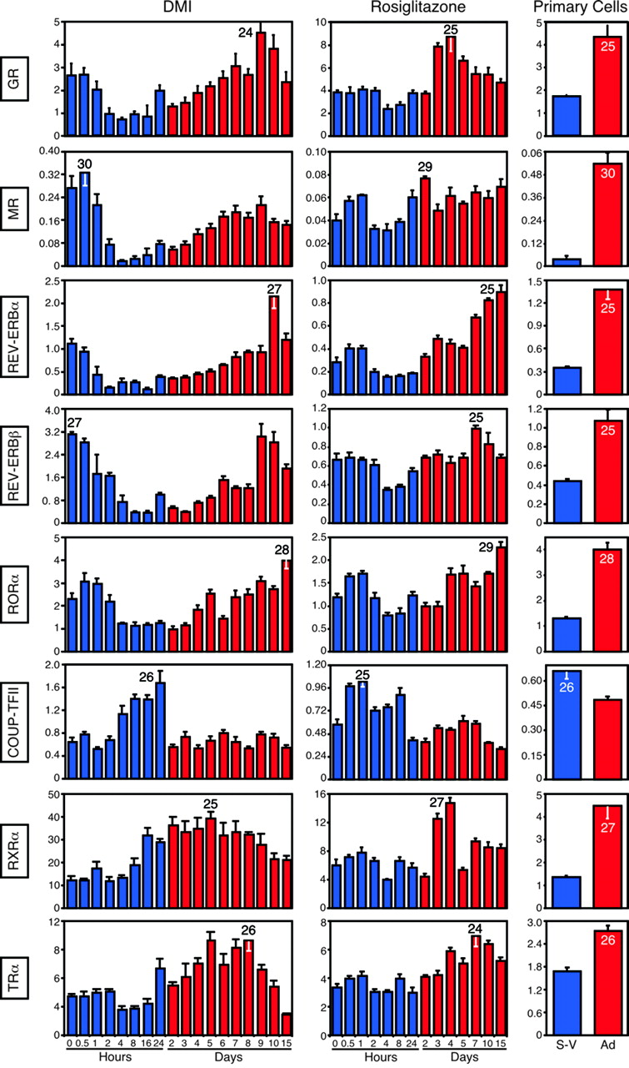
VDR and COUP-TFII Expression during Adipogenesis of 3T3-L1 Cells
Induction Medium
Differentiation Medium
0 6 12 18 24h 2d 3 4 5 6 7 8d
0h 4h 8h 18h 1D 2D 3D 4D 5D 6D 7D 8D
COUP-TFII
VDR
VDR
COUP-TFII
mRNA
Fu et al., Mol. Endo. 19: 2437 (2005)

Slide 3
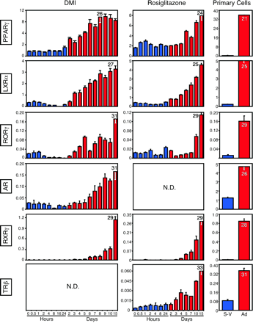
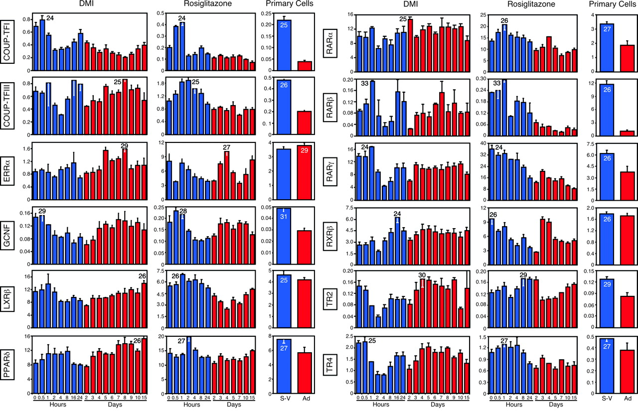
NR Expression during Adipogenesis of 3T3-L1 Cells (2)
Induction Medium
Differentiation Medium
0 6 12 18 24h 2d 3 4 5 6 7 8d
0h 4h 8h 18h 1D 2D 3D 4D 5D 6D 7D 8D
LXR α
Nur77
PPAR γ
LXRα
NUR77
PPARγ
Fu et al., Mol. Endo. 19: 2437 (2005)

Slide 4
NR Expression during Adipogenesis of 3T3-L1 Cells
Induction Medium
Differentiation Medium
0 6 12 18 24h 2d 3 4 5 6 7 8d
0h 4h 8h 18h 1D 2D 3D 4D 5D 6D 7D 8D
GCNF
COUP-TFI
RXR α
Actin
Fu et al., Mol. Endo. 19: 2437 (2005)

Slide 5
Other Nuclear Receptors
Inducing Medium
Djffer.Medium
3T3-L1 cells
0 2 4 8 18h 1 2 3 4 5 6 7 8
0h 4h 8h 18h 1D 2D 3D 4D 5D 6D 7D 8D
REV-ERB α
REV-ERB β
ROR α
LXR β
HNF4α

