Slide 1
models/kinematic_car_test.py – main simulation code
models/kinematic_car_test.py/create_env
Create map (maze, oblique_maze)
sim/simulation.py/Robot
Create a robot car (set system)
models/kinematic_car.py
Set car dynamics, geometry, and states
planning/path_generator/search_path_generator.py
/trajectory_generator/constant_speed_generator.py
Set global and local path planner
control/dcbf_optimizer.py
Set robot controller
sim/simulation.py
Build and run simulation

Slide 2
models/kinematic_car_test.py – main simulation code
models/kinematic_car_test.py/create_env
Create map (maze, oblique_maze)
sim/simulation.py/Robot
Create a robot car (set system)
models/kinematic_car.py
Set car dynamics, geometry, and states
planning/path_generator/search_path_generator.py
/trajectory_generator/constant_speed_generator.py
Set global and local path planner
control/dcbf_optimizer.py
Set robot controller
sim/simulation.py
Build and run simulation

Slide 3
models/kinematic_car_test.py – main simulation code
models/kinematic_car_test.py/create_env
Create map (maze, oblique_maze)
sim/simulation.py/Robot
Create a robot car (set system)
models/kinematic_car.py
Set car dynamics, geometry, and states
planning/path_generator/search_path_generator.py
/trajectory_generator/constant_speed_generator.py
Set global and local path planner
control/dcbf_optimizer.py
Set robot controller
sim/simulation.py
Build and run simulation

Slide 4
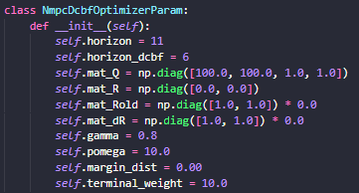
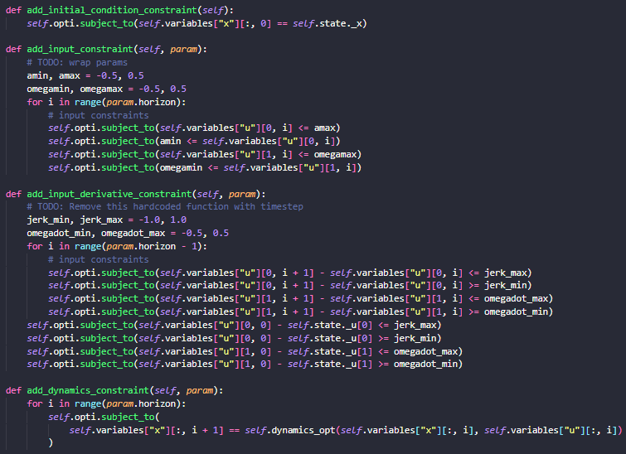
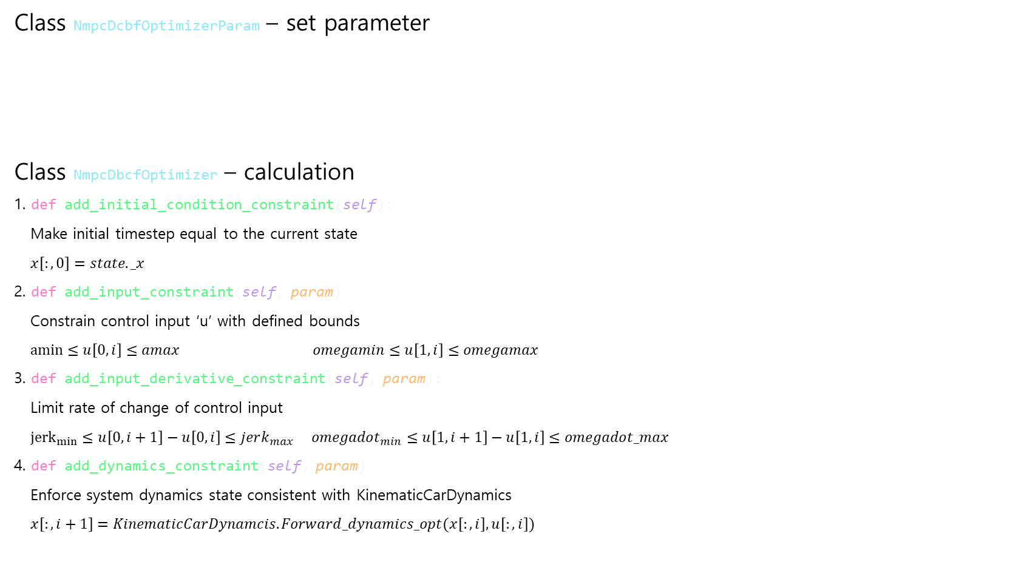
control/dcbf_optimizer.py – main controller code
Class NmpcDcbfOptimizerParam – set parameter
Class NmpcDbcfOptimizer – calculation
1. def add_initial_condition_constraint(self):
Make initial timestep equal to the current state
$x\left[:,0\right]=state._x$
2. def add_input_constraint(self, param)
Constrain control input ‘u’ with defined bounds
$amin≤u\left[0,i\right]≤amax omegamin≤u\left[1,i\right]≤omegamax$
3. def add_input_derivative_constraint(self, param):
Limit rate of change of control input
${jerk}_{min}≤u\left[0,i+1\right]−u\left[0,i\right]≤jerk_{max} omegadot_{min}≤u\left[1,i+1\right]−u\left[1,i\right]≤omegadot_max$
4. def add_dynamics_constraint(self, param)
Enforce system dynamics state consistent with KinematicCarDynamics
$x\left[:,i+1\right]=KinematicCarDynamcis.Forward_dynamics_opt(x\left[:,i\right],u\left[:,i\right])$

Slide 5
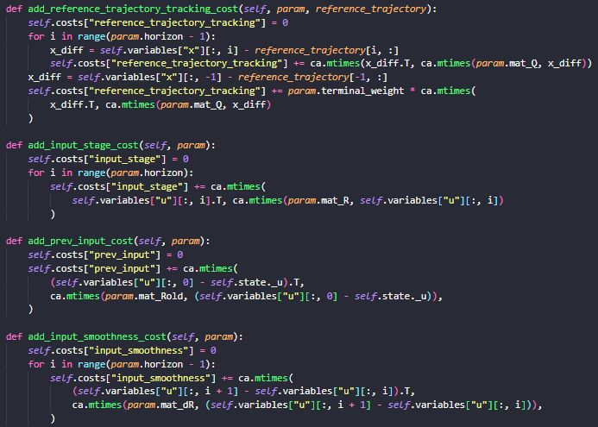
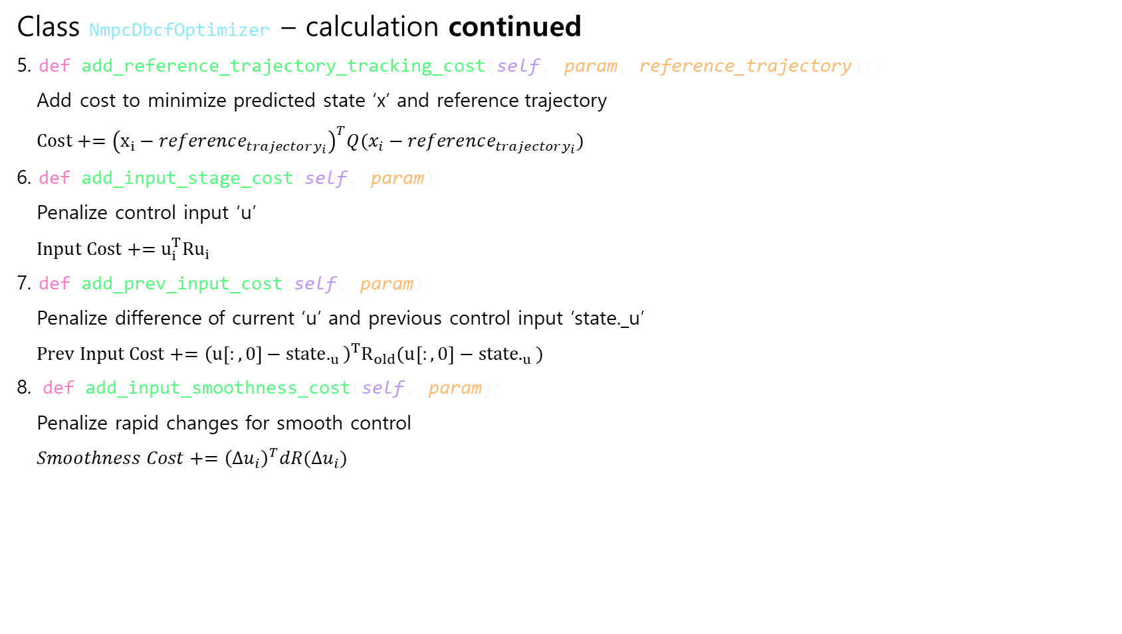
control/dcbf_optimizer.py – main controller code
Class NmpcDbcfOptimizer – calculation continued
5. def add_reference_trajectory_tracking_cost(self, param, reference_trajectory)::
Add cost to minimize predicted state ‘x’ and reference trajectory
$Cost+={\left(x_{i}−reference_{trajectory_{i}}\right)}^{T}Q(x_{i}−reference_{trajectory_{i}})$
6. def add_input_stage_cost(self, param)
Penalize control input ‘u’
$Input Cost+=u_{i}^{T}Ru_{i}$
7. def add_prev_input_cost(self, param)
Penalize difference of current ‘u’ and previous control input ‘state._u’
$Prev Input Cost+={\left(u\left[:,0\right]−state._{u}\right)}^{T}R_{old}(u\left[:,0\right]−state._{u})$
8. def add_input_smoothness_cost(self, param):
Penalize rapid changes for smooth control
$Smoothness Cost+={\left(∆u_{i}\right)}^{T}dR(∆u_{i})$

Slide 6
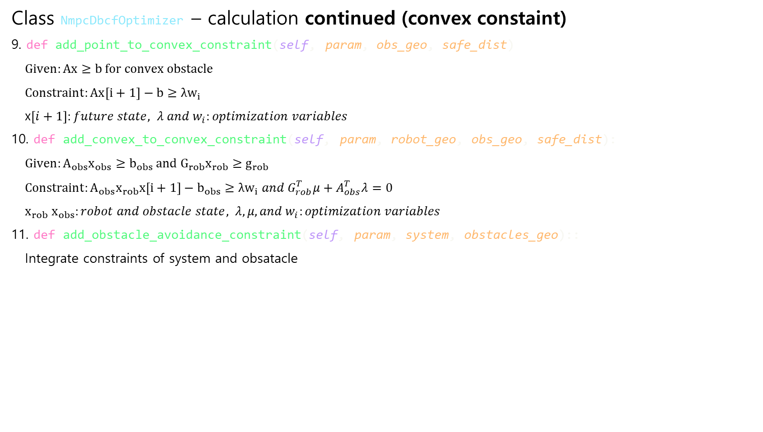
control/dcbf_optimizer.py – main controller code
Class NmpcDbcfOptimizer – calculation continued (convex constaint)
9. def add_point_to_convex_constraint(self, param, obs_geo, safe_dist)
$Given:Ax≥b for convex obstacle$
$Constraint:Ax\left[i+1\right]−b≥λw_{i}$
x$\left[i+1\right]:future state, λ and w_{i}:optimization variables$
10. def add_convex_to_convex_constraint(self, param, robot_geo, obs_geo, safe_dist):
$Given:A_{obs}x_{obs}≥b_{obs} and G_{rob}x_{rob}≥g_{rob}$
$Constraint:A_{obs}x_{rob}x\left[i+1\right]−b_{obs}≥λw_{i} and G_{rob}^{T}μ+A_{obs}^{T}λ=0$
$x_{rob} x_{obs}:robot and obstacle state, λ, μ, and w_{i}:optimization variables$
11. def add_obstacle_avoidance_constraint(self, param, system, obstacles_geo)::
Integrate constraints of system and obsatacle

Slide 7
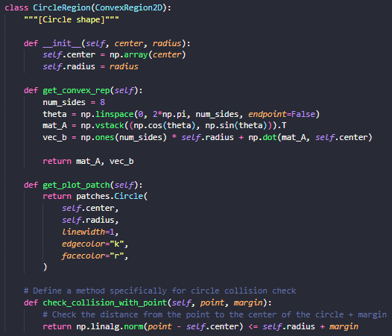
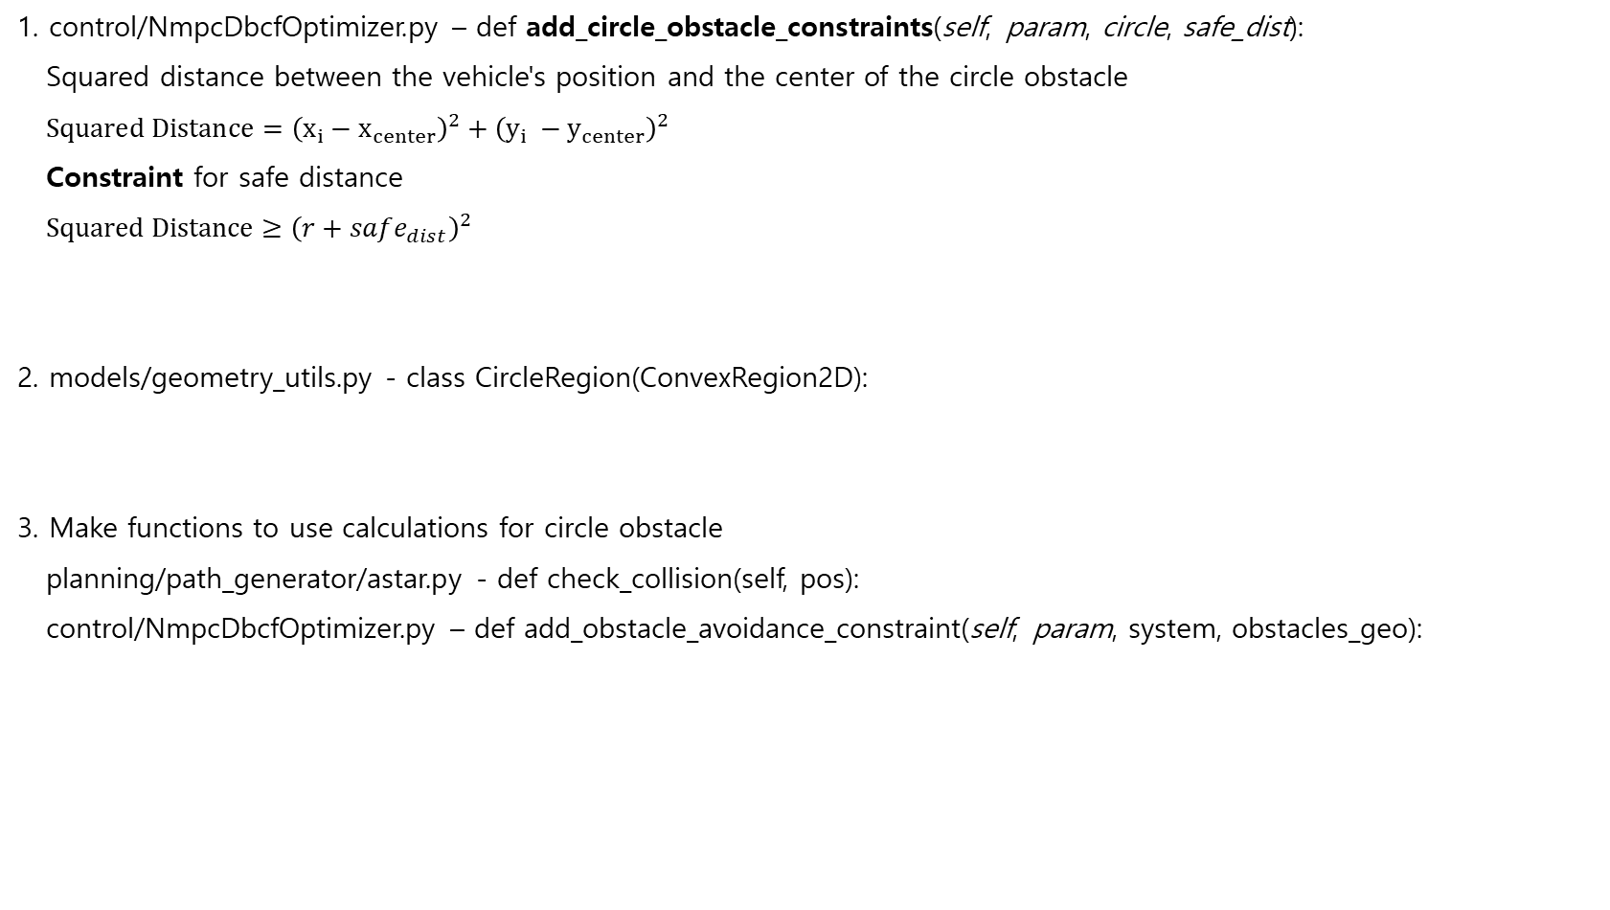
Adding Circle obstacle map
1. control/NmpcDbcfOptimizer.py – def add_circle_obstacle_constraints(self, param, circle, safe_dist):
Squared distance between the vehicle's position and the center of the circle obstacle
$Squared Distance={\left(x_{i}−x_{center}\right)}^{2}+{\left(y_{i} −y_{center}\right)}^{2}$
Constraint for safe distance
$Squared Distance≥{\left(r+safe_{dist}\right)}^{2}$
2. models/geometry_utils.py - class CircleRegion(ConvexRegion2D):
3. Make functions to use calculations for circle obstacle
planning/path_generator/astar.py - def check_collision(self, pos):
control/NmpcDbcfOptimizer.py – def add_obstacle_avoidance_constraint(self, param, system, obstacles_geo):

Slide 8
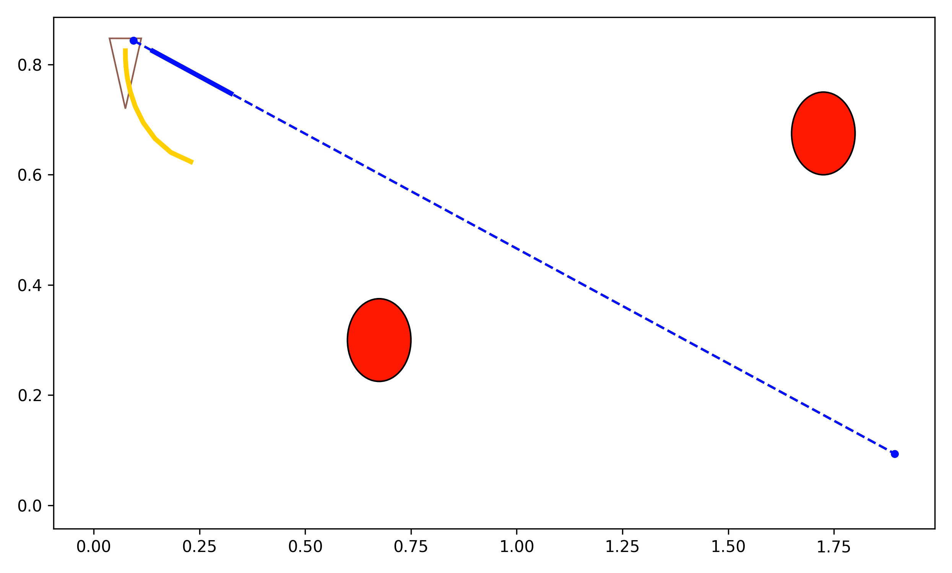
Adding Circle obstacle map
Currently not working when circle obstacle is on the way to the trajectory
Future work - planner

Slide 9
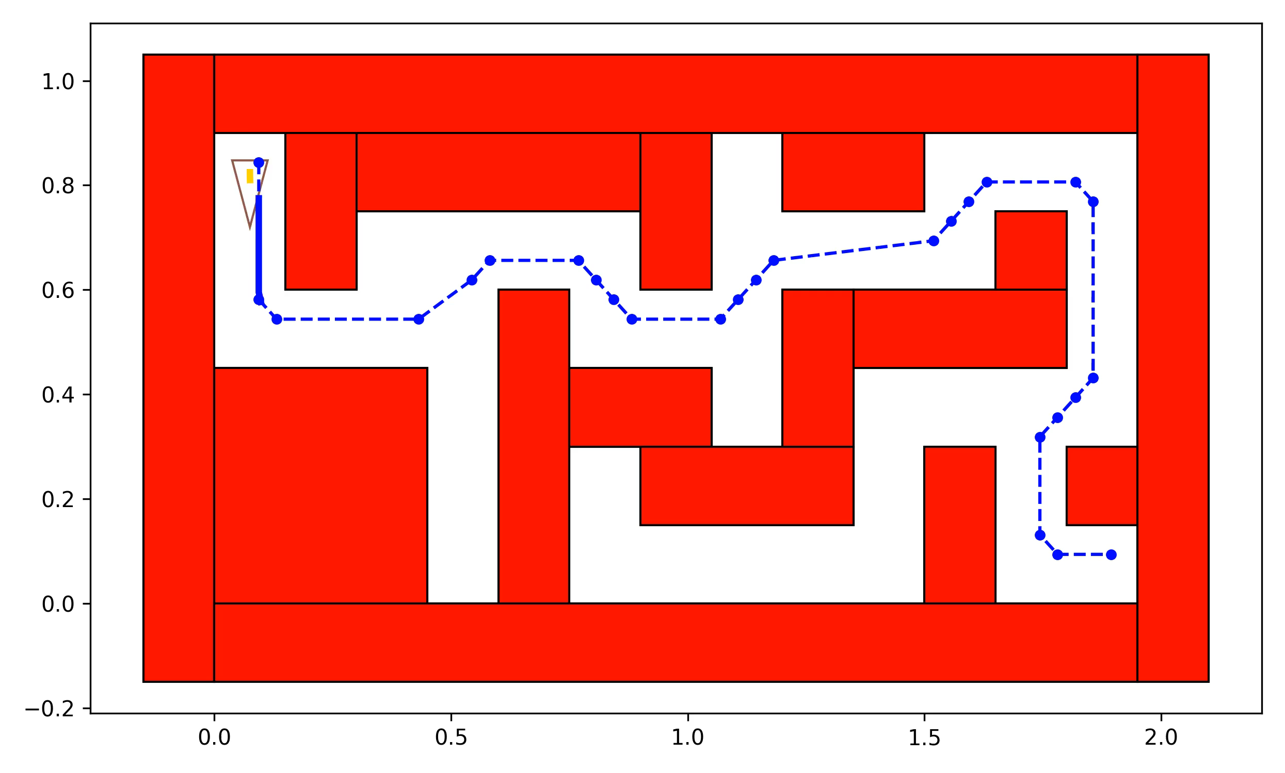

Horizon 3 vs 11
Future work

