Slide 1
CK-AppIdentity
Basic Distributed Applications Topologic Model

Slide 2
Primary Objectives
Be the simplest model to describe a distributed system topology.
Be as simple as possible to configure.
  Configured identity related information are immutable during a run.
  Dynamic identities can be added, removed and reconfigured while executing.
Supports different topologies
  Centralized with a shared, central, directory of all the parties.
  Decentralized where parties only sees peers.
  With and/or without Message Bus.
Applies to simple Agents as well as Multi-Tenant site.
Handles totally external end points
  Customer web services
  Cloud Services (Azure, AWS, GitHub, etc.)

Slide 3
Secondary Objectives
Follows the “Package First” approach.
Encapsulates complexities
  Capabilities discovery
  Secret keys management
Supports “Observability”
  Logs from a Party are identified and can be easily managed.
Be agnostic of deployment details
  Transport layers (TCP/IP, quic, mqtt, etc.)
  VLAN and/or WAN

Slide 4
DomainName/EnvironmentName/PartyName
This triple identifies any Party in the Universe.
This drives the Observability layer
  Logs are collected with this 3-levels hierarchy.
  Any “Event Source” (whatever the event is) is identified by this triple.
How can a simple model like this one cover all our needs?
We’ll now present different static configurations.
  Starting with a simple Agent up to a multi-tenant site that drives multiple domains.
  This will define the dream.
Then we’ll see the “dynamic” aspect, and some required “magic”…
  …to make this the reality.

Slide 5
A simple Agent.
One should be able to understand the interactions of any Party by looking at its Application Identity configuration
{
"DomainName": "LaToulousaine",
"EnvironmentName": "Production",
"Local": {
"Name": "Trolley1"
},
"Remotes": [
{
"Name": "LogTower",
"Address": "148.54.11.18:3712"
},
{
"Name": "SignatureBox",
"Address": "155.88.22.22"
}]
}
There should be no more than that for our Trolley1:
  Sends its logs to a “LogTower” party.
  Can initiate communications with the “SignatureBox” party.
The “Address” is not a URI or URL.
  It can be any string that makes the remote reachable from this party.

Slide 6
The SignatureBox.
{
"DomainName": "LaToulousaine",
"EnvironmentName": "Production",
"Local": {
"Name": "SignatureBox"
},
"Remotes": [
{
"Name": "LogTower",
"Address": "148.54.11.18:3712"
},
{
"Name": "Trolley1"
},
{
"Name": "Trolley2"
},
{
"Name": "PickingStation"
}]
}
The SignatureBox also sends its logs to the same LogTower and knows the Trolley1 but also the Trolley2 and a PickingStation.
These 3 remotes have no Address.
  "LaToulousaine/Production/SignatureBox" is a server for them.
  This is enough for the warehouse to do its work.

Slide 7
Simplifications
From now on, we don't show the LogTower configuration .
  This is the same for every party (if we want to target the same LogTower).
We also don’t specify the “EnvironmentName” anymore.
  This defaults to the IHostEnvironment.EnvironmentName (that defaults to “Development”)
Domain and Environment names configuration inherit from the root to the Remotes.
  Inheriting is the default behavior.
  Overriding the Domain and Environment names is possible: a Remote can be in another Domain and another Environment.

Slide 8
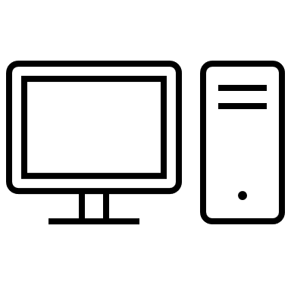

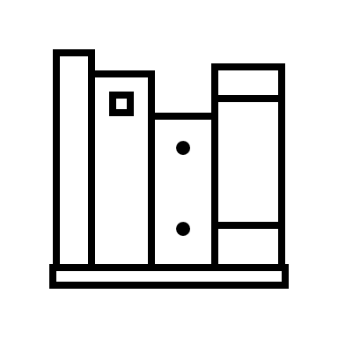

What we have so far: a warehouse.
Now we want the SignatureBox to interact with a OneCS application (the supervision and operation portal).
The OneCS application typically lives in the cloud.
If the SignatureBox can be reached from the outside, we just need to declare the new OneCS remote on the SignatureBox.
SignatureBox
Trolley1
Trolley2
PickingStation
Devices

Slide 9
OneCS (can reach the SignatureBox).
The name of this new Party is the same as the DomainName: this Party is the "domain controller"
{
"DomainName": "LaToulousaine",
"Local": {
"Name": "SignatureBox"
},
"Remotes": [
{
"Name": "Trolley1"
},
{
"Name": "Trolley2"
},
{
"Name": "PickingStation"
},
{
"Name": "LaToulousaine"
}]
}
{
"DomainName": "LaToulousaine",
"Local": {
"Name": "LaToulousaine"
},
"Remotes": [
{
"Name": "SignatureBox",
"Address": "65.12.13.14"
}]
}
Initiate
2-ways exchange

Slide 10
OneCS (cannot reach the SignatureBox).
This may be the most common configuration pattern.
{
"DomainName": "LaToulousaine",
"EnvironmentName": "Production",
"Local": {
"Name": "SignatureBox"
},
"Remotes": [
{
"Name": "Trolley1"
},
{
"Name": "Trolley2"
},
{
"Name": "PickingStation"
},
{
"Name": "LaToulousaine",
  "Address": "27.28.29.30:3712"
}]
}
{
"DomainName": "LaToulousaine",
"Local": {
"Name": "LaToulousaine"
},
"Remotes": [
{
"Name": "SignatureBox“
}]
}
Initiate
2-ways exchange
Notes:
We are NOT going to use any relay or hole punching strategies here. We require that A can reach B OR B can reach A directly, if both A and B are behind NAT this doesn’t work and that’s it.
See https://bford.info/pub/net/p2pnat/index.html for a detailed discussion about NAT traversing.

Slide 11
LaToulousaine is actually a SaaS customer…
There is only one OneCS Application for multiple Domains. LaToulousaine is just one of them.
The SaaS offer scales horizontally:
  A set of servers:
    Parties are named “OneCS1”, “OneCS2”, “OneCS3”, etc.
    And share the same Domain: “SaasOneCS”
Each OneCS application contains and defines the Domains they handle.

Slide 12
LaToulousaine in SaaS is hosted by OneCS1
The actual configuration of the Remote Party is:
{
"DomainName": "SaasOneCS",
"Local": {
"Name": "OneCS1"
},
"Remotes": [
{
"Name": "LaToulousaine",
"Domain": {
"Remotes": [
{
"Name": "Trolley1"
},
{
"Name": "Trolley2"
},
{
"Name": "PickingStation"
}]
}
}]
}
{
"DomainName": "SaasOneCS",
"Name": "LaToulousaine",
"Domain": {
"DomainName": "LaToulousaine",
"Local": {
"Name": "LaToulousaine"
},
"Remotes": [
{
"Name": "Trolley1"
},
{
"Name": "Trolley2"
},
{
"Name": "PickingStation"
}]
}
Domain Controller
"EnvironmentName" is also under control of the Remote definition.

Slide 13
Oups! LaToulousaine is NOT in production yet!
{
"DomainName": "SaasOneCS",
"Environment": "Production",
"Local": {
"Name": "OneCS1"
},
"Remotes": [
{
"Name": "LaToulousaine",
"Environment": "Staging",
"Domain": {
"Remotes": [ … ]
}
}]
}
{
"DomainName": "SaasOneCS",
"Environment": "Staging",
"Name": "LaToulousaine",
"Domain": {
"DomainName": "LaToulousaine",
"Environment": "Staging",
"Local": {
"Name": "LaToulousaine"
},
"Remotes": [ … ]
}
Party Full Name | Description
SaasOneCS/Production/OneCS1 | The server n°1 of the SaasOffer.
SaasOneCS/Staging/LaToulousaine | Host of the Domain in the Saas offer.
LaToulousaine/Staging/LaToulousaine | The controller of the customer domain.
LaToulousaine/Staging/Trolley1 LaToulousaine/Staging/Trolley2 etc. | The customer’s agents.

Slide 14
LaToulousaine goes to London
We may keep the single LaToulousaine domain and define the English Agents in them…
  … and deal with “Trolley1” and “London_Trolley1”.
  This less than ideal!
We can do better but this requires a small adjustment to the Domain notion.
  LaToulousaine domain must continue to exists: its logs are grouped under this root key, a repository exists for “LaToulousaine” (and may be a Stack), we earn money from “LaToulousaine”, OneCS must continue to have a “LaToulousaine” landing page with its users (no matter how much warehouses there are and where they are).

Slide 15
The “Extended Domain Name”
We allow the DomainName to contain “/”.
“LaToulousaine/London” and “LaToulousaine/France/Toulouse” are valid domain names.
Everything that has been said about the fundamental triple Domain/Environment/Party is still true.
  We don’t manage a tree of resources.
  The 2-levels only architecture of the Application Identity is unchanged.
Only the “Full Path” of a Party must be redesigned:
  The Environment is injected after the first part of the domain name.

Slide 16
The final D/E/P Party identity
The logical identity is a triple of string “DomainName”, ”EnvironmentName”, “PartyName”.
Its full name is a NormalizedPath.
It ultimately defaults to “Undefined/Development/Unknown”.
DEP | Path
D: LaToulousaine/France/Toulouse E: Production P: Trolley45 | LaToulousaine/Production/France/Toulouse/Trolley45
D: LaToulousaine/London E: Development P: RobotTrolley | LaToulousaine/Development/London/RobotTrolley

Slide 17
Security and privacy
No keys appear in the configuration.
At least one X509 certificate must be available per Party.
  SaasOneCS/Production/OneCS1 can work with a single certificate.
Keys are managed “by design” in a store by CK.AppIdentity.
  The simplest store is a folder with folders and/or files that contain the certificate files.
  Stronger key store may be implemented later.
Any relationship between 2 parties can be protected with a dedicated pair of keys.

Slide 18
Other uses…
Describing and configuring external services.
  Package First…
{
"DomainName": "Signature",
"EnvironmentName": "Production",
"Local": {
"Name": "CodeCenter"
},
"Remotes": [
{
"DomainName": "Undefined",
"Name": "GitOpenSource",
"GitHub": {
"Organization": "Signature-OpenSource",
"SecretToken": "45kKJDHldf57dsj87f6fefAsdjhfsdfzr654ZEd5zf"
}
},
{
"DomainName": "Undefined",
"Name": "GitSource",
"GitHub": {
"Organization": "Signature-Code",
"SecretToken": “Lkjdchbej236ecec6876edc3evqwx57d2455zefdaa"
}
}]
}
“Undefined” is the reserved Domain name that means “external to the System”
We don’t need an “Address”: this remote is a GitHubApp because of the “GitHub” configuration key.
The package CK.AppIdentity.GitHubApp handles this automatically.

Slide 19
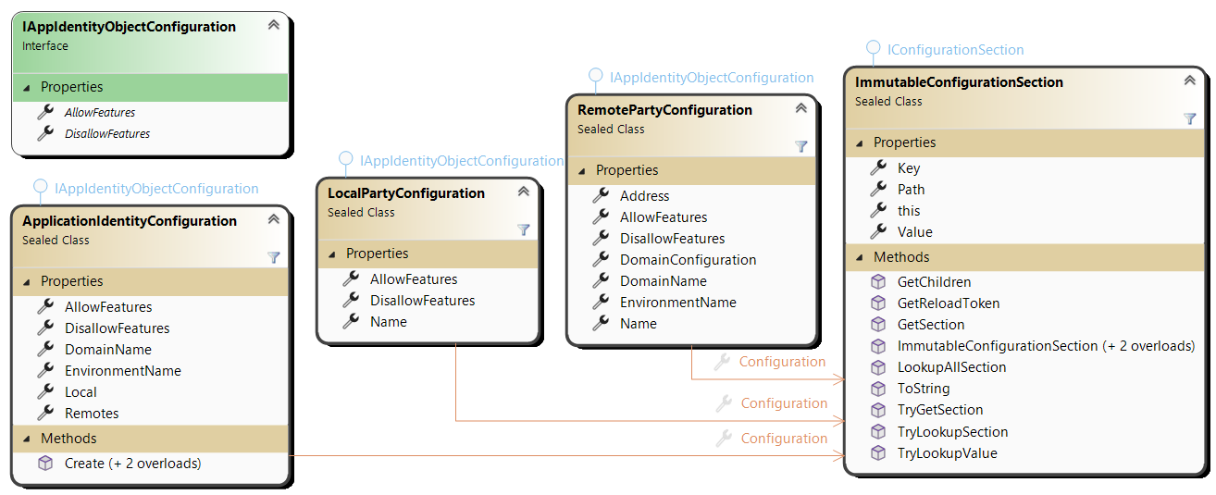
A simple Configuration Model

Slide 20
Exploit the .Net Configuration model
ApplicationIdentityConfiguration supports any .Net Configuration source.
Provides 2 helpers and MutableConfigurationSection and ImmutableConfigurationSection to support direct manipulation code
static ApplicationIdentityConfiguration? Create( IActivityMonitor monitor,
IConfigurationSection configuration,
string? defaultLocalName = null,
string? defaultEnvironmentName = "Development" )
var configuration = ApplicationIdentityConfiguration.Create( monitor, c =>
{
c["DomainName"] = "Test";
c["Local:Name"] = "Listener";
c["Remotes:0:Name"] = "Sender";
c["AllowFeatures"] = "BlobChannel";
} );

Slide 21
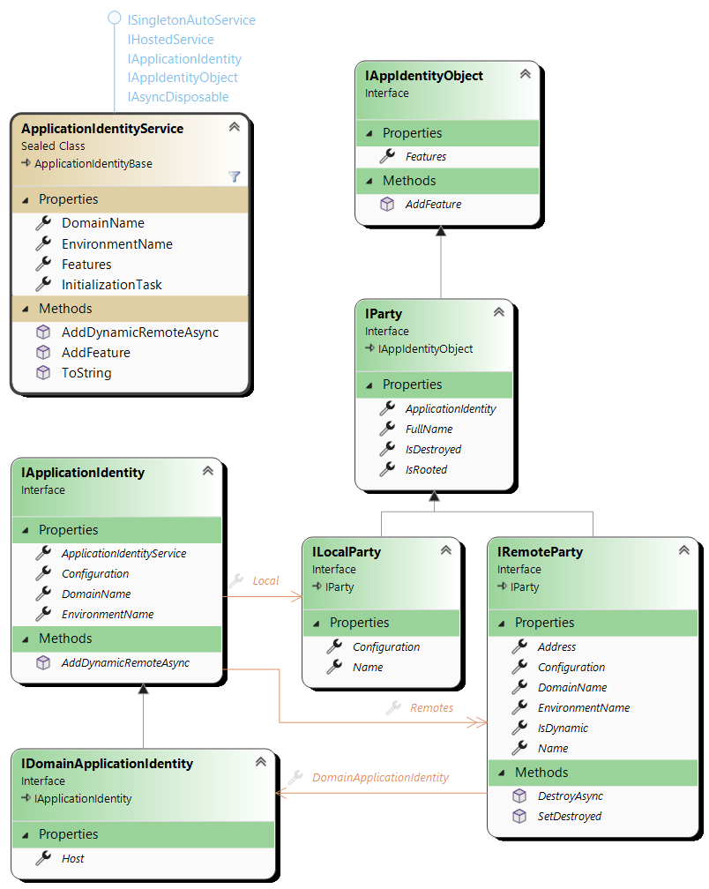
Runtime Model
Root ApplicationIdentityService is an automatic hosted service singleton.
A Remote can define a Domain.
New Remotes can be added dynamically (AddDynamicRemoteAsync).
Only dynamic Remotes can be destroyed (SetDestroyed or DestroyAsync).
Thread safety
  Once InitializationTask is resolved, everything is stable.
  A background micro agent handles the dynamic Remotes mutations.

Slide 22
The “Features”
Developer uses Features.
Features are IEnumerable<object> available on:
  The root ApplicationIdentityService
  Local and Remote parties (but not on the DomainApplicationIdentity).
  void AddFeature( object feature ) and void RemoveFeature( object feature )
One can add and remove a Feature “from the outside”:
  void AddFeature( object feature )
  void RemoveFeature( object feature )
But Feature are primarily instantiated, configured, added to and removed from the relevant parties thanks to ApplicationIdentityFeatureDriver specialized services.

Slide 23
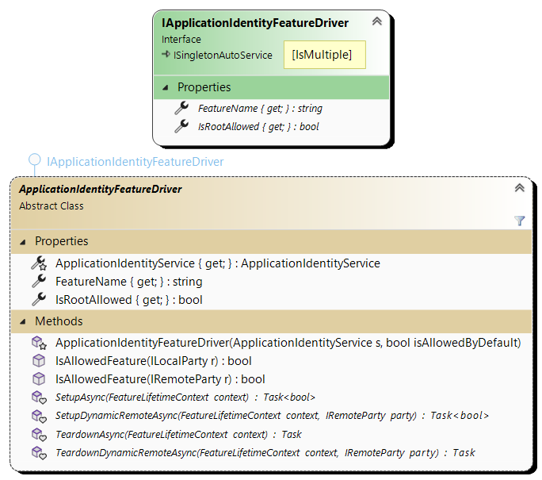
Feature Driver
Setup the whole service.
Setup new dynamic Remotes.
Teardown destroyed Remotes.
Teardown the whole service.
A feature driver type name MUST be suffixed with 'FeatureDriver'

Slide 24
Opt-In/Out and Allow/DisallowFeatures
Features can be opt-in or opt-out.
  This is provided when calling the base ApplicationIdentityFeatureDriver constructor.
Features can then be allowed or disallowed by the configuration.
  The BlobChannel is an opt-in feature. To exchange byte[] it must be allowed.
protected ApplicationIdentityFeatureDriver( ApplicationIdentityService s,
bool isAllowedByDefault )
{
"DomainName": "Test",
"Local": { "Name": "Sender" },
"AllowFeatures": "BlobChannel"
"Remotes": [
{
"Name": "Target",
"Address": "tcp:127.0.0.1“
}]
}
{
"DomainName": "Test",
"Local": { "Name": “Target" },
"Remotes": [
{
"Name": "Sender",
"AllowFeatures": ["BlobChannel"]
}]
}
Notes:
Allow/DisallowFeatures can be a string or an array of strings.

Slide 25
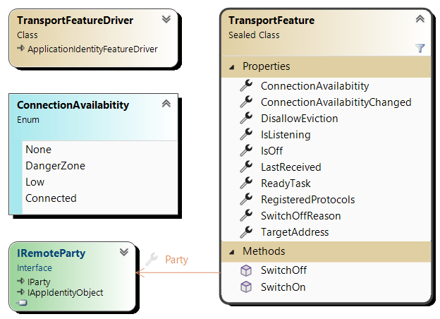
The TransportFeature
Opt-out feature: available by default on all Remotes that are not in the domain “Undefined”
  To remove it:
  "DisallowFeatures": "Transport“
Transport is “on” by default but can be SwithOff/SwitchOn
DisallowEviction is false by default (like MQTT).
The ReadyTask can be awaited before using the Transport.

Slide 26
The exchange Channels
A Remote’s TransportFeature handles the transport to the other side.
  Listener vs. Sender is automatically handled based on the configuration.
  The transport technology can be specified. The default is “tcp”.
The TransportFeatures exposes the properties relevant to the communication but is not itself in charge of exchanging data.
Channels are Features that implements a protocol and exposes it to the developer.
Channels implementation provides:
  A Protocol that can be in multiple versions.
  A way to build and send, receive and parse TransportMessage objects.
Notes:
Before detailing the Channels, we need to cover the TransportMessage and its Factories and the Transport and TransportType model.

Slide 27
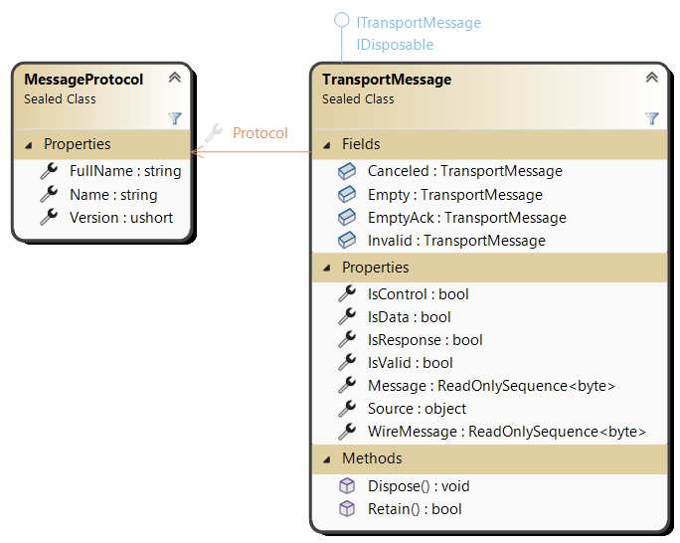
TransportMessage
Prefix-Length encoding
  Single header byte
  MessageLength (0 to 4 bytes)
  Payload (up to 2 GiB)
Header byte: L0|L1|CD|R0|R1|P0|P1|P2
  L0-L1: number of bytes of the message length.
  CD: “Control/ Data” bit.
  R0-R1: Reserved for future use.
  P0-P2: Protocol number (0 to 7).
The Protocol Number defines the "type" of the message: the writer/serializer that has been used to write the payload and the reader/deserializer that must be used to read it back.
Notes:
All messages exchanged by the Transport layer are prefixed by the message's protocol and length.
- The prefix starts with a first byte: `|L0|L1|CD|R0|R1|P0|P1|P2|`.
- The 2 MSB (L0-L1) gives us the number of bytes of the message length:
- `00` 1 byte, the message length is between 0 and 255 bytes.
- `01` 2 bytes, the message length is between 256 and 65535 bytes.
- `10` 3 bytes, the message length is between 65536 and 16 777 215 bytes.
- `11` 4 bytes, the message length is between 16 777 216 and 2 147 483 648 bytes (2 Gib).
- The `CD` bit is the "Control vs. Data" bit. This is a convenient bit that can be used by protocols
as a one bit discriminator, typically between a regular data message and one (or more) control message.
- `R0` and `R1` bit are reserved for future use.
- P0-P2 bits is the Protocol, a number between 0 and 7. This number defines the "type" of the
message: the writer or serializer that has been used to write the payload and the reader or "deserializer"
that must be used to read it back.
- Then comes the message length itself (1 to 4 bytes)
- Then the message payload itself.
At a higher level "MessageProtocol” are identified by a string (its unique name).
A protocol defines how the message is encoded and how they are exchanged: by merging these 2 concepts here,
we greatly simplify the implementation and the understandability of the Transport layer. The protocol simply
defines the encoding it uses.

Slide 28
The 8 protocols maximal count
Only 8 protocols can be expressed.
  The “0 Protocol” protocol is reserved: this is the protocol of CK.AppIdentity.TransportLayer itself that handles special messages used to negotiate, accept, reject incoming parties and outgoing connections.
  This lets 7 possible protocols.
This limit applies to a Remote party pair:
  There can be any number of possible protocols in an application
  2 parties that start to interact initially negotiate the ones they can and want to use.
Any Transport between 2 parties can simultaneously support up to 7 different protocols.
Notes:
The `"0 Protocol"` protocol name is reserved: this is the protocol of CK.AppIdentity.TransportLayer itself that handles
special messages used to negotiate, accept, reject incoming parties and outgoing connections.
This lets 7 possible protocols. This may seem a limitation however this limit applies to a Remote party pair: there
can be any number of possible protocols in an application, among them 2 parties that start to interact initially
negotiate the ones they can and want to use. Any Transport between 2 parties can support up to 7 different protocols.
The final length of a message on the wire is between 2 bytes (the special Empty message, see below) and 2 Gib.
A minimal 1 byte message requires 3 bytes (in any of the 7 available protocols).

Slide 29
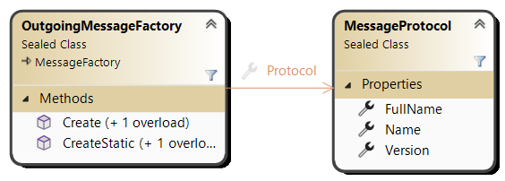
Creating new messages
Only an OutgoingMessageFactory can
create new messages:
Messages must be disposed once done with them
  Allocated memory is reused.
Messages can be “Retained” when needed (reference counting)
CreateStatic returns messages don’t need to be disposed.
  Dispose()/Retain() calls are ignored.
public TransportMessage Create( Action<IBufferWriter<byte>> writer,
bool isControl = false );
public TransportMessage Create( Action<MutableSequence<byte>> writer,
bool isControl = false );

Slide 30
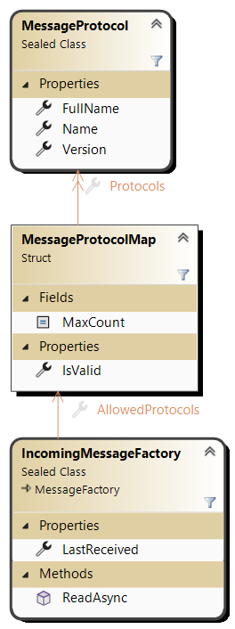
Reading incoming messages
Only an IncomingMessageFactory can read messages:
From any asynchronous function that can fill a buffer with an exact count of bytes.
The developer never interacts directly with an IncomingMessageFactory.
Concrete Transport implementations provide the exactReader function.
public Task<TransportMessage> ReadAsync
(
Func<Memory<byte>, CancellationToken, ValueTask> exactReader,
int maxMessageLength = int.MaxValue,
CancellationToken cancellation = default
)

Slide 31
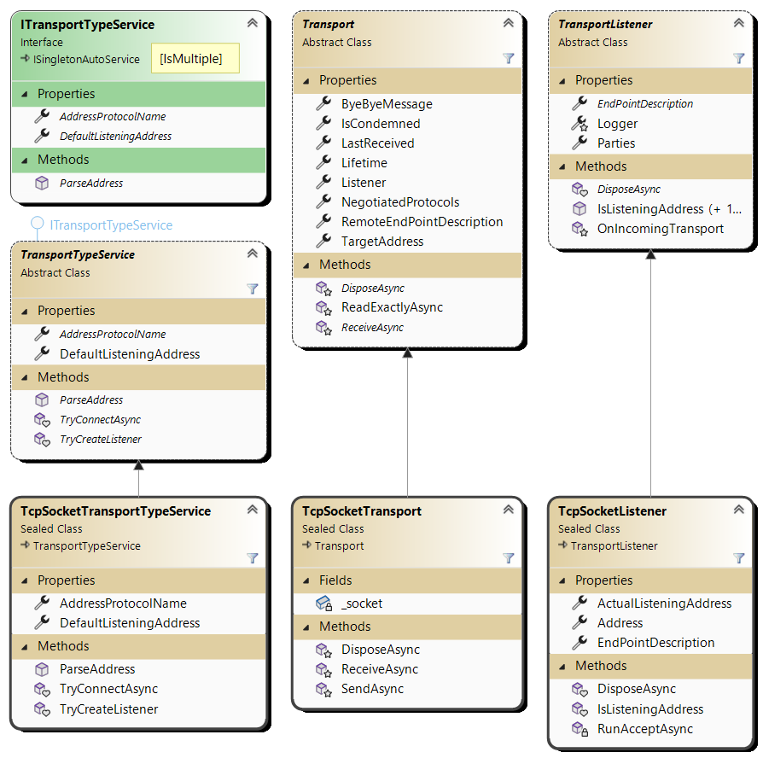

Implementing
Transports
3 classes to specialize.
Straight wrappers, no error management required.
Package First
Example of TCPSocket
  AddressProtocolName: “tcp”
Developers don’t interact with Transports layer.

Slide 32
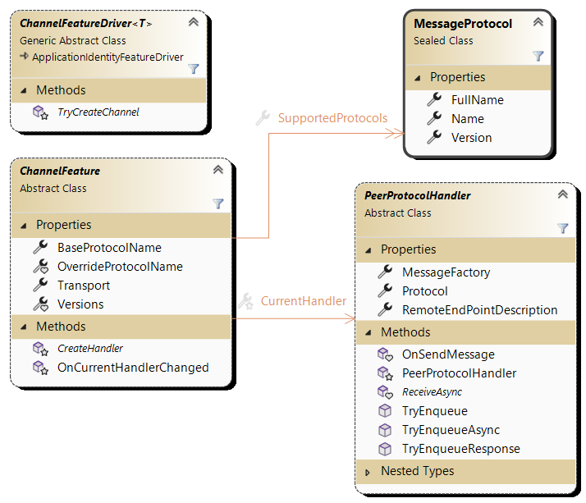
Channel Feature
3 classes to specialize.
  3 abstract methods.
Protocols can optionally be versioned.
  Negotiation is automatic.
Driver’s type name must be suffixed by "ChannelFeatureDriver“.

Slide 33
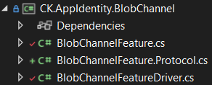
The BlobChannel
The BlobChannel is more a sample than a useful channel.
Using a Channel
  CK.AppIdentity.BlobChannel.Tests/BasicExchangeTests
The CK.AppIdentity.BlobChannel implementation
  BlobChannelFeatureDriver.cs
  BlobChannelFeature.cs
  BlobChannelFeature.Protocol.cs

Slide 34
Roadmap
Cris feature (next slide).
Enlistment of new Parties: AcceptUri & UnknownRemote
Poco store (https://github.com/microsoft/FASTER)
  KV or Log?
  For the moment, we can live with a in-memory only store.
“X509Store” (.Net core or not?)
  First step
    The primary signing certificate that identifies the party.
    Rolling it (or not?)
  Other certificates
    Name for them?
    Rolling?
    Orchard use the X509Store only for its primary certificate, others are on disk, optionally protected by a password.
    https://github.com/OrchardCMS/OrchardCore/blob/main/src/OrchardCore.Modules/OrchardCore.OpenId/Services/OpenIdServerService.cs
  How to generate TSL compliant certificates?
Provide a way to monitor the TransportMessage Retain/Dispose errors
  Because ref counting sucks

Slide 35
Cris feature
Common DI or 2 DI (one for the WebApp, one for AppIdentity)?
2 DI containers introduce the “Absolute Singletons” issue
  Should the same instance of a singleton service be registered in both DI?
  For all singleton services? May be for IRealObject only?
My preference:
  A CK-AppIdentity:Local:WebApplication section that defines the WebApp as an “island” of the application.
    DI of the app has no “Web” dependent services (“Process” services only).
    The WebApplicationBuilder.Services is pre-configured with all the “process services” registrations.
  Can we build the App DI without all the services that depends on the “Web” layer?
    ScopedHttpContext, IAuthenticationService, etc.
  Is the “Front” vs. “Process” distinction enough?
    In such case, “Front” means “Web”…
    This may be a first approach, but ideally services are tagged with more than a single “trait”.
    Or we skip any service defined in “Microsoft.AspNetCore” namespace ? A list of regex on AQN?
    Does a “list of regex on AQN” defines an “End Point”?
      If yes, one should be able to “ConfigureServices” with or without a set of “End Points”…
  Even if this is possible, we have yet to synchronize the singleton instances (or not)…
  This may be the best way in terms of architecture BUT it’s not a short-term solution.
The other way is that the Application DI is the WebApp one (if the app is a WebApp) just like today.
  But now services must be “hidden”/”overridden” in AppIdentity services, at least for the CrisExecutor.
  If a command handler relies on a “Web” singleton or scoped service, we are doomed (will fail at runtime).
  But CK.Cris.Executor do its job (CommandValidator, RawCommandExecutor) based on an explicit IServiceProvider.
  We can provide a IServiceProvider that hides/replaces some services for the command handling.
  ➔ This is not ideal, but it should work if not too many “Web” services are concerned and we can provide a replacement for the services at stake …

Slide 36
Other questions & To do
Internalize TransportMessage
  Differentiate IOutgoingTransportMessage and IIncomingTransportMessage
  Assume the outgoing message mutability: Freeze and IsFrozen
Add a “Layer” API on the TransportMessage
Implements the “BigMessage” slicing (0 Protocol).
Should “Response” channel be renamed “HighPriority”?
  Responses would use it but the “CancelCurrentBigMessage” would also use it (and it is not a response).

