Slide 1
CK-AppIdentity
Basic Distributed Applications Topologic Model

Slide 2
Primary Objectives
Be the simplest model to describe a distributed system topology.
Be as simple as possible to configure.
Configured identity related information are immutable during a run.
Dynamic identities can be added, removed and reconfigured while executing.
Supports different topologies
Centralized with a shared, central, directory of all the parties.
Decentralized where parties only sees peers.
With and/or without Message Bus.
Applies to simple Agents as well as Multi-Tenant site.
Handles totally external end points
Customer web services
Cloud Services (Azure, AWS, GitHub, etc.)

Slide 3
Secondary Objectives
Follows the “Package First” approach.
Encapsulates complexities
Capabilities discovery
Secret keys management
Supports “Observability”
Logs from a Party are identified and can be easily managed.
Be agnostic of deployment details
Transport layers (TCP/IP, quic, mqtt, etc.)
VLAN and/or WAN

Slide 4
DomainName/PartyName/EnvironmentName
This triple identifies any Party in the Universe.
This drives the Observability layer
Logs are collected with this 3-levels hierarchy.
Any “Event Source” (whatever the event is) is identified by this triple.
DomainName can be a path.
PartyName is usually prefixed by ‘$’.
EnvironmentName is always prefixed by ‘#’.
The triple can be expressed as a simple FullName string.

Slide 5
A FullName is autodescriptive
LaToulousaine
LaToulousaine/France
LaToulousaine/France/Albi
LaToulousaine/France/Albi/$Trolley1
LaToulousaine/$LaToulousaine
LaToulousaine/France/$France
EnvironmentName (#Dev by default) can appear everywhere in the path, as well as the $PartyName (with the ‘$’ prefix)
Organization
Workspace
Workspace
Party
OrganizationController
WorkspaceController

Slide 6
Naming constraints
DomainName
Cannot be longer than 127 characters.
Defaults to “Undefined”.
PartyName
Cannot be longer than 31 characters.
Can start or not with ‘$’. Always start with a ‘$’ when used in a FullName.
Defaults to “Unknown”
EnvironmentName
Cannot be longer than 31 characters (including the leading ‘#’).
Defaults to ‘#Dev’.
FullName’s max length is 192 characters.

Slide 7
A simple Agent.
One should be able to understand the interactions of any Party by looking at its Application Identity configuration.
{
"DomainName": "LaToulousaine",
"EnvironmentName": "#Production",
"PartyName": "$Trolley1"
"Remotes": [
{
"Name": "$LogTower",
"Address": "148.54.11.18:3712"
},
{
"Name": "$SignatureBox",
"Address": "155.88.22.22"
}] }
{
"FullName": "LaToulousaine/$Trolley1/#Production",
"Parties": [
{
"PartyName": "$LogTower",
"Address": "148.54.11.18:3712"
},
{
"PartyName": "$SignatureBox",
"Address": "155.88.22.22"
}] }
There should be no more than that for our Trolley1:
Sends its logs to a “LogTower” party.
Can initiate communications with the “SignatureBox” party.
The “Address” is not a URI or URL.
It can be any string that makes the party reachable from this party.
Environment names start with a #.

Slide 8
The SignatureBox.
{
"FullName": "LaToulousaine/$SignatureBox/#Production",
"Parties": [
{
"DomainName": "CentralLogwer",
"PartyName": "LogTower",
"Address": "148.54.11.18:3712"
},
{
"PartyName": "Trolley1"
},
{
"PartyName": "Trolley2"
},
{
"PartyName": "PickingStation"
}]
}
The SignatureBox ends its logs to a central LogTower and knows the Trolley1 but also the Trolley2 and a PickingStation.
These 3 remotes have no Address.
"LaToulousaine/$SignatureBox" is a server for them.
This is enough for the warehouse to do its work.

Slide 9
Simplifications
From now on, we don't show the LogTower configuration .
This is the same for every party (if we want to target the same LogTower).
We also don’t specify the “EnvironmentName” anymore.
This defaults to the IHostEnvironment.EnvironmentName (where the .NET default “Development” is shortened to “#Dev”)
Domain and Environment names configuration inherit from the root to the Remotes.
Inheriting is the default behavior.
Overriding the Domain and Environment names is possible: any Remote can be in Domain and Environment independent of its group of “Remotes”.

Slide 10


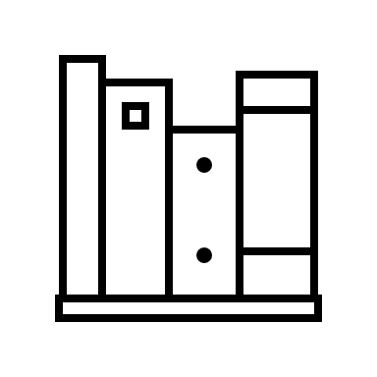

What we have so far: a warehouse.
Now we want the SignatureBox to interact with a OneCS application (the supervision and operation portal).
The OneCS application typically lives in the cloud.
If the SignatureBox can be reached from the outside, we just need to declare the new OneCS party on the SignatureBox.
Trolley1
SignatureBox
Trolley2
PickingStation
Devices

Slide 11
OneCS (can reach the SignatureBox).
The name of this new Party is the same as the DomainName: this Party is the "domain controller"
{
"FullName": "LaToulousaine/$SignatureBox",
"Parties": [
{
"PartyName": "Trolley1"
},
{
"PartyName": "Trolley2"
},
{
"PartyName": "PickingStation"
},
{
"PartyName": "LaToulousaine"
}]
}
{
"FullName": "LaToulousaine/$LaToulousaine"
"Parties": [
{
"PartyName": "$SignatureBox",
"Address": "65.12.13.14"
}]
}
Initiate
2-ways exchange

Slide 12
OneCS (cannot reach the SignatureBox).
This may be the most common configuration pattern.
{
"FullName": "LaToulousaine/$SignatureBox",
"Parties": [
{
"PartyName": "$Trolley1"
},
{
"PartyName": "$Trolley2"
},
{
"PartyName": "$PickingStation"
},
{
"PartyName": "$LaToulousaine",
"Address": "27.28.29.30:3712"
}]
}
{
"FullName": "LaToulousaine/$LaToulousaine",
"Parties": [
{
"PartyName": "$SignatureBox"
}]
}
Initiate
2-ways exchange
Notes:
We are NOT going to use any relay or hole punching strategies here. We require that A can reach B OR B can reach A directly, if both A and B are behind NAT this doesn’t work and that’s it. See https://bford.info/pub/net/p2pnat/index.html for a detailed discussion about NAT traversing.

Slide 13
LaToulousaine is actually a SaaS customer…
There is only one OneCS Application for multiple Domains. LaToulousaine is just one of them.
The SaaS offer scales horizontally:
A set of servers:
Parties are named “OneCS1”, “OneCS2”, “OneCS3”, etc.
And share the same Domain: “SaasOneCS”
Each OneCS application contains and defines the Domains they handle.

Slide 14
LaToulousaine in SaaS is hosted by OneCS1
{
"FullName": "SaasOneCS/$OneCS1", "Parties": [ {
"FullName": "LaToulousaine/$LaToulousaine",
"Parties": [
{
"PartyName": "$SignatureBox"
}]
}]
}
{
"FullName": "LaToulousaine/$SignatureBox",
"Parties": [
{
"PartyName": "$Trolley1"
},
{
"PartyName": "$Trolley2"
},
{
"PartyName": "$PickingStation"
},
{
"PartyName": "$LaToulousaine",
"Address": "27.28.29.30:3712"
}]
}
No Change!!!
“LaToulousaine/$LaToulousaine” is the “Domain Controller”.
It is a Local Party like its host “SaasOneCS/$OneCS1”
The previous autonomous application “LaToulousaine/$LaToulousaine” is now hosted.

Slide 15
Oups! LaToulousaine is NOT in production yet!
{
"FullName": "SaasOneCS/$OneCS1/#Production", "Parties": [ {
"FullName": "LaToulousaine/$LaToulousaine",
"EnvironmentName": "#Staging",
"Parties": [
{
"PartyName": "$SignatureBox"
}]
}]
}
{
"FullName": "LaToulousaine/$SignatureBox/#Staging",
"Parties": [
{
"PartyName": "$Trolley1"
},
{
"PartyName": "$Trolley2"
},
{
"PartyName": "$PickingStation"
},
{
"PartyName": "$LaToulousaine",
"Address": "27.28.29.30:3712"
}]
}

Slide 16
LaToulousaine goes to London
We may keep the single LaToulousaine domain and define the English Agents in them…
… and deal with “Trolley1” and “London_Trolley1”.
This less than ideal!
We can do better by simply using the DomainName
DomainName can be a path.

Slide 17
LaToulousaine goes to London!
{
"FullName": "SaasOneCS/$OneCS1", "Parties": [ {
"FullName": "LaToulousaine/France/$France",
"Parties": [
{
"PartyName": "$SignatureBox"
}]
},
{
"FullName": "LaToulousaine/London/$London",
"Parties": [
{
"PartyName": "$SignatureBox"
}]
}]
}
{
"FullName": "LaToulousaine/France/$SignatureBox",
"Parties": [
{
"PartyName": "$France",
"Address": "27.28.29.30:3712"
}]
}
{
"FullName": "LaToulousaine/London/$SignatureBox",
"Parties": [
{
"PartyName": "$London",
"Address": "27.28.29.30:3712"
}]
}

Slide 18
Security and privacy
No keys appear in the configuration.
At least one X509 certificate (signing and certificate signing key) is automatically available per Party.
SaasOneCS/OneCS1 can work with a single certificate.
Keys are managed “by design” in a store by CK.AppIdentity.
The store is in “%LocalAppData%/CK-AppIdentity” and is shared by all the applications that may run on the computer.
Private certificate are password-protected, the password is protected by the standard IDataProtector (Microsoft.AspNetCore.DataProtection.Abstractions).
Key rolling is automatic.
KeyManagementFeature is provided by CK.AppIdentity.KeyManagement package.

Slide 19
Other uses…
Describing and configuring external services.
Package First…
{
"FullName": "Signature/$CodeCenter/#Production",
"Parties": [ {
"DomainName": "External",
"PartyName": "GitOpenSource", "GitHub": { "Organization": "Signature-OpenSource",
"SecretToken": "45kKJDHldf57dsj87f6fefAsdjhfsdfzr654ZEd5zf"
}
},
{
"FullName": "External/$GitSource", "GitHub": { "Organization": "Signature-Code",
"SecretToken": "Lkjdchbej236ecec6876edc3evqwx57d2455zefdaa"
} }]
}
“External” and “Undefined” are the reserved Domain names that means “external to the System”
We don’t need an “Address”: this remote is a GitHubApp because of the “GitHub” configuration key.
The package CK.AppIdentity.GitHubApp handles this automatically.

Slide 20
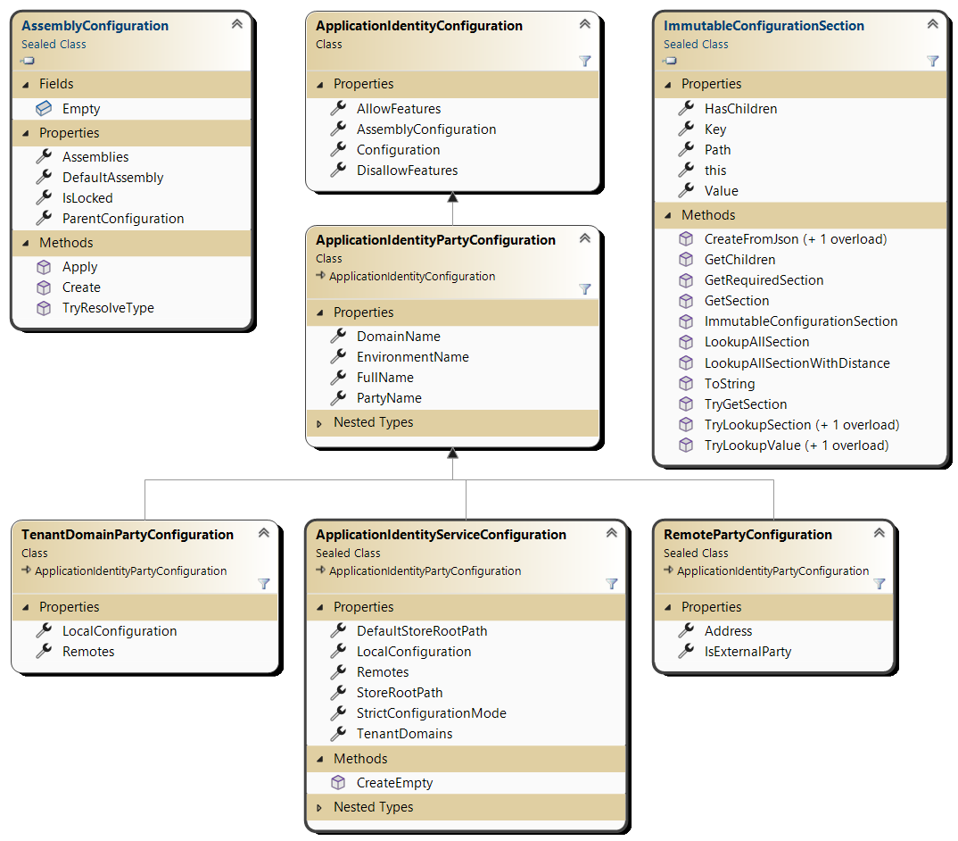
Configuration Model

Slide 21
Exploit the .Net Configuration API
ApplicationIdentityConfiguration supports any .Net Configuration source.
Provides 2 helpers and MutableConfigurationSection and ImmutableConfigurationSection to support direct manipulation code
static ApplicationIdentityConfiguration? Create( IActivityMonitor monitor,
IConfigurationSection configuration,
string? defaultLocalName = null,
string? defaultEnvironmentName = "#Development" )
var configuration = ApplicationIdentityConfiguration.Create( monitor, c =>
{
c["FullName"] = "Test/$Listener";
c["Remotes:0:PartyName"] = "Sender";
c["AllowFeatures"] = "BlobChannel";
} );

Slide 22
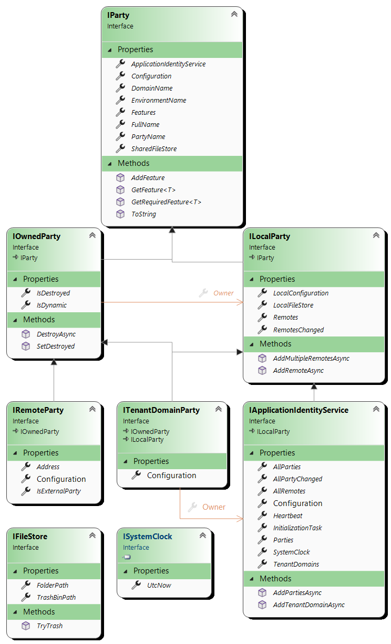
Runtime Model
Root IApplicationIdentityService is an automatic hosted service singleton.
Thread safety
Once InitializationTask is resolved, everything is stable.
A background micro agent handles the dynamic Remotes mutations.

Slide 23
The “Features”
Developer uses Features.
Features are IEnumerable<object> available on all parties.
Features can only be added:
void AddFeature( object feature )
But Feature are primarily instantiated, configured and added to the relevant parties thanks to ApplicationIdentityFeatureDriver specialized services.

Slide 24
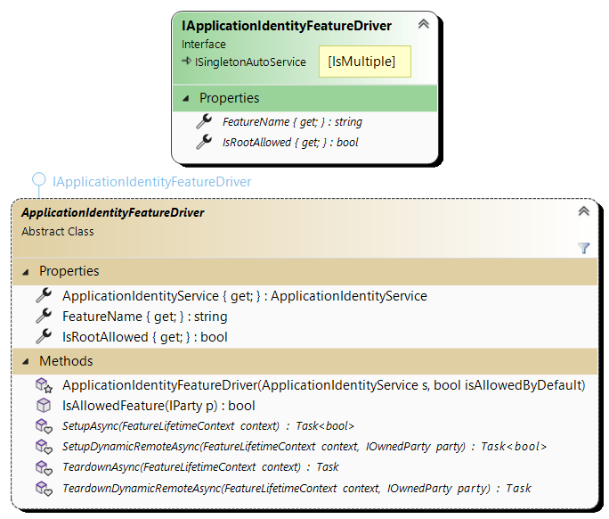
Feature Driver
Setup the whole service.
Setup new dynamic Remotes.
Teardown destroyed Remotes.
Teardown the whole service.
A feature driver type name MUST be suffixed with 'FeatureDriver'

Slide 25

Opt-In/Out and Allow/DisallowFeatures
Features can be opt-in or opt-out.
This is provided when calling the base ApplicationIdentityFeatureDriver constructor.
Features can then be allowed or disallowed by the configuration.
The BlobChannel is an opt-in feature. To exchange byte[] it must be allowed.
protected ApplicationIdentityFeatureDriver( ApplicationIdentityService s, bool isAllowedByDefault )
{
"FullName": "Test/$Sender", "AllowFeatures": "BlobChannel"
"Parties": [ {
"PartyName": "Target", "Address": "tcp:127.0.0.1“ }]
}
{
"FullName": "Test/$Target" }, "Parties": [ {
"PartyName": "Sender", "AllowFeatures": ["BlobChannel"] }]
}
Notes:
Allow/DisallowFeatures can be a string or an array of strings.

Slide 26
CK.AppIdentity.KeyManagement
Test/$SaasApp
Infra/$LogTower
$SaaSCentral
External/$GoogleApi
Tenant1/$Tenant1
$Box
Tenant2/$Tenant2
$Box
External/$ERP
Adds 2 kind of object-features
A ILocalKeys on each ILocalParty
A IRemoteKeys on each IRemoteParty
LocalKeys
RemoteKeys
RemoteKeys
RemoteKeys
LocalKeys
RemoteKeys
LocalKeys
RemoteKeys
RemoteKeys

Slide 27
TransportManagerFeature
Test/$SaasApp
Infra/$LogTower
$SaaSCentral
External/$GoogleApi
Tenant1/$Tenant1
$Box
Tenant2/$Tenant2
$Box
External/$ERP
TransportManagerFeature
Available on the root ApplicationIdentityService.
Centralizes transport events for all remote’s TransportFeatures.
TransportFeature
Decorates all Remote that are not “External” and have RemoteKeys.
LocalKeys
TransportManagerFeature
RemoteKeys
TransportFeature
RemoteKeys
TransportFeature
RemoteKeys
LocalKeys
RemoteKeys
TransportFeature
LocalKeys
RemoteKeys
TransportFeature
RemoteKeys

Slide 28
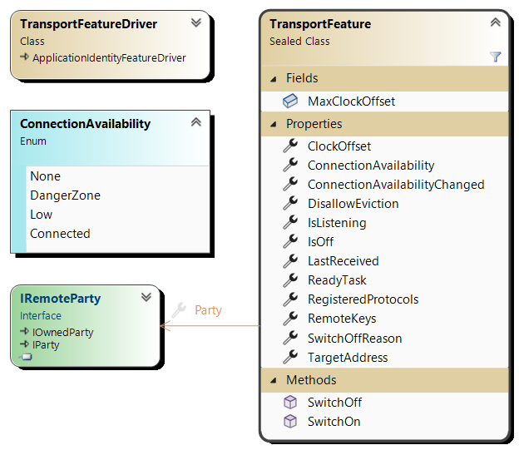
The TransportFeature
Opt-out feature: available by default on all Remotes (not External)
To remove it: "DisallowFeatures": "Transport“
Transport is “on” by default but can be SwithOff/SwitchOn
DisallowEviction is false by default (like MQTT).
The ReadyTask can be awaited before using the Transport:
➔ At least one connection has been established recently with the other side

Slide 29
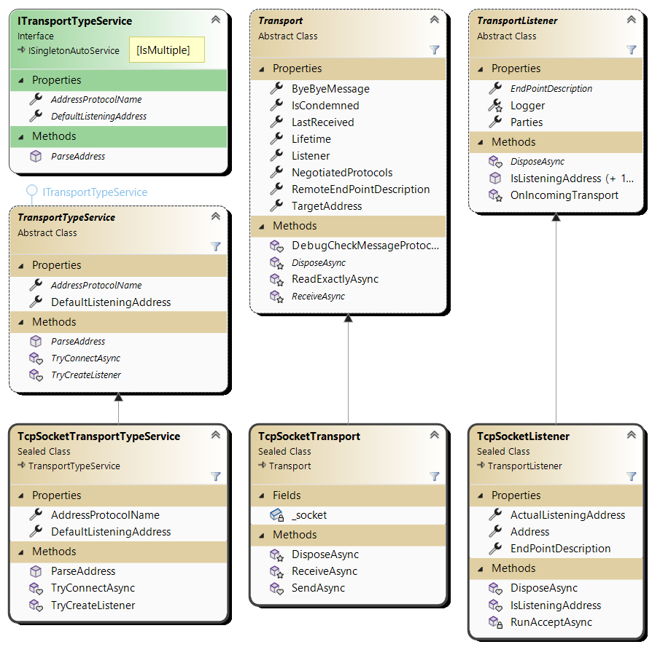

Implementing Transports
3 classes to specialize.
Straight wrappers, no error management required.
Package First
Example of TCPSocket
AddressProtocolName:
“tcp”
DefaultListeningAddress:
new IPEndpoint(IPAddress.Any,37120)
Developers don’t interact with Transports layer.

Slide 30
The Channels
A Remote’s TransportFeature handles the transport to the other side.
Listener vs. Sender is automatically handled based on the configuration.
The transport technology can be specified. The default is “tcp”.
The TransportFeatures exposes the properties relevant to the communication but is not itself in charge of exchanging data.
Channels are Features that implements a protocol and exposes it to the developer.
Channels implementation provides:
A Protocol that can be in multiple versions.
A way to build and send, receive and parse messages.
Notes:
Before detailing the Channels, we need to cover the TransportMessage and its Factories and the Transport and TransportType model.

Slide 31
TransportMessage
Prefix-Length encoding
Single header byte
MessageLength (0 to 4 bytes)
Payload (up to 2 GiB)
Header byte: L0|L1|CD|R0|R1|P0|P1|P2
L0-L1: number of bytes of the message length.
CD: “Control/ Data” bit.
R0-R1: Reserved for future use.
P0-P2: Protocol number (0 to 7).
The Protocol Number defines the "type" of the message: the writer/serializer that has been used to write the payload and the reader/deserializer that must be used to read it back.
Notes:
All messages exchanged by the Transport layer are prefixed by the message's protocol and length.
- The prefix starts with a first byte: `|L0|L1|CD|R0|R1|P0|P1|P2|`.
- The 2 MSB (L0-L1) gives us the number of bytes of the message length:
- `00` 1 byte, the message length is between 0 and 255 bytes.
- `01` 2 bytes, the message length is between 256 and 65535 bytes.
- `10` 3 bytes, the message length is between 65536 and 16 777 215 bytes.
- `11` 4 bytes, the message length is between 16 777 216 and 2 147 483 648 bytes (2 Gib).
- The `CD` bit is the "Control vs. Data" bit. This is a convenient bit that can be used by protocols
as a one-bit discriminator, typically between a regular data message and one (or more) control message.
- `R0` and `R1` bit are reserved for future use.
- P0-P2 bits is the Protocol, a number between 0 and 7. This number defines the "type" of the
message: the writer or serializer that has been used to write the payload and the reader or "deserializer"
that must be used to read it back.
- Then comes the message length itself (1 to 4 bytes)
- Then the message payload itself.
At a higher level "MessageProtocol” are identified by a string (its unique name).
A protocol defines how the message is encoded and how they are exchanged: by merging these 2 concepts here, we greatly simplify the implementation and the understandability of the Transport layer. The protocol simply defines the encoding it uses.

Slide 32
The 8 protocols maximal count
Only 8 protocols can be expressed.
The “0 Protocol” protocol is reserved: this is the protocol of CK.AppIdentity.TransportLayer itself that handles special messages used to negotiate, accept, reject incoming parties and outgoing connections.
This lets 7 possible protocols.
This limit applies to a Remote party pair:
There can be any number of possible protocols in an application
2 parties that start to interact initially negotiate the ones they can and want to use.
Any Transport between 2 parties can simultaneously support up to 7 different protocols.
Notes:
The `"0 Protocol"` protocol name is reserved: this is the protocol of CK.AppIdentity.TransportLayer itself that handles
special messages used to negotiate, accept, reject incoming parties and outgoing connections.
This lets 7 possible protocols. This may seem a limitation however this limit applies to a Remote party pair: there
can be any number of possible protocols in an application, among them 2 parties that start to interact initially
negotiate the ones they can and want to use. Any Transport between 2 parties can support up to 7 different protocols.
The final length of a message on the wire is between 2 bytes (the special Empty message, see below) and 2 Gib.
A minimal 1 byte message requires 3 bytes (in any of the 7 available protocols).

Slide 33
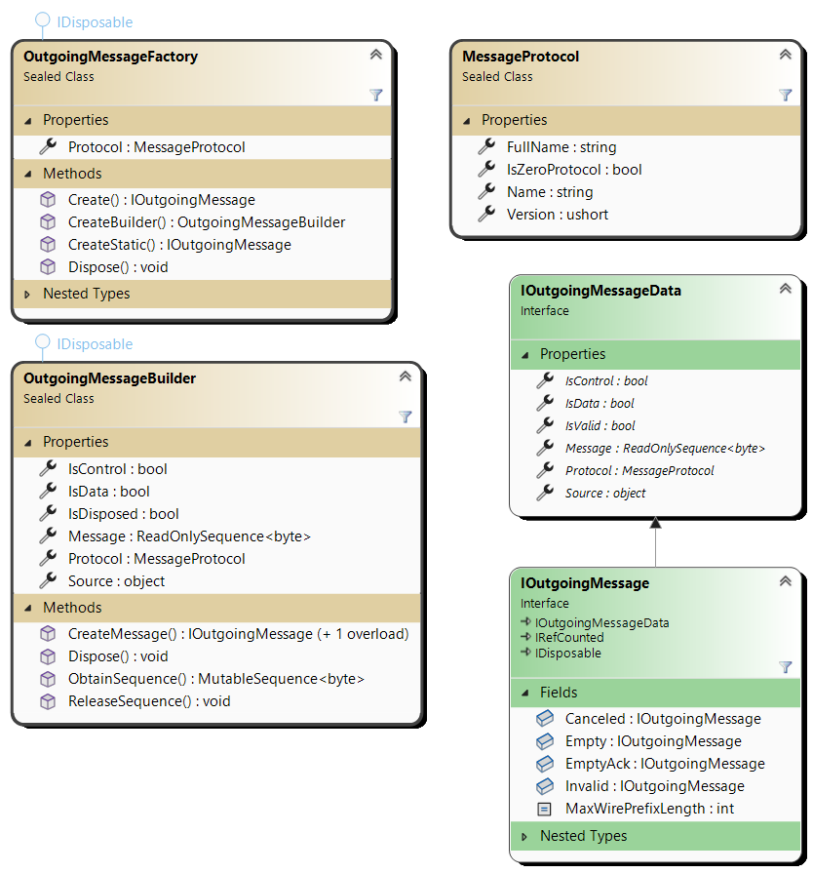
Outgoing messages
Use MutableSequence and FastByteWriter helper
Messages must be disposed once done with them
Allocated memory is reused.
Messages can be “Retained” when needed (reference counting)
CreateStatic returned messages don’t need to be disposed.
Dispose()/Retain() calls are ignored.

Slide 34
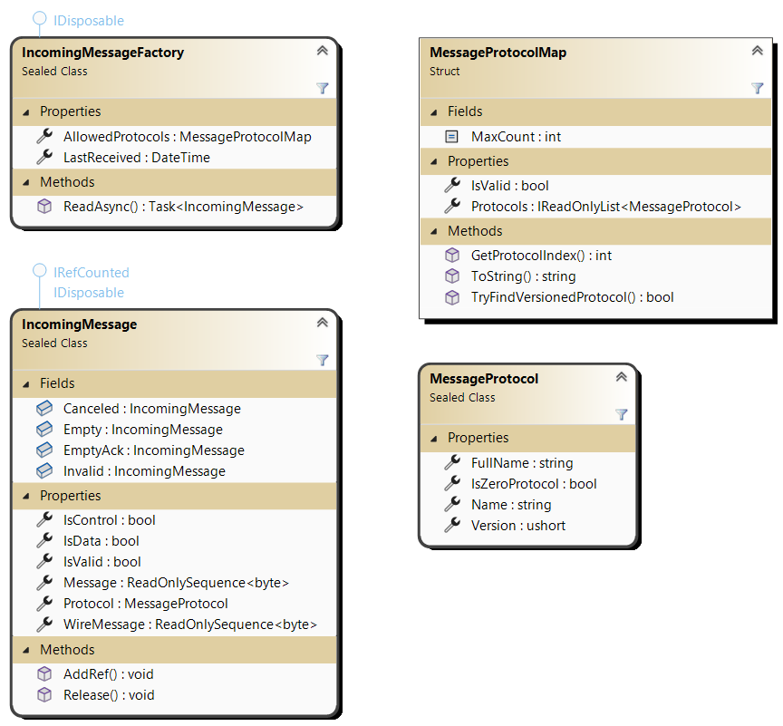
Incoming messages
The developer never interacts with an IncomingMessageFactory.
Messages must be disposed once done with them
Allocated memory is reused.
Messages can be “Retained” when needed (reference counting).
Helper: FastByteReader.

Slide 35
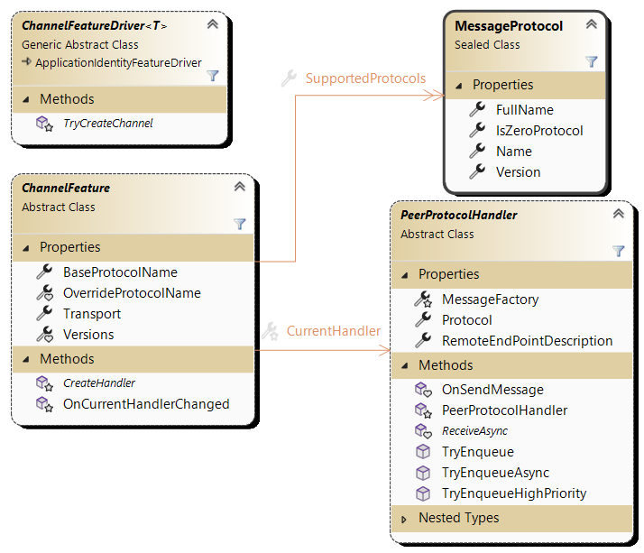
Channel Feature
3 classes to specialize.
3 abstract methods.
Protocols can optionally be versioned.
Negotiation is automatic.
Driver’s type name must be suffixed by "ChannelFeatureDriver“.

Slide 36
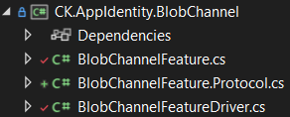
The BlobChannel
The BlobChannel is more a sample than a useful channel.
Using a Channel
CK.AppIdentity.BlobChannel.Tests/BasicExchangeTests
The CK.AppIdentity.BlobChannel implementation
BlobChannelFeatureDriver.cs
BlobChannelFeature.cs
BlobChannelFeature.Protocol.cs

Slide 37
ANNEX

Slide 38
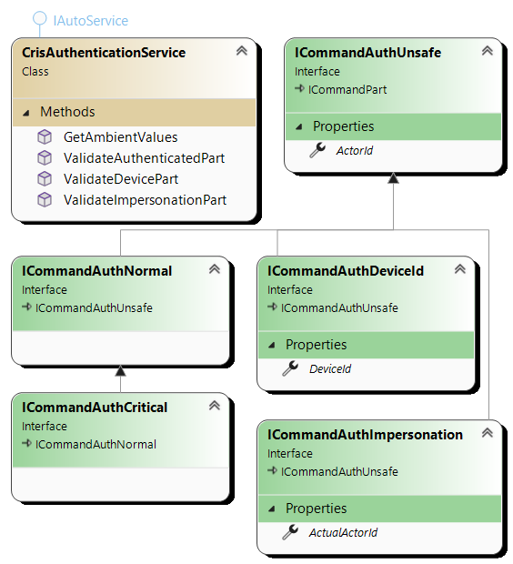
Handling User Authentication
“Authentified Commands” (from CK.Auth.Cris)
The IAuthenticationInfo service is the key
This is a “Ubiquitous Endpoint” service
This service must be resolved and secured by the Endpoint
The global “Web” endpoint uses an encrypted token and cookie.
“Authentified Commands” cannot be fooled
The ActorId, DeviceId and ActualActorId are checked against the secured IAuthenticationInfo service.

Slide 39
User and Commands through Parties (1/2)
“$Trolley1” can send an Authenticated Command to “$Box” in the name of (Alice,3712).
“$Trolley1” must provide a proof to “$Box” that Alice is the “real” Alice (otherwise the Authenticated Command will be rejected).
“$Trolley1” must first obtain this proof by:
Let Alice logins herself into a “Central User Directory” shared with “$Box”
The proof must be Alice’s IAuthenticationInfo and a digital signature.
“$Box” can verify that the signature has been generated by the “Central User Directory” for “$Trolley1” and that the IAuthenticationInfo has not been tampered.

Slide 40
User and Commands through Parties (2/2)
When “$Trolley1” sends a Command in the name of Alice to “$Box”…
it also sends the proof.
“$Box” AppIdentity’s endpoint receives the command and the proof.
It builds a “ScopedData” with the proof and the fact that it is “$Trolley1” that sent the command.
Its Endpoint is configured to resolve the IAuthenticationInfo service by:
Accessing the ScopedData’s proof and sender.
Verifying the signature and on success, returns the IAuthenticationInfo.
“$Box” validates and executes the command
Commands are executed in the background by runners in a scoped service container parametrized with the ScopedData.
If any service involved in the validation or execution of the command requires the IAuthenticationInfo, it is resolved.
Command execution outcomes (Validation result, events and result) are sent back to “$Trolley1”

Slide 41
Roadmap
Cris feature.
Poco or Message store (https://github.com/microsoft/FASTER)
KV or Log?
For the moment, we can live with a in-memory only store.
How to generate TSL compliant certificates?
Provide a way to monitor the TransportMessage Retain/Dispose errors
Because ref counting sucks
OutgoingMessage mutability: implement Freeze() and IsFrozen
Implement the “BigMessage” slicing (0 Protocol).
Tunneling (the “via:” protocol).

