Slide 2
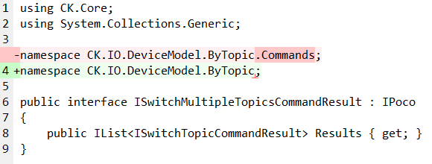
Namespace simplification
A CK.IO namespace is dedicated to IO...
That are commands in CRIS: no need to append Commands to the namespace.
Struct or other utility types can perfectly fit in this namespace.
It is the feature (here, the ByTopic feature of the Devices) that matters, not the kind/type of the objects.

Slide 3

ColorTopic
public enum ColorTopic
{
Off,
WhiteBlinking,
White,
RedBlinking,
Red,
GreenBlinking,
Green,
BlueBlinking,
Blue,
YellowBlinking,
Yellow,
MagentaBlinking,
Magenta,
CyanBlinking,
Cyan,
}
public static class ColorTopicExtensions
{
/// <summary>
/// Gets whether this color is blinking.
/// </summary>
/// <param name="color">This color.</param>
/// <returns>True if this color is blinking, false otherwise.</returns>
public static bool IsBlinking( this ColorTopic color ) => ((int)color & 1) != 0;
}
public enum ColorTopic
{
White,
Red,
Green,
Blue,
Yellow,
Magenta,
Cyan,
WhiteBlinking,
RedBlinking,
GreenBlinking,
BlueBlinking,
YellowBlinking,
MagentaBlinking,
CyanBlinking
}
Extension methods can be used on Enums.
Bit flags are fun ☺.
A “default” (0) for an enum is always a good practice.
Here, “Off” makes sense…
And this simple value can heavily simplify the commands…

Slide 4
Color… Topic?
These colors have been defined as “general enough” to be handled by very different devices.
Why are they bound to the Topic world?
Aren’t they StandardColors?
This lead us to the global architecture…

Slide 5
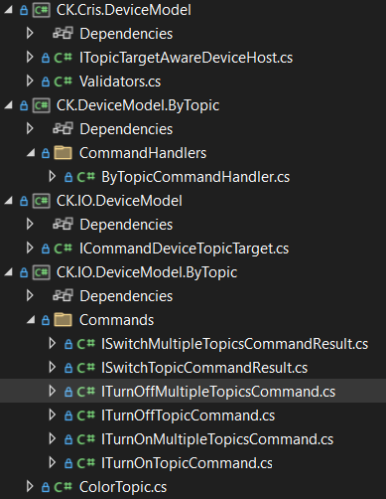
Arch!
Move to CK-DeviceModel (planned)
CK.IO.DeviceModel
Defines the CRIS IO of all host/devices.
Can be deployed on a client that has no devices.
CK.Cris.DeviceModel
Implements the CRIS handlers.
Must be deployed where the Devices are (the “server”).
If ColorTopic is StandardColor, this must be moved to the heart (CK.DeviceModel itself).
So that devices can handle it for other things than Topic.
Caution: Binary serialization must be handled carefully!
Currently:
ITopicTargetAwareDeviceHost could be ITopicAwareDeviceHost
CK.Cris.DeviceModel as no dependency on CK.DeviceModel
However, ITopicTargetAwareDeviceHost IS a IDeviceHost…
CK.DeviceModel.ByTopic
Handles “switching topics color”.
Do all topic aware devices have colors?
What about “getting topics sum of weight”, “closing topic gates” ?

Slide 6
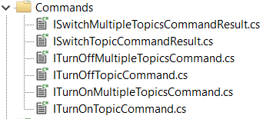
Less is Better
TurnOn vs. TurnOff
Exploiting the new “Off” color
public interface ISetTopicColorCommand : ICommand<ISetTopicCommandResult>
{
List<ColorTopic> Colors { get; set; }
TimeSpan TurnOffAfter { get; set; }
}

Slide 7
Less is Better
OnMultipleTopic vs. OnTopic (and their 2 command results)
We can remark that…
public interface ICommandDeviceTargetTopic : ICommandPart
{
string Topic { get; set; }
string? DeviceFullName { get; set; }
}
A “ByTopic” command implies, by design, a multi-result!
public interface ISwitchTopicCommandResult : IPoco
{
public string Topic { get; set; }
public Dictionary<string, bool> ResultByDeviceName { get; set; }
}

Slide 8
Topics are always multiple!
public interface ICommandDeviceTargetTopic : ICommandPart
{
string Topic { get; set; }
string? DeviceFullName { get; set; }
}
public interface ICommandDeviceTargetTopic : ICommandPart
{
List<string> TargetTopics { get; }
}
A Topic in the command is a string that:
Uses '/' as separator.
Must start with the the DeviceHostName
Must be followed by the DeviceName or '*' for all the devices of the host.
Is generally followed by any number of identifiers.
What about the result?

Slide 9
Do we need a multi-result?
public interface ISwitchTopicCommandResult : IPoco
{
public string Topic { get; set; }
public Dictionary<string, bool> ResultByDeviceName { get; set; }
}
If there is an error on a device… …then the command is on error.
Extending the base command:
We can have Errors, Warnings and Infos
The handler must accept a UserMessageCollector
public interface ICommandDeviceTargetTopic : ICommandPart, ICommand<IStandardResultPart>
{
List<string> TargetTopics { get; }
}
public interface ISetTopicColorCommand : ICommandDeviceTargetTopic
{
List<ColorTopic> Colors { get; set; }
TimeSpan TurnOffAfter { get; set; }
}
ISetTopicCommand

Slide 10
What if we need more detailed results?
Command/Result
Covariance
in action!
Instead of:
We define:
And:
CRIS handles this because…
…and
public interface ISetTopicColorCommand : ICommandDeviceTargetTopic
{
List<ColorTopic> Colors { get; set; }
TimeSpan TurnOfAfter { get; set; }
}
public interface ISetTopicCommandResult : IStandardResultPart
{
public string Topic { get; set; }
public Dictionary<string, bool> ResultByDeviceName { get; set; }
}
public interface ISetTopicColorCommand : ICommandDeviceTargetTopic, ICommand<ISetTopicCommandResult>
{
List<ColorTopic> Colors { get; set; }
TimeSpan TurnOfAfter { get; set; }
}
ICommandDeviceTargetTopic : ICommandPart, ICommand<IStandardResultPart>
ISetTopicColorCommand : ICommandDeviceTargetTopic, ICommand<ISetTopicCommandResult>
ISetTopicCommandResult : IStandardResultPart

Slide 11
Simple semantics
public interface ISetTopicColorCommand : ICommandDeviceTargetTopic
{
List<ColorTopic> Colors { get; set; }
TimeSpan TurnOffAfter { get; set; }
}
Always multiple colors?
This applies only to LEDS, basic displays have one color.
Even for LEDS, this suppose that the caller wants to interleave colors.
This one is simple and applies to anything:
The “Advanced” one, for devices that support this (and callers that need this capability):
public interface ISetTopicColorCommand : ICommandDeviceTargetTopic
{
ColorTopic Color { get; set; }
TimeSpan TurnOffAfter { get; set; }
}
public interface ISetTopicMultiColorCommand : ICommandDeviceTargetTopic
{
List<ColorTopic> Colors { get; set; }
TimeSpan TurnOffAfter { get; set; }
}

Slide 12
What’s next? TurnOffAfter!
public interface ISetTopicColorCommand : ICommand<ISetTopicCommandResult>
{
List<ColorTopic> Colors { get; set; }
TimeSpan TurnOffAfter { get; set; }
}
This is currently implemented in the ObservableDomain…
It should be supported by CRIS or at the Device level.
But this should be crash-proof (at least basically) and:
Device level: we have no persistence of a Device state yet.
CRIS level: CK.Cris.DelayedCommand is a quick & light implementation that also lacks a persistent layer.
But… is this only a persistence issue?
My intuition:
This could be managed at the Device level because:
It is easier.
This would be better managed at the CRIS level because:
This is not only a persistence issue.
Delaying, repeating and cancelling any command is a general useful concept.

Slide 13
Currently implemented DelayedCommand
public interface IDelayedCommand : ICommand
{
/// Gets or sets the execution date of the Command.
DateTime ExecutionDate { get; set; }
/// Gets or sets whether a past ExecutionDate immediately executes the command.
/// By default, a date in the past triggers an incoming validation error.
bool AllowPastExecutionDate { get; set; }
/// Gets or sets whether the command must only be kept in memory.
/// By default, if the service that implements delayed command execution is a persistent one,
/// the command is persisted.
bool KeepOnlyInMemory { get; set; }
/// Gets or sets the command to execute at ExecutionDate.
[NullInvalid]
IAbstractCommand? Command { get; set; }
}
How can this be canceled?
Canceling a delayed command is cool.
But when was the last time you needed this?
If we want to cancel a command… …it’s because we KNOW that it must not be executed anymore.

Slide 14
R&D – Open Issue
["ISetTopicColorCommand", { "TopicTargets" = […], "Color" = "Red", "TurnOffAfter"="00:00:5" }]
["ISetTopicColorCommand", { "TopicTargets" = […], "Color" = "Red" }]
["IDelayedCommand", {
"ExecutionDate" = "???", "Command" = ["ISetTopicColorCommand", { "TopicTargets" = […], "Color" = "Off" }]
}]
IBatchCommand
Steps[0]
["ISetTopicColorCommand", { "TopicTargets" = […], "Color" = "Red" }]
Not a Command!
Steps[1]
IWorkflow
["IPauseCommand", { "Delay" = "00:00:5" }]
Steps[2]
["ISetTopicColorCommand", { "TopicTargets" = […], "Color" = "Red" }]
["IInterpretedCommand", {
"Program" = "exec SetTopic TopicTargets = ’…’, Color = Red;
wait 5 seconds;
exec SetTopic TopicTargets = ’…’, Color = Off;
"
}]

