Slide 1

Refactoring GOLF
Email: snahider@gmail.com
Twitter: @snahider
Angel Núñez Salazar
Gustavo Quiroz Madueño
Email: gquiroz@gmail.com
Twitter: @quiroz_gustavo
Daniel Lindner
(translation only)
Email: lindner@schneide.com
Twitter: @daniellindner

Slide 2

Description
A game using refactoring exercises
Teams will be formed and each is given a starting and ending code.
Similar to golf, the goal is to use the least amount of moves to get from the start point to end.
The best solutions will be presented to the rest of the attendees.
Notes:
Para este momento todos debe estar sentados en parejas

Slide 3
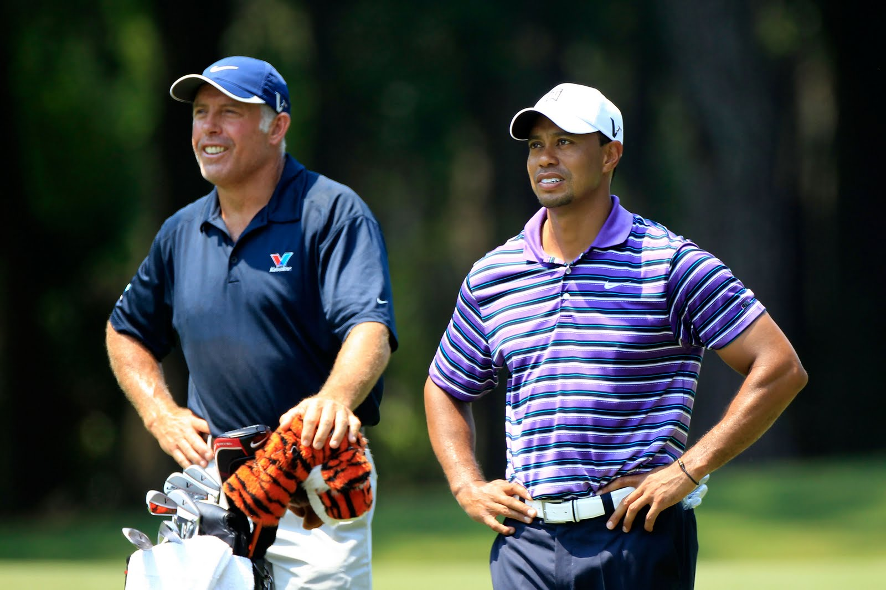
Team
Caddie
Player
Each team will consist of 2 people
Notes:
Para este momento todos debe estar sentados en parejas

Slide 4
Player
Performs the refactorings using the computer
Besides being the team DRIVER

Slide 5
Caddie
Record the number of moves and penalties committed
Ensure that constantly run tests
Besides being the team NAVIGATOR
Notes:
- De manera adicional todas las actividades del navigator ( aconsejar sobre el siguiente movimiento o jugada)
Manejar las hojas con el inicio y el fin
Asegurarse que los test se están ejecutando de manera muy continua (podría ser una regla)
Asegurarse que las reglas y roles se están cumpliendo.

Slide 6
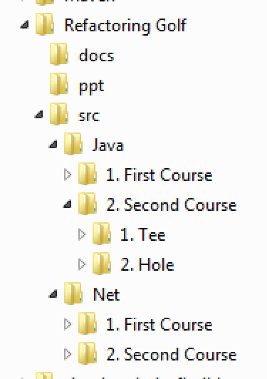
Playing Field
We will make two different games and each game will be using C # or Java.
Each game has a starting point (Tee) and the goal is to reach the end point (Hole).

Slide 7
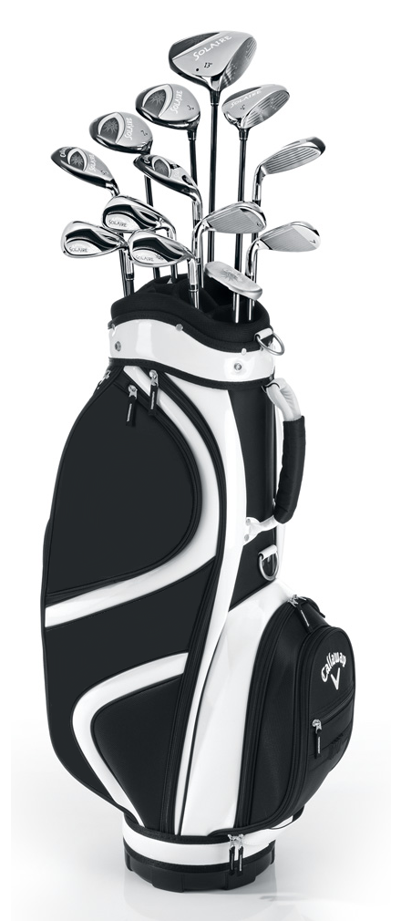
Equipment
An IDE of your choice.
(The code is in VS2010 and Eclipse but you can import it easily)
*Recommendation*
If using VS install Resharper
A sheet to write down the scores.
Each game code on paper.

Slide 8
Points
General
+1 Each refactoring
+1 Copy + Paste
+1 Any shortcut for editing code
+0 Formatting or deleting blank lines
+0 Change access methods or classes
Penalties
+2 Each manually modified line
x2 Each change until it compiles again

Slide 9
Winning Team
The team with the lowest score wins.
After the game, the winning team shows its solution to the other attendees.

Slide 10
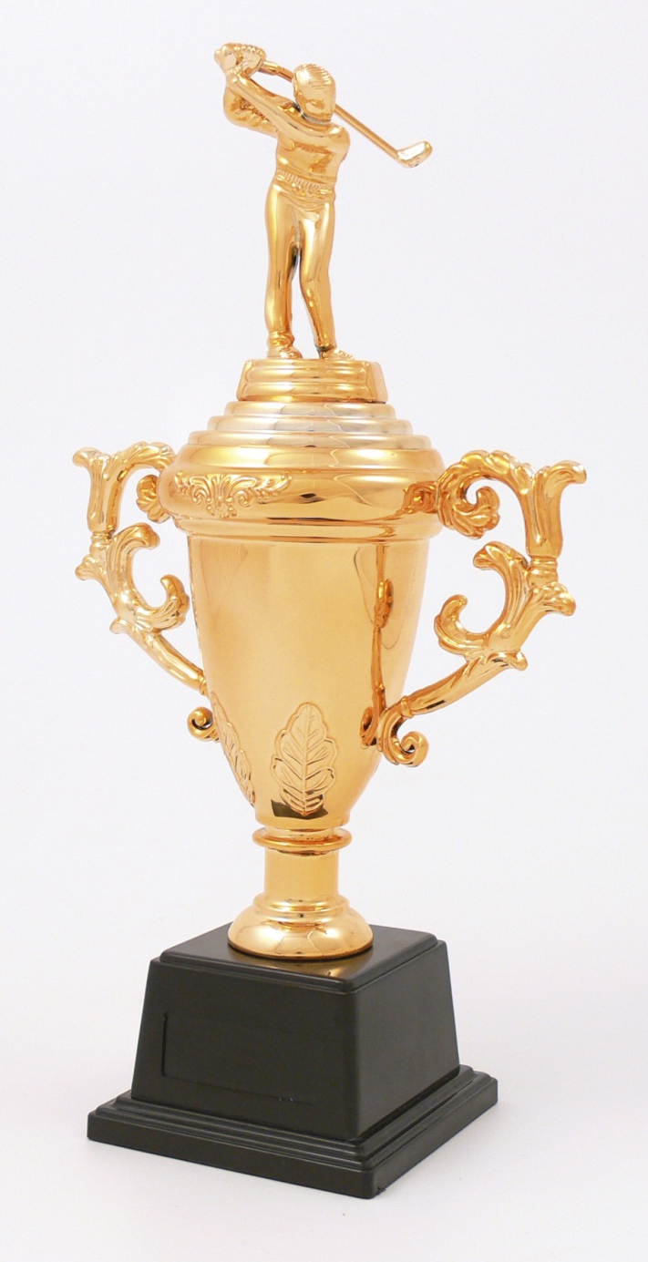
Awards
The winner of each game will take 2 licenses for JetBrains.
Each license is valid for Resharper or IntelliJ according to personal choice.

Slide 11
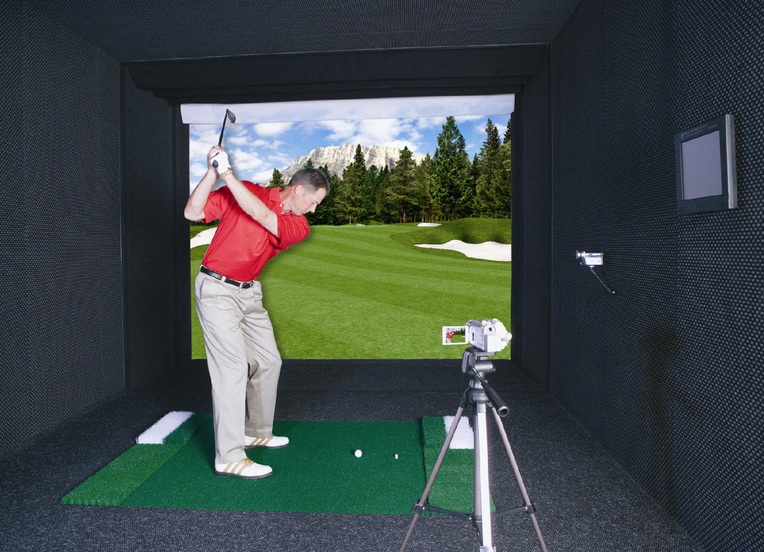
DEMO

Slide 12

1st COURSE

Slide 13
Objective
Learn and practice various simple and complex refactorings
Notes:
Existe un gran catálogo de refactorings y la meta es tratar de practicar la mayor cantidad
(Move Method, Inline Method, Extract Interface,
Replace Conditional with Polymorphism, etc)

Slide 14
Description
The code represents the domain of an online bicycles store.
Notes:
Existe un gran catálogo de refactorings y la meta es tratar de practicar la mayor cantidad
(Move Method, Inline Method, Extract Interface,
Replace Conditional with Polymorphism, etc)

Slide 15
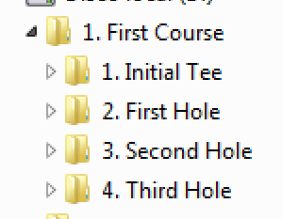
Rules
It is a set of 3 holes, all teams will start on the tee and on the following holes simultaneously.
The time is 12 minutes per hole, at the end of each hole the best team display their results.

Slide 16
Ready To Start
Open the initial code in the IDE, compile and make sure all tests pass.
Do not forget the activities of each team role.
The first team to finish should raise their hand.
You have 12 minutes per hole.

Slide 17

2nd COURSE

Slide 18
Objective
Learn and practice various strategic refactoring
(Parallel Change and Narrowed Change)
Notes:
Strategies for larger design changes.

Slide 19
Description
The code is a class representing a Stack (datastructure)
The goal is to replace the simple array by a specialized class that manages collections.

Slide 20
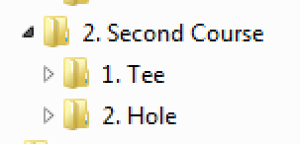
Rules
It is a journey of a single hole
The whole journey time is 18 minutes, when the time is up the best team displays their results.

Slide 21
Ready To Start
Open the initial code in the IDE, compile and make sure all tests pass.
Do not forget the activities of each team role.
The first team to finish should raise their hand.
You have 18 minutes for the entire journey.

Slide 22
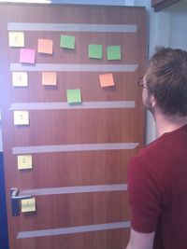
Feedback
No one can get through the door without leaving some kind of idea, comment or feedback
No matter if it is a basic problem or a smiley face, everybody should put something on the door.

