Slide 1
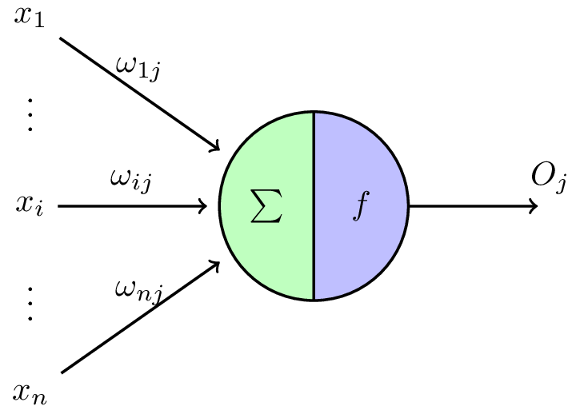
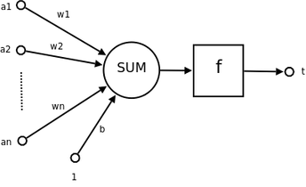
神经元
Notes:
图片来自于百度图片搜索：http://image.baidu.com/search/detail?ct=503316480&z=0&ipn=d&word=%E7%A5%9E%E7%BB%8F%E7%BD%91%E7%BB%9C%E5%8D%95%E5%85%83%E5%9B%BE%E7%89%87&step_word=&hs=0&pn=0&spn=0&di=116575915060&pi=0&rn=1&tn=baiduimagedetail&is=0%2C0&istype=2&ie=utf-8&oe=utf-8&in=&cl=2&lm=-1&st=-1&cs=4230833034%2C3798177152&os=2539014247%2C2433507706&simid=4258519104%2C514630718&adpicid=0&lpn=0&ln=1930&fr=&fmq=1490856963671_R&fm=result&ic=0&s=undefined&se=&sme=&tab=0&width=&height=&face=undefined&ist=&jit=&cg=&bdtype=0&oriquery=&objurl=http%3A%2F%2Fwww.myexception.cn%2Fimg%2F2012%2F09%2F23%2F105316349.png&fromurl=ippr_z2C%24qAzdH3FAzdH3Fooo_z%26e3B4yjxvjrpt5g_z%26e3BvgAzdH3Fr6526w4AzdH3F09nba0_z%26e3Bip4s&gsm=0&rpstart=0&rpnum=0

Slide 2
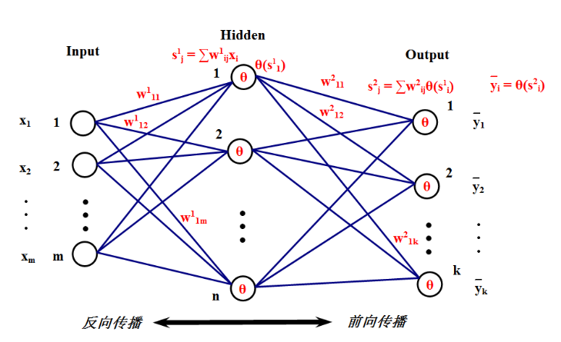
http://img.blog.csdn.net/20150321122210091

Slide 3
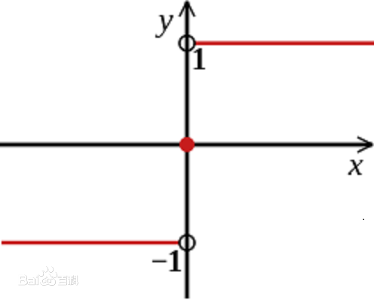
单层感知机： 感知机学习旨在求出将训练数据集进行线性划分的分类超平面，为此，导入了基于误分类的损失函数，然后利用梯度下降法对损失函数进行极小化，从而求出感知机模型。
感知机模型：f(x)= sign(w*x+b)
误分类驱动：
学习的策略：就是在假设空间中选取损失函数最小的模型参数w,b
这种算法的基本思想是：当一个实例点被误分类，即位于分类超平面错误的一侧时，则调整w和b，使分类超平面向该误分类点的一侧移动，以减少该误分类点与超平面的距离，直到超平面越过该误分类点使其被正确分类为止。

Slide 4
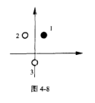
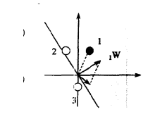
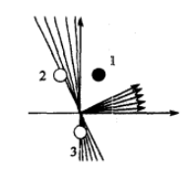
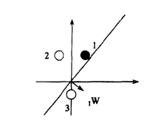
总结学习规则：
单神经元感知器：
如果实际输出信号 等于 训练给定信号，则w^{new} = w^{old} + p
如果实际输出信号 小于 训练给定信号，则w^{new} = w^{old} - p
如果实际输出信号 大于 训练给定信号，则w^{new} = w^{old}
Notes:
感知机学习规则：http://blog.csdn.net/xierhacker/article/details/51816484

Slide 5
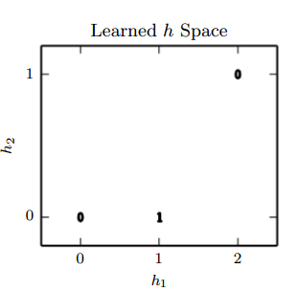
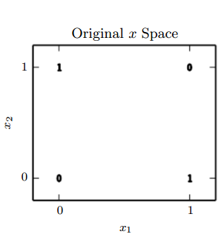
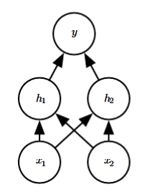
XOR实例
h_{i} = g(x^{T}W:,i + c_{i})

Slide 6



Gradient-Based Learning
6.2.1 Cost Functions
Maximum Likelihood:
Learning Conditional Statistics

Slide 7

6.2.2 Output Units：The choice of cost function is tightly coupled with the choice of output unit.
1、Linear Units for Gaussian Output Distributions：
Linear output layers are often used to produce the mean of a conditional Gaussian distribution: p(y | x) = N (y; y , I)
2、Sigmoid Units for Bernoulli Output Distributions
A Bernoulli distribution is defined by just a single number. The neural net needs to predict only P(y = 1 | x).
*:Any time that w^{T}h + b strayed outside the unit interval, the gradient of the output of the model with respect to its parameters would be 0.

Slide 8

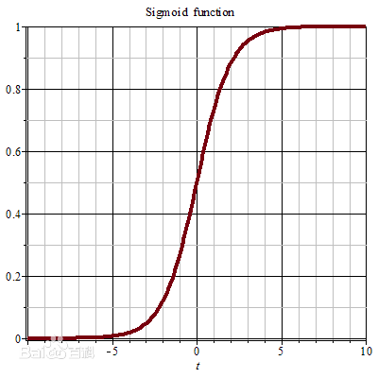


A sigmoid output unit is defined by:
其中，Sigmoid函数由下列公式定义：
其对x的导数可以用自身表示:
When we use other loss functions, such as mean squared error, the loss can saturate anytime σ(z) saturates

Slide 9
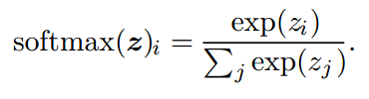
Softmax Units for Multinoulli Output Distributions：Any time we wish to represent a probability distribution over a discrete variable with n possible values, we may use the softmax function.
To generalize to the case of a discrete variable with n values:
y_{i} = P(y = i | x)
First, a linear layer predicts unnormalized log probabilities:
z = W^{T}h + b,
where z_{i} = log P(y = i | x).
Formally, the softmax function is given by:
As with the logistic sigmoid, the use of the exp function works very well when
training the softmax to output a target value y using maximum log-likelihood.

Slide 10
Other Output Types

Slide 11
6.3 Hidden Units
6.3.1 Rectified Linear Units and Their Generalizations
Rectified linear units use the activation function g(z) = max{0, z}.
ReLU是线性修正，公式为：g(x) = max(0, x)，是purelin的折线版。它的作用是如果计算出的值小于0，就让它等于0，否则保持原来的值不变。这是一种简单粗暴地强制某些数据为0的方法，然而经实践证明，训练后的网络完全具备适度的稀疏性。而且训练后的可视化效果和传统方式预训练出的效果很相似，这也说明了ReLU具备引导适度稀疏的能力。
Notes:
http://www.cnblogs.com/neopenx/p/4453161.html

Slide 12
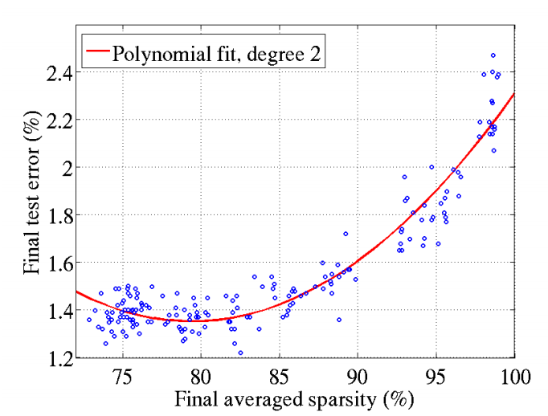
对比大脑工作的95%稀疏性来看，现有的计算神经网络和生物神经网络还是有很大差距的。
ReLu只有负值才会被稀疏掉，即引入的稀疏性是可以训练调节的，是动态变化的。

Slide 13
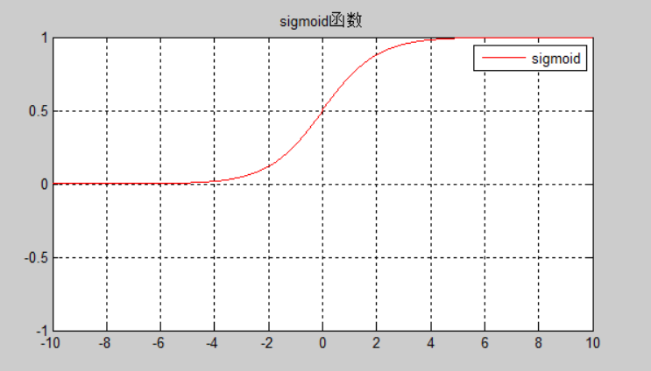
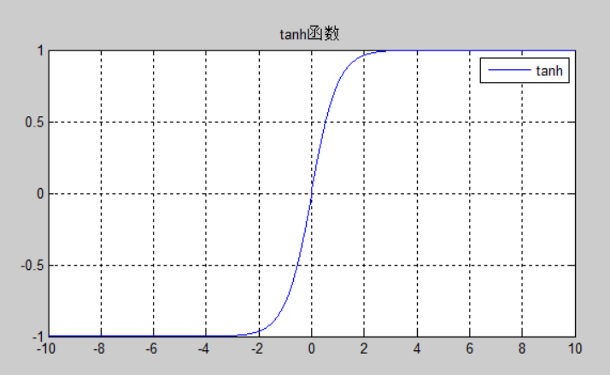
Logistic Sigmoid and Hyperbolic Tangent
Prior to the introduction of rectified linear units, most neural networks used the logistic sigmoid activation function:g(z) = σ(z) or the hyperbolic tangent activation function g(z) = tanh(z).
These activation functions are closely related because tanh(z) = 2σ(2z) − 1
Notes:
http://blog.csdn.net/fendoubasaonian/article/details/52974608

Slide 14
6.3.3 Other Hidden Units:
h = cos(W x + b)
hi = :Radial basis function or RBF unit
g(a) = ζ(a) = log(1 + ea) : Softplus
g(a) = max(−1, min(1, a)) :Hard tanh

Slide 15
6.4 Architecture Design
6.4.1 Universal Approximation Properties and Depth
6.4.2 Other Architectural Considerations

Slide 16
6.5 Back-Propagation and Other Differentiation Algorithms
6.5.1 Computational Graphs
6.5.2 Chain Rule of Calculus
6.5.3 Recursively Applying the Chain Rule to Obtain Backprop
6.5.4 Back-Propagation Computation in Fully-Connected MLP
6.5.5 Symbol-to-Symbol Derivatives
6.5.6 General Back-Propagation
6.5.7 Example: Back-Propagation for MLP Training
6.5.8 Complications
6.5.9 Differentiation outside the Deep Learning Community
6.5.10 Higher-Order Derivatives

