Slide 1



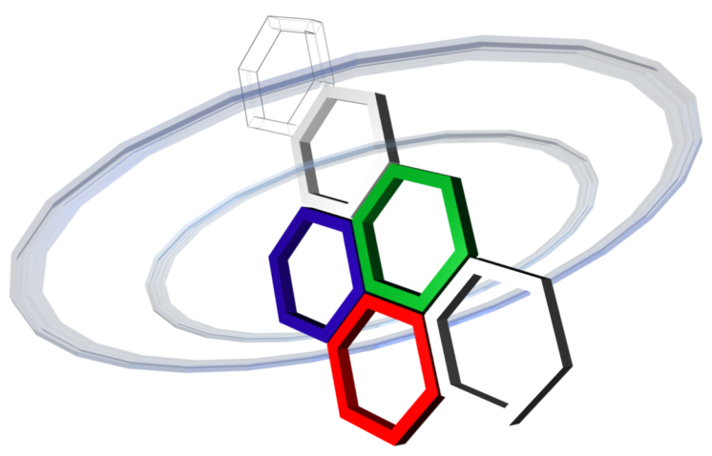
How to calculate capacity bound in TR OFDM with AN
Sidney Golstein,
Rottenberg François, Trung-Hien Nguyen, Philippe De Doncker, François Horlin, Julien Sarrazin
GEOHYPE project
ANR funding - JCJC program

Slide 2
Outline
Problem Statement
System Model
Capacity computation

Slide 3
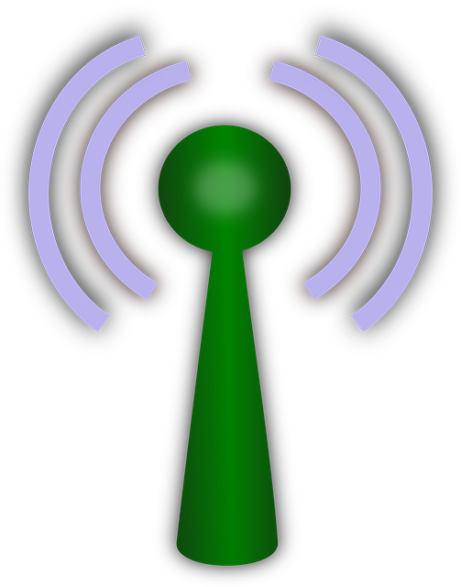


1) Problem Statement
Goal
Secure communication between Alice and Bob
Eve tries to eavesdrop the data
Concept
One antenna at TX, one antenna at RX’s (SISO)
Data precoding at Alice to reach Bob
Addition of Artificial Noise to corrupt Eve’s data decoding
Hypothesis:
Alice knows Bob instantaneous CSI
Alice does not know Eve instantaneous CSI (Eve is passive)
No spatial correlation between Bob and Eve channels
No frequency correlation between subcarriers
$$h_{B}$$
Bob
TX
Alice
$$h_{E}$$
Eve
→ Investigated scheme: AN injection in FD TR SISO OFDM system
Goal: Determine a secrecy capacity lower bound for the scheme
Notes:
Ici on voit un exemple typique de network avec pleins d’entités connectées les unes aux autres. Réseaux de plus en plus dépokyés dans le monde entier et le réseau sans fil s’étend aussi de plus en plus.
La sécurité dans ces réseaux est une grande problématique.
Sécurité est basé sur le fait qu'on doit faire confiance aux différents éléménts / utilisateurs du réseau
Il est donc important d’implémenter des protocols de sécurité à toutes les couches de protocol de cmmunictaton.

Slide 4
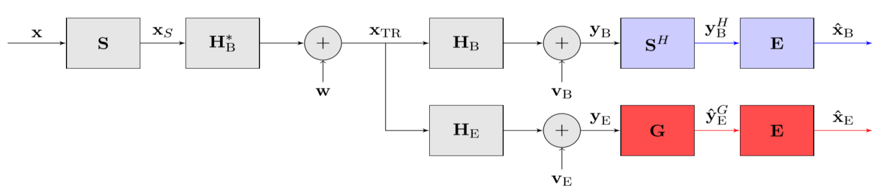

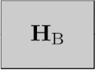

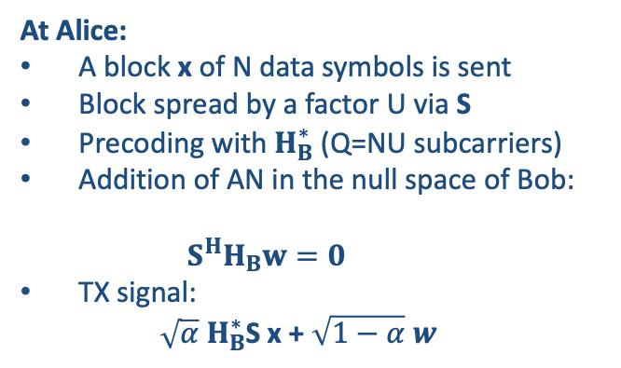
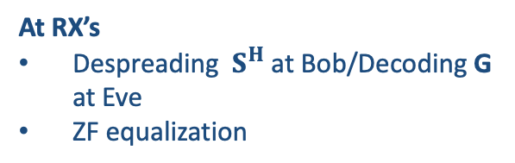
2) System Model
2.2 FD TR SISO OFDM system with added AN
At Alice:
A block x of N data symbols is sent
Block spread by a factor U via S
Precoding with $H_{B}^{∗}$ (Q=NU subcarriers)
Addition of AN in the null space of Bob:
$$S^{H}H_{B}w=0$$
TX signal:
$\sqrt{α} H_{B}^{∗}$S x + $\sqrt{1−α} w$
ALICE
BOB
Spreading
Precoding
EVE
DATA
TIME REVRSAL PRECODING IN FREQUENCY DOMAIN
ARTIFICIAL NOISE INJECTION
PROPAGATION CHANNELS
RX NOISE
DECODING
SYMBOL ESTIMATION
At RX’s
Despreading $S^{H}$ at Bob/Decoding G at Eve
ZF equalization
$$AN$$
f
$$x$$
$$x_{S}$$
$$x_{TR}$$
$$y_{B}$$
$${\hat{x}}_{B}$$
$$+$$
H
f
f
f
f
f
$$y_{E}$$
$${\hat{x}}_{E}$$
G
f
f

Slide 5

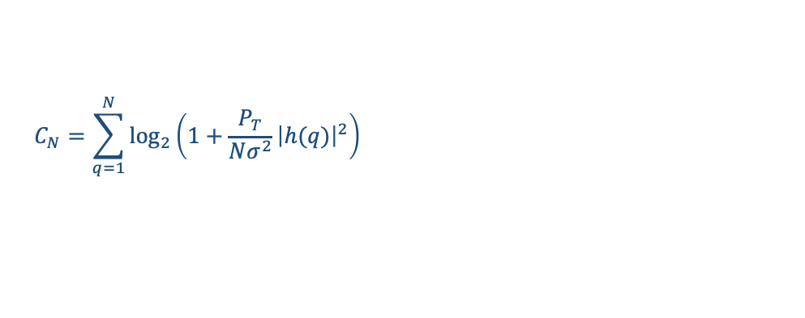

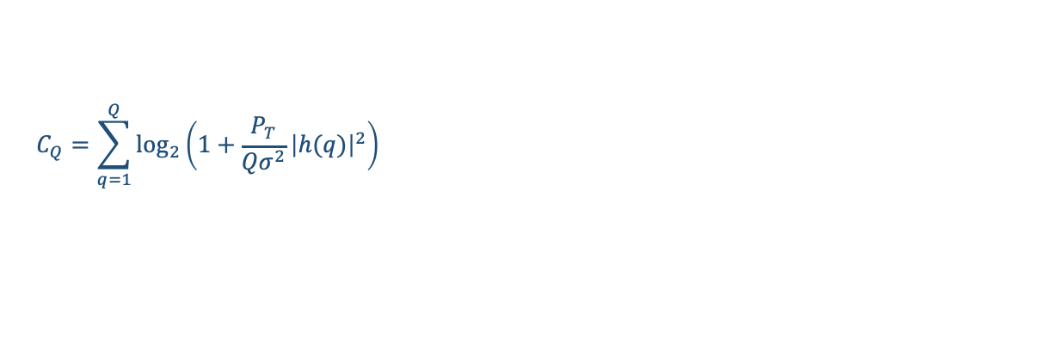
3) Capacity computation
At Eve : Analytic SINR upper bound to derive
Jenssen’s innequality: Upper bound of Eve capacity before post processing
Relation between MIMO and ODFM in terms of capacity (1/2)
MIMO systems: Example of Q uncoupled transmission lines(⬄ completely uncorrelated MIMO channel):
$$C_{1}=\log_{2}\left(1+\frac{P_{T}}{σ^{2}}{\left|h\right|}^{2}\right)$$
(SISO)
$$C_{Q}=\sum_{q=1}^{Q}{\log_{2}\left(1+\frac{P_{T}}{{Qσ}^{2}}{\left|h(q)\right|}^{2}\right)}$$
(MIMO, equal power distributed on every line)
OFDM systems: Example of N orthogonal sub-carriers:
$$C_{1}=\log_{2}\left(1+\frac{P_{T}}{σ^{2}}{\left|h\right|}^{2}\right)$$
(Single Carrier)
$$C_{N}=\sum_{q=1}^{N}{\log_{2}\left(1+\frac{P_{T}}{Nσ^{2}}{\left|h(q)\right|}^{2}\right)}$$
(Multi-orthogonal carriers)
(equal power distributed on every subcarrier)

Slide 6
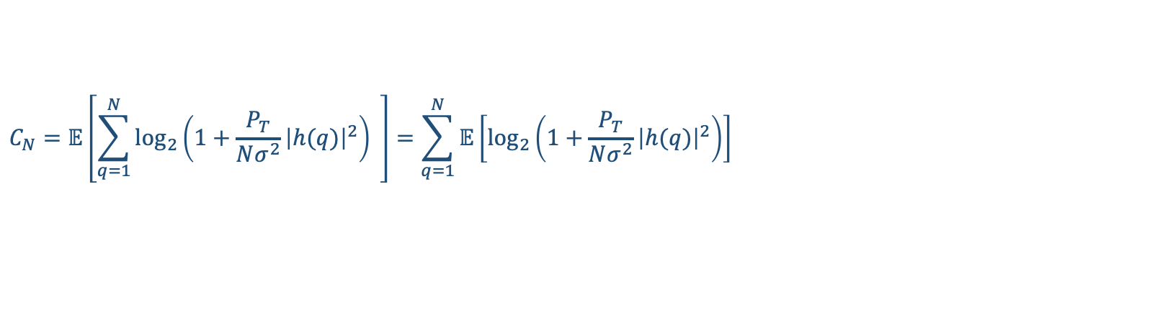
3) Capacity computation
Relation between MIMO and ODFM in terms of capacity (2/2)
$$C_{N}=𝔼\left[\sum_{q=1}^{N}{\log_{2}\left(1+\frac{P_{T}}{Nσ^{2}}{\left|h(q)\right|}^{2}\right)} \right]=\sum_{q=1}^{N}{𝔼\left[\log_{2}\left(1+\frac{P_{T}}{Nσ^{2}}{\left|h(q)\right|}^{2}\right)\right]}$$
In our case, no correlation bw sub-carriers, same statistics for each sub-channel, and same average power distributed over N subcarriers, so:
$$C_{N}=N𝔼\left[\log_{2}\left(1+\frac{P_{T}}{Nσ^{2}}{\left|h(q)\right|}^{2}\right)\right]$$
Sufficient to investigate
Now, how to include the BOR effect? getting inspiration from SIMO systems…

Slide 7



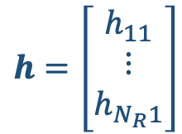


3) Capacity computation
SIMO configuration
Benefits of spatial diversity
$$h_{11}$$
RX
TX
$$h=\left[\begin{matrix}h_{11} \\ ⋮ \\ h_{N_{R}1}\end{matrix}\right]$$
$$h_{N_{R}1}$$
$N_{R}$ antennas
$$C_{SIMO}=\log_{2}\left(1+\frac{P_{T}}{σ^{2}}h^{H}h\right)$$
(or $C_{SIMO}=\log_{2}\left(1+ρ_{R}h^{H}h\right)$ if h normalized)

Slide 8
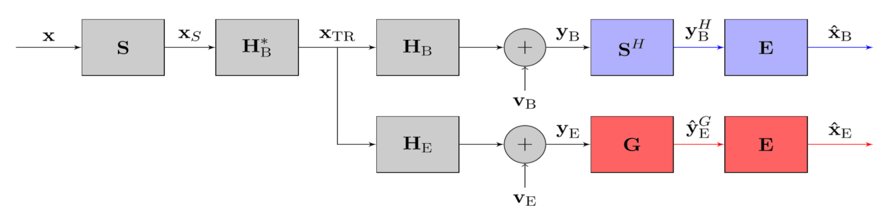


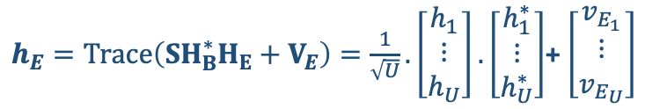
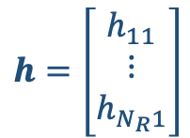




3) Capacity computatoon
Intuitive relationship bw SIMO and BOR effect in terms of capacity
$$h=\left[\begin{matrix}h_{11} \\ ⋮ \\ h_{N_{R}1}\end{matrix}\right]$$
System model
$$h_{11}$$
RX
TX
$$y=hx+n$$
$$h_{N_{R}1}$$
$h_{E}=\text{Trace}\left(SH_{B}^{∗}H_{E}+V_{E}\right)=\frac{1}{\sqrt{U}}.\left[\begin{matrix}h_{1} \\ ⋮ \\ h_{U}\end{matrix}\right].\left[\begin{matrix}h_{1}^{∗} \\ ⋮ \\ h_{U}^{∗}\end{matrix}\right]$+ $\left[\begin{matrix}v_{E_{1}} \\ ⋮ \\ v_{E_{U}}\end{matrix}\right]$
$N_{R}$ antennas
$$C_{symb}=\log_{2}\left(1+\frac{P_{T}}{σ^{2}}h_{E}^{H}h_{E}\right)$$
Now, how to include the AN in the capacity?
AN determined from :
$$S^{H}H_{B}w=0$$

