Slide 1



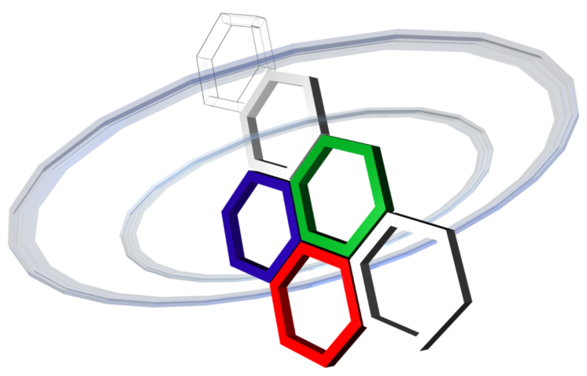
Physical Layer Security in Frequency-Domain Time-Reversal SISO OFDM Communication
Sidney Golstein,
Rottenberg François, Trung-Hien Nguyen, Philippe De Doncker, François Horlin, Julien Sarrazin
GEOHYPE project
ANR funding - JCJC program

Slide 2
Outline
Problem Statement
System Model
2.1. Conventional FD TR SISO OFDM scheme
2.2. FD TR SISO OFDM scheme with added AN
Performance Assessement
3.1. Secrecy Capacity
3.2. Optimal amount of useful data energy to transmit
3.3. Secrecy rate optimization via waterfilling
Conclusion & Future Works

Slide 3
1) Problem Statement (1)
Context
Wireless communication: unsecure in nature (broadcasting)
Physical Layer Security (PLS) can secure wireless communication
Secure communication if eavesdropper (Eve) channel degraded compared to legitimate receiver (Bob) →SINR degradation and/or AN injection in the null space of Bob
Investigated scheme: AN injection in FD TR SISO OFDM system
Applications of PLS
Prevent eavesdropping without need of upper layer data encryption scheme
PLS on top of encryption scheme to furrther enhance security
Notes:
PLS: Recently become an emerging technique to secure wireless com. Secrecy is achieved by exploiting the physical properties of the network
Secure com as soon as the legitimate receiver (Bob) has an advantage in terms of capacity compared to the eavesdropper (Eve)
Channel capacity: the maximum of the mutual information between the input and output of the channel, where the maximization is with respect to the input distribution Maximum information rate that can be achieved with an arbitrarily low probability error.

Slide 4
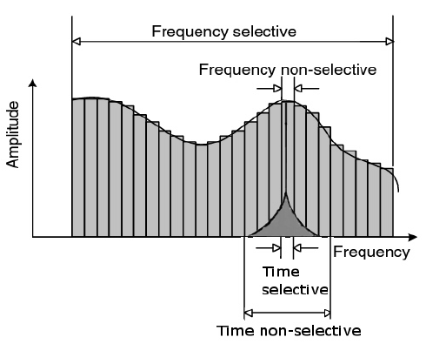
1) Problem Statement (2)
Context
Wireless communication: unsecure in nature (broadcasting)
Physical Layer Security (PLS) can secure wireless communication
Secure communication if eavesdropper (Eve) channel degraded compared to legitimate receiver (Bob) →SINR degradation and/or AN injection in the null space of Bob
Investigated scheme: AN injection in FD TR SISO OFDM system
Recall on OFDM
Idea:
Frequency division multiplexing scheme
Decompose signal spectrum in multiple subcarriers (multi-carriers modulation)
Data carried on orthogonal subcarriers
Advantage:
Allow to deal with fading channels (frequency non-selective on each subcarrier)

Slide 5
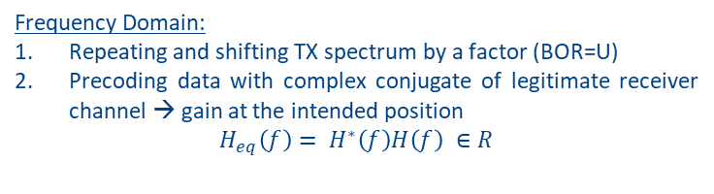

1) Problem Statement (3)
Context
Wireless communication: unsecure in nature (broadcasting)
Physical Layer Security (PLS) can secure wireless communication
Secure communication if eavesdropper (Eve) channel degraded compared to legitimate receiver (Bob) →SINR degradation and/or AN injection in the null space of Bob
Investigated scheme: AN injection in FD TR SISO OFDM system
Recall on Time Reversal
Time Domain:
Upsampling TX signal by a factor (BOR=U)
Precoding with time reversed version of legitimate receiver channel → focusing gain at the intended position
$$h_{eq}\left(τ\right)= h^{∗}\left(−τ\right)⊗h\left(τ\right) ∈R$$
Frequency Domain:
Repeating and shifting TX spectrum by a factor (BOR=U)
Precoding data with complex conjugate of legitimate receiver channel → gain at the intended position
$$H_{eq}\left(f\right)= H^{∗}\left(f\right)H\left(f\right) ∈R$$
→ FD TR can easily be implemented using OFDM

Slide 6
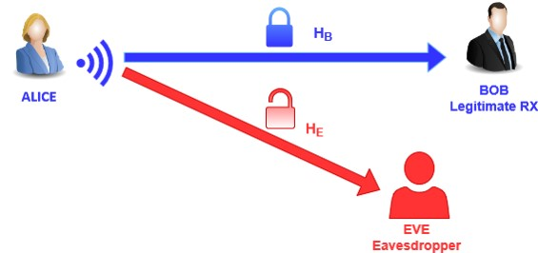
1) Problem Statement (4)
Goal
Secure communication between Alice and Bob
Eve tries to eavesdrop the data
Concept
One antenna at TX, one antenna at RX’s (SISO)
Data precoding at Alice to reach Bob
Addition of Artificial Noise to corrupt Eve’s data decoding
Hypothesis:
Alice knows Bob instantaneous CSI
Alice does not know Eve instantaneous CSI (Eve is passive)
No spatial correlation between Bob and Eve channels
No frequency correlation between subcarriers
AWGN of same level at Bob and Eve
Notes:
Precoding: implementation of the TR scheme in the FD

Slide 7
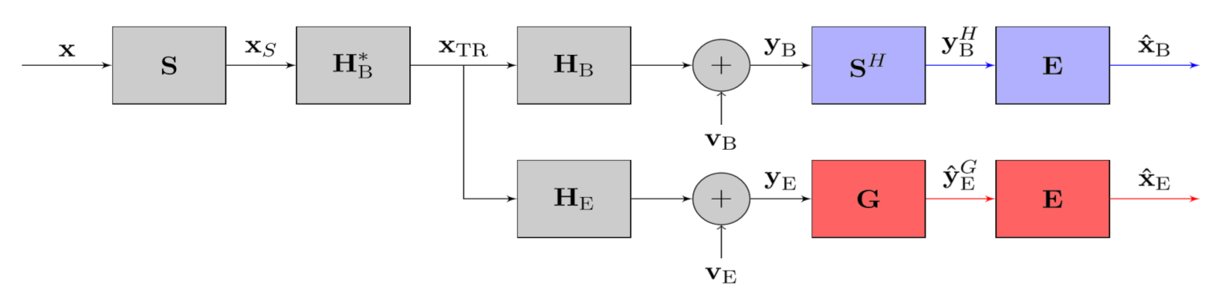
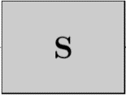
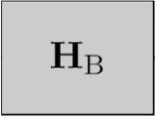
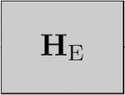
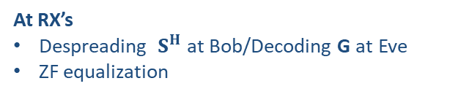
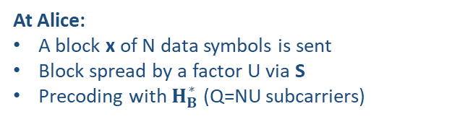




2) System Model (1)
2.1 Conventional FD TR SISO OFDM system
At Alice:
A block x of N data symbols is sent
Block spread by a factor U via S
Precoding with $H_{B}^{∗}$ (Q=NU subcarriers)
ALICE
BOB
Spreading
Precoding
At RX’s
Despreading $S^{H}$ at Bob/Decoding G at Eve
ZF equalization
EVE
DATA
TIME REVRSAL PRECODING IN FREQUENCY DOMAIN
PROPAGATION CHANNELS
RX NOISE
DECODING
SYMBOL ESTIMATION
$$x$$
$$x_{S}$$
$$y_{B}$$
$${\hat{x}}_{B}$$
H
f
f
f
f
$$y_{E}$$
$${\hat{x}}_{E}$$
G
f
f
Notes:
I will present the conventionnal FD TR scheme where no AN is added.

Slide 8


2) System Model (2)
2.1 Conventional FD TR SISO OFDM system (2)
At Bob:
Real gain for each RX symbol
Gain depends on BOR value (frequency diversity)
Perfect data recovery if high SNR scenario after ZF equalization
ALICE
BOB
Spreading
Precoding
EVE
At Eve:
No frequency diversity
Decoding performance depends on G
Perfect data recovery if high SNR scenario after ZF equalization → NOT SECURE
DATA
TIME REVRSAL PRECODING IN FREQUENCY DOMAIN
PROPAGATION CHANNELS
RX NOISE
DECODING
SYMBOL ESTIMATION
RX signal at Bob
Before ZF Equalization:
Estimated symbol:
RX signal at Eve
Before ZF Equalization:
Estimated symbol:

Slide 9
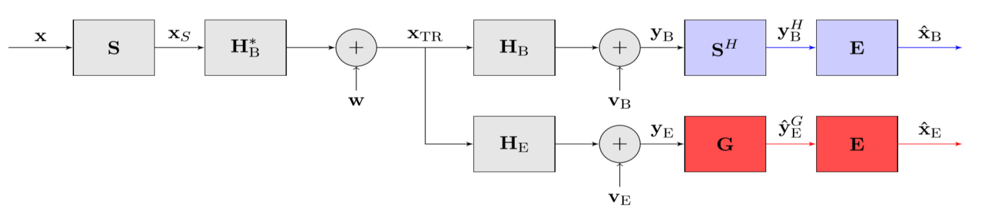

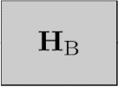

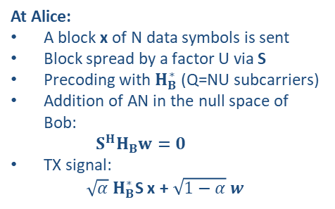
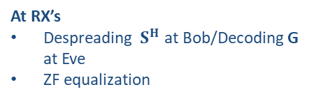
2) System Model (3)
2.2 FD TR SISO OFDM system with added AN
At Alice:
A block x of N data symbols is sent
Block spread by a factor U via S
Precoding with $H_{B}^{∗}$ (Q=NU subcarriers)
Addition of AN in the null space of Bob:
$$S^{H}H_{B}w=0$$
TX signal:
$\sqrt{α} H_{B}^{∗}$S x + $\sqrt{1−α} w$
ALICE
BOB
Spreading
Precoding
EVE
DATA
TIME REVRSAL PRECODING IN FREQUENCY DOMAIN
ARTIFICIAL NOISE INJECTION
PROPAGATION CHANNELS
RX NOISE
DECODING
SYMBOL ESTIMATION
At RX’s
Despreading $S^{H}$ at Bob/Decoding G at Eve
ZF equalization
$$AN$$
f
$$x$$
$$x_{S}$$
$$x_{TR}$$
$$y_{B}$$
$${\hat{x}}_{B}$$
$$+$$
H
f
f
f
f
f
$$y_{E}$$
$${\hat{x}}_{E}$$
G
f
f

Slide 10
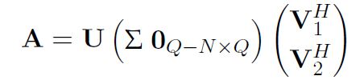
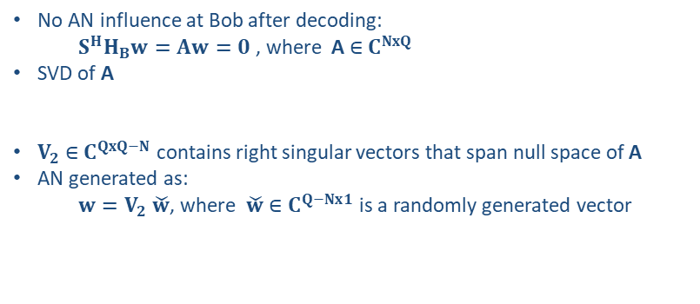
2) System Model (4)
2.2 FD TR SISO OFDM system with added AN (2)
AN Generation
Parameters: N symbols, Spreading BOR = U → Q = NU subcarriers
ALICE
BOB
Spreading
Precoding
EVE
DATA
TIME REVRSAL PRECODING IN FREQUENCY DOMAIN
ARTIFICIAL NOISE INJECTION
PROPAGATION CHANNELS
RX NOISE
DECODING
SYMBOL ESTIMATION
No AN influence at Bob after decoding:
$S^{H}H_{B}w=Aw=0$ , where A$∈$ $C^{NxQ}$
SVD of A
$V_{2}$ $∈$ $C^{QxQ−N}$ contains right singular vectors that span null space of A
AN generated as:
$w=V_{2} \check{w}$, where$\check{w}∈$ $C^{Q−Nx1}$ is a randomly generated vector
→ As soon as $U≥2,$AN signal is random to Eve
Notes:
As soon as the spreading factor is at least 2 , such that we have more subcarriers than symbols sent, we see that we can generate w from a set of infinite possibilifies. This leads to an impossibility at Eve to guess the AN signal.

Slide 11



2) System Model (5)
2.2 FD TR SISO OFDM system with added AN (3)
At Bob:
Real gain for each RX symbol
Gain depends on BOR value (frequency diversity)
Perfect data recovery if high SNR scenario after ZF equalization
BOB
ALICE
Spreading
Precoding
EVE
At Eve:
No frequency diversity
Decoding performance depends on G
Received data corrupted by AN term even if high SNR scenario→ SECURE
DATA
TIME REVRSAL PRECODING IN FREQUENCY DOMAIN
ARTIFICIAL NOISE INJECTION
PROPAGATION CHANNELS
RX NOISE
DECODING
SYMBOL ESTIMATION
RX signal at Bob
Before ZF Equalization:
Estimated symbol:
RX signal at Eve
Before ZF Equalization:
Estimated symbol:

Slide 12



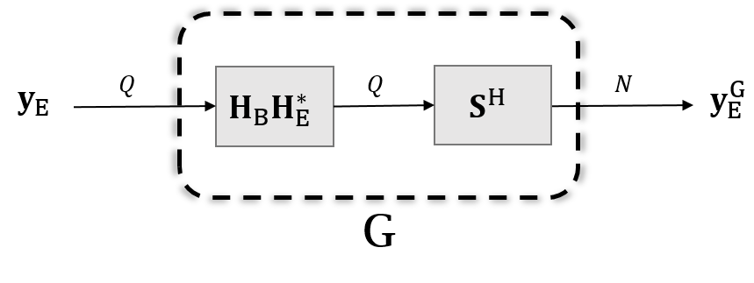
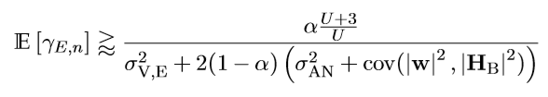

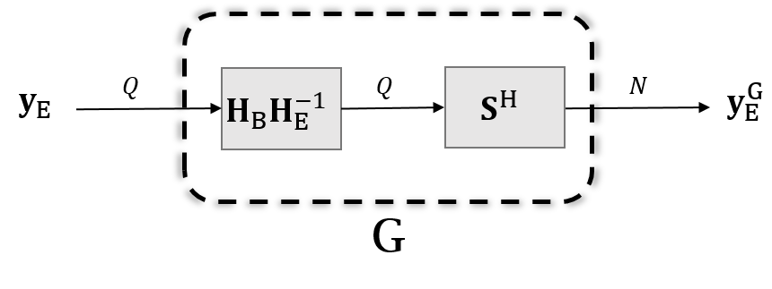



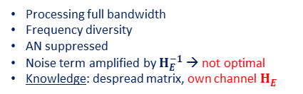
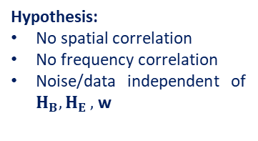


3) Performance Assessement (1)
3.1 Secrecy Capacity
Hypothesis:
No spatial correlation
No frequency correlation
Noise/data independent of $H_{B}{, H}_{E},$ w
At Bob:
At Eve: Depends on the decoding
Eve different decoding structures | Description | Ergodic SINR | Expected performance at Eve
Same as Bob
G = $S^{H}$
Simple despreading
Knowledge: despread matrix
Low
Matched Filter
G = $H_{E}^{ }H_{B}^{∗}$
Processing full bandwidth;
Coherent weight multiplication at each subcarrier →frequency diversity:
Knowledge: despread matrix, estimation of equivalent channel
Medium to high
AN killer
G = $H_{B}^{ }H_{E}^{−1}$
No analytic expression
Processing full bandwidth
Frequency diversity
AN suppressed
Noise term amplified by $H_{E}^{−1}$ → not optimal
Knowledge: despread matrix, own channel $H_{E}^{ }$
Depends on Eve subcarrier gain
LMMSE
Minimizes the MSE of estimated symbol
Knowledge: despread matrix, own channel $H_{E}^{ }$, AN energy
High
No analytic expression
Notes:
We compute the average, i.e. ergodic secrecy capacity. Secrecy capacity = maximum transmission rate that can be supported by the
legitimate receiver’s channel while ensuring the impossibility for the eavesdropper to retrieve the data

Slide 13
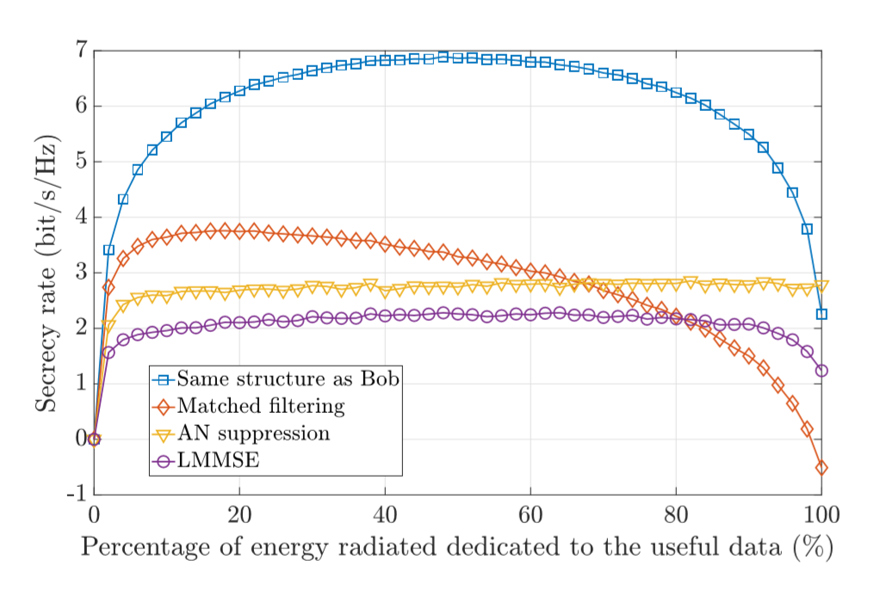
3) Performance Assessement (2)
Secrecy performances
Despreading only: high SR since poor performance at Eve
AN killer: flat curve since AN suppressed and noise amplified whatever α
LMMSE: low SR (high performance at Eve) since tradeoff between AN supression and noise amplification
Matched filter: Relatively low SR, negative SR when high percentage of data injected
Secrecy rate comparaison between the different decoding structure, Eb/N0 = 20 dB, BOR = 4

Slide 14
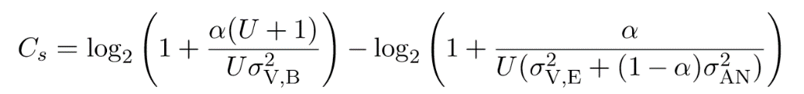
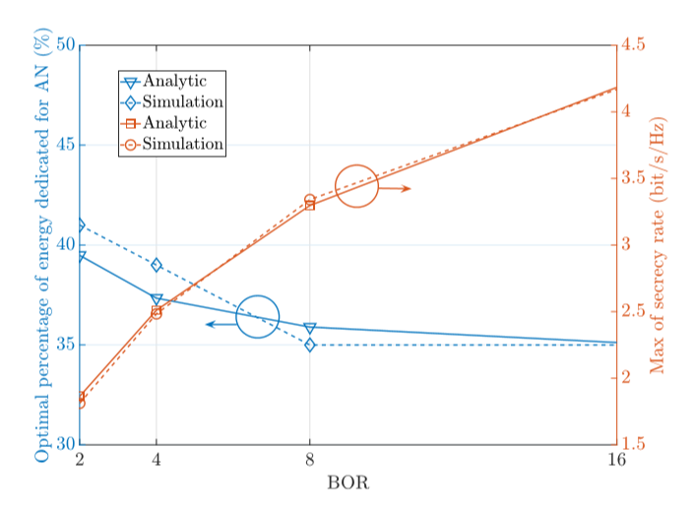
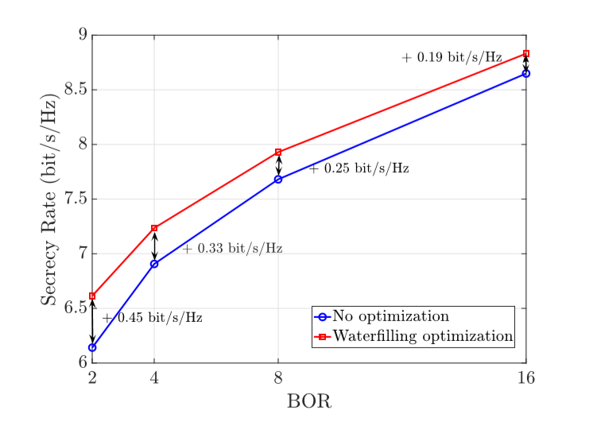
3) Performance Assessement (3) (Only for Bob and Eve with the same capabilities)
3.2 Optimal amount of AN to inject
3.3 Secrecy rate optimization via waterfilling
Analytic expression of SR to maximize:
Optimal amount of AN→ same coefficient on each subcarrier → capacity proportional to subcarrier energy → Tune the weights at each subcarrier to increase SR)
Optimal amount of AN to inject, Eb/N0 = 5 dB
SR optimization via waterfilling, Eb/N0 = 20 dB

Slide 15
4) Conclusions & Future Works
Conclusions:
Enhancement of PLS for FD TR SISO OFDM communication scheme via AN injection
Different eavesdropper decoding structures investigated → different performances/hypothesis
Future Works:
More robust scheme (precoding and/or AN injection) to improve the PLS
Extension to MIMO system
Multi-users communication scheme
More realistic channel model
Real demonstrator

