Slide 1
Impact of imperfect channel estimation on the performances
Sidney Golstein

Slide 2
Outline
System model and assumptions
Bob SINR modeling
Performances
MF Decoder
SDS Decoder (not shown since similar procedure as MF Decoder)
OC Decoder (not shown since similar procedure as MF Decoder)

Slide 3
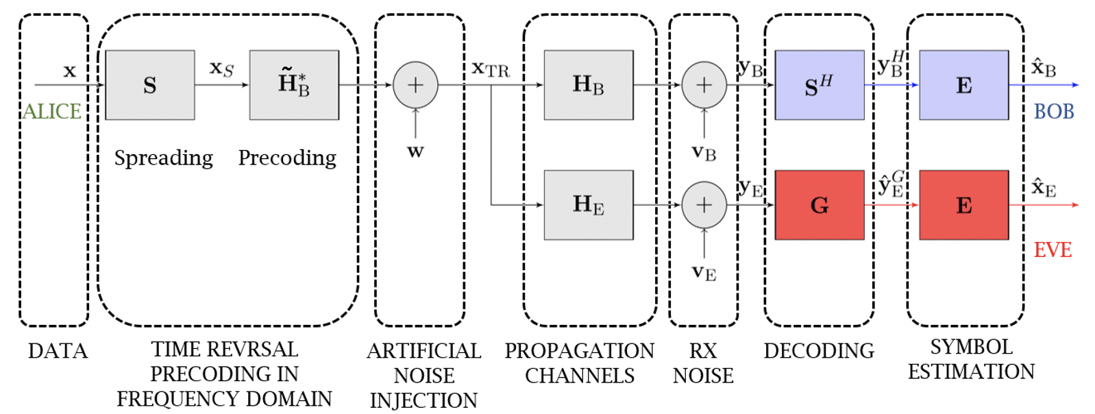
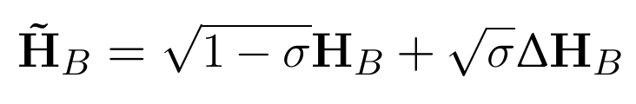
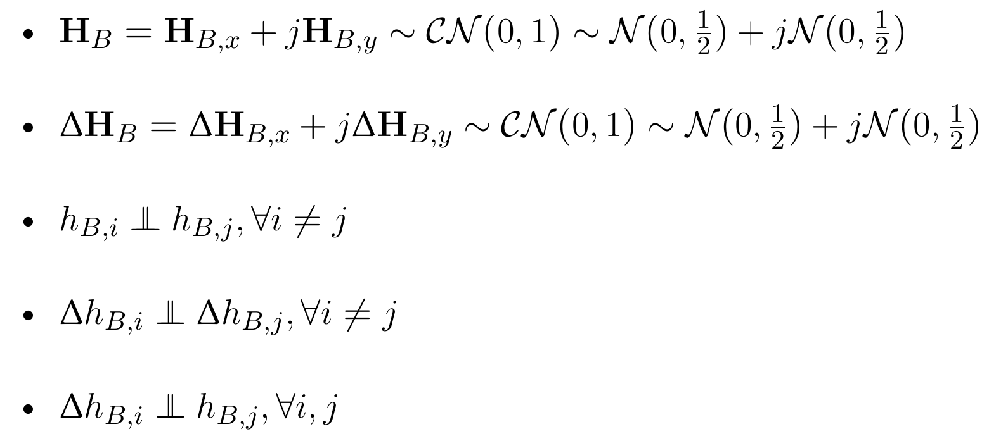
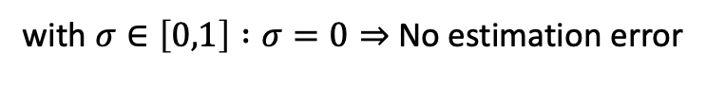
System Model and assumptions
Alice estimates:
with $σ∈\left[0,1\right] :σ=0⇒$No estimation error
Assumptions:
Eve perfectly estimates the precoding → imperfect CSI @Alice does
not affect Eve’s performances
Other idea to model the error?

Slide 4
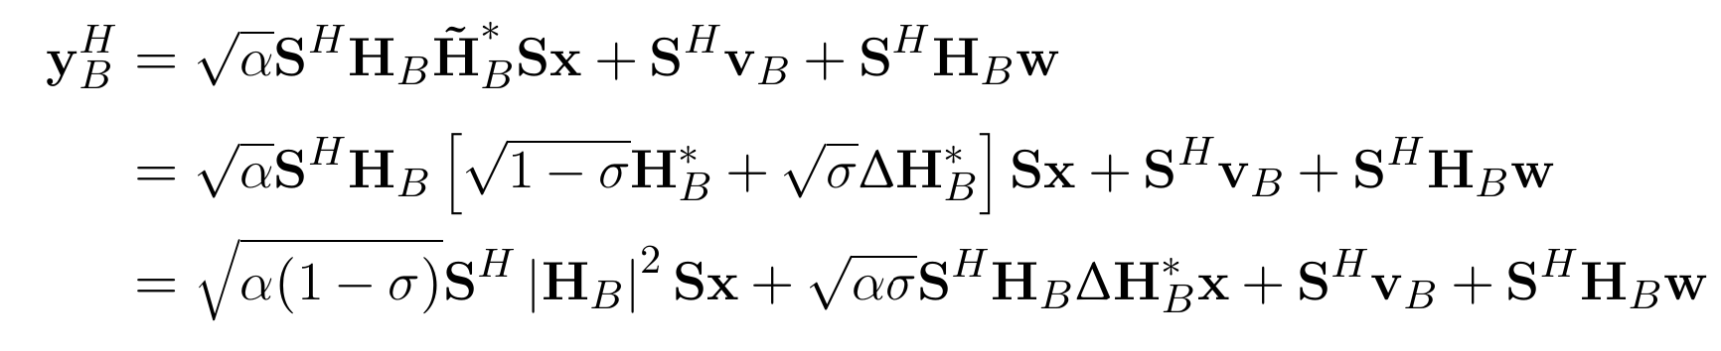

Bob SINR modeling (1)
Received signal at Bob:
with: since AN designed to be in the null space of ${\tilde{H}}_{B}^{∗}$
→ New terms compared to no CSI error
Received signal at Eve: Identical (with ${\tilde{H}}_{B}^{∗}$) as for classical scenario

Slide 5
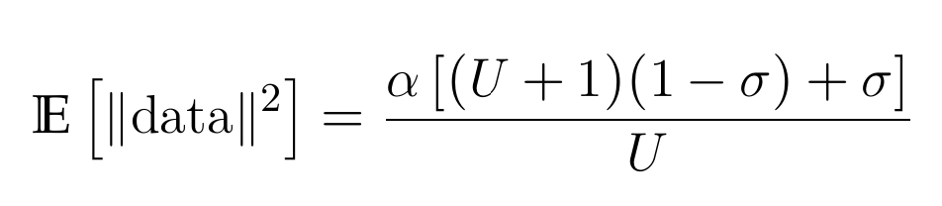
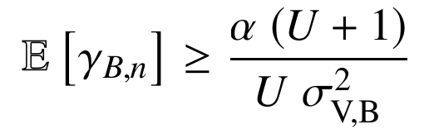
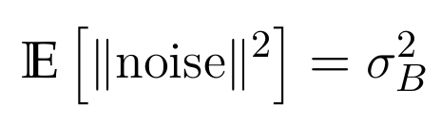
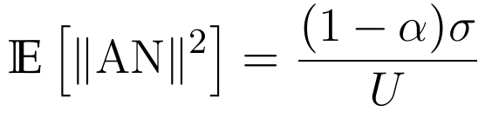
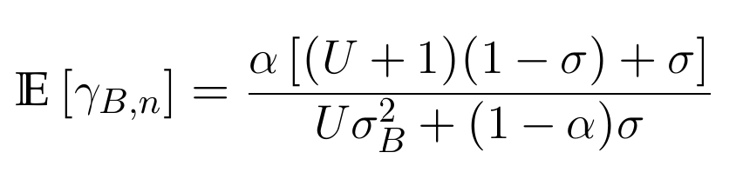


Bob SINR modeling (2)
Received signal at Bob:
data
noise
AN
With CSI error:
Without CSI error ($σ=0$):
(2)
→
(1)
→ (1) = (2) if $σ= 0$(i.e. no CSI error)

Slide 6
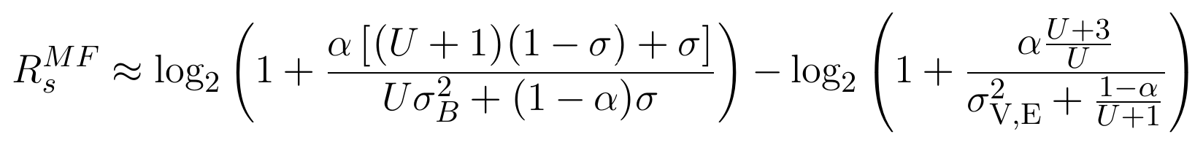
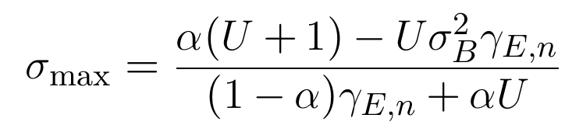
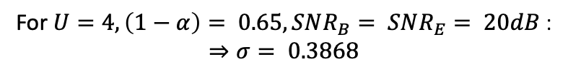
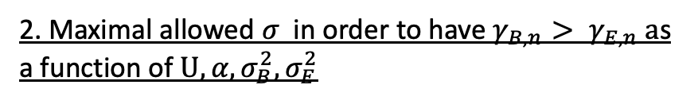
MF Decoder (1)
1. SR Expression
2. Maximal allowed $σ$in order to have $γ_{B,n}> γ_{E,n} a$s a function of $U, α, σ_{B}^{2}, σ_{E}^{2}$
For $U=4, \left(1−α\right)= 0.65, SNR_{B}= SNR_{E}= 20dB$:
$$⇒σ= 0.3868$$
U = 4 ; SNR = 20dB @E and @B

Slide 7



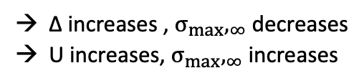
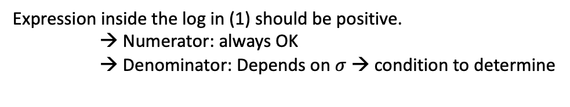
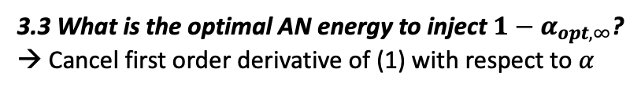
MF Decoder (2)
3. Guaranteeing SR = ∆
3.1 What should be Bob SNR $δ_{B,∞}$ to ensure SR = $Δ$ when Eve SINR = $∞$?
Remembering that the SNR is given by: $δ_{B}= 10\log_{10}{\frac{1}{U σ_{B}^{2}} }$
with
(1)
Expression inside the log in (1) should be positive.
→ Numerator: always OK
→ Denominator: Depends on $σ$ → condition to determine
3.2 What is the maximal acceptable CSI error $σ_{max},_{∞}$?
∆ increases , $σ_{max},_{∞}$ decreases
U increases, $σ_{max},_{∞}$ increases
3.3 What is the optimal AN energy to inject ${1−α}_{opt, ∞}$?
→ Cancel first order derivative of (1) with respect to $α$
$$σ_{E}^{2}= 0$$

Slide 8
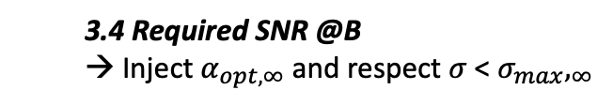
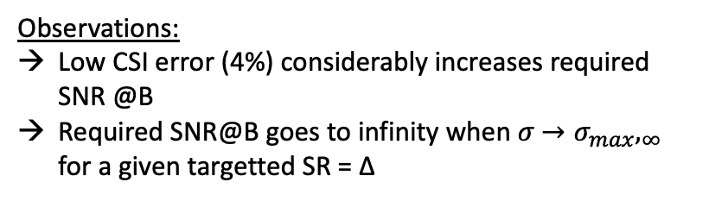
MF Decoder (3)
3. Guaranteeing SR = ∆
3.4 Required SNR @B
→ Inject $α_{opt, ∞}$ and respect $σ$ < $σ_{max},_{∞}$
Observations:
Low CSI error (4%) considerably increases required SNR @B
Required SNR@B goes to infinity when $σ$ $→σ_{max},_{∞}$ for a given targetted SR = ∆

