Slide 1
FA2022 Week 01
Setup
Anusha and Nathan

Slide 2
Slide Styling Guidelines
Remove this slide once you have read the guidelines
Do not put "SIGPwny" or "Meeting" or "Seminar" (or synonyms) in the title
Unless it is for info meetings or the Recursive Meeting :)
Use dashes ("-") for bullet points
Use straight quotes (""), not smart quotes (“”)
Avoid moving text boxes for titles and headings
Unless they are all consistently moved!
Stick to SIGPwny theme colors in the color picker
Do not make text too small (font size 20 is the limit)
Reference Brand Guidelines here:
https://docs.google.com/document/d/1SioiiGVKlwm0sn56YOr_ESFkqx1HeAv7JfERbel_AoM/edit

Slide 3
Announcements
CSAW this weekend
Free pizza! 🍕
Fall CTF registration open
fallctf.sigpwny.com

Slide 4

What is SIGPwny?
Computer Security Club at UIUC
Largest Special Interest Group in ACM@UIUC
Don't talk to me or my child ever again

Slide 5
Two Meetings/Week!

Slide 6
Traditional Thursdays
15 Minutes Talking, 45 Minutes Doing
6-7PM Siebel CS 1404

Slide 7
Seminar Sundays
1+ hours talking, many hours doing
2-3PM Siebel CS 1404

Slide 8
Code of Conduct
Be respectful.
Be inclusive.
Nothing illegal.
No NSFW or suggestive content.
Don't spam.
Use common sense.

Slide 9
Pwny CTF (ctf.sigpwny.com)
Create an account right now!
Where we put our challenges for you to build hands on experience
Solve challenges, find flags, submit flags on website

Slide 10

WARNING before we go any further!
(The “Don’t Get Arrested” Slide)
We will teach you things that you could use unethically & illegally
https://www.law.cornell.edu/uscode/text/18/1030
Read it!
CFAA TLDR
Computer Fraud and Abuse Act
Attacking “protected” computers
Anywhere between a fine and TWENTY years in jail.
If you don’t have EXPLICIT permission to break into it, DON’T
We are NOT lawyers and CAN’T give you legal advice
We are NOT suggesting, telling, or implying you should actually do these things. By participating in this club and agreeing to our Code of Conduct, you agree that your actions are your own and you will deal with the consequences.
Marcus Hutchins, Controversial Hacker who saved the internet, got arrested for past crimes.

Slide 11
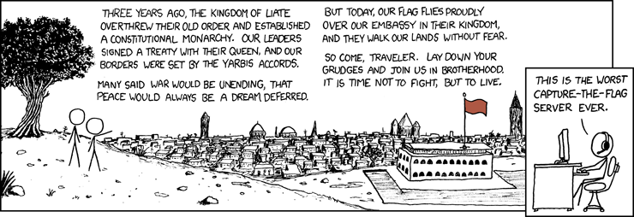
sigpwny{setup}
funny image here

Slide 12
Table of Contents
What is a shell
I want one
Getting into the shell
OS Differences + Different Shells
WSL or Virtual Machines?
Installing WSL
Starter commands
Tools to install

Slide 13
> The Terminal
"It’s where things happen" - Ravi

Slide 14
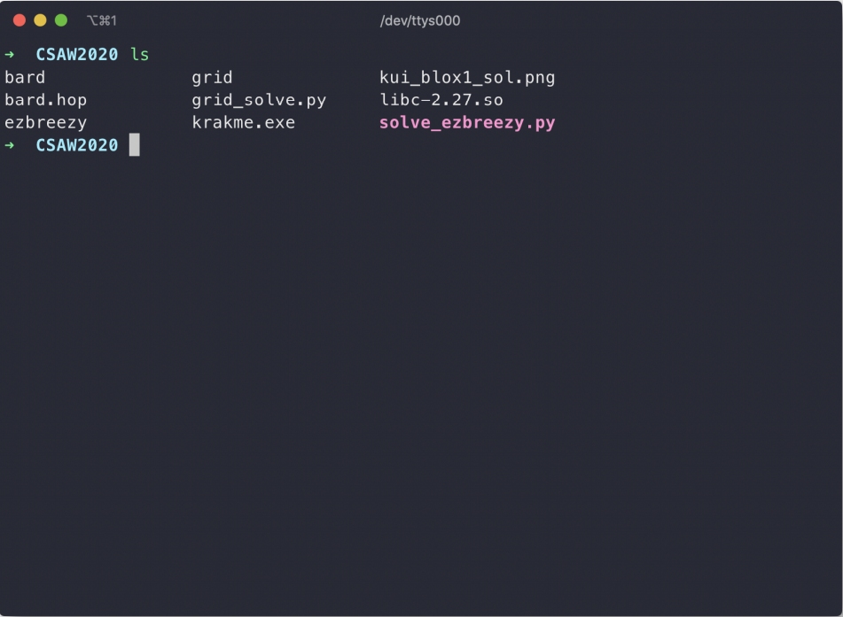
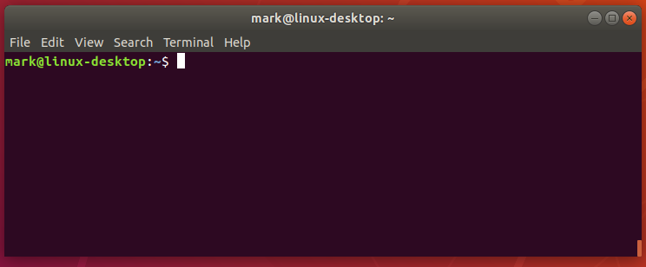
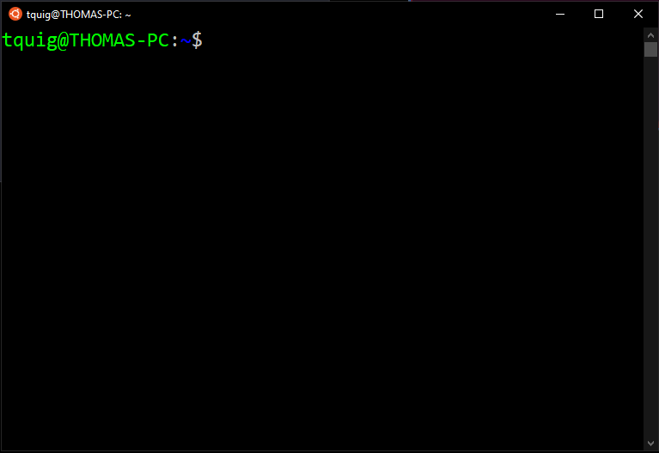

Slide 15
Linux
You’re good to go!

Slide 16
Windows
macOS
WSL
Virtual Machine
Built-In Terminal
Virtual Machine

Slide 17
PowerShell? Command Prompt?
Those are shells too!
However, they're limited in tools and are Windows-based terminals, not Linux-based

Slide 18
Windows Subsystem for Linux

Slide 19
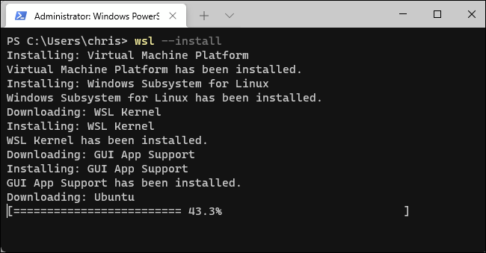
Installing WSL
Open command prompt as administrator
(Start button → type cmd → right click → open as administrator)
Type wsl --install
Restart computer
Open command prompt
Enter WSL by typing wsl
You now have a linux shell

Slide 20
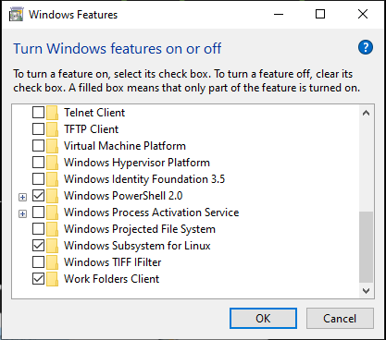
WSL - Older Windows 10 Versions
Go to the Windows search bar
Search "Turn Windows features on or off"
Check "Virtual Machine Platform" and "Windows Subsystem for Linux"
Restart

Slide 21
WSL - Older Windows 10 Versions
Open the Microsoft Store and search for "Ubuntu"

Slide 22
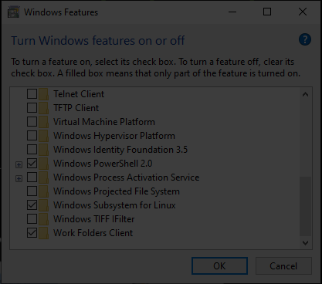
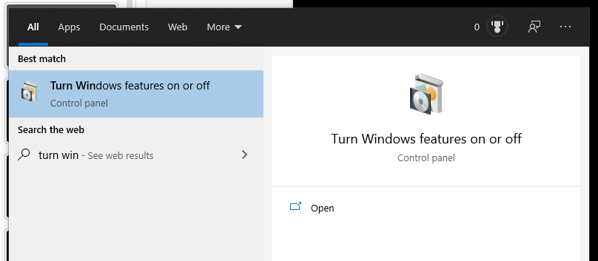
Windows Subsystem for Linux
⊞ + S
Search “Turn Windows features on or off”

Slide 23
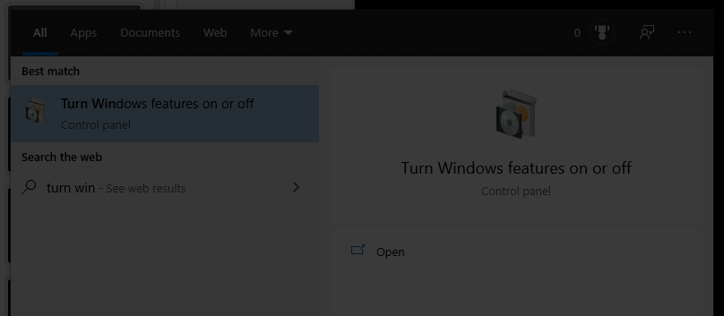
Windows Subsystem for Linux
⊞ + S
Search “Turn Windows features on or off”

Slide 24

Windows Subsystem for Linux
⊞ + S
Search “Turn Windows features on or off”

Slide 25
Restart!

Slide 26
Go set this up!

Slide 27
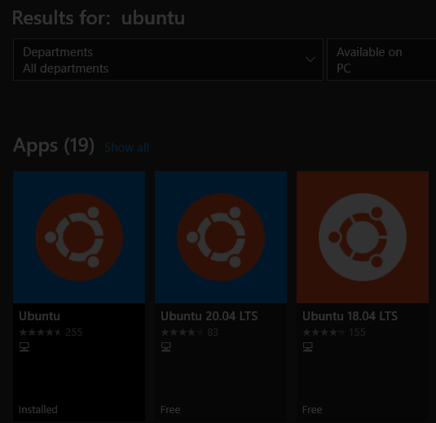
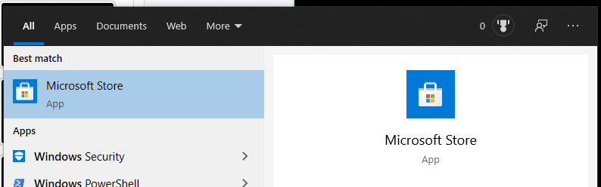
Getting A Terminal
Open the Microsoft Store
Search “Ubuntu”

Slide 28
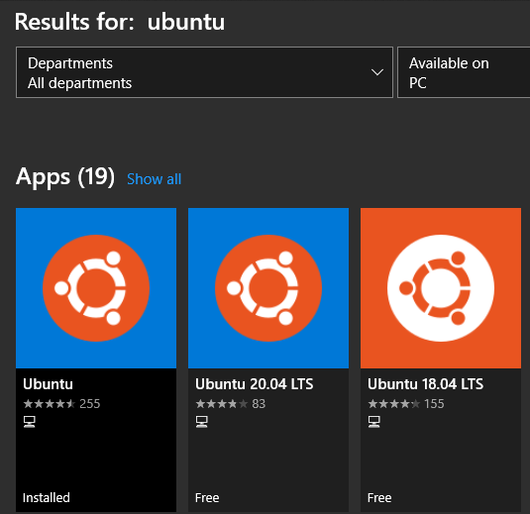
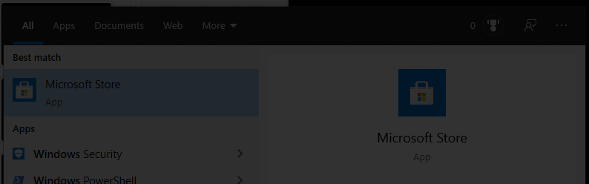
Getting A Terminal
Open the Microsoft Store
Search “Ubuntu”

Slide 29
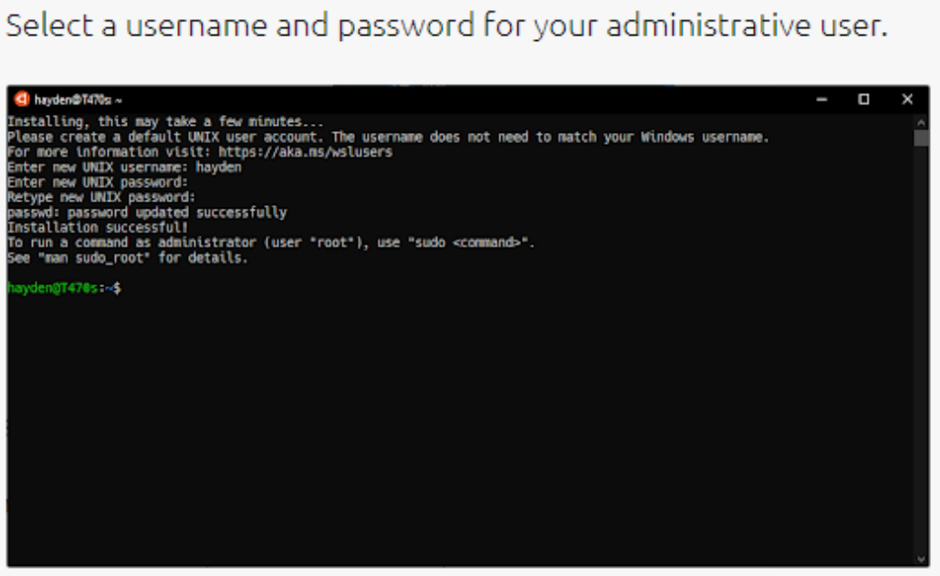
Set a "root" user

Slide 30
macOS Terminal
Command + Space
Search “Terminal”

Slide 31


Filesystems
dirC/ Directory C
file1.txt
dirA/ Directory A
file1.txt
/
root
file1.txt
dirB/
Directory B
file2.txt

Slide 32
cd /
dirC/ Directory C
file1.txt
dirA/ Directory A
file1.txt
/
root
file1.txt
dirB/
Directory B
file2.txt

Slide 33
cd dirA
dirC/ Directory C
file1.txt
dirA/ Directory A
file1.txt
/
root
file1.txt
dirB/
Directory B
cd starts here!
file2.txt

Slide 34
cd dirA
cd starts here!
dirC/ Directory C
file1.txt
dirA/ Directory A
file1.txt
/
root
file1.txt
dirB/
Directory B
file2.txt

Slide 35
cd starts here!
dirC/ Directory C
file1.txt
dirA/ Directory A
file1.txt
/
root
file1.txt
dirB/
Directory B
file2.txt

Slide 36
cd dirC
cd starts here!
dirC/ Directory C
file1.txt
dirA/ Directory A
file1.txt
/
root
file1.txt
dirB/
Directory B
file2.txt

Slide 37
cd dirC
cd starts here!
dirC/ Directory C
file1.txt
dirA/ Directory A
file1.txt
/
root
file1.txt
dirB/
Directory B
file2.txt

Slide 38
cd starts here!
dirC/ Directory C
file1.txt
dirA/ Directory A
file1.txt
/
root
file1.txt
dirB/
Directory B
file2.txt

Slide 39
cd dirB
cd starts here!
dirC/ Directory C
file1.txt
Error: dirB not found
dirA/ Directory A
file1.txt
/
root
file1.txt
dirB/
Directory B
file2.txt

Slide 40
cd /dirB
dirC/ Directory C
file1.txt
dirA/ Directory A
file1.txt
/
root
file1.txt
dirB/
Directory B
cd starts here!
file2.txt

Slide 41
cd ../../dirB
cd starts here!
dirC/ Directory C
file1.txt
dirA/ Directory A
file1.txt
/
root
file1.txt
dirB/
Directory B
file2.txt

Slide 42
cd ../../dirB
cd starts here!
dirC/ Directory C
file1.txt
dirA/ Directory A
file1.txt
/
root
file1.txt
dirB/
Directory B
file2.txt

Slide 43
cd ../../dirB
cd starts here!
dirC/ Directory C
file1.txt
dirA/ Directory A
file1.txt
/
root
file1.txt
dirB/
Directory B
file2.txt

Slide 44
cd ../../dirB
cd starts here!
dirC/ Directory C
file1.txt
dirA/ Directory A
file1.txt
/
root
file1.txt
dirB/
Directory B
file2.txt

Slide 45
cd ../../dirB
dirC/ Directory C
file1.txt
dirA/ Directory A
file1.txt
cd starts here!
/
root
file1.txt
dirB/
Directory B
file2.txt

Slide 46
How to get to dirA?
dirC/ Directory C
file1.txt
dirA/ Directory A
file1.txt
cd starts here!
/
root
file1.txt
dirB/
Directory B
file2.txt

Slide 47
How to get to dirA?
dirC/ Directory C
file1.txt
dirA/ Directory A
file1.txt
cd starts here!
/
root
file1.txt
dirB/
Directory B
file2.txt

Slide 48
"cd /dirA" or "cd ../dirA"
dirC/ Directory C
file1.txt
dirA/ Directory A
file1.txt
"cd .." starts here!
/
root
file1.txt
dirB/
Directory B
"cd /" starts here!
file2.txt

Slide 49
Paths
Absolute Path
Relative Path
The full path that always starts at root (/)
/dirA/file1.txt
/dirA/dirC/file1.txt
The partial path relative to where you are currently in the terminal
(Relative to dirA)
file1.txt
dirC/file1.txt

Slide 50
cd starts here!
dirC/ Directory C
file1.txt
dirA/ Directory A
file1.txt
/
root
file1.txt
dirB/
Directory B
file2.txt

Slide 51
"cd dirC" or "cd ./dirC" or "cd dirC/"
cd starts here!
dirC/ Directory C
file1.txt
dirA/ Directory A
file1.txt
/
root
file1.txt
dirB/
Directory B
file2.txt

Slide 52
./dirC == dirC == dirC/
Also ././dirC and ./././dirC and ././././dirC and...
These are just conventions!

Slide 53
Useful Commands - Filesystem
ls [directory]: lists files in your current directory or specified directory
cd <directory>: changes your current directory to specified directory
mv <source> <dest>: moves file from source to dest (rename), if dest is a directory, move source
rm <file>: removes file (NOT REVERSIBLE)
cat <file>: prints the contents of file (sometimes it prints gibberish, think why that might happen)
./file: executes whatever is at file
man <command>: lets you see info about a command and all of its parameters/options
<parameter> means it's a required parameter
[parameter] means it's an optional parameter

Slide 54
Useful Commands - Networking
nc <ip> <port>: netcat, connect to ip on port port. (First Command - netcat)
ssh <user@ip> [port]: secure remote shell, run an instance of a shell as user at the IP address
ping <ip>: see if an IP address is up using ICMP (usually blocked by firewalls)
curl <url>: network access tool that is mainly used to access websites from the terminal
wget <url>: Simplified/modern curl that downloads the file with relevant name

Slide 55
Networking Fundamentals
nc -l <port>: open a network socket to listen on specified port
nc <ip> <port>: open a connection to the specified IP and port
Ports - communication endpoints on your computer (1-65535)

Slide 56
Next Steps - Bandit
ssh bandit0@bandit.labs.overthewire.org -p 2220

Slide 57
Next Steps - Bandit
ssh bandit0@bandit.labs.overthewire.org -p 2220 command IP port
user

Slide 58
Next Meetings
2022-09-08 - This Thursday
Web I
Intro to Web Hacking
2022-09-09 - This Friday
CSAW CTF '22 Qualifying Round
We will be playing in this weekend long CTF - come join us!
2022-09-11 - Next Sunday
Web II
Advanced Web Hacking

