Slide 1
FA2022 Week 02
Web Hacking I
Emma and Michael

Slide 2
Slide Styling Guidelines
Remove this slide once you have read the guidelines
Do not put "SIGPwny" or "Meeting" or "Seminar" (or synonyms) in the title
Unless it is for info meetings or the Recursive Meeting :)
Use dashes ("-") for bullet points
Use straight quotes (""), not smart quotes (“”)
Avoid moving text boxes for titles and headings
Unless they are all consistently moved!
Stick to SIGPwny theme colors in the color picker
Do not make text too small (font size 20 is the limit)
Reference Brand Guidelines here:
https://docs.google.com/document/d/1SioiiGVKlwm0sn56YOr_ESFkqx1HeAv7JfERbel_AoM/edit

Slide 3
Announcements
CSAW Tomorrow!
Free pizza!
Fall CTF
fallctf.sigpwny.com

Slide 4
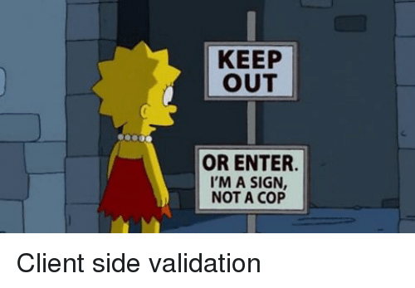
sigpwny{ctrl_sh1ft_c}

Slide 5
Table of Contents
How the web works
Clients and Servers
How websites work
The bones, skin, and brain of the internet
HTML
CSS
JavaScript
Cookies, local storage
Chrome Devtools
Challenge walkthrough

Slide 6
How the Web Works
At a very high level!

Slide 7



How the Web Works
example.com/index.html
Browser
Server

Slide 8
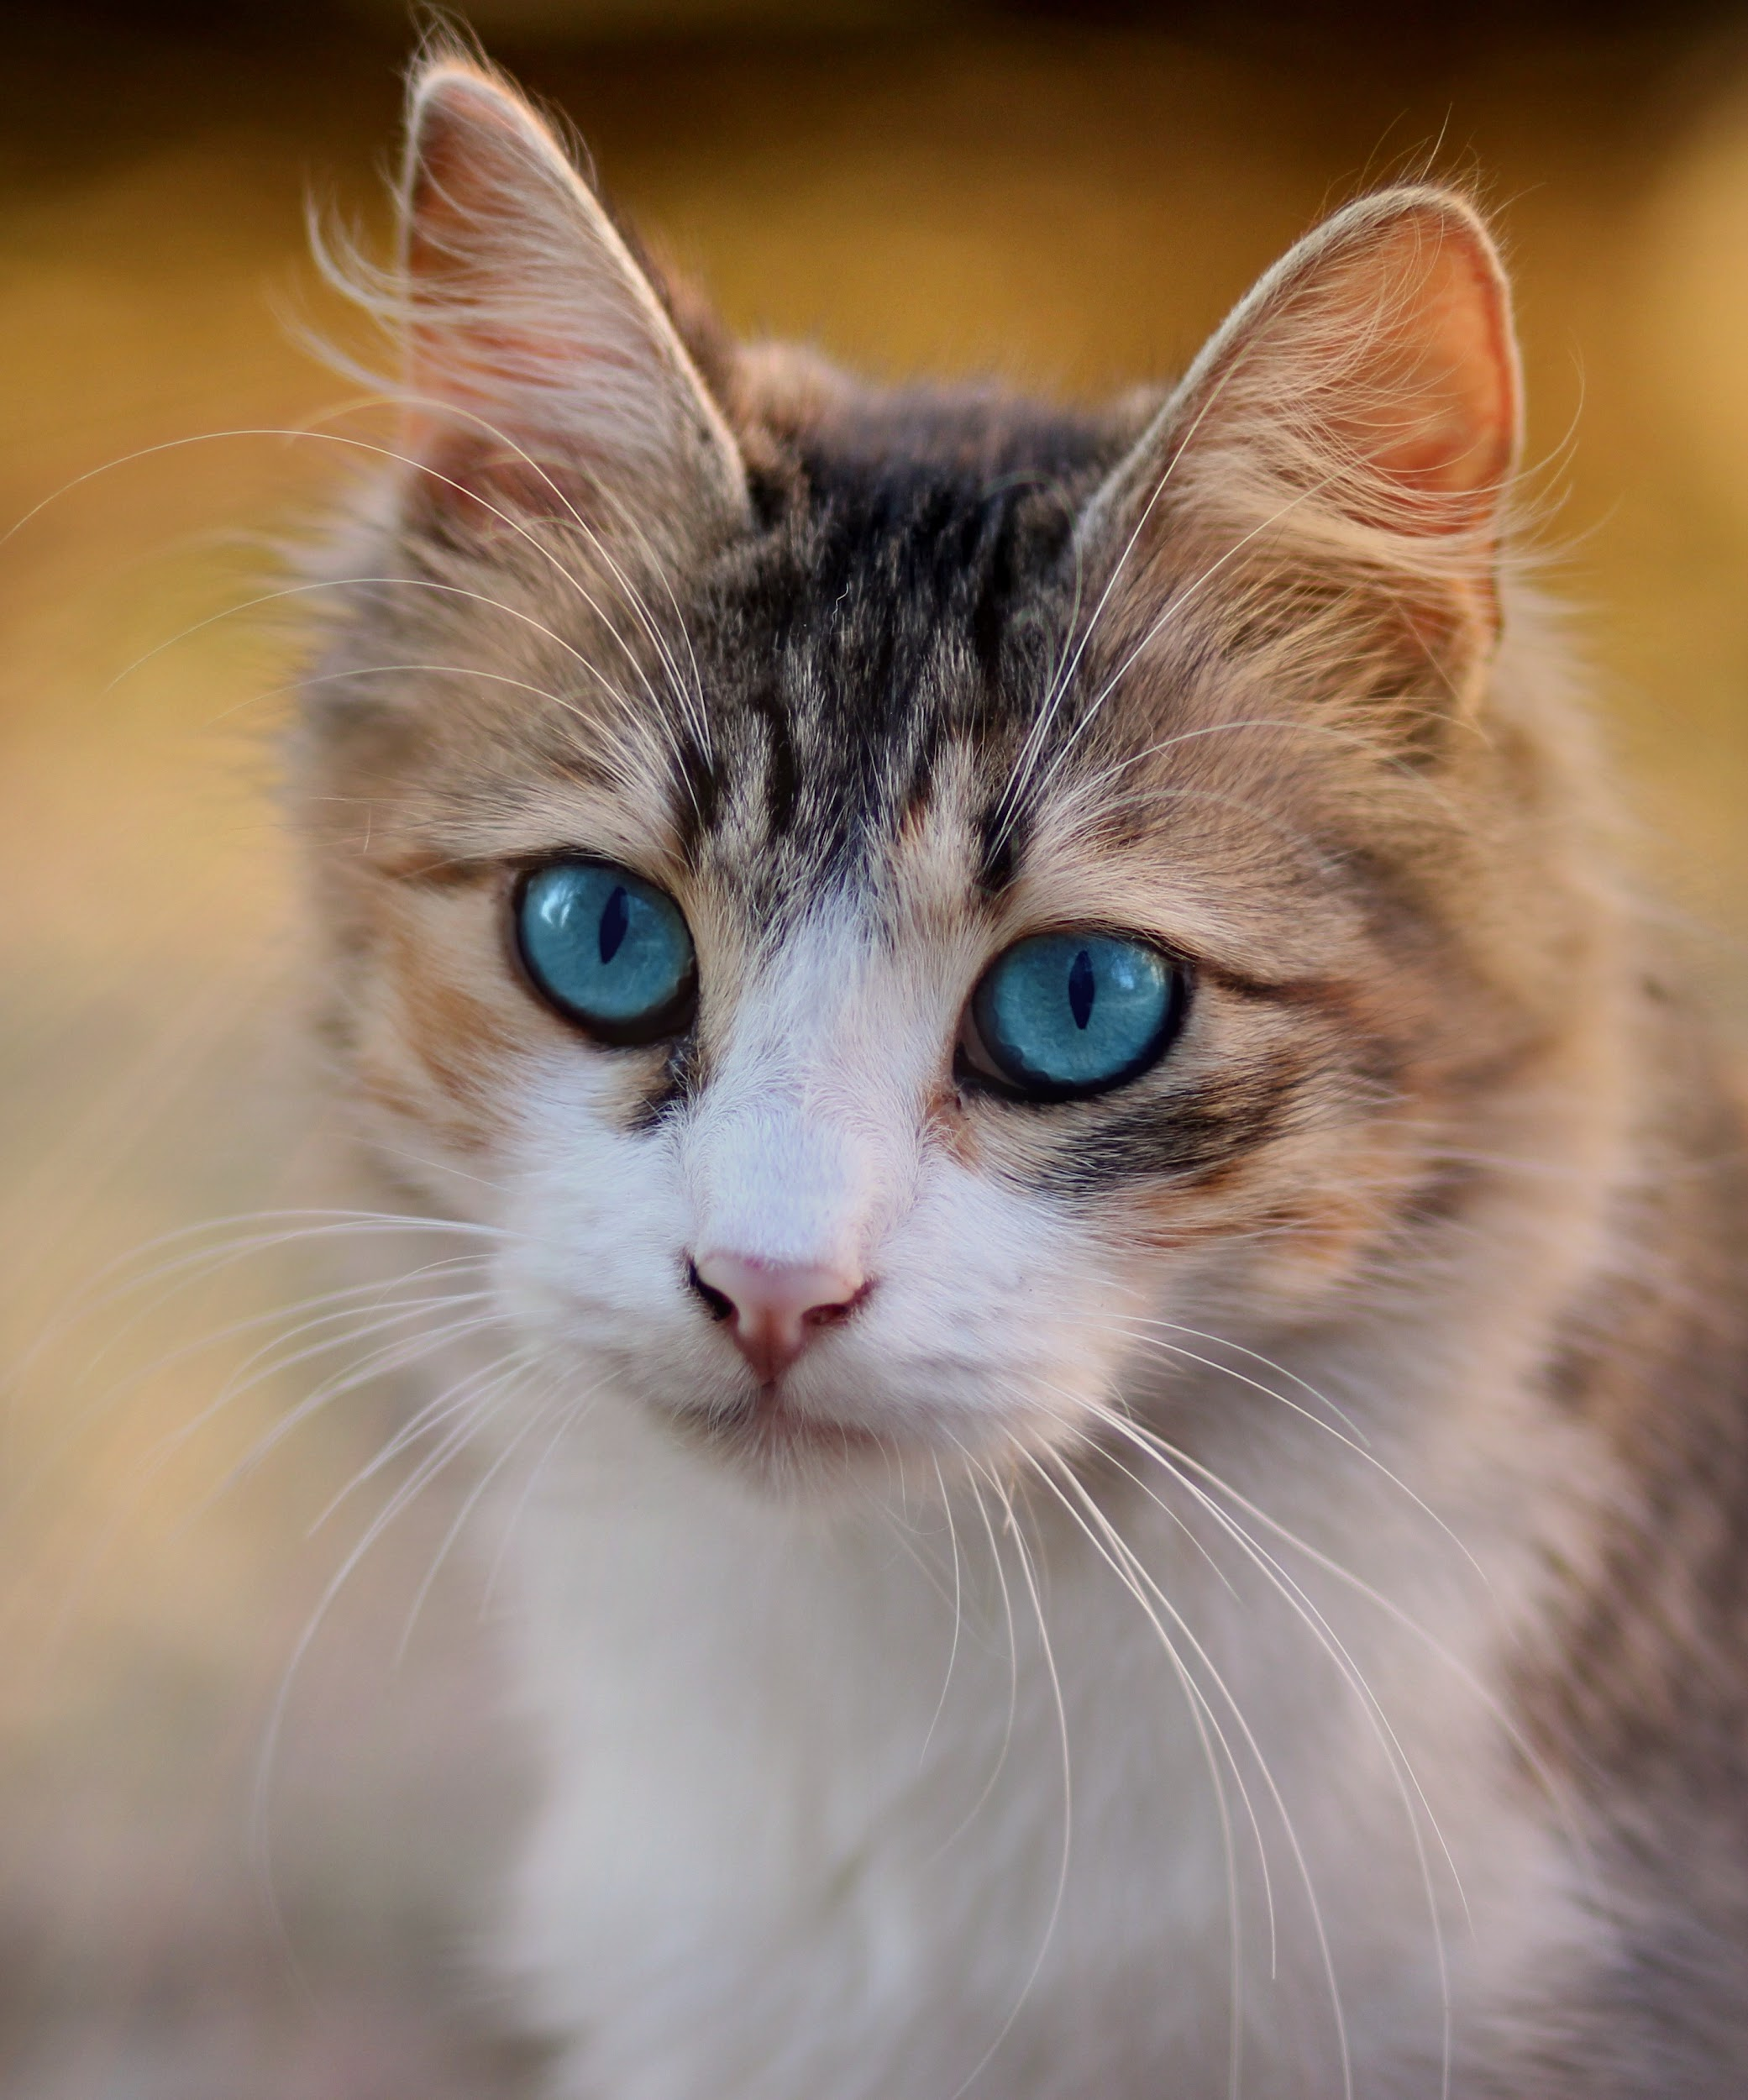
How the Web Works
example.com/cat.jpg
Browser
Server

Slide 9

How the Web Works
example.com/script.js
Browser
Server

Slide 10
How Websites Work
The bones, skin, and brains of the Internet

Slide 11
How Websites Work
Websites displayed by browser according to
HTML
CSS
Javascript

Slide 12
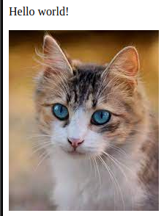
HTML - The Bones
Defines the layout of websites
Where are the images, buttons, and textboxes?
Defines where to load the javascript and CSS from
<html>
<p>Hello world!</p>
<img src="cat.jpg">
<script src="script.js"></script>
</html>

Slide 13
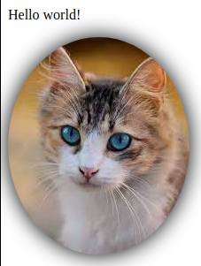
CSS - The Skin
Defines what website elements should look like
Can be written in the HTML or loaded from external file
img {
border-radius: 50%;
filter: drop-shadow(0 0 0.75rem black);
}

Slide 14
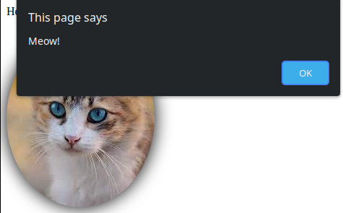
JavaScript - The Brains
Programming language to make website do something
Do something when button is pressed
Animate things on webpage
Make requests to other endpoints
document.getElementById("cat").onclick = () => alert("Meow!");

Slide 15
Cookies and Local Storage

Slide 16
Cookies 🍪
Small pieces of information stored across visits to same web page
Maintained by browser, sent along with requests
Main usages:
Maintain a “session” after you log in to a site
Track you for advertising purposes

Slide 17
Local Storage
Store key/value pairs like a cookie
Not sent with requests to server
Larger storage size limit (4KB vs 5MB)
Can persist indefinitely

Slide 18
Important Tools

Slide 19
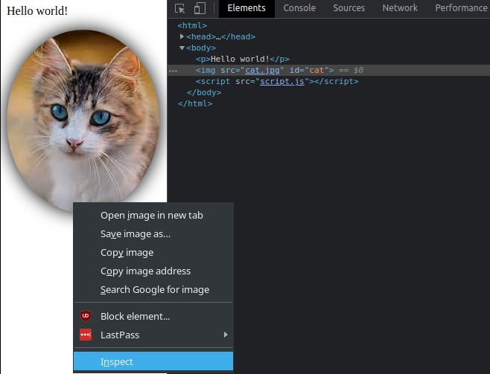
Devtools - Inspect Element
Inspect HTML of page
Delete or add elements
View event listeners and styles

Slide 20
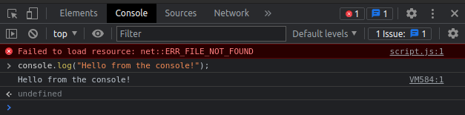
Devtools - Console
View errors
Execute your own javascript to interact with page and existing javascript

Slide 21
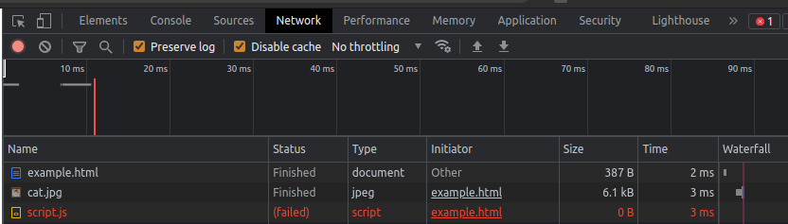
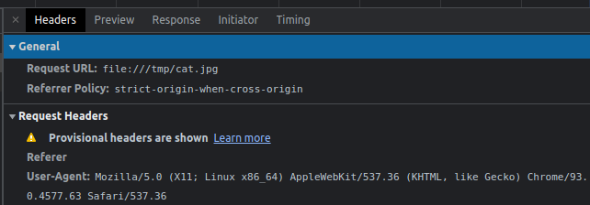
Devtools - Network
View requests sent from your browser
Resources requested from server
Login forms
File uploads

Slide 22
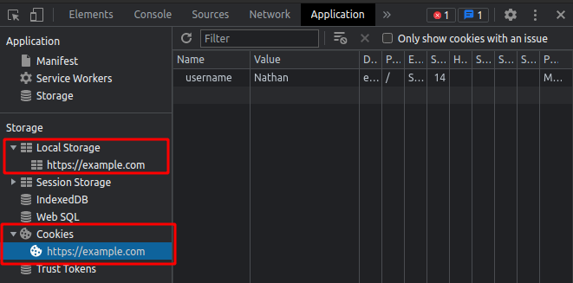
Devtools - Application
View cookies and local storage for a website
Modify contents to mess with web service

Slide 23
Challenge Walkthrough!

Slide 24
Next Meetings
2022-09-05 - This Friday
CSAW CTF '22 Qualifying Round
We will be playing in this weekend long CTF - come join us!
2022-09-11 - This Sunday
NO MEETING
2022-09-15 - Next Thursday
Web Hacking II
Advanced Web Hacking

