Slide 1
FA2022 Week 03
Rev/Pwn Setup
Minh and Pete

Slide 2
Announcements
Fall CTF 2022
This Saturday!!! 12 - 6PM
CIF 3039

Slide 3
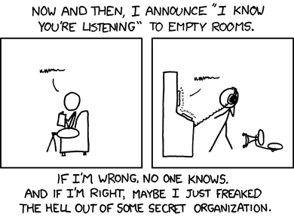
ctf.sigpwny.com
sigpwny{i_love_nsa_software}

Slide 4
Outline
Goal: Get everyone set up with Ghidra, Python, and pwntools in preparation for Thursday, Reverse Engineering I
Installing Java Developer Kit
Windows
Mac Intel
Mac M1
Linux
Installing Ghidra
Installing Python, pwntools, GDB

Slide 5
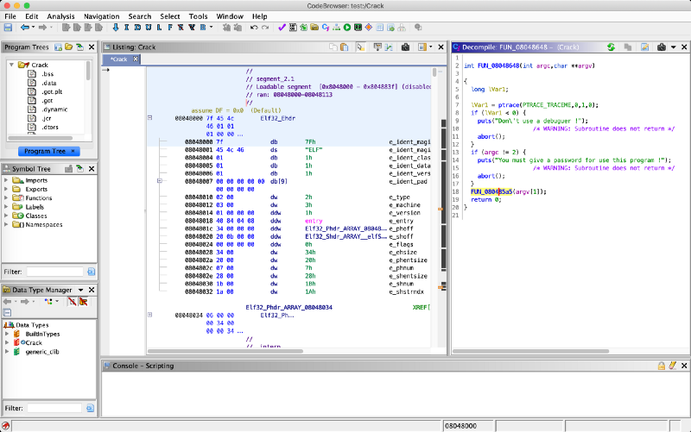

What is Ghidra?
Ghidra is a reverse engineering toolkit developed by the NSA and made open source
Allows you to disassemble applications - essentially turn an unreadable application into readable code

Slide 6
JDK on Windows

Slide 7
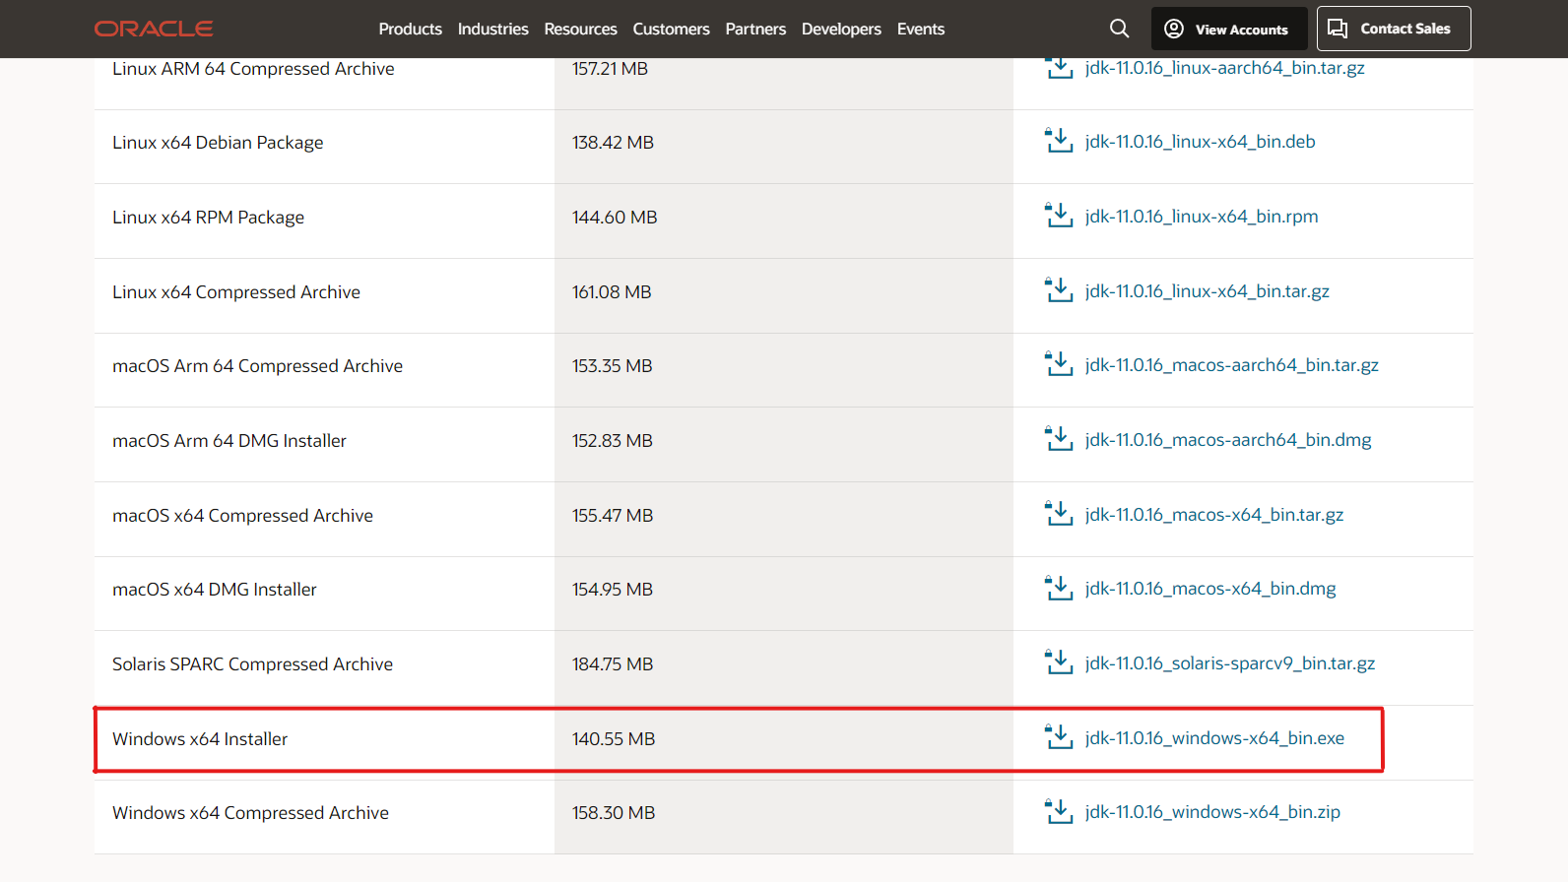
Installing Java Developer Kit
Install JDK 11 (not JRE!) from Oracle
https://www.oracle.com/java/technologies/javase/jdk11-archive-downloads.html
or Google
"oracle java se 11"

Slide 8
JDK on Intel/M1 Mac

Slide 9
Installing Java Developer Kit
Go to https://brew.sh and run the setup command
If it is already installed, make sure to update with `brew update`
Install openjdk java11 or newer: `brew install java11`

Slide 10
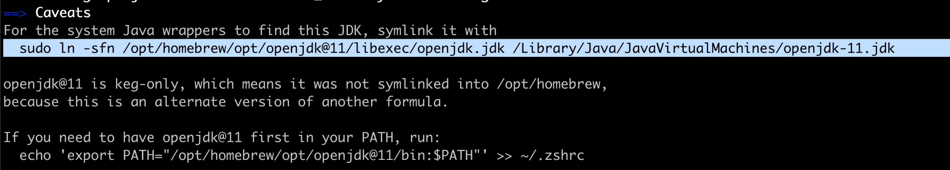
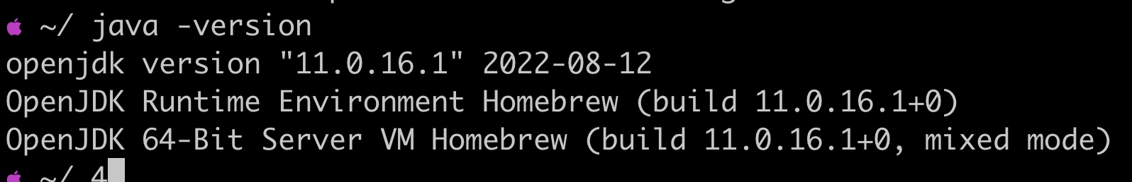
Linking Java
Link your Java JDK
sudo ln -sfn /opt/homebrew/opt/openjdk@11/libexec/openjdk.jdk /Library/Java/JavaVirtualMachines/openjdk-11.jdk
THESE COMMANDS SHOULD BE COPIED FROM END OF BREW OUTPUT
Run `java -version` to check that openjdk 11 (or newer) is found
If it isn’t found, add jdk11 to your path
echo 'export PATH="/opt/homebrew/opt/openjdk@11/bin:$PATH"' > ~/.zshrc && source ~/.zshrc

Slide 11
JDK on Linux
Note that we recommend installing JDK and Ghidra on Windows instead of WSL

Slide 12
Installing JDK
sudo apt update
sudo apt install openjdk-11-jdk
Newer JDKs are OK
That's it!

Slide 13
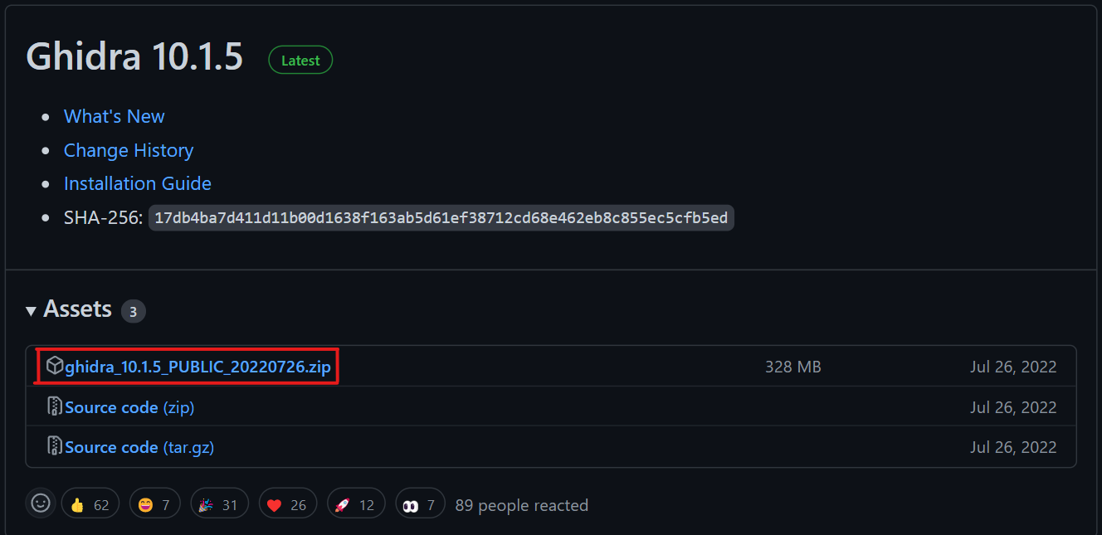
Downloading Ghidra
https://github.com/NationalSecurityAgency/ghidra/releases
or Google "github ghidra release"
Download the public archive in assets for the latest release (ghidra_X.X.X_PUBLIC_XXXXXXXX.zip, not Source code.zip)

Slide 14
Running Ghidra
Windows:
Double click ghidraRun.bat
Mac/Linux:
Open Terminal, navigate to the directory where Ghidra is downloaded using something like `cd ~/Downloads/ghidra_XX`
Make ghidraRun executable: `chmod +x ./ghidraRun`
Launch Ghidra: `./ghidraRun`

Slide 15
Python and Pwntools

Slide 16
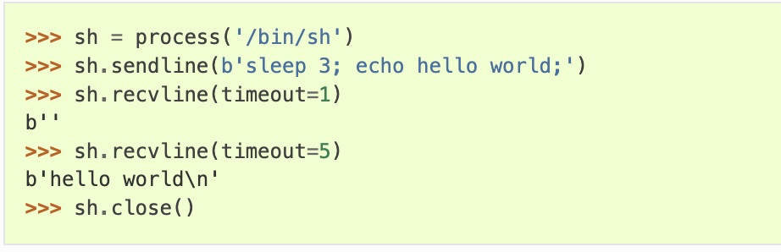
What is pwntools?
pwntools is a CTF framework and exploit development library.
Intended to make exploit writing as simple as possible.

Slide 17
Installing Python
Mac:
brew install python
python3 -m ensurepip
Windows (WSL)/Linux:
sudo apt update && sudo apt install python3 python3-pip
We recommend Windows users use Python/pwntools in WSL rather than native Windows

Slide 18
Installing Pwntools
M1 Setup before pwntools
$ git clone https://github.com/unicorn-engine/unicorn.git
$ brew install cmake
$ brew install qemu
$ cd unicorn/bindings/python
$ python setup.py install
pip3 install pwntools
OR
pip install pwntools
If you get "command not found" you may need to reboot for Python/pip to be added to PATH

Slide 19
Installing GDB
Non M1 Mac:
brew install gdb
M1 Mac:
x86 emulator required, stick around
Windows (WSL)/Linux:
sudo apt install gdb
We recommend Windows users use Python/pwntools in WSL rather than native Windows

Slide 20
Next Meetings
If you are on a M1 Mac please stick around!
2022-09-22 - This Thursday
Reverse Engineering I
Use the tools we installed today to reverse engineer apps!
2022-09-24 - This Saturday
Fall CTF 2022
fallctf.sigpwny.com
2022-09-25 - Next Sunday
No meeting

Slide 21
x86 VM on M1 Mac
For debugging and running x86 applications

Slide 22
Warning
M1 macs run a ARM-based processor
We want to run a x86-based linux VM
Virtualization
Fast
Docker, VirtualBox
Target architecture must be same as hardware architecture
Emulation
Slow
qemu, UTM
Hardware architecture can be anything

Slide 23
x86 VM Install
Install UTM
mac.getutm.app
Download an AMD64/x86 VM (e.g. Ubuntu 22.04 LTS)
ubuntu.com/download/desktop
Ubuntu Server 22.04 recommended
Desktop GUI will be extremely slow

Slide 24
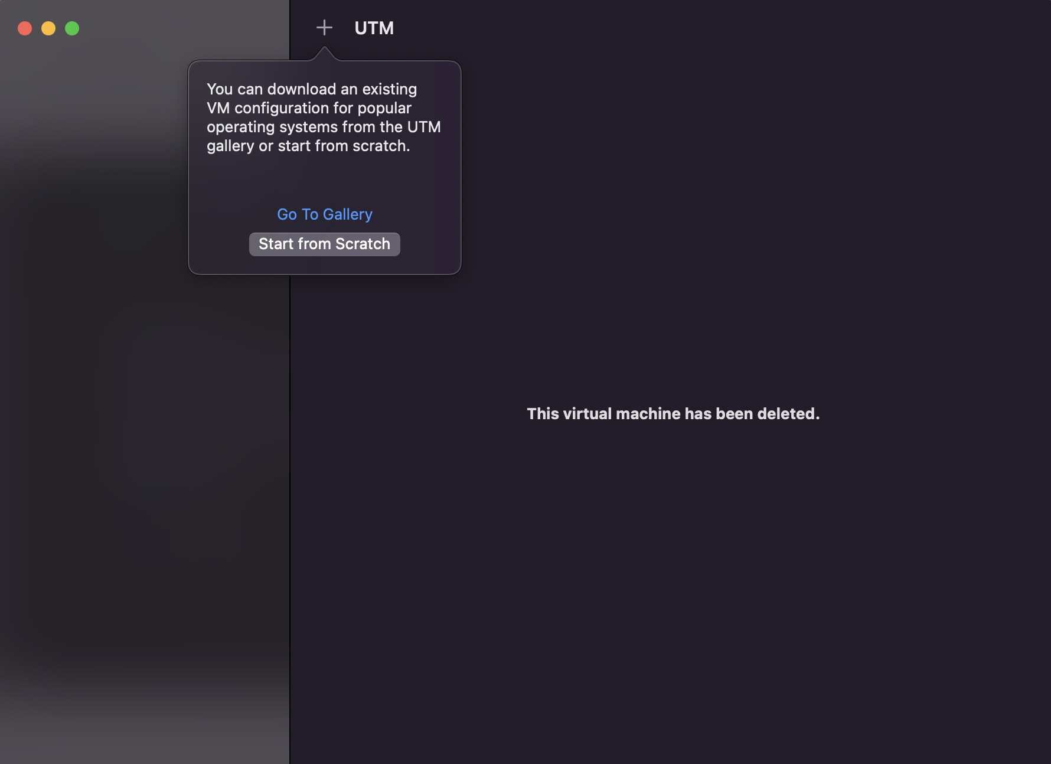
x86 VM Install
Open UTM
“Start from Scratch”

Slide 25
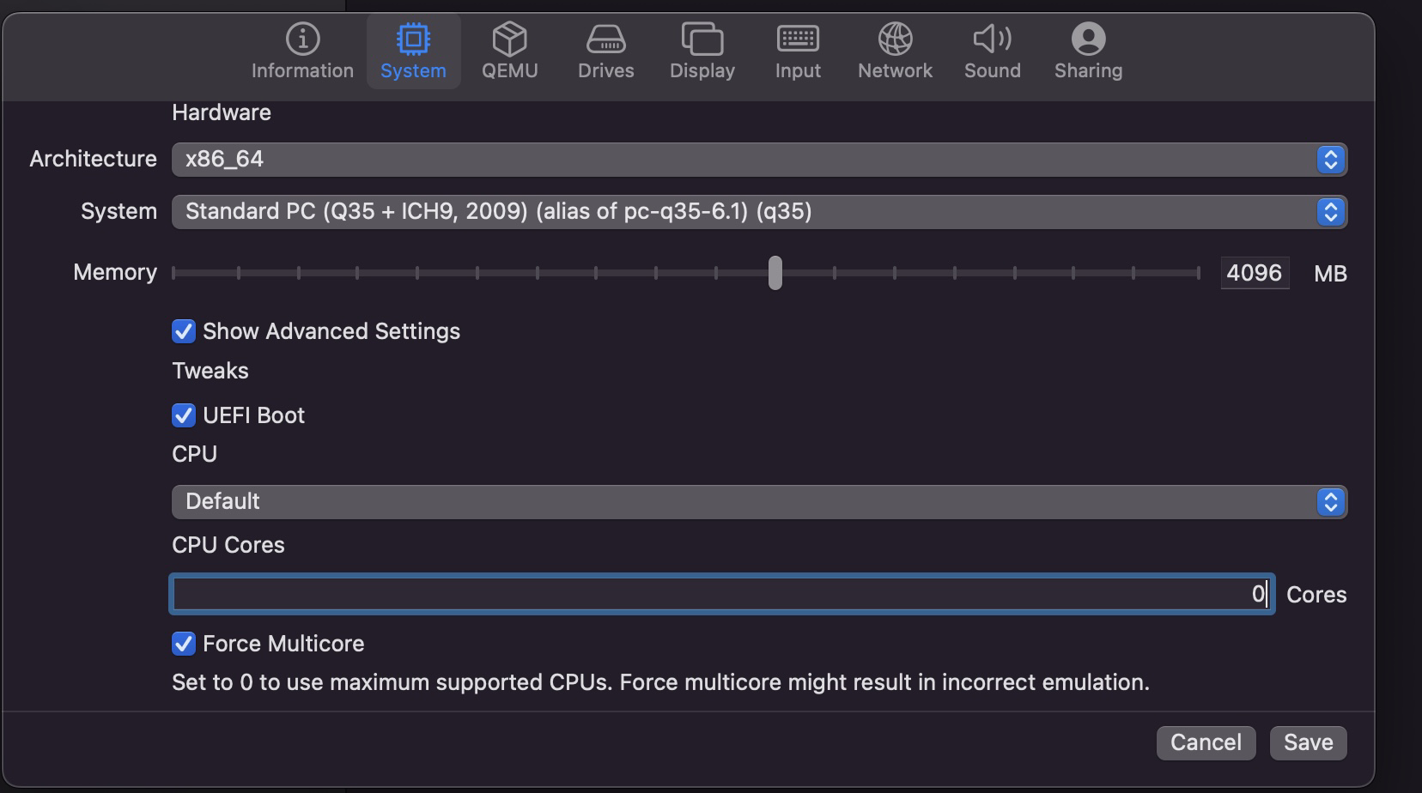
x86 VM Install
Set the architecture
Set the memory limit to 4 or more GB
Turn on Force Multicore with 0 Cores

Slide 26
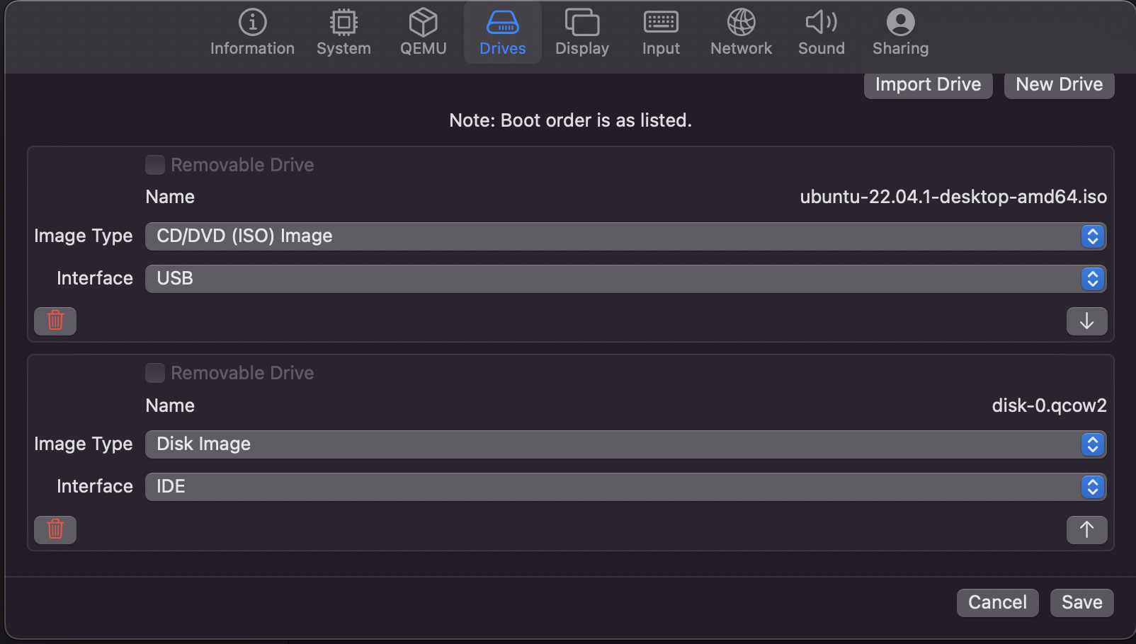
x86 VM Install
Add the ISO as a USB device
Create a second IDE Disk > 20GB
Leave all other settings (Display, Input, etc.) default

Slide 27
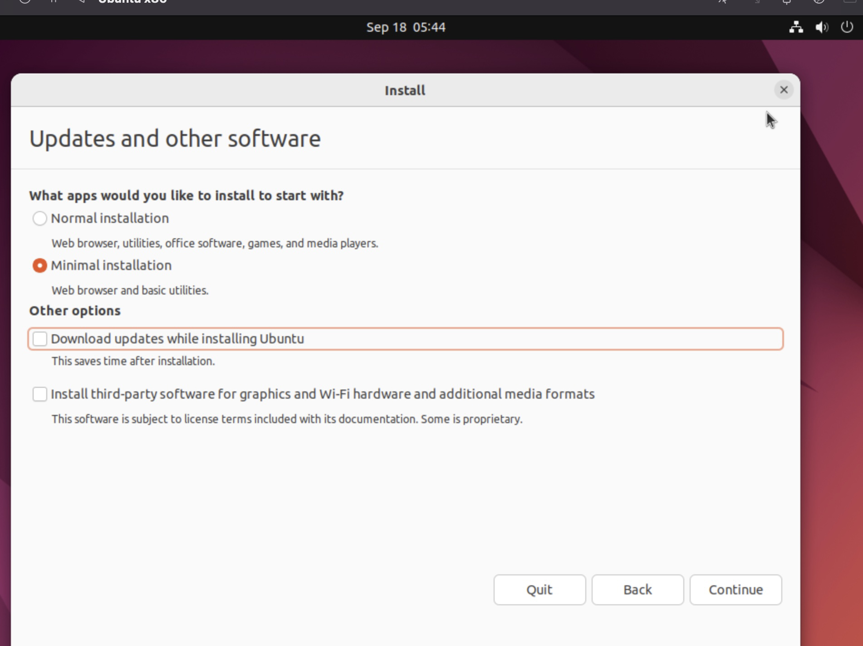
x86 VM Install
Desktop
Follow normal Ubuntu installation
Install the minimal installation and don’t download updates
Server
Accept all defaults

Slide 28
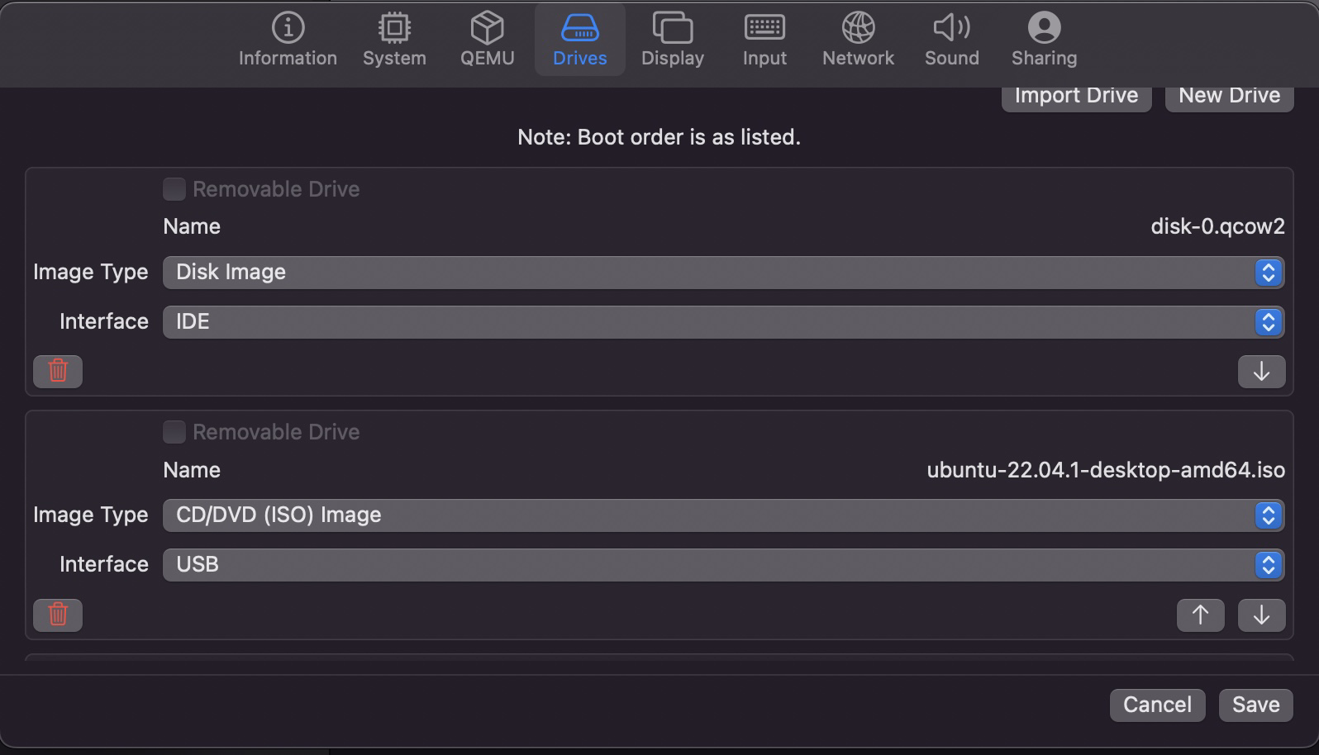
x86 VM Install
After the installer finishes, remove the USB drive from the “Drives” section
Restart UTM

Slide 29


