Slide 1
FA2022 Week 04
Reverse Engineering I
Richard and Pete

Slide 2
Announcements
Fall CTF 2022
This Saturday, CIF 3039 12 - 6PM!
Bring your friends
No meeting this Sunday

Slide 3
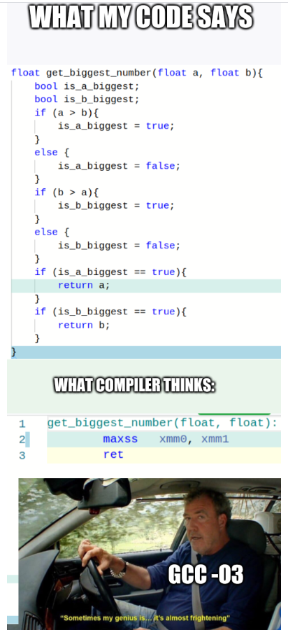
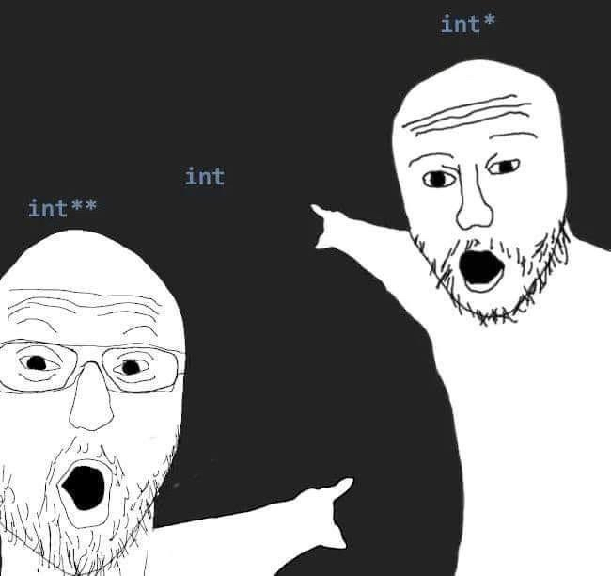
ctf.sigpwny.com
sigpwny{plz_no_nsa_backdoor}

Slide 4
Table of Contents
RE
What is reverse engineering?
Compilation
Executables
Static vs dynamic analysis
Ghidra
Demo
GDB
Demo

Slide 5
What is Reverse Engineering?
Figure out how a program works
Crack programs and write keygens?
Find secrets in the program?
Find bugs in the code?
Many different languages, different strategies for RE
Today: C/C++ on Linux ("ELF binaries")
Notes:
goal of RE: how program works without source code
different applications
different languages, C/C++, java, python, etc
a binary is what your computer runs, does not include source code, difficult to understand

Slide 6




Compilation
Compiler
(Clang)
Executable
Source code
Notes:
compiler: does optimizations, generates executable for particular OS/architecture

Slide 7
Executable
Processor understands machine code
Registers & stack
Register: store 64 bit number
Stack: function local variables
Heap: malloc’d memory
Data segment: global variables
Notes:
aka binary
machine code
hard for humans to understand
computer uses register and stack
registers store numbers, can be used as pointer or value
stack: push and pop, used for locals, return addresses
heap: different place to store larger stuff

Slide 8
Static vs Dynamic Analysis
Static
Tools: Ghidra
Decompile
Debugging analogy: read source code
Dynamic
Tools: GNU Debugger (GDB)
Run the program
Set breakpoints, step through, try various inputs
Debugging analogy: print statements after running

Slide 9
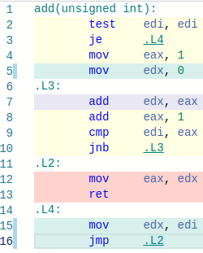
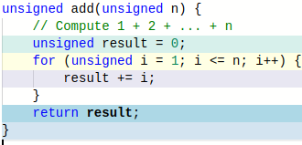
Reverse it!
https://godbolt.org/

Slide 10
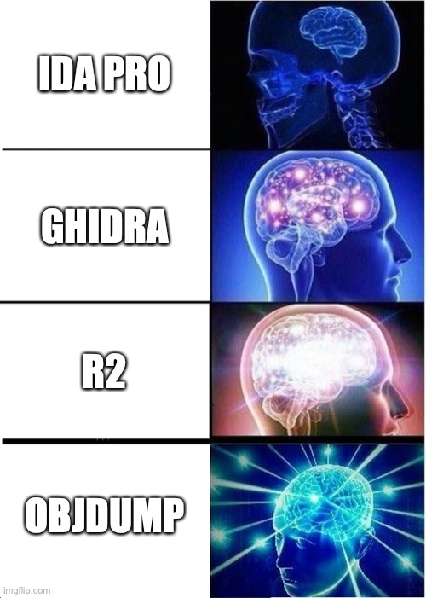
Ghidra to the rescue!
Open source disassembler/decompiler
Disassembler: binary to assembly
Decompiler: assembly to pseudo-C
Written by the NSA 😳

Slide 11
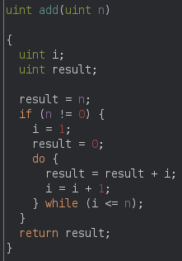
Ghidra to the rescue!

Slide 12
Ghidra Follow Along
Open Ghidra!
sigpwny.com/rev_setup
Download "debugger" from https://ctf.sigpwny.com/challenges

Slide 13
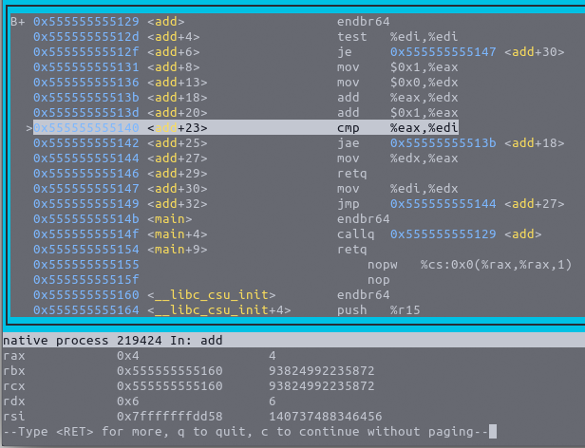
Dynamic Analysis with GDB
Run program, with the ability to pause and resume execution
View registers, stack, heap
Steep learning curve
Important: chmod +x ./chal to run file
Notes:
can pause (breakpoints)
view arbitrary variables, registers, stack
steep learning curve, helpful for RE & debugging
look how ugly it is!

Slide 14
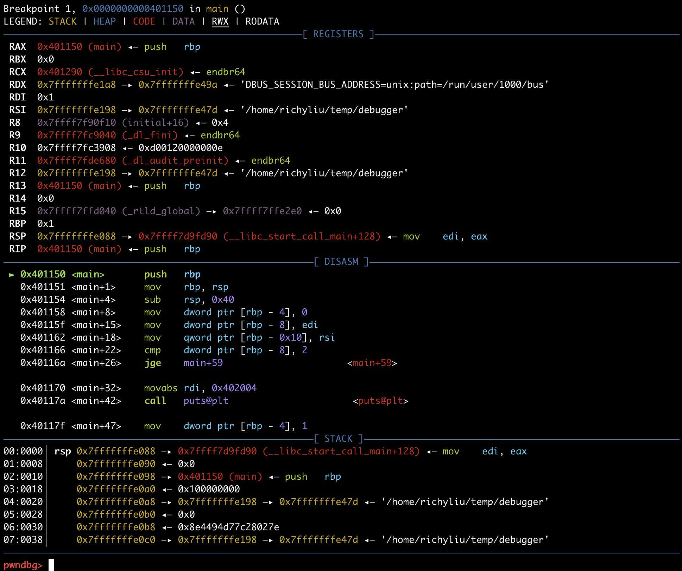
pwndbg
git clone https://github.com/pwndbg/pwsndbg
cd pwndbg
./setup.sh
Notes:
better UI, more features

Slide 15
GDB Follow Along
Same file as Ghidra follow along (debugger)
Notes:
again download file
gdbinit
running
r
r with args
disassembly (flavor)
set disassembly-flavor intel
set disassemble-next-line on
stepping, by instruction or by line
si, ni, s, n, c
breakpoints
i b, enable/disable, delete
start, starti
differences
registers
info reg (i r)
i r rsp
memory access
word sizes
x/gx, wx, bx
hex, string, decimal
dereferencing
{void*}
printing
p/
calling conventions
rdi, rsi, rdx, rcx,
function args: i r rdi rsi

Slide 16
Ghidra Cheat Sheet
Get started:
View all functions in list on left side of screen. Double click main to decompile main
Decompiler:
Middle click a variable to highlight all instances in decompilation
Type “L” to rename variable
“Ctrl+L” to retype a variable
Type “;” to add an inline comment on the decompilation and assembly
Alt+Left Arrow to navigate back to previous function
General:
Double click an XREF to navigate there
Search -> For Strings -> Search to find all strings (and XREFs)
Choose Window -> Function Graph for a graph view of disassembly

Slide 17
GDB Cheat Sheet
b main - Set a breakpoint on the main function
b *main+10 - Set a breakpoint a couple instructions into main
r - run
r arg1 arg2 - Run program with arg1 and arg2 as command line arguments. Same as ./prog arg1 arg2
r < myfile - Run program and supply contents of myfile.txt to stdin
c - continue
si - step instruction (steps into function calls)
ni - next instruction (steps over function calls)
x/32xb 0x5555555551b8 - Display 32 hex bytes at address 0x5555555551b8
x/4xg addr - Display 4 hex “giants” (8 byte numbers) at addr
x/16i $pc - Display next 16 instructions at $rip
x/s addr - Display a string at address
x/4gx {void*}$rcx - Dereference pointer at $rcx, display 4 QWORDs
p/d {int*}{int*}$rcx - Dereference pointer to pointer at $rcx as decimal
info registers - Display registers (shorthand: i r)
x86 Linux calling convention ("System V ABI"): RDI, RSI, RDX, RCX, R8, R9

Slide 18
Go try for yourself!
https://ctf.sigpwny.com
Start with first_re
Practice practice practice! Ask for help!

Slide 19
Next Meetings
2022-09-24 - This Saturday
Fall CTF!!!
Play in our annual beginners CTF!
2022-09-25 - This Sunday
No meeting!
2022-09-29 - Next Thursday
OSINT
Open Source Intelligence - stalk your targets!!

Slide 20


