Slide 1
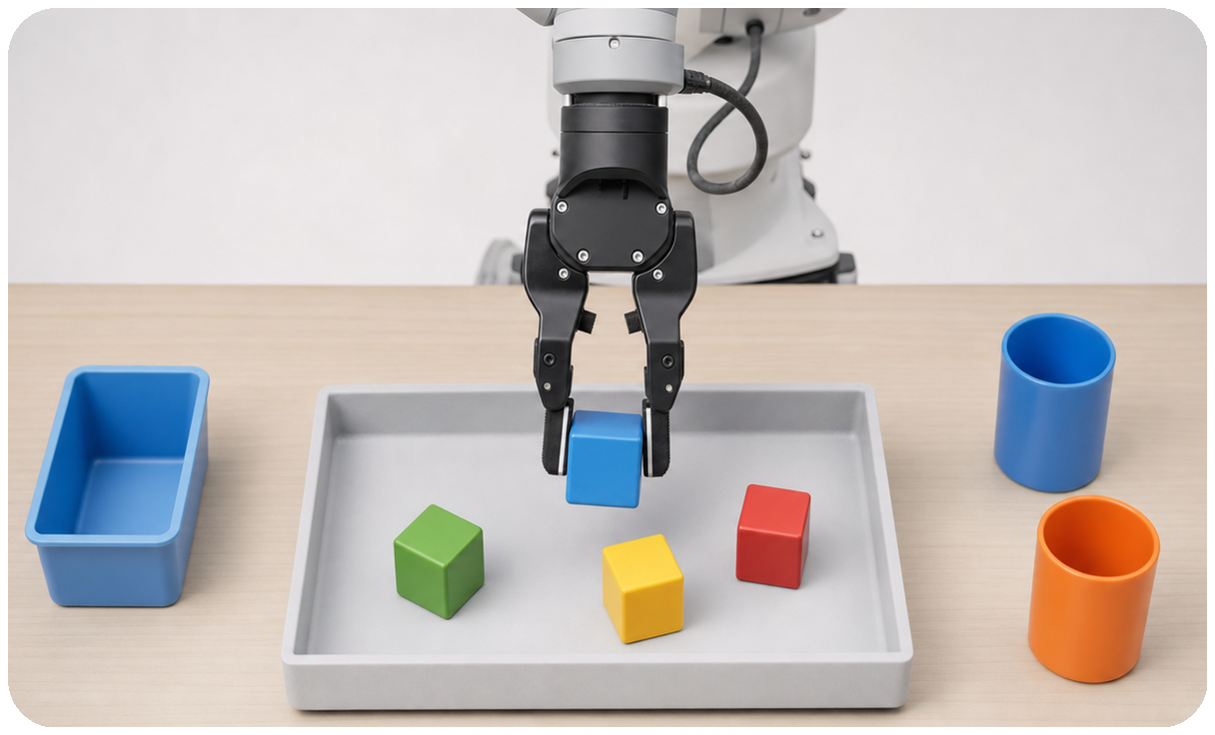
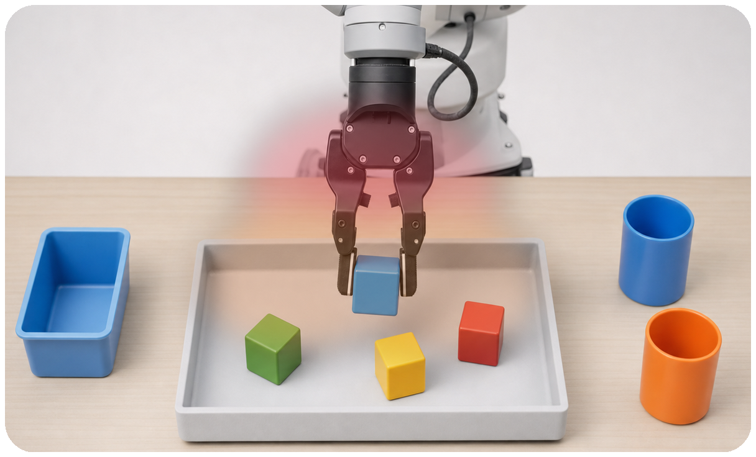
ProprioVLA
Adapter attention enhances the intermediate VLM embedding before the action head
Unified Framework
Training-only Supervisors
VLM
StateReconstructionOnly 500
VLM embedding
adapter enhancement tokens -> state decoder
Action Head
State Decoder
observation
enhanced VLM embedding
KL off
state loss
instruction
ProprioVLA Adapter
action chunk
normalized KL Loss Only 500
state
query tokens
value embeddings
attention
attention map matches mined heatmap
enhancement tokens
norm. KL
recon off
normalized KL loss
supervisors constrain the adapter only
VLM/value embeddings
state/query tokens
attention weights
enhanced embedding
mined heatmap

