Slide 1
ProprioVLA
State-conditioned visual grounding with two lightweight supervision choices
Unified Framework
Two Supervisors
Base VLA
StateReconstructionOnly 500
reconstruct state from attended visual token
multimodal representation
Fusion
State Decoder
observation image
KL off
state loss
Adapter
Action Head
normalized KL Loss Only 500
match mined heatmap with attention tokens
norm. KL
action chunk
recon off
normalized KL loss
visual-language tokens
state tokens
self-grounded visual tokens
attention tokens
mined heatmap

Slide 2
ProprioVLA
State-conditioned visual grounding with two lightweight supervision choices
Unified Framework
Two Supervisors
Base VLA
StateReconstructionOnly 500
reconstruct state from attended visual token
multimodal representation
Fusion
State Decoder
observation image
KL off
state loss
Adapter
Action Head
normalized KL Loss Only 500
match mined heatmap with attention tokens
norm. KL
action chunk
recon off
normalized KL loss
visual-language tokens
state tokens
self-grounded visual tokens
attention tokens
mined heatmap

Slide 3
VLM
Grounding
Head
Grounding
Head
Grounding
Head
Action Head

Slide 4
VLM
Grounding
Head
Grounding
Head
Grounding
Head
Action Head

Slide 5
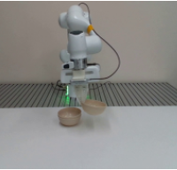
Stack Bowls
Observation
Task Prompt
VLM
Grounding
Head
Grounding
Head
Action Head
Guiding Head
Reconstruction Loss
Action Loss
Reconstruction Loss

Slide 6
Guiding Head
Stack Bowls
Observation
Task Prompt
Residual Flow
VLM
Guiding Head
Action Head
Guiding Head
State
Action Loss
Reconstruction Loss

Slide 7
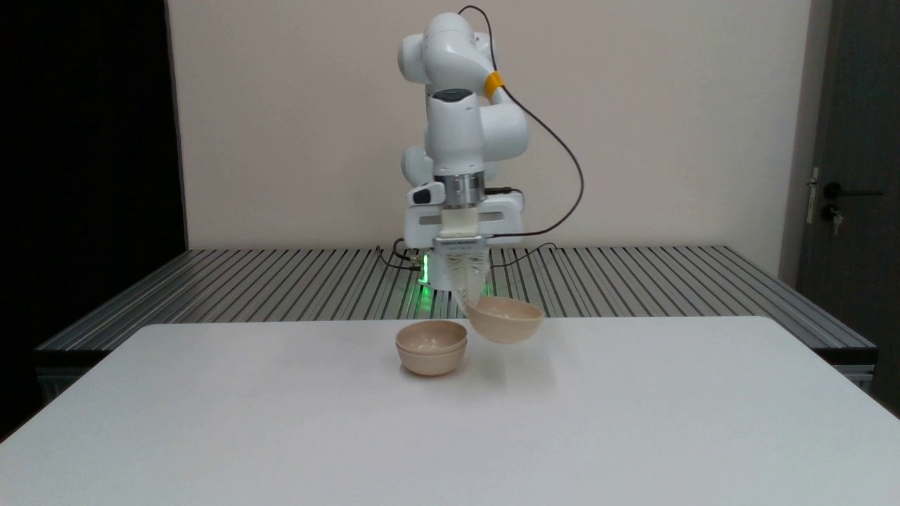
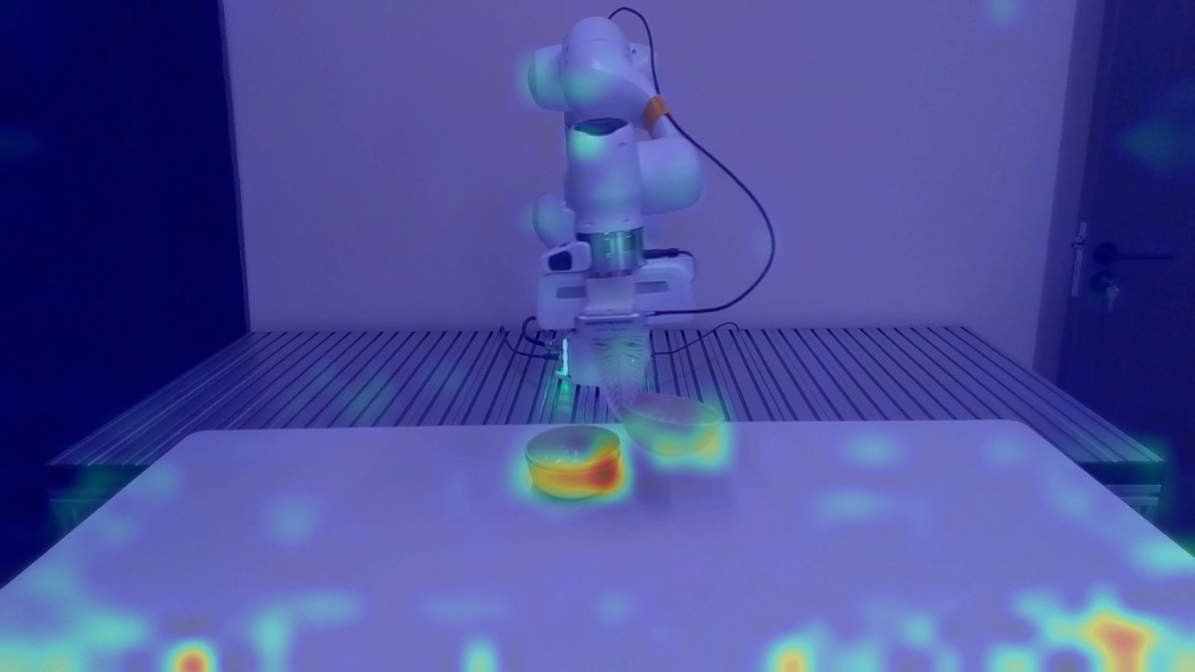
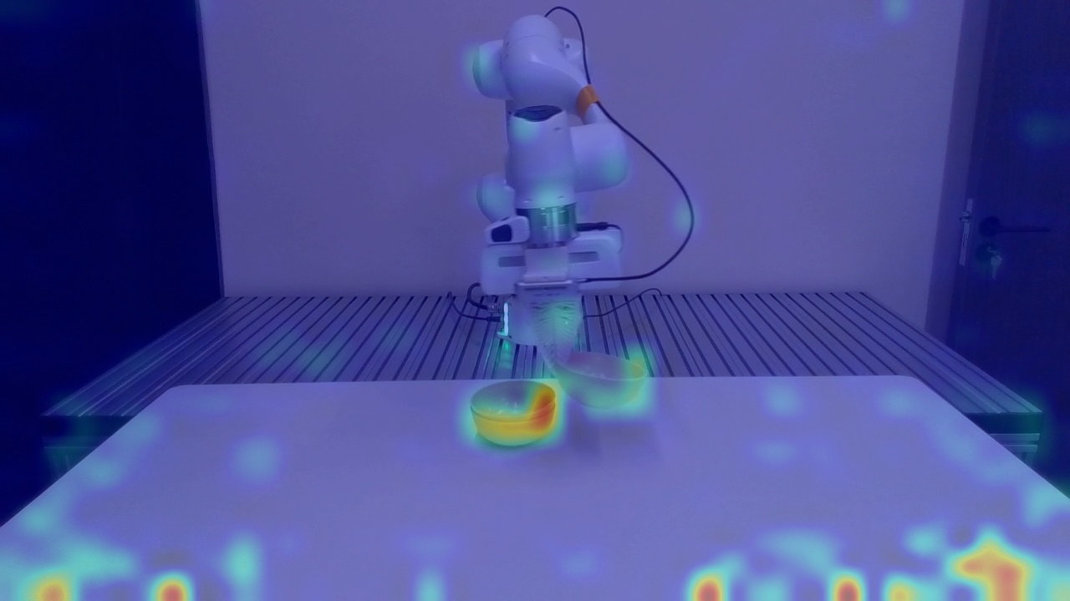
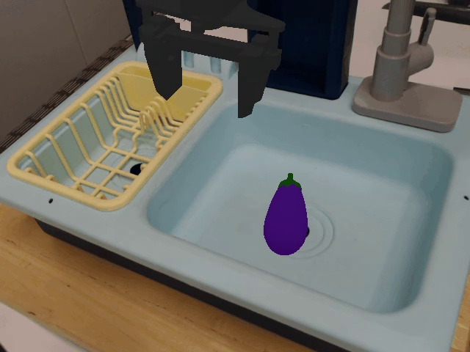
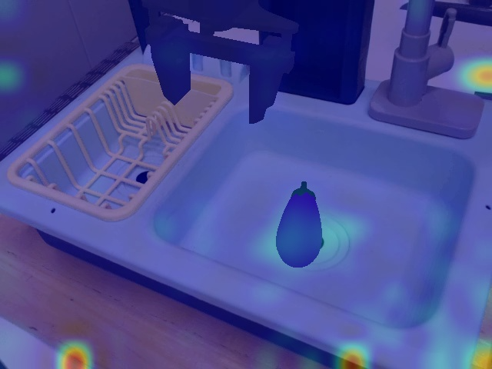
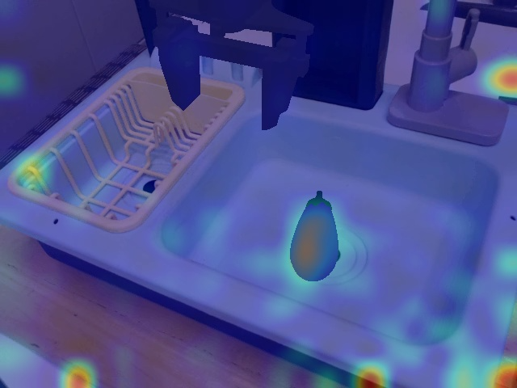

Slide 8
RGB Input
Task Prompt
Guidance Prompt
RGB Input
Task Prompt
Guidance Prompt
Proprioceptive Guidance Prompt: Where is the robot itself?
Real-world Task: Stack Bowls.
Task Prompt: Stack the three bowls on the table together.
Simulation Task: Put eggplant.
Task Prompt: Put the eggplant into the basket.

