Slide 1
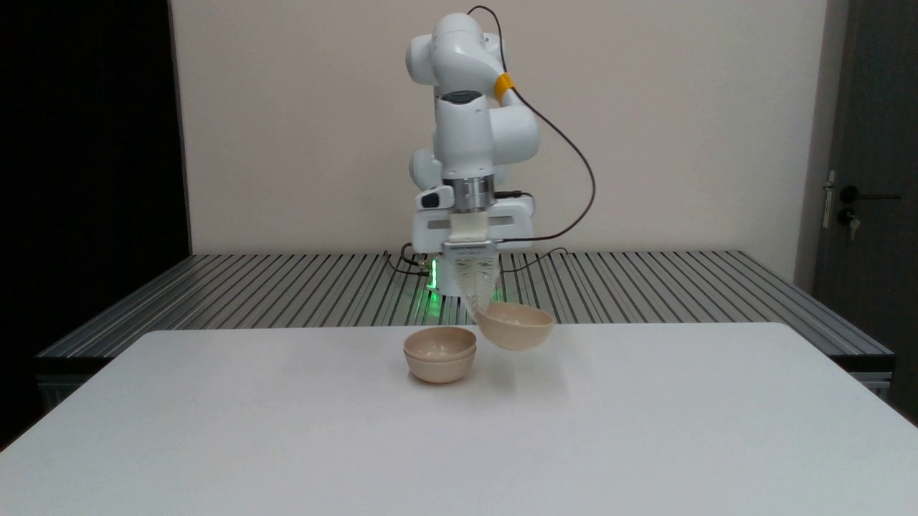
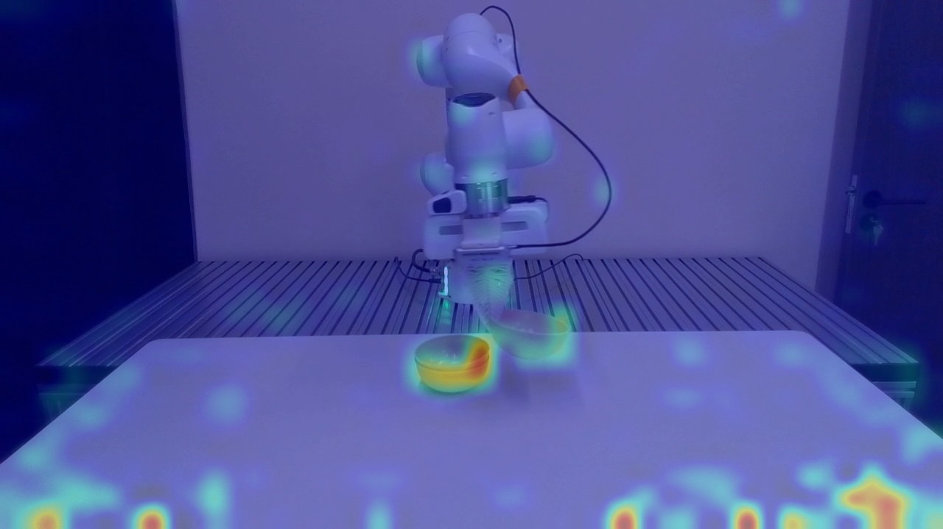
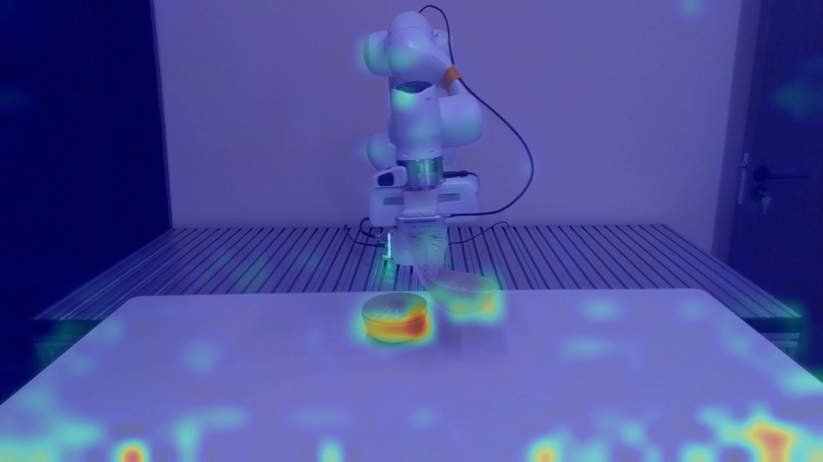
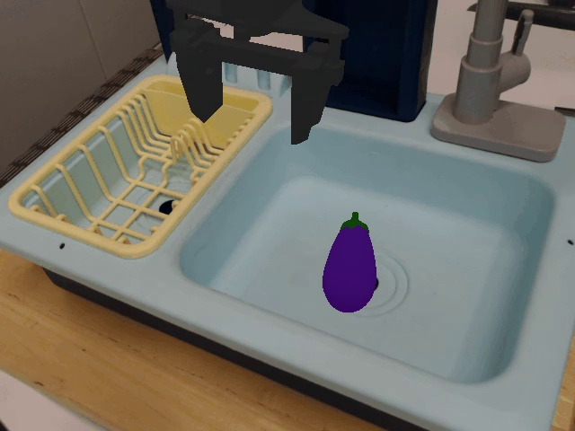
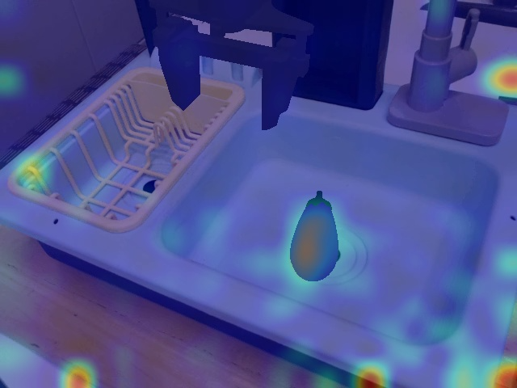
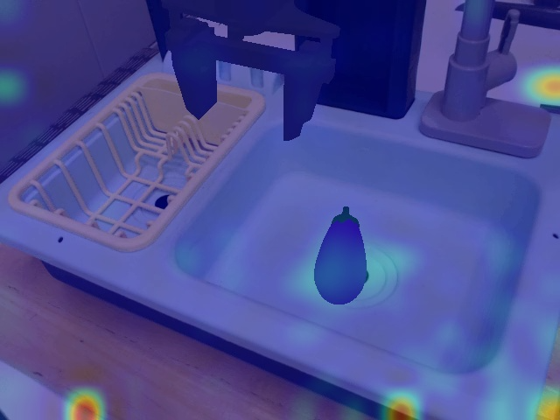
RGB Input
Task Prompt
Guidance Prompt
RGB Input
Task Prompt
Guidance Prompt
Proprioceptive Guidance Prompt: Where is the robot itself?
Real-world Task: Stack Bowls.
Task Prompt: Stack the three bowls on the table together.
Simulation Task: Put eggplant.
Task Prompt: Put the eggplant into the basket.

