Slide 1


Evaluating the Diversity, Equity and Inclusion of NLP Technology:
A Case Study for Indian Languages
Simran Khanuja*, Sebastian Ruder*, Partha Talukdar

Slide 2
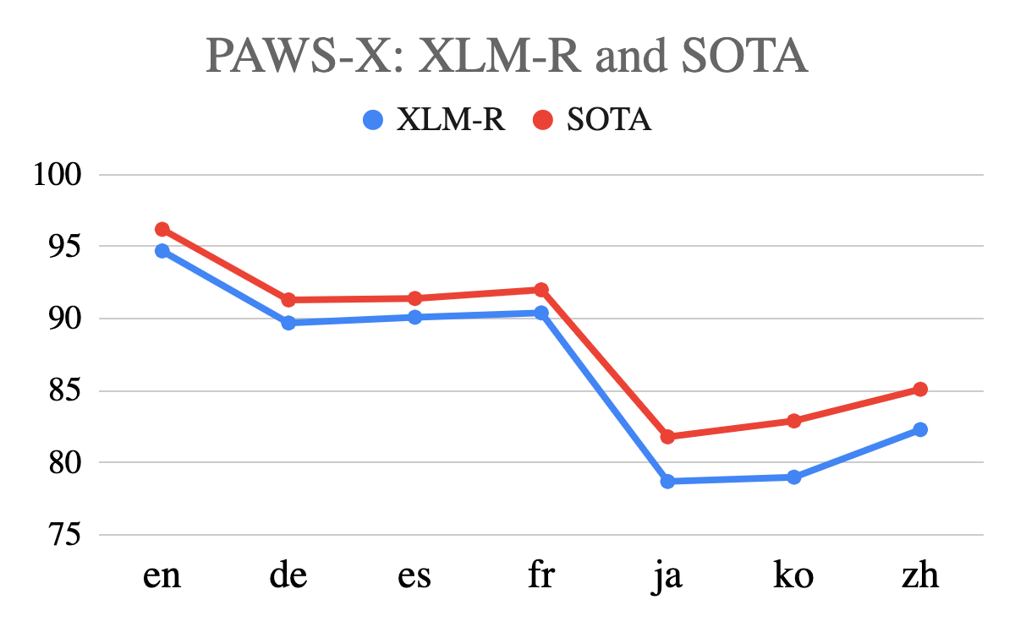
Why is average accuracy simply not enough?
SOTA model reports 2.3% average accuracy gain over XLM-R.
Does this mean that the SOTA model is “better” than XLM-R?
Three questions:
Does it improve the diversity w.r.t. the population it supports?
Doesn’t increase languages’ supported
Does it improve the equity of the model across languages?
Difference in performance between languages remains similar (XLM-R : 2.6%; SOTA : 2.4%)
Does it improve the inclusivity of the model across users?
XLM-R is 550M while SOTA model is 662M
Why not? No incentives!
2.3% avg.↑
Per-language results on a multilingual task of a model currently SOTA on a prominent multilingual leaderboard.
Notes:
So what prompted us to develop this framework in the first place? When we were choosing amongst multilingual models to use for a certain subet of low-resource languages, we observed that even the SOTA model on a prominent multilingual leaderboard is just not good enough. Even though its average accuracy is better than say the 2nd best model, it only provides for marginal improvements in most languages. Can we conclude that SOTA model is hence “better” that the 2nd best? If we look at it purely from the perspective of its position on the multilingual leaderboard, one would say yes. However, does it …Q1) … NO; Q2) … NO; Q3) … NO. Why not? Why haven’t model builders attempted to work on improving the above? This is largely an artifact of the lack of incentives. The leaderboard design incentivizes model builders to simply improve average accuracies across languages
nsufficiency in coverage of languages remains, equally disparate amongst languages; and models are only getting bigger

Slide 3
Why is DEI for technology important?
Diversity
Equity
Inclusion
As technology makers, we hold the responsibility to serve all of the world’s population, to the best of our capabilities.
As technology makers, we hold the responsibility to reduce the propagation of bias through technology we serve.
As technology makers, we hold the responsibility to serve all users, regardless of their status/accessibility.
If we don’t incentivize diversity, we will simply keep improving performance in languages that we have data for.
If we don’t incentivize equity, we won’t make modeling improvements to gain equitable performance despite imbalanced data proportions.
If we don’t incentivize inclusion, models will keep scaling up and become less accessible, in pursuit of higher accuracies.
Notes:
And why do we focus on DEI in particular? We borrow from the social construct of equal representation which rests on these three pillars.
To accelerate efforts towards holistic development of multilingual models; we propose a framework that can keep track of the DEI of NLP technology

Slide 4
DEI for NLP Models: Three pillars of our evaluation framework
Diversity
How do we measure the diversity of populations being served by our technology?
✅
Blasi et. al, 2022 incorporate demand (speaker population as proxy) to measure the utility of a system.
Equity
How do we measure the equity of technology across languages to reduce propagation of bias through technology?
❌
Propose to use the Gini coefficient (widely used as a measure of statistical dispersion in Economics)
Inclusion
How accessible is the technology we build across users?
✅
Ethayarajh and Jurafsky, 2020; Ma et al., 2021 incorporate efficiency metrics in model performance
Notes:
To accelerate efforts towards holistic development of multilingual models; we propose a framework that can keep track of the DEI of NLP technology

Slide 5
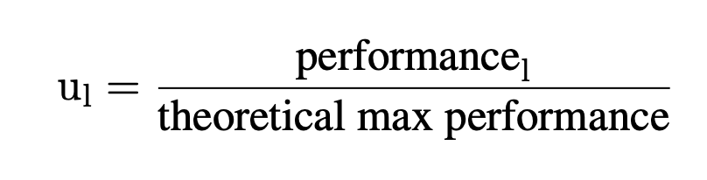
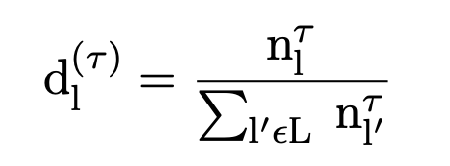
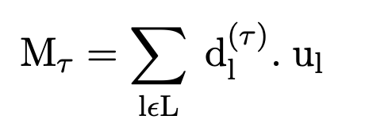
Diversity: Utility, Demand and the Global Metric
Utility: Performance of a system normalized by the best possible performance (typically, human-level performance) afforded by the task.
Demand: Allows for a demographic or linguistic perspective.
Under the former, demand is proportional to the number of speakers of the language itself (τ=1).
Under the latter, the demand across languages is identical (τ=0).
Global Metric: Composed of the utility of a technology weighed by its demand.
Given our user-centric aim to measure benefit for all speakers, we employ the demographic notion of demand in our global metric (M_{τ=1}).
[Top-to-bottom] Formal definitions of utility, demand, and the global metric (M_{𝞃} ) as defined by Blasi et. al, 2022

Slide 6
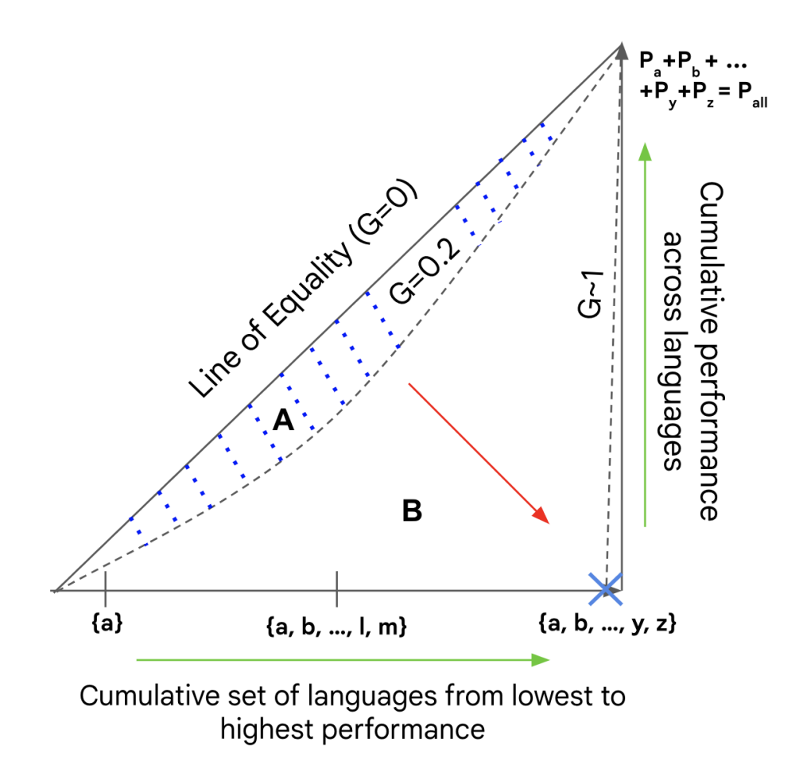
Equity: Gini Coefficient
Standard measures of statistical dispersion like standard deviation or calculating range are sub-optimal choices as they are scale-dependant, unbounded and highly sensitive to outliers.
Six desirable attributes of sparsity measures:
Robin Hood: drop in high-performant and gain in low-performant languages ⇒ higher equity
Scale Invariance
Rising Tide: adding a constant value to each language’s performance ⇒ higher equity
Cloning: composition of identical distributions ⇒ no change in equity
Bill Gates: Performance_{L1}→ ∞ ⇒ Equity → 0
Babies: adding languages with zero performance in the distribution ⇒ lower equity
Hurley and Rickard (2009) prove the Gini coefficient to be the only measure having all six, among a varied set of alternatives.
Notes:
In economics, measuring statistical inequalities is important for multiple applications, eg, to quantify disparity in income distributions. The choice of income income equality indicator is of significant importance since it has implications in measuring health, state-level mortality,
Scale Invariance: no change in relative performance should lead to no change in equity, regardless of changes in absolute values;
equity must remain invariant under cloning, i.e., if two identical distributions are combined, the equity remains unchanged;

Slide 7
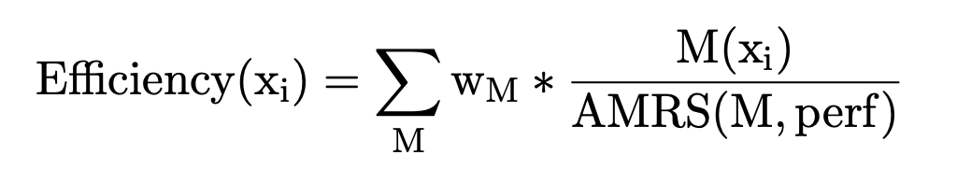
Inclusion: Efficiency Score
We incorporate efficiency into model performance based on throughput and memory:
Throughput: Number of instances the model can process per second on a CPU.
Memory Saved: The size of the model is considered to be a measure of how expensive a model is to use in practice. Memory used is transformed into memory saved by subtracting it from a maximum available memory of 16 GB.
We choose w_{perf}= 0.5; w_{throughput}= 0.25; w_{memory}= 0.25 as default weights. In practice, these weights can be adjusted based on user constraints.
Ma et al., 2021 define efficiency to be a weighted combination of several metrics like throughput, memory saved, etc., whose weights can be adjusted as per user constraints

Slide 8
Experimental Setup
Languages and Tasks
22 scheduled languages of India spoken by 97% of the population.
Four tasks selected from XTREME (Hu et. al, 2020):
Named Entity Recognition (NER)
Part-of-Speech Tagging (POS)
Natural Language Inference (NLI)
Question Answering (QA)
Models
Selection motivated by two factors: i) General vs region-specific choices; ii) model efficiency.
Fine-tuning
English
Availability of labeled data across task
Distant pivot; sub-optimal transfer
Hindi
15/22 languages in same language family
Labeled data available across tasks
Highest speaker population; future proof w.r.t annotation
Model | Pre-training Languages | Size
IndicBERT | 12 IN | 18M
MuRIL (B) | 16 IN | 237M
MuRIL (L) | 16 IN | 550M
XLM-R (L) | 101 (15 IN) | 550M
Notes:
To accelerate efforts towards holistic development of multilingual models; we propose a framework that can keep track of the DEI of NLP technology

Slide 9
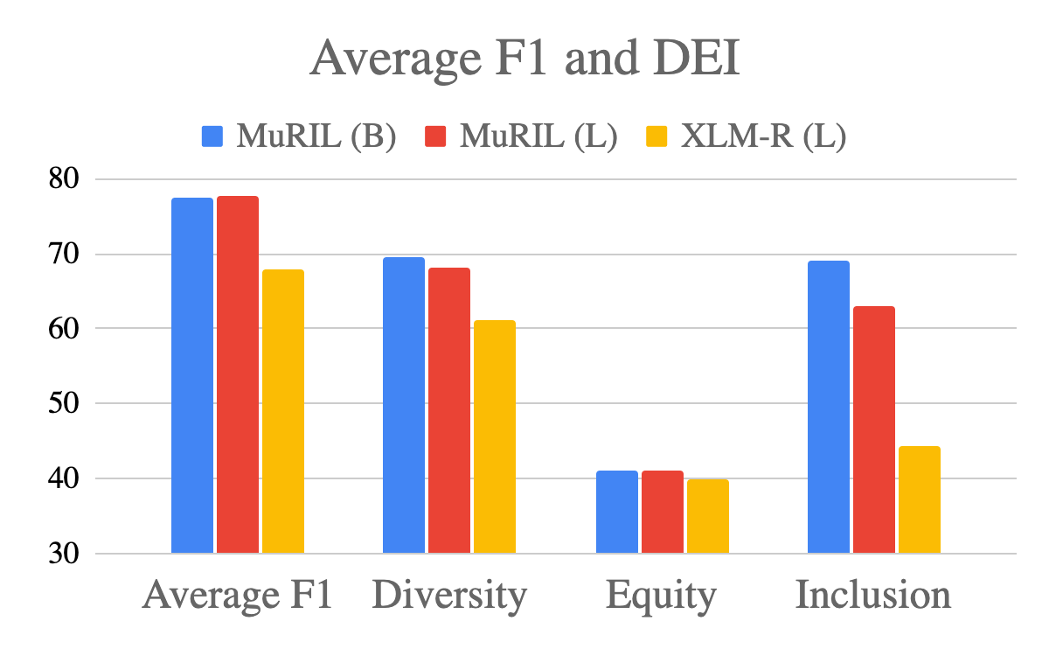
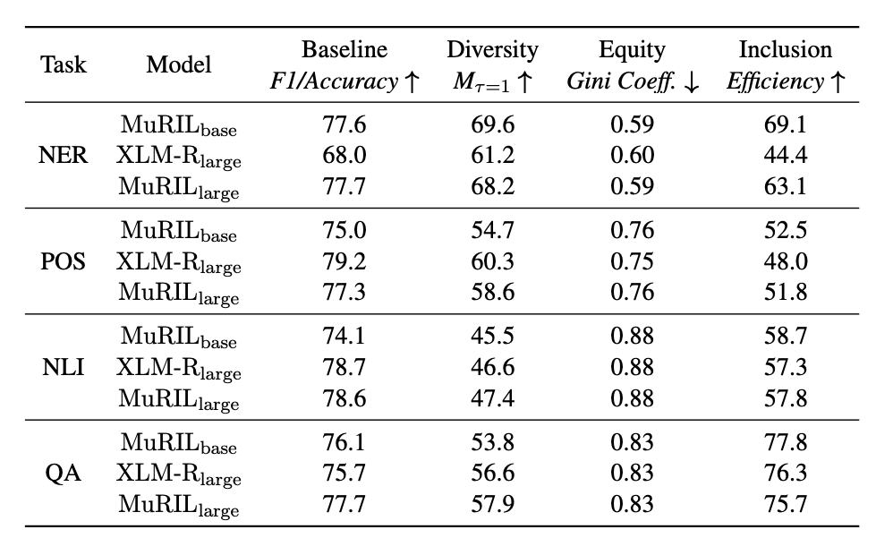
DEI Results for 22 Indian Languages
Visualizing performances for one task (NER)
Diversity measures help discern that model improvements are skewed towards languages with high speaker populations
Equity across models is the same across tasks, despite major differences in average F1 across languages.
Inclusion performance signifies that region-specific base models are most efficient.
Average F1/Accuracy v/s DEI: Differences in average performance do not reflect differences in DEI

Slide 10
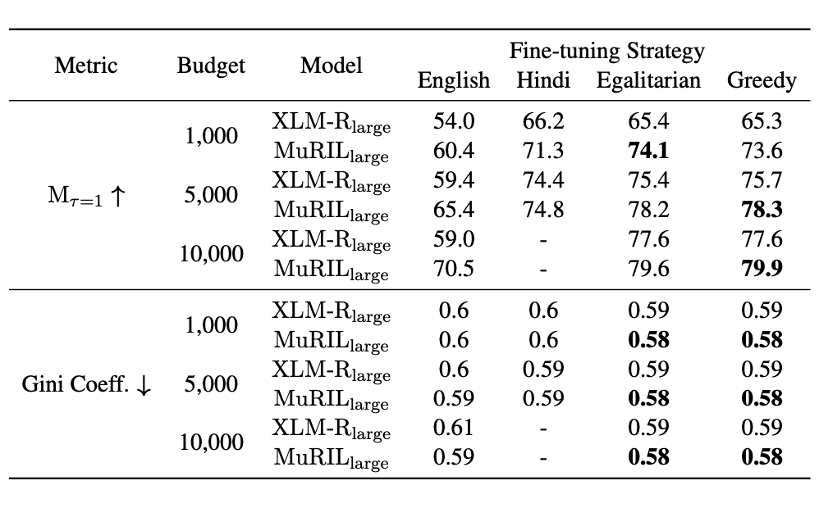
How can we improve the DEI of pre-trained models?
Why do these disparities exist?
Model performances mostly reflect the amount of raw data used in pre-training.
Highly ambitious undertaking to create equitable data resources for 7000 languages.
How can we optimally leverage a data annotation budget to optimally fine-tune models?
Fully computational: empirically estimate performance of a target language when fine-tuned on a source, which follows a power-law distribution.
Greedy approach: At each step, allocate a sample to the source language conferring the highest marginal gain (w.r.t DEI) to all target languages.
Performance better than or equal to an egalitarian distribution!
We propose a novel annotation allocation algorithm that optimizes DEI during fine-tuning

Slide 11
How can our community help improve DEI of NLP technology?
Data Efforts
Build representative evaluation sets for all languages as they are required to accurately measure DEI.
Collect small amounts of data across many languages for fine-tuning, to maximize marginal gain.
Collect at grassroots level: involve the community to capture culturally relevant phenomenon. (example: Masakhane)
Incentivize rural, low-income workers to provide for such data.
Trading off multilinguality and regionality
Make region-specific choices, both in pre-training and fine-tuning.
Localizing the problem enables one to incorporate linguistic expertise and provide support for culturally relevant phenomena.
However, avoid excessive fragmentation as it leads to higher maintenance costs.
Notes:
To accelerate efforts towards holistic development of multilingual models; we propose a framework that can keep track of the DEI of NLP technology

Slide 12
Thanks!

