Slide 1
Multilingual End-to-end Dependency Parsing with Linguistic typology knowledge

Slide 2
Linguistic Typology
Linguistic typology is the classification of human languages according to their syntactic, phonological and semantic features.
Linguistic typology existed as an independent research domain since long but recently it has been used along with Cross-lingual/Multi-lingual NLP to address the issue of data-sparsity in low-resource languages.
However, all the popular typological databases suffer from a major shortcoming of limited coverage. In fact, values of many important typological features for numerous low-resource languages are missing in these databases. This significantly limits their utility with Cross-lingual/Multi-lingual NLP.

Slide 3
Multitask Learning Framework
In this work we proposed a Multitasking Model that predicts the missing typology features while utilising the linguistic typology knowledge (both known and predicted) to perform Cross-lingual Dependency Parsing.
Multitask Learning (MTL) is neural network framework which involves performing of two or more tasks simultaneously leading to knowledge/parameter sharing. These tasks are closely related thus complement each other leading to improved performance on all of them.
Even in scenarios where we primarily care about a single task, using a closely related task as an auxiliary task for MTL can be useful.
In this work, we use Linguistic Typology feature-prediction task as auxiliary task for End-to-end Cross-lingual Dependency Parsing.

Slide 4
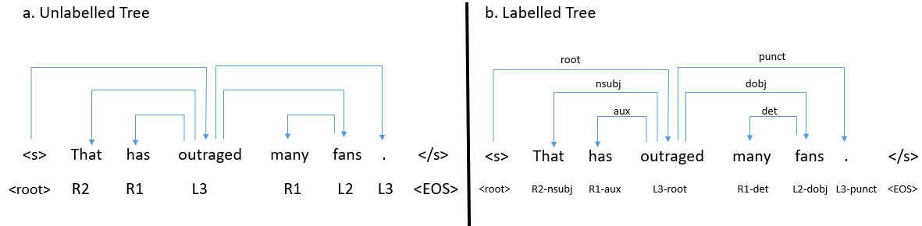
Major Contribution
In this work, we make following contributions:
We evaluated the performance an End-to-end BERT Based Parser which can parse a sentence by directly predicting relative head-position tag for each word within input sentence. This is inspired by the End-to-end Seq2seq Dependency Parser proposed by (Li et al., 2018).
We added the auxiliary task of Linguistic typology prediction to our Base End-to-end BERT Based Parser to observe the changes in performances under various experimental settings.
Li, Zuchao, et al. "Seq2seq dependency parsing." Proceedings of the 27th International Conference on Computational Linguistics. 2018.

Slide 5
Auxiliary task
Inducing typology knowledge through MTL rather than directly feeding it along with word-embeddings have following advantages.
The model can also be applied to low-resource languages for which many typology feature values are unknown/missing.
The auxiliary task should help to improve the performance on the main dependency parsing task as well, since it would make the model give special emphasis on the syntactic typology (specially word-order typology) of language being parsed while predicting the dependency relations.

Slide 6
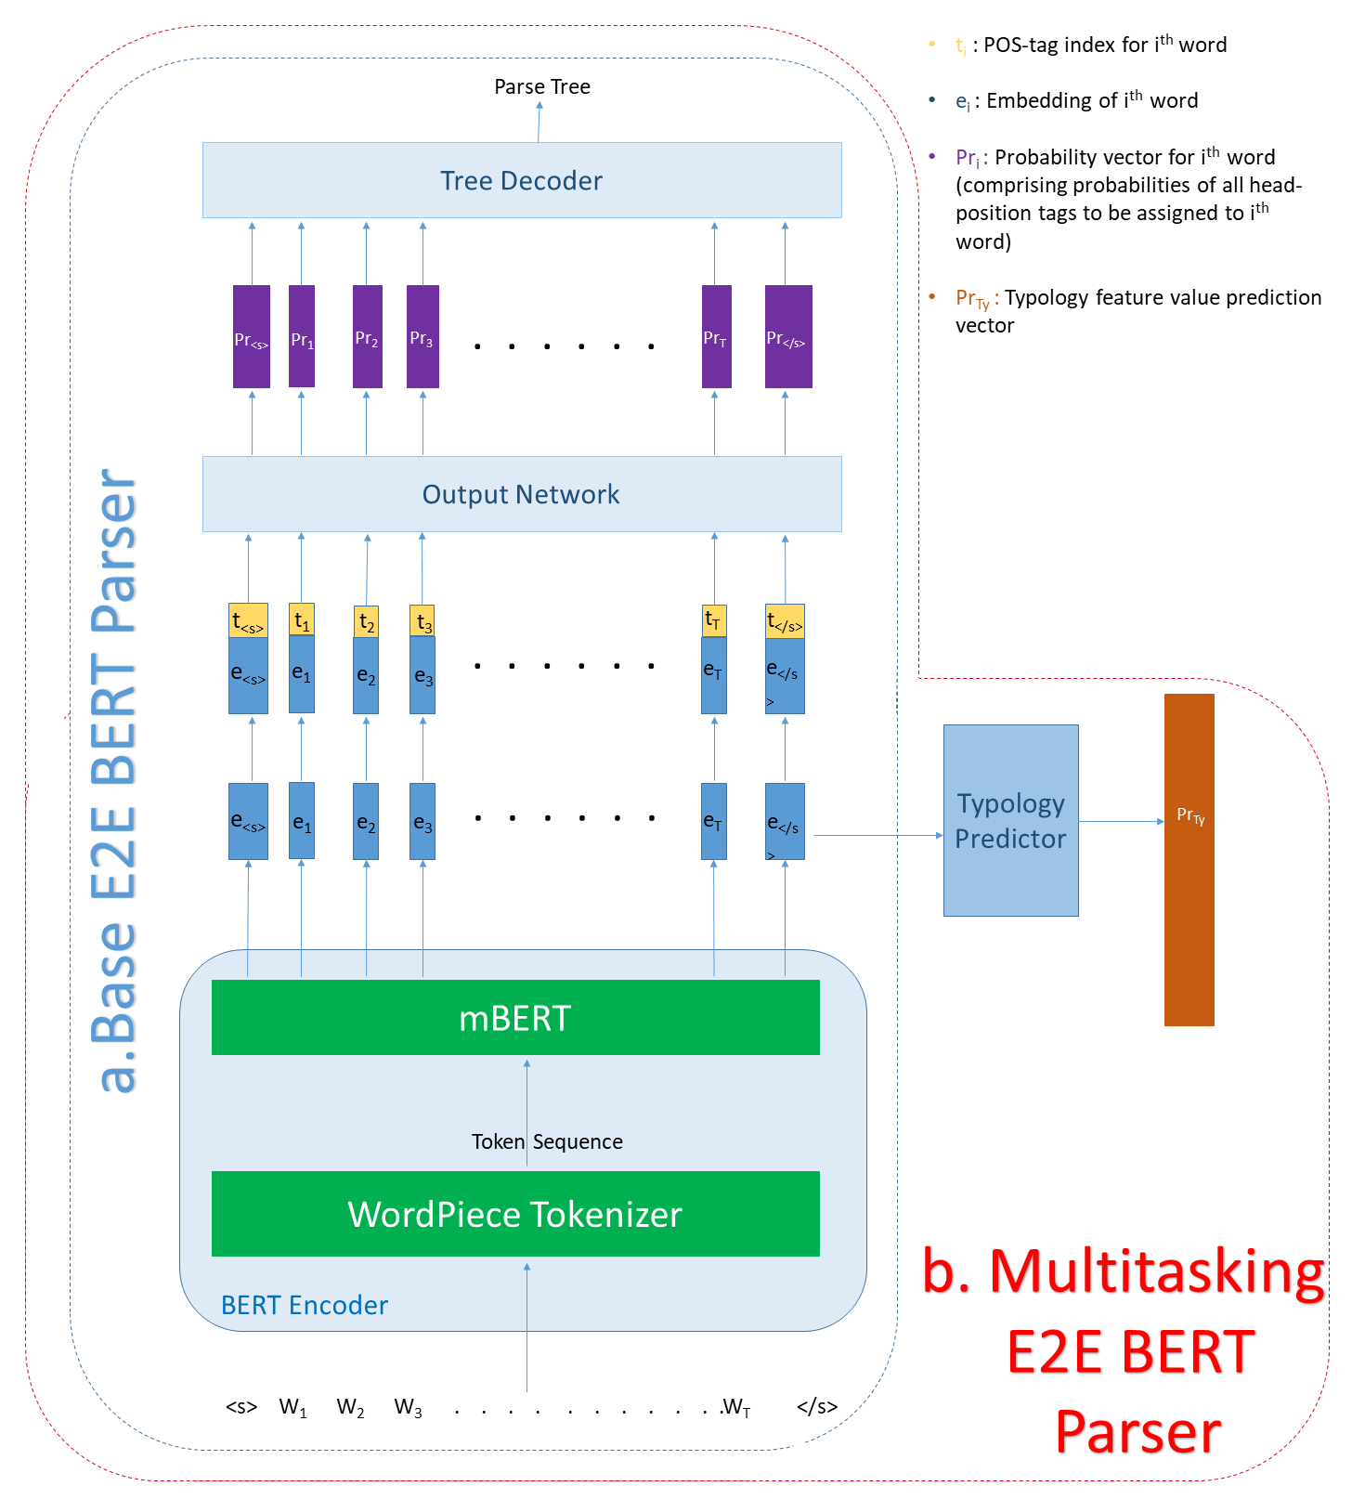

Slide 7
mBERT based E2E Dependency Parserers
The Base End-to-end BERT based Dependency Parser directly predicts the relative head position tag of each word within input sentence as performed by (Li et al., 2018).
Figure a in the previous slide depicts the architecture of our baseline model. The depicted architecture comprises of three components namely BERT Encoder, Output Network and Tree-decoder described in detail in subsequent slides.
Similarly, Figure b in the previous slide demonstrates the architecture of our proposed Multitasking End-to-end BERT based Dependency Parser. The model is very similar to the Base E2E BERT Parser with one extra component namely the Linguistic typology predictor which predicts the typology features of language being parsed, described in details in subsequent slides.

Slide 8
Bert Encoder
It is a BERT based network which takes as input, the entire sentence as sequence of tokens. The model outputs d−1 dimensional word-embeddings for all words within the input sentence (where d is a hyperparameter).
We use WordPiece tokenizer (Wu et al., 2016) to tokenize input sentence and extract embeddings. For each word within input sentence, we use the BERT output corresponding to the first word-piece of it as its embedding, ignoring the rest.
We add pos-tag information in our parser by appending index of pos-tag of each word, to the encodings outputted by BERT encoder as evident in
Wu, Yonghui, et al. "Google's neural machine translation system: Bridging the gap between human and machine translation." arXiv preprint arXiv:1609.08144 (2016).

Slide 9
Output Network, Tree-decoder, Typology predictor
Output Network: It is a simple feed-forward network with softmax activation function. The network takes-in the embedding matrix from the BERT encoder and outputs the probabilities of all possible relative head position tags to be assigned to each word.
Tree-decoder: This component decodes the most probable correct label sequence from Probabilities outputted by Output Network. The correct label sequence would satisfy all the constraints of a dependency parse-tree (outlined by (Li et al., 2018)). We used dynamic programming with beamsearch to efficiently extract the most probable label-sequence.
Linguistic typology predictor: It is a simple deep feed forward neural network which takes in the embedding generated by BERT Encoder for token < /s > and outputs probabilities of values of binary syntactic typology features for the language being parsed as 1. Such features are provided by URIEL database

Slide 10
Hyper-parameters
We trained both BERT Encoder (fine-tuning of pretrained BERT model) and Output Network components of Base E2E BERT Parser model jointly, by optimizing the cross-entropy loss between true relative head-position tags and probabilities outputted by the Output Network.
On the other hand, Multitasking E2E BERT parser is trained to perform tasks of Prediction of relative head-position tag sequence and Prediction of typology features simultaneously through MTL, by optimizing the total-loss as the sum of cross-entropy loss over true head-position tag-sequence and the binary cross-entropy loss over true typology values.
The missing typology features pose a problem during training of the Multitasking BERT Parser as there are no true-values for these to optimize loss with. We address this issue through masking technique. We masked the missing typology features and train only on available ones for each source language.
The next slide outlines hyper-parameters used the training.

Slide 11
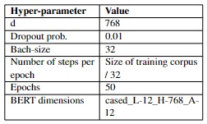
Hyperparameters

Slide 12
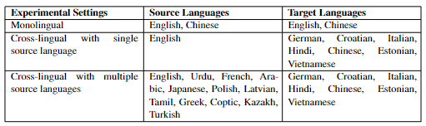
Experimental Setups
We evaluated the performance of our models in three distinct experimental settings namely Monolingual, Cross-lingual with Single source language and Cross-lingual with Multiple source languages.
In CL-Single settings all the parsers are trained in single source language English, whereas in CL-Poly settings the parsers are trained on a mixed polyglot corpus of all source languages listed in the table below (with each language equally represented). The training corpus size is always kept constant for experimental accuracy. In both Cross-lingual settings we experimented with Few-shot and Zero-shot scenerios.

Slide 13
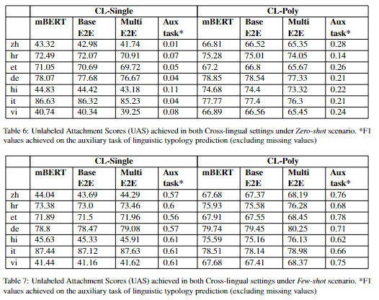
Results

Slide 14
Key Inferences
In CL-Single setup under both Few-shot and Zero-shot scenarios, all the evaluated mBERT based cross-lingual models (baseline and proposed models) perform better on target languages which are genealogically or geographically closer to the source language English.
On the other hand, in CL-Poly setup, the evaluated models show almost uniform performance across all target languages in both Few-shot and Zero-shot scenarios.
Overall, Cross-lingual transfering ability of an mBERT based multilingual dependency parser, to a distinct and unseen target language increases significantly due to polygot training.
In Monolingual settings, the auxiliary task of predicting linguistic typology features does lead to improvement in parsing performance indeed
In Cross-lingual settings, the auxiliary task does not help the model to improve the cross-lingual transfer parsing in an unseen language (which are not the part of training corpus). However, the task does enable the model to better learn to distinctively parse in each of the languages on which it is trained, even if the training corpus consists of only few sentence in the language.

Slide 15
Thank You

