Slide 1
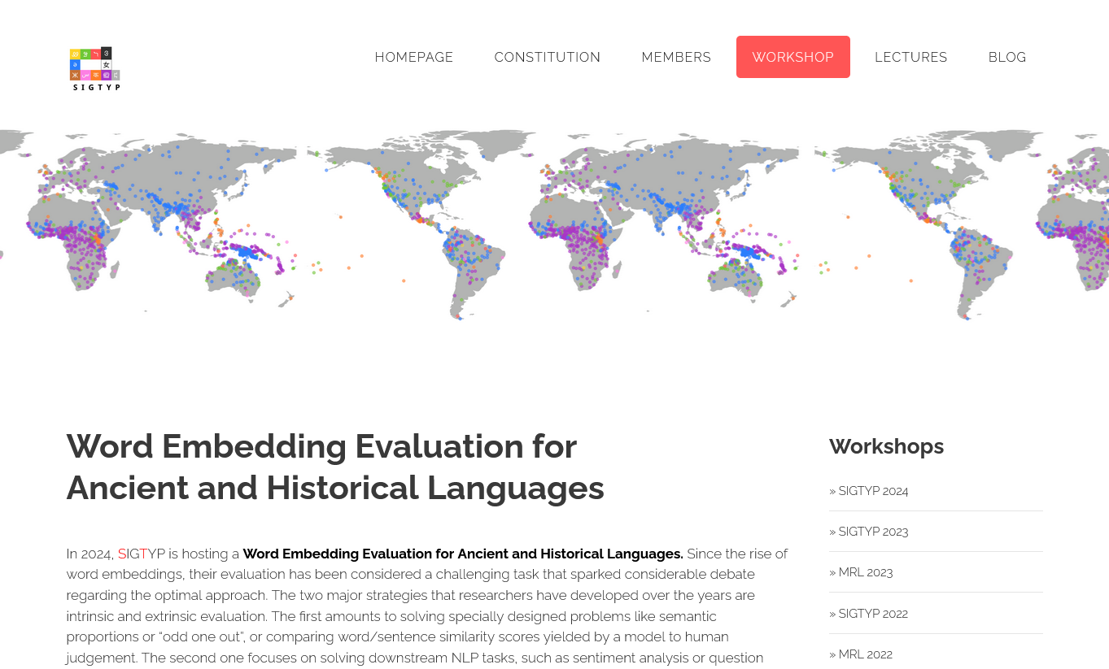
UDParse@SIGTYP 2024 modern language models for historical languages
Johannes Heinecke
Notes:
Welcome to my presentation on our participation at the SIGTYP 2024 shared task on word embedding for ancient and historical languages

Slide 2
SIGTYP 2024 Shared Task
Tasks and metrics
Constrained vs unconstrained (i.e. additional data allowed)
POS-tagging
Full morphological annotation
Lemmatisation
Filling gaps
at word-level
at character-level
Evaluation
Codalab platform
Task | Metrics
POS-tagging | Accuracy @1, F1
Detailed morphological annotation | Macro-average of Accuracy @1 per tag
Lemmatisation | Accuracy @1, Accuracy @3
Filling the gaps (word-level) | Accuracy @1, Accuracy @3
Filling the gaps (character-level) | Accuracy @1, Accuracy @3
Notes:
The shared task came in two variants : constrained on provided data or unsconstrained (we participated in the unsconstrained variant only)
There were five tasks, POS tagging, morpholoigcal annotation and lemmatisation and filling masked words or characters. Evaluation was provided by the codalb platform using mostly accuracy as metric

Slide 3
Languages
No other language using this script
Language | Code | Family | Branch | Script | Dating | Train-T | Valid-T | Test-T | Train-S | Valid-S | Test-S
Ancient Greek | grc | Indo-European | Hellenic | Greek | VIII c. BCE – 110 CE | 334,043 | 41,905 | 41,046 | 24,800 | 3,100 | 3,101
Ancient Hebrew | hbo | Afro-Asiatic | Semitic | Hebrew | X c. CE | 40,244 | 4,862 | 4,801 | 1,263 | 158 | 158
Classical Chinese | lzh | Sino-Tibetan | Sinitic | Hanzi | 47 – 220 CE | 346,778 | 43,067 | 43,323 | 68,991 | 8,624 | 8,624
Coptic | cop | Afro-Asiatic | Egyptian | Coptic | I – II c. CE | 57,493 | 7,282 | 7,558 | 1,730 | 216 | 217
Gothic | got | Indo-European | Germanic | Latin | V – VIII c. CE | 44,044 | 5,724 | 5,568 | 4,320 | 540 | 541
Medieval Icelandic | isl | Indo-European | Germanic | Latin | 1150 – 1680 CE | 473,478 | 59,002 | 58,242 | 21,820 | 2,728 | 2,728
Classical and Late Latin | lat | Indo-European | Romance | Latin | I c. BCE – IV c. CE | 188,149 | 23,279 | 23,344 | 16,769 | 2,096 | 2,097
Medieval Latin | latm | Indo-European | Romance | Latin | 774 – early XIV c. CE | 599,255 | 75,079 | 74,351 | 30,176 | 3,772 | 3,773
Old Church Slavonic | chu | Indo-European | Slavonic | Cyrillic | X – XI c. CE | 159,368 | 19,779 | 19,696 | 18,102 | 2,263 | 2,263
Old East Slavic | orv | Indo-European | Slavonic | Cyrillic | 1025 – 1700 CE | 250,833 | 31,078 | 32,318 | 24,788 | 3,098 | 3,099
Old French | fro | Indo-European | Romance | Latin | 1180 CE | 38,460 | 4,764 | 4,870 | 3,113 | 389 | 390
Vedic Sanskrit | san | Indo-European | Indo-Aryan | Latin (transcr.) | 1500 – 600 BCE | 21,786 | 2,729 | 2,602 | 3,197 | 400 | 400
Old Hungarian | ohu | Finno-Ugric | Ugric | Latin | 1440 – 1521 CE | 129,454 | 16,138 | 16,116 | 21,346 | 2,668 | 2,669
Old Irish | sga | Indo-European | Celtic | Latin | 600 – 900 CE | 88,774 | 11,093 | 11,048 | 8,748 | 1,093 | 1,094
Middle Irish | mga | Indo-European | Celtic | Latin | 900 – 1200 CE | 251,684 | 31,748 | 31,292 | 14,308 | 1,789 | 1,789
Early Modern Irish | ghc | Indo-European | Celtic | Latin | 1200 – 1700 CE | 673,449 | 115,163 | 79,600 | 24,440 | 3,055 | 3,056
All related languages use different scripts, none uses the Latin script
oldest language
Notes:
There were 16 historical languages to process, 13 for all 5 tasks, Old, Middle and Early modern Irish only for the gap filling tasks
CLICK
Coptic is the only language with a script not used in any other language (past or present)
CLICK
Sanskrit was the oldest languages with texts dating from 1500 to 600 BC
CLICK
Sanskrit came in a transcribed version (Latin), a script not used by any of Sanskrit’s successor languages

Slide 4
Provided Data
Data for tasks 1, 2, and 3
CoNLL-U format
Column 4 (UPOS) uses universal POS tags defined in the Universal Dependencies (UD) project
Column 6 (morphological features) are partially universally defined in UD
Tasks: Predict columns 3 (lemma), 4 (POS), and 6 (morphological features)
Test data is also tokenized (no need to split texts into sentences and word tokens)
The data for Old French has fewer morphological features than the other languages
# text = Espoir qu'Amors s'estoit anclose En aucune chanbre celee,
# newdoc id = YvainKu
# sent_id = YvainKu-3462.new
1 Espoir espoir ADV ADVgen _ 0 root _ _
2 qu' que SCONJ CONsub _ 6 mark _ SpaceAfter=No
3 Amors amor NOUN NOMcom _ 6 nsubj _ _
4 s' soi PRON PROper _ 6 expl _ SpaceAfter=No
5 estoit estre AUX VERcjg VerbForm=Fin 6 aux _ _
6 anclose enclore VERB VERppe Tense=Past|VerbForm=Part 1 ccomp _ _
7 En en ADP PRE _ 9 case _ _
8 aucune aucun DET DETind PronType=Ind 9 det _ _
9 chanbre chambre NOUN NOMcom _ 6 obl _ _
10 celee celer VERB VERppe Tense=Past|VerbForm=Part 9 acl _ SpaceAfter=No_
11 , , PUNCT PONfbl _ 1 punct _ _
Notes:
For the first 3 tasks, the data was provided in the ConLL-U format (Universal Dependencies project)
The corpus is segmented in tokenised sentences, for each token, the lemma, POS, morphological and dependency relations and heads are provided (the exception being Old Hungarian, for which no syntactical information was present.
In the test data the POS, lemmas and morphological information was obviously masked
CLICK
For the POS the universal tagset from UD was used, the morphological features also used UD tagsets, but not all features were used for every language. For instances, Old French lacked morphological features for nouns.

Slide 5
Provided Data
Data for tasks 4a and b
10% of words and 5% of characters masked in train/dev/test
Sentences without any masked word or character may exist
Masked words (isl)
Masked characters (chu) (“character” in the sense of Unicode point. Masked charactets include punctuation symbols and spaces)
Classical Chinese is decomposed into strokes using the hanzipy python library
jah qemun at imma [MASK] bairandans hafanana fram fidworim jah qemun at imma usliþan bairandans hafanana fram fidworim
ik usgiba ik usgiba
jah matidedun jah [MASK] waurþun allai jah matidedun jah sadai waurþun allai
The three masked characters here are “ь”, the accent on “ь” and the space
мѫче[_]иѥ ст꙯ааго савина мѫчениѥ ст꙯ааго савина
блѫдницѫ плакавь҆шѫ сꙙ в[_][_][_]небесъскꙑи крѫгъ наставь҆ꙗше блѫдницѫ плакавь҆шѫ сꙙ вь҆ небесъскꙑи крѫгъ наставь҆ꙗше
凵一口丷一人一一[_]一[_]一一丨一丶戈㇝㇇亅一㇇亅一㇒㇛丶亅 豈人主之子孫則必不善哉
八[_]二八亅丨𠁼㇃丿一丿丨丶一二丨丷丷一口一丨一戈口
Notes:
For tasks 4a and 4b, 10% of words and 5% of characters were masked in the training, validation and test data.
Sentences without masked data existed, as well as multiple masked words or characters in adjacent positions.
For Classical Chinese, the ideograms were decomposed into strokes by the hanzipy python library
CLICK
Masked characters are in fact unicode points. So they could be letters, diacritical symbols or spaces

Slide 6
Our approaches
Tools
UDParse for tasks 1, 2, and 3 (using multilingual LMs for modern languages): 1st place
Encoder/Decoder transformers for task 4a (did not work at all)
5-grams model for task 4b (worked well): 1st place
Notes:
For our participation we used three approachs and ended first for all tasks except the task 4a on predicting masked words.

Slide 7
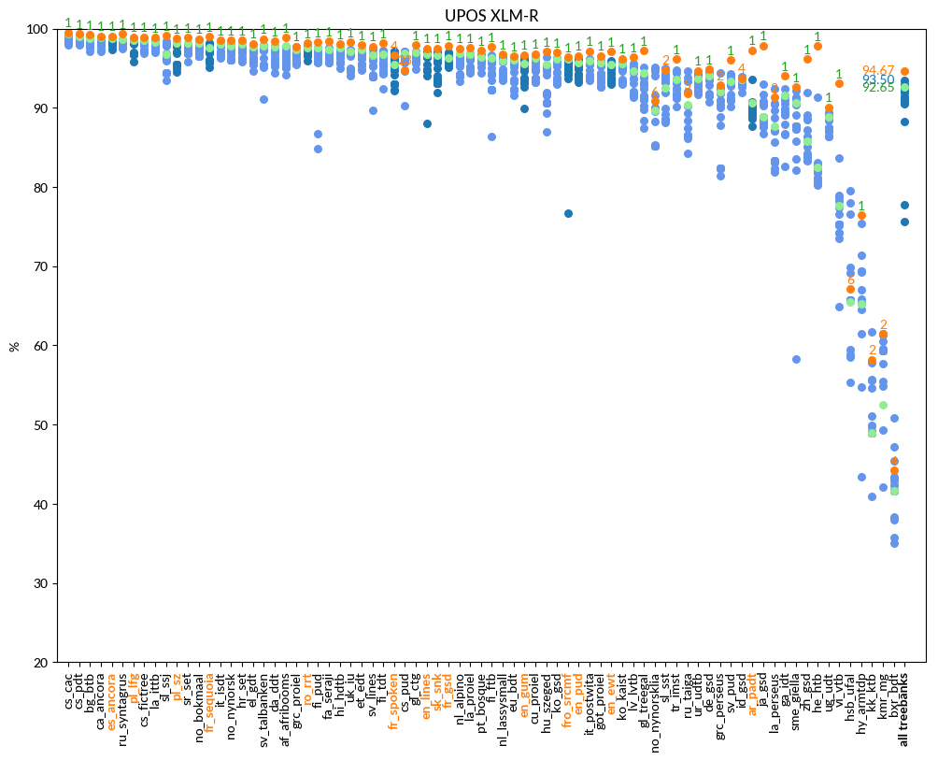
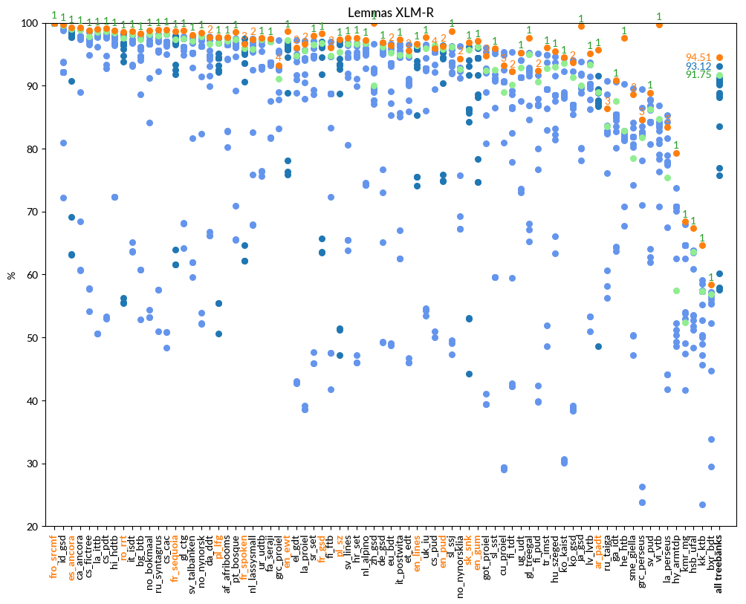
Tasks 1, 2, and 3 POS tagging, Lemmatisation, morphological feature assignment
Based on the dependency parser UDParse
which is an enhanced version of UDPipe-Future (Straka 2018), winner of the CoNLL 2018 shared task on dependency parsing
these 3 tasks closely linked to dependency parsing
UDParse improves much above UDPipe-Future since it uses multilingual context aware embeddings (BERT, RoBERTa (available at https://github.com/Orange-OpenSource/udparse)
Notes:
We used the dependency parser UDPArse for tasks 1 to 3.
UDParse is an evolution of UDPipeFutre, the winner of the 2018 Conll shared task on dependency parsing.
We chose Udparse since its State of the Art results implies
Good performance in POS tagging, Lemmatisation and morphological analysis as well

Slide 8
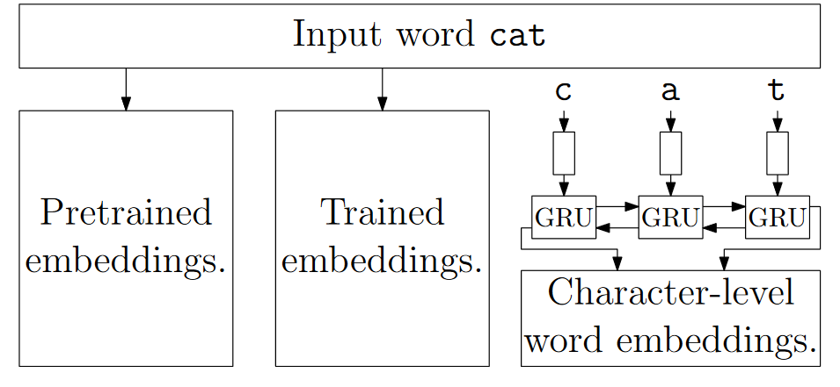
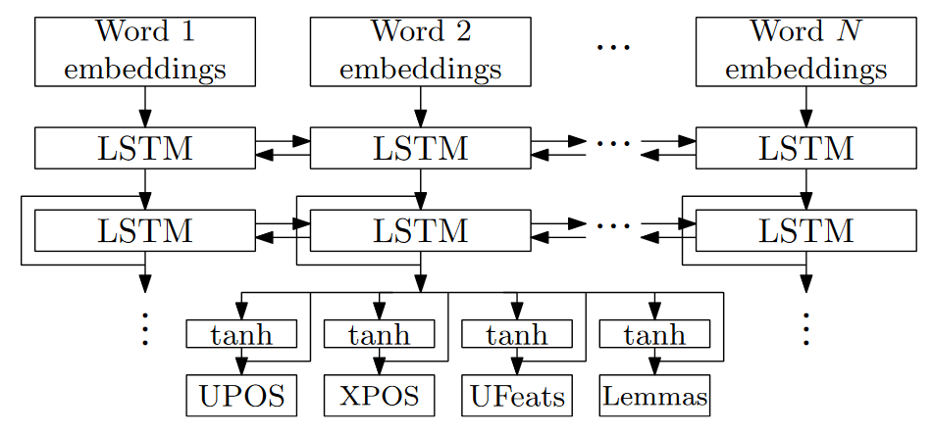
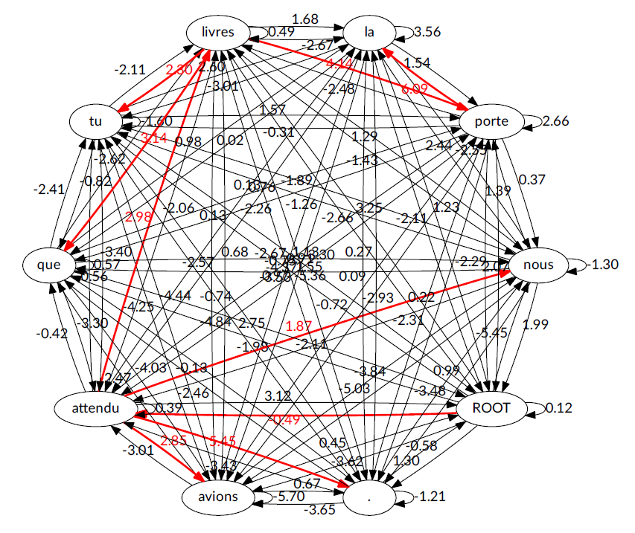
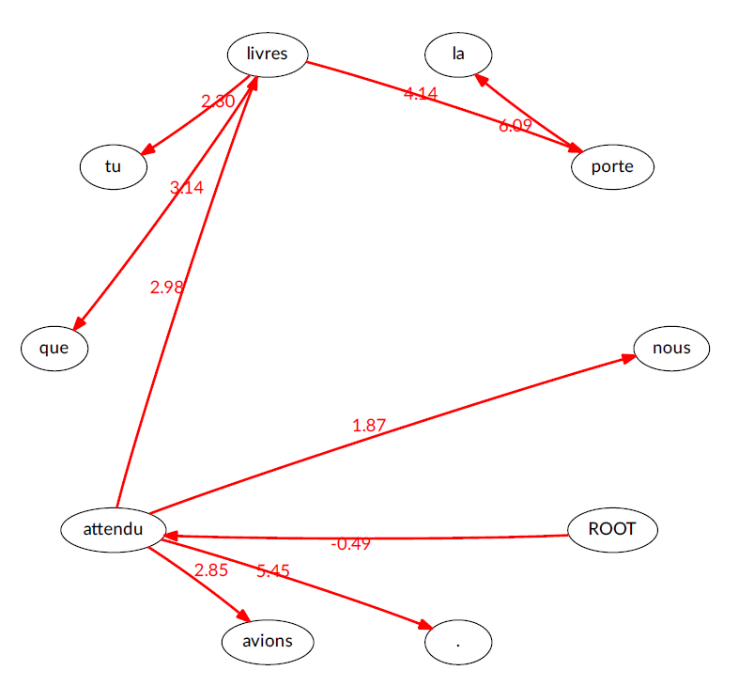
UDParse
POS Tagging
first representing each word with its embedding, contextualizing them with bidirectional RNNs, and finally using a softmax classifier to predict the tags
Lemmatisation
convert each lemma to a rule generating it from the word form, and then classify each input word into one of such rules
Dependency Parsing
Graph parser with Chu-Liu-Edmonds algorithm
word embeddings
tagger and lemmatiser model
Notes:
POS tagging is solved as a classification task using vectors from context aware word embeddings (like multilingual Bert or XLM Roberta.
In addition to these additional character and word vectors are calculated during training)
For Lemmatisation UDPipeFuture (and thus UDParse) generates rules to modify the forms lemmas and then classifies a word onto a rule
CLICK The dependency parser is a graph parser which produces a graph of all possible dependency relations.
CLICK The Chu-Liu-Edmonds algorith calculates the most probable dependency tree in function of the scores for each relation

Slide 9
Tasks 1, 2, and 3 Parameters
Language code | POS | Lemma | Morphological features
chu | XLMR | XLMR | XLMR
cop | XLMR | GPT2 | XLMR
fro | XLMR | mBERT | XLMR
got | XLMR | mBERT | mBERT
grc | XLMR | XLMR | XLMR
hbo | heBERT | XLMR | heBERT
isl | XLMR | XLMR | XLMR
lat | XLMR | XLMR | XLMR
latm | XLMR | XLMR | XLMR
lzh | mBERT | mBERT | mBERT
ohu | XLMR | XLMR | mBERT
orv | XLMR | XLMR | XLMR
san | mBERT | mBERT | XLMR
Comparison with modern
(successor) languages, which are included in the LMs
Several underlying (Modern) Language(s) Model(s)
Multingual BERT
XLM-RoBERTa
GPT2
heBERT (chu, orv)
slavicBERT (hbo)
Code | UPOS | Lemma
fro | 96.01 | 95.11
hbo | 97.84 | 98.15
ohu | 96.71 | 86.91
orv | 94.99 | 89.23
XLMR is best option in most of the times, sometimes mBERT is slightly better, for Ancient Hebrew heBERT gives the best results.
Code | UPOS | Lemma
fr | 97.93 | 98.41
he | 97.81 | 97.60
hu | 97.07 | 95.51
ru | 99.35 | 98.90
Notes:
In order to find the best underlying Word Embeddings (which were trained on Modern languages only) we tried several models like Multilingual BERT or XLM Roberta or the language specific models like HeBERT or slavicBERT on the validation date.
CLICK
As for modern languages XLM Roberta is the best option in most cases. Sometimes the best models for POS tagging, Lemmatisation or morphological analysis were not the same
CLICK
Although the historical languages are not covered by theses embeddings, the results on these languages are not very different than the results for modern languages covered by BERT or XLM Roberta

Slide 10
Task 4a Filling gaps at word level
Did not at all work out as hoped (also a time issue)
AutoModelForMaskedLM with distilbertbase-multilingual-cased
Only predicted single token (available in distilBERT’s vocabulary) for masked word.
Most masked words are a combination of tokens →impossible to be correct
MBartForConditionalGeneration with facebook/mbart-large-50
Predicted n tokens for a masked word → caused problems when several adjacent words were masked
Notes:
For Task 4b, predicting masked words we tried two approaches with pretrained language models,
AutoModelForMaskedLM with a mutilingual distilBERT and Mbart for conditional generation with facebook’s mbart large 50.
Unfortunately both approaches were a clear failure with accuracy below 5%
In the first case we had the problem that the model only predicts a single token per masked word. However most masked words needed multiple distilbert tokens to be represented
In the second case the model predicted 0 to n tokens for a masked word, which posed problems for adjacent masked words

Slide 11
Task 4b Filling gaps at character level
Constrained approach (even in the unconstrained variant of the ST)
Count all 5-grams in training test
In masked text take all 5-grams around a masked character (here “%”)
Ne voloi% aler nule part
oit␣a is the best candidate, we retain t to obtain Ne voloit aler nule part
We use bigrams or trigrams, if no 5-gram can be found
olio%
oloie frequency of 6 in training corpus,
oloil (3),
oloir (8),
oloit (15, currently the best match)
oi%␣a
oia␣a (1),
oie␣a (17),
oif␣a (1),
oil␣a (3),
oir␣a (3),
ois␣a (14),
oit␣a (57, retained),
oiz␣a (8)
%␣ale
␣␣ale (3),
a␣ale (1),
e␣ale (3),
i␣ale (2),
l␣ale (1),
n␣ale (2),
r␣ale (6),
s␣ale (2),
t␣ale (17),
z␣ale (1),
«␣ale (1)
loi%␣
loie␣ (2),
loil␣ (2),
loir␣ (6),
lois␣ (1),
loit␣ (22, new best match)
i%␣al
it␣al (3)
Notes:
In order to predict masked characters we chose the historical technique of 5-grams. So even though we participated in the unconstrained variant of the shared task, this approach only uses data provided by the shared task
We first counted all 5-ngrams in the training data.
We then had a sliding window of size 5 on the masked characters (here the percent sign)
CLICK
To find the most frequent 5-ngram
CLICK
If there were more than 1 masked characters within the sliding window, we used tree or even bee-grams

Slide 12
Results
Code | UPOS | Lemma | Morph. features | Word fill | Character fill | Average
chu | 97.00 | 92.70 | 96.49 | 2.80 | 66.77 | 71.15
cop | 97.33 | 98.28 | 98.88 | 0.00 | 0.00 | 58.90
fro | 96.01 | 95.11 | 98.33 | 3.28 | 62.77 | 71.10
got | 96.47 | 95.41 | 96.23 | 2.67 | 74.59 | 73.07
grc | 96.49 | 93.39 | 97.78 | 3.07 | 68.46 | 71.84
hbo | 97.84 | 98.15 | 97.05 | 5.39 | 36.85 | 67.05
isl | 96.88 | 97.23 | 95.92 | 3.42 | 66.45 | 71.98
lat | 96.83 | 96.99 | 96.66 | 3.51 | 67.91 | 72.38
latm | 98.79 | 98.69 | 98.83 | 4.73 | 72.93 | 74.79
lzh | 93.76 | 99.91 | 96.24 | 6.10 | 0.00 | 59.20
ohu | 96.71 | 86.91 | 96.62 | 6.31 | 66.52 | 70.61
orv | 94.99 | 89.23 | 95.16 | 5.03 | 61.34 | 69.15
san | 90.02 | 91.48 | 92.60 | 3.86 | 70.10 | 69.61
ghc | — | — | — | 3.29 | 58.09 | 30.69
mga | — | — | — | 4.03 | 53.38 | 28.71
sga | — | — | — | 2.79 | 58.38 | 30.59
Code | UPOS | Lemma | Morph. features
chu | 3.64 | 3.09 | 11.42
cop | 2.35 | 2.54 | 51.47
fro | 4.44 | 3.18 | 70.06
got | 2.74 | 3.46 | 77.28
grc | 6.16 | 2.33 | 72.68
hbo | 3.77 | 2.86 | 54.26
isl | 2.88 | 3.45 | 60.09
lat | 4.44 | 4.90 | 78.49
latm | 1.56 | 1.65 | 67.89
lzh | 2.85 | 1.10 | 52.66
ohu | 3.12 | –2.53 | 73.42
orv | 4.66 | 4.79 | 69.60
san | 0.65 | 7.24 | 84.26
Difference w.r.t baseline
The submitted file had an error. Tests after the end of the ST revealed an accuracy of 62.26
Something went wrong here
Notes:
The results are shown here
CLICK
And the difference to the baseline provided by the organisers
CLICK
And with exception of Old Hungarian, POS tagging, lemmatisation, and morphological analysis are well above the baseline
CLICK
Unfortunately, during the submission of our results to the codalab platform, a typo in a script did not submit our data for Coptic (tasks 4a and b). That is why it is 0. Tests after the shared tasks showed that we could have arrived at 62,26%

Slide 13
Conclusion
Language Models based on Modern languages can help some NLP tasks for historical languages
Basic approaches (like 5-gram patterns) can already produce good results
Even languages without modern successors (like Coptic) or historical languages transcribed into a foreign alphabet (here Sanskrit, written in the Latin script) can be processed with acceptable results

Slide 14
Thank you very much for your attention
johannes.heinecke@orange.com
https://github.com/Orange-OpenSource/udparse
Notes:
Thank you very much for your attention
I’d like to thank the organisers of the shared as well as the SIGTYP workshop organizers for having organised the Shared Task in this workshop

