Slide 1
Buckling Analysis of cylindracal shell in Abaqus
Case study, Mathilde Faanes, exam 24.01.24

Slide 2
Outline
• Objective of the work
• Description of the structure and model
• Results of FEA
• Discussion
• Conclusions

Slide 3

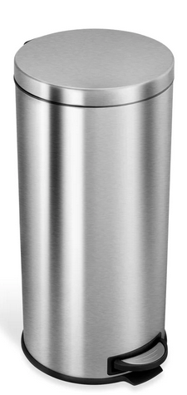
Objective
Instability problem for element in compression
How much can a simple cylindrical shell from the daily life be loaded?
Compare Buckling stress to yield strength
Simple structure -> can compare with analytical model

Slide 4
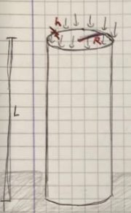
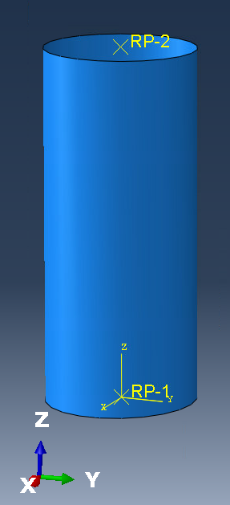
Model
Dimensions:
R=150mm
L=700mm
h=1mm
Material properties
Aluminium alloy
E-modul: 72 GPa
Yield strength: 200 MPa
Poissons ratio: 0.33
Load
Evenly distributed on shell edge
Boundary conditions
Clamped bottom
Free top

Slide 5
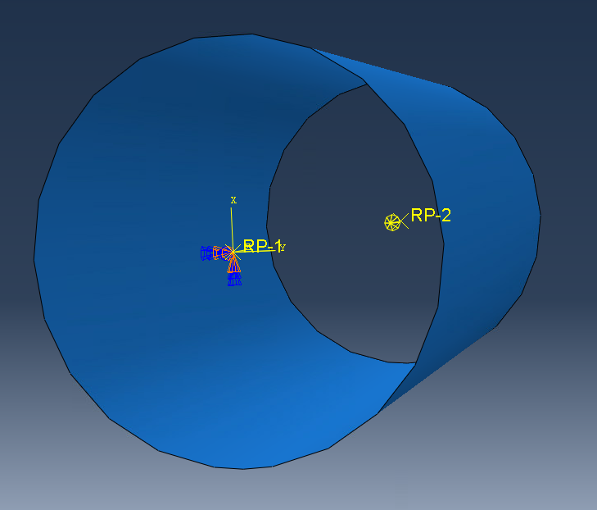
Abaqus analysis
Load and Boundary conditions
Two reference points coupled with top and bottom node surface
Even load distribution
Improves stability
Adapts to mesh changes
Clamped RP1
Concentrated force with magnitude 1 in RP2
Elements
S4R
Simple geometry, single curved -> quadrilateral element
Simulating for different mesh size

Slide 6
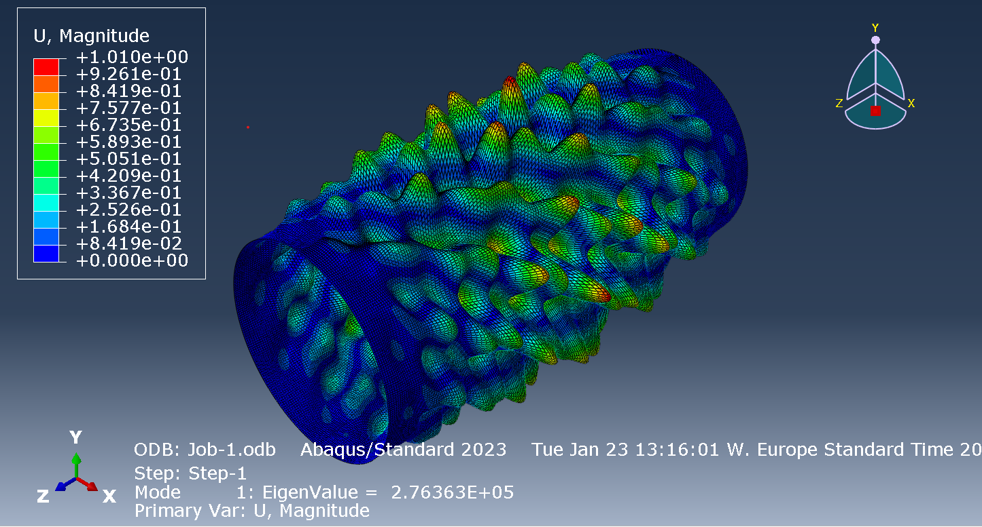
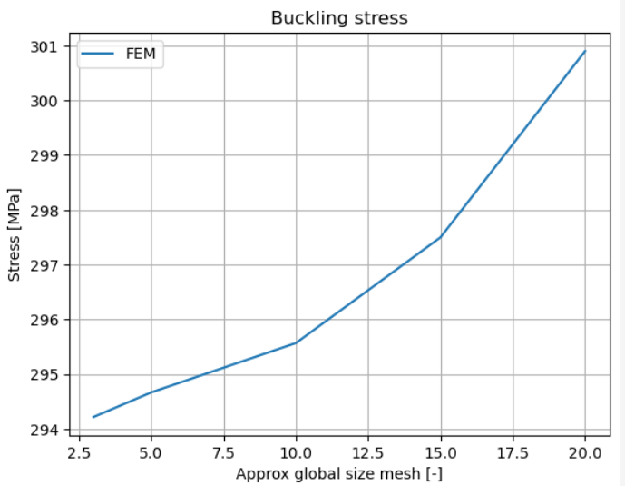
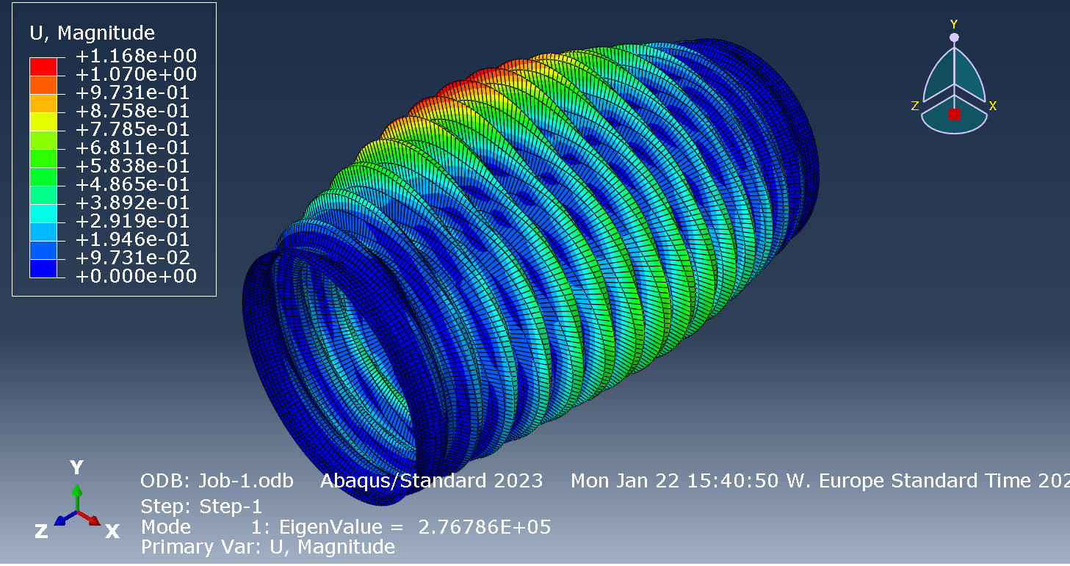
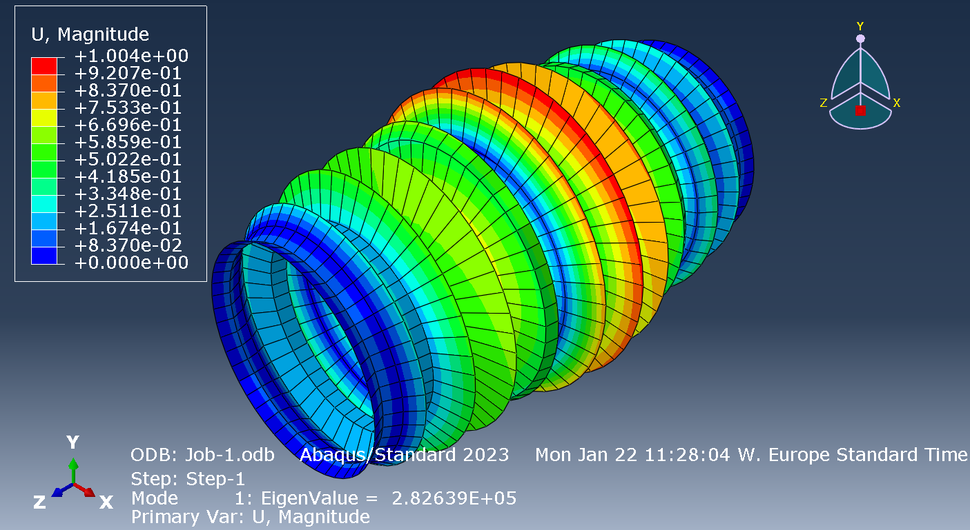
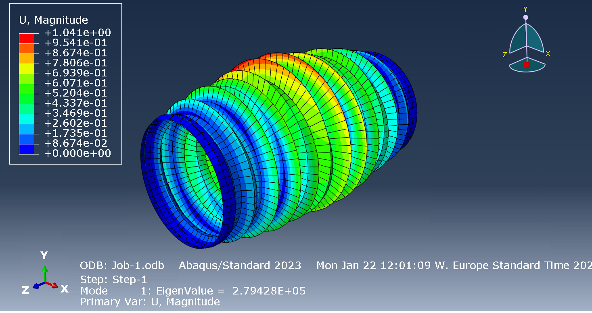
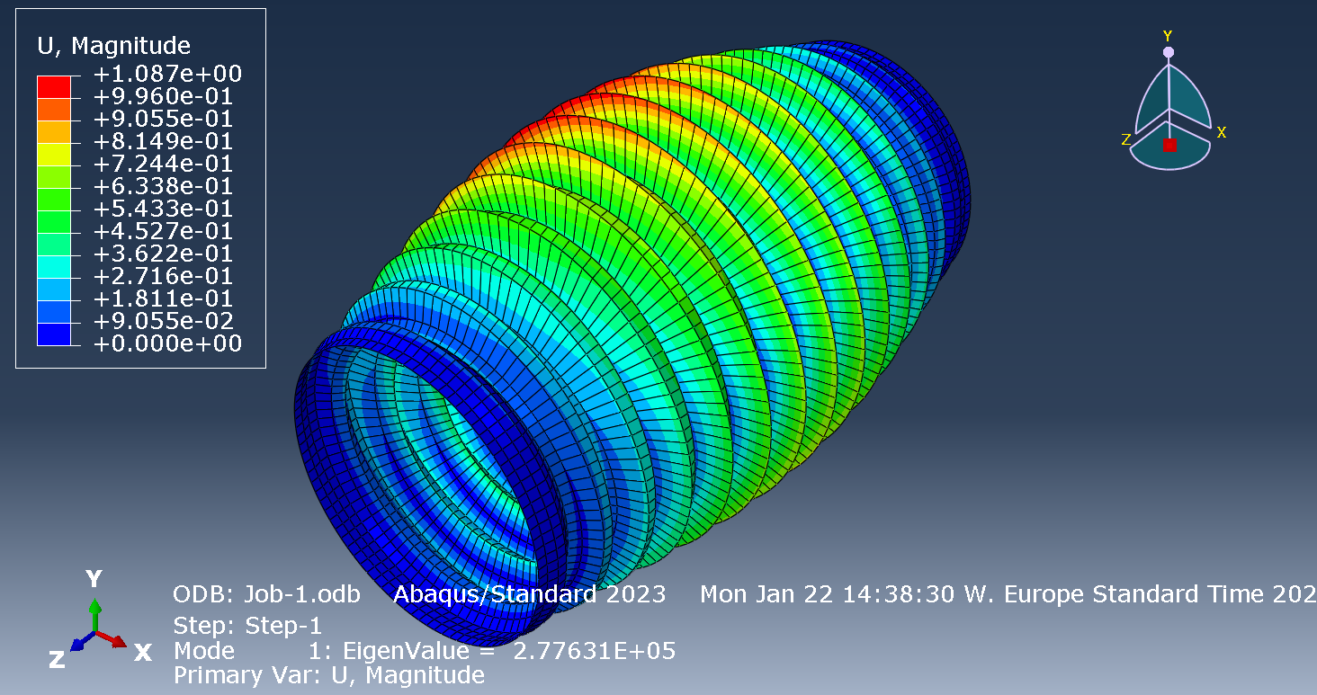
Simulations
Step: linear perturbation
Additional small perturbations are added on primary loading
Buckling stress decreases with finer mesh
Number of buckles increases from coarsest finer mesh
Very fine mesh-> very different deformation shape
Assuming small displacement -> cannot trust deformed shape

Slide 7
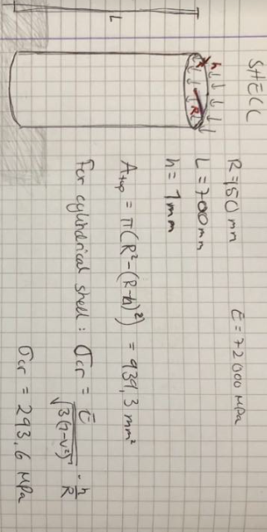
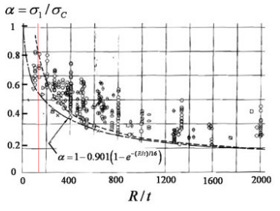
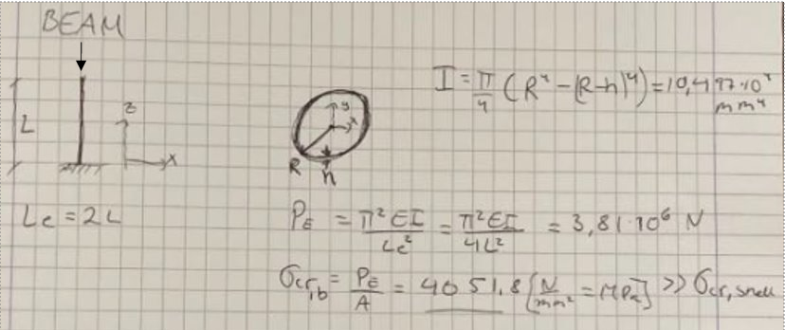
Analytical solution
Buckling load cylindrical shell:
Derived from equilibrium eq. and compatibility eq.
Independent of Length: must check for columns buckling
Knock down factor
Critical stress = 161.5 MPa (With KDF=0.55)
M=32.9

Slide 8
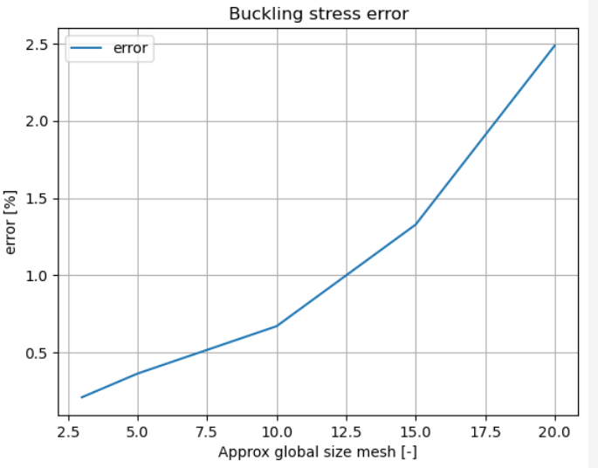
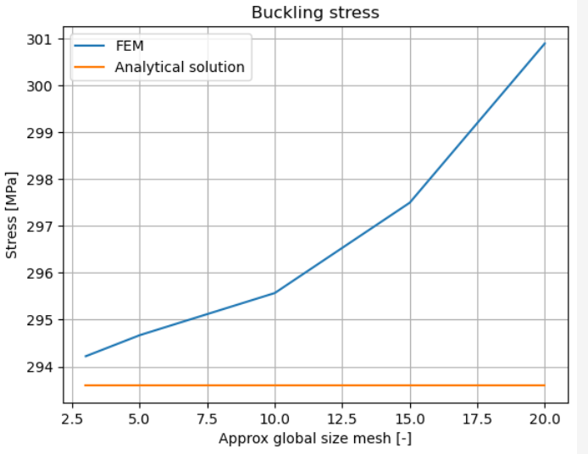
Comparison
FEA gives higher value
Finer mesh gives lower error
Finer mesh matches number of buckles

Slide 9
Conclusions
Should we be careful loading the kitchen trashcan top?
161.5 MPa -> 151.7 kN
Whether buckling or yielding occurs first depends on KDF and yield strength.
Pure compression is not realistic, calculated capacity is therefore most likely overestimated because bending moments will occur

Slide 10
Sourses
Hutchinson, J.W. (2010). Science Direct. Knockdown factors for buckling of cylindrical and spherical shells subject to reduced biaxial membrane stress. From: https://www.sciencedirect.com/science/article/pii/S002076831000051X

Slide 11
Cylinder
PART: 3D deformable shell extrution
Property: elastic, E=72000 (MPa), v=0.33
Create section: shell, homogeounos
Assign section: middle surface
Assembley: create instance: dependent: mesh on part
Tools bar: RP1: in orgin, RP2: in other end
Interaction: create constraints: (name RP1) coupeling RP1 and node surface. Same for RP2
LOAD: create BC in RP1, prevent ALL displacement rotation, so cylinder connot rotate around the point
STEP: create step, linear pertubation, buckling. Numer of eigenvalue requested: 1, max number of iteration: 300
MESH: mesh size 1: 20
S4R: A 4-node doubly curved thin or thick shell, reduced integration, hourglass control, finite membrane strains.
LOAD: concentrated force in RP2. Magnitude 1

