Slide 1
Fjern denne
Description of the structure
Objective of the work
Description of the loading and the boundary conditions
Description of the model:
material’s model
translation of the loading and boundary conditions in the corresponding FE ones
choice of the element type and size
Results
Discussion of the results (with comparison with simplified, analytical solutions)
Conclusions
Sigrid sin case nr 5

Slide 2
Analysis of uniform and point load on a plate shell of aluminum in Abaqus

Slide 3

Outline
Description
Objective
Model
Abaqus Simulation
Discussion & Comparison
Conclusion

Slide 4



Objective
Idea
How much force can a plate shell of aluminum withstand?
What is the effect of a uniform load and several point loads?
Assumptions

Slide 5
Description
Structure
Load
Boundary Condition
Structure

Slide 6
Model
Material
Model

Slide 7
Abaqus Simulations
Material
Model

Slide 8
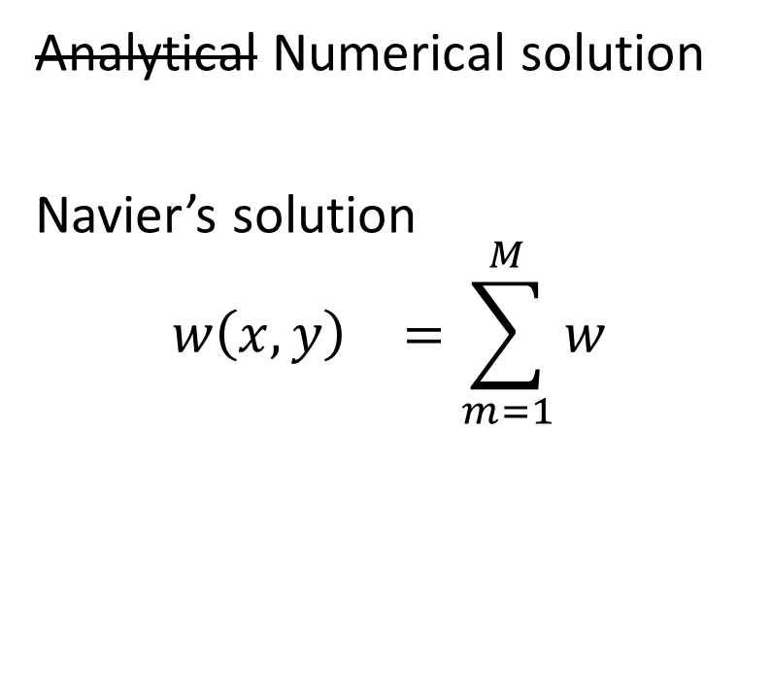
Discussion Comparison
&
Comparison
Analytical Numerical solution
Navier’s solution
$${w\left(x, y\right)}^{}=\sum_{m=1}^{M}{w}$$

Slide 9
Conclusion
Model

