Slide 1
On Complexity of Buﬀers Allocation Problems for Production Lines with Unreliable Machines
A. Dolgui¹, A. Eremeev², M. Kovalyov ³, V. Sigaev²
¹ Division for Industrial Engineering and Computer Sciences, Ecole des Mines de Saint Etienne, France,
dolgui@emse.fr
² Omsk Branch of Sobolev Institute of Mathematics SB RAS, eremeev@ofim.oscsbras.ru
³ United Institute of Informatics Problems National Academy of Sciences of Belarus, Surganova 6, 220012 Minsk, Belarus
kovalyov_my@newman.bas-net.by

Slide 2
Outline of the Talk
Model of tandem production line and performance evaluation methods
Knapsack-type buffer allocation problems for tandem lines and for series-parallel lines
Complexity of knapsack-type problems for series-parallel lines
Expected profit maximization problem and its complexity
Conclusions and open questions

Slide 3
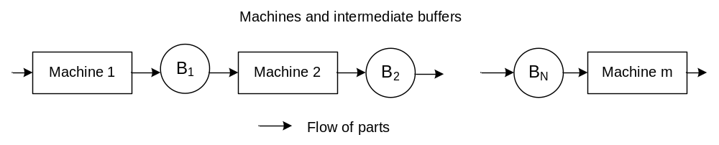
Tandem Production Line
Machines may break down only when they are working.
The time to failure and time to repair for each machine are mutually independent and exponentially distributed;
Working machine has a constant cycle time and production rate;
There is a sufficient number of raw parts at the input of the system.
The completed parts depart from the system immediately.
Parameters of machine i:
λ_{i} is the failure rate;
μ_{i} is the repair rate;
u_{i} is the average production rate.

Slide 4
Performance Evaluation Methods
Existence of steady-state distribution + asymptotic analysis (Sevast'yanov B. A.,1962)
Differential Kolmogorov equations for two michines and buffer between them (Levin A.A. & Pasko N.I.,1969).
Aggregation and decomposition techniques for evaluation of multiple-machine tandem lines
(Gershwin et al.,1987, 1994, 2009),
(Dallery Y., David R., Xie X., 1988)
(Dolgui & Svirin, 1992)

Slide 5
Aggregation Method
(Dolgui, Svirin,1992)
Two machines in series:
(λ₁, μ₁, u₁)
(λ₂, μ₂, u₂)
(λ*, μ*, u*)
Parameters λ*, μ*, u* of equivalent machines are calculated from differential equations corresponding to the Markov model of two machines and a buffer.
V(h) is strictly increasing on [0,d_{i} ] for any i=1,…,N (this can be shown using the closed-form expressions e.g. from (Coillard & Proth, 1984).

Slide 6
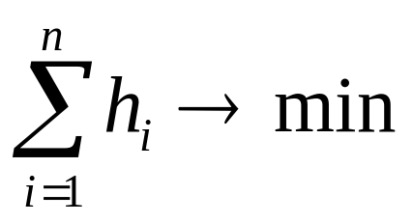
Knapsack Problem of Type 1 for Tandem Lines
Vector of variables: h = (h₁,…,h_{n})∈ Z ^{n},
where h_{i} is the volume of buffer i, i=1,…,n.
V(h) is the average production rate (steady state throughput);
, V(h) ≥ V₀.
DP (Yamashita & Altiok, 1998)
Sample Path Optimization Method (Gurkan, 2000)
Tabu Search (Demir et al, 2011)

Slide 7
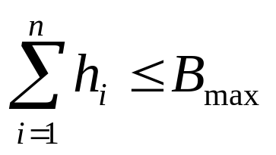
Knapsack Problem of Type 2 for Tandem Lines
V(h) → max,
Integer Linear Programming (Soyster et al, 1979)
DP and Greedy heuristic (Jafari, Shanthikumar,1989)
Genetic algorithms (Spinellis & Papadopoulos, 2000)
Hybrid Tabu Search (Shi & Men, 2003; Demir et al,2013)

Slide 8
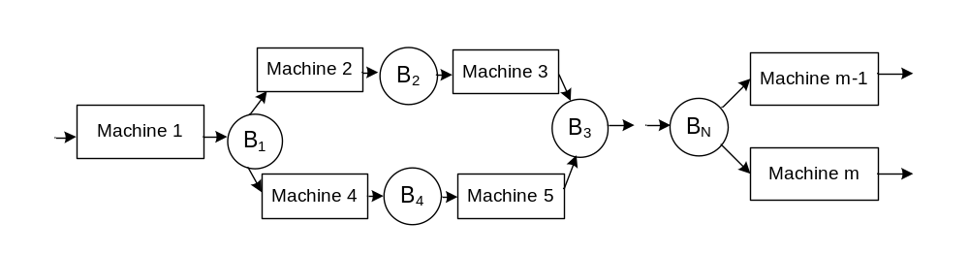
Series-Parallel Production Line
Two machines in parallel:
(λ₁, μ₁, u₁)
(λ*, μ*, u*)
(λ₂, μ₂, u₂)

Slide 9
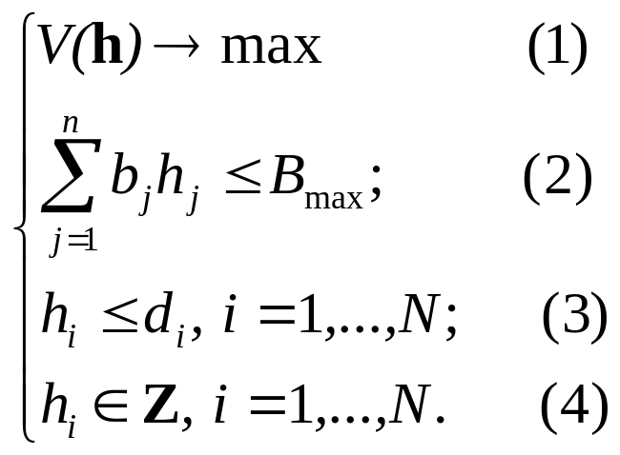
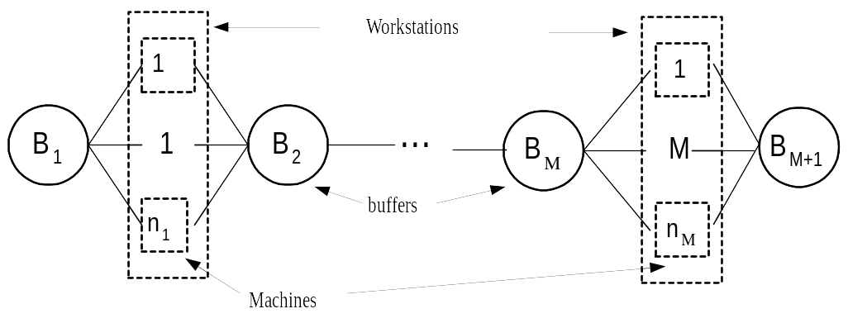
Knapsack Problem of Type 2 with Linear Constraint
where d_{i} is the maximum admissible volume of buffer i.
Genetic algorithm for general case of series-parallel lines
(Dolgui, Eremeev, Kolokolov, Sigaev, 2000)
Simulated Annealing, Ant Colony Optimization for serial lines of workstations (Nahas, N., Nourelfath, M. , Ait-Kadi, 2009)

Slide 10
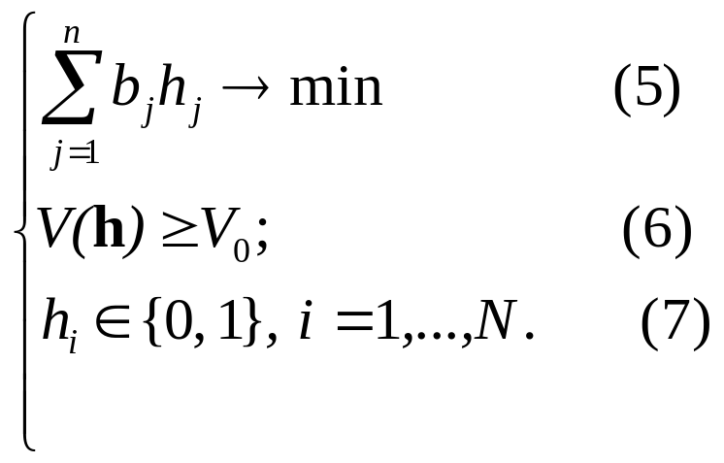
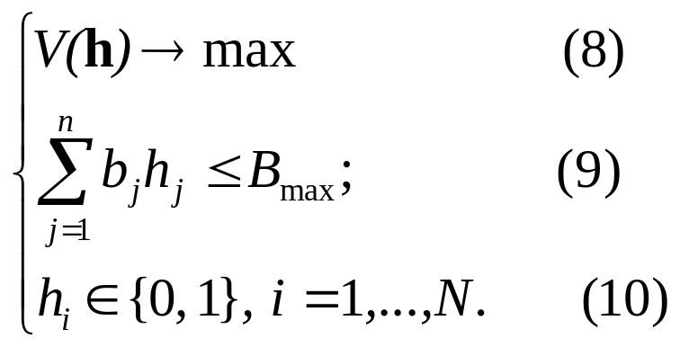
Complexity of Knapsack-Type Problem
h₁
…
h_{n}
Line with simple structure
Proposition 1. (Dolgui et al., 2007) Knapsack problem of type I (5)-(7) for series-parallel lines is NP-hard even in the case of lines with simple structure.
Proposition 2. Knapsack problem of type II (8)-(10) for series-parallel lines is NP-hard even in the case of lines with simple structure.

Slide 11
Expected Profit Maximization for Tandem Lines
R(V) is the revenue due to production rate V;
T_{ам} is the amortization time of the line (line life);
J(h) is the cost of buffer configuration h;
Functions R(V) and J(h) are assumed to be non-decreasing.

Slide 12
Expected Profit Maximization Algorithms
Gradient method for linear J(h)
  (Gershwin, Schor, 2000)
Genetic algorithm with local search
(Dolgui, Eremeev, Kolokolov, Sigaev, 2000).
Hybrid Branch-and-Bound algorithm
(Dolgui, Eremeev, Sigaev, 2007).

Slide 13
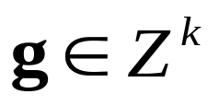
Branch and Bound Scheme
Depth-first brancing
A node of the branching tree is a 4-tuple (k, a, b, g), where
k∈ {1,2,…,N} is the number of buffers for which the size is fixed;
a,b ∈{0,…,d_{k}};
is a vector containing the fixed values of coordinates (buffer sizes) for buffers with indices 1,…,k.

Slide 14
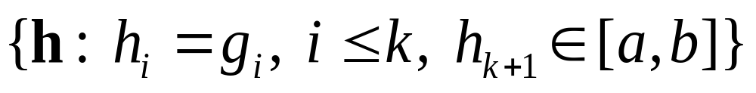
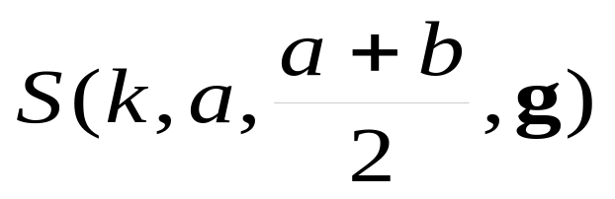
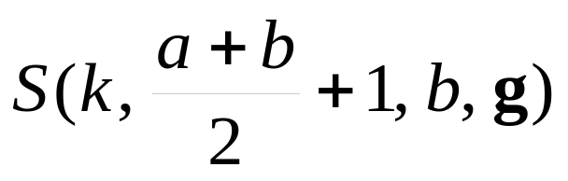
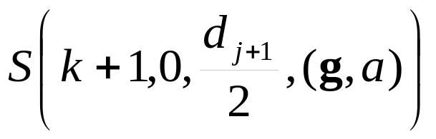
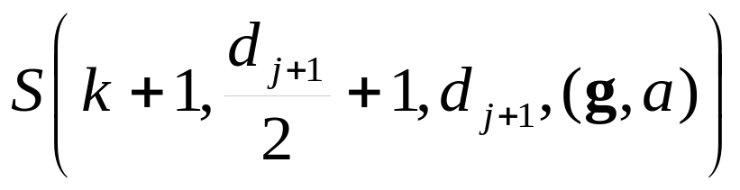
Branching
Each 4-tuple is associated with a set of solutions:
S(k, a, b, g) = .
Branching at node (k, a, b, g), a<b, splits the subset S(k, a, b, g) into
and
If a=b, then S(k, a, b, g) splits into
and

Slide 15
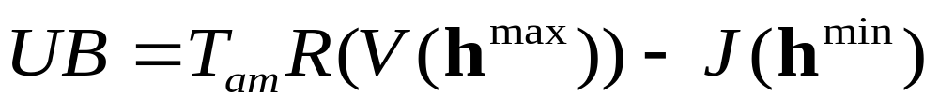
Upper Bound and BBA Precision
For a subset S(k, a, b, g) we have
where
h^{max}=(g₁,…,g_{k},b,d^{k+2},…, d^{N}),
h^{min}=(g₁,…,g_{k},a,0,…,0).
Proposition 3. (Dolgui et al, 2007) The output of the BBA differs from the optimum by at most 2ε, where ε is an upper bound on precision of evaluation procedure for V(h).

Slide 16
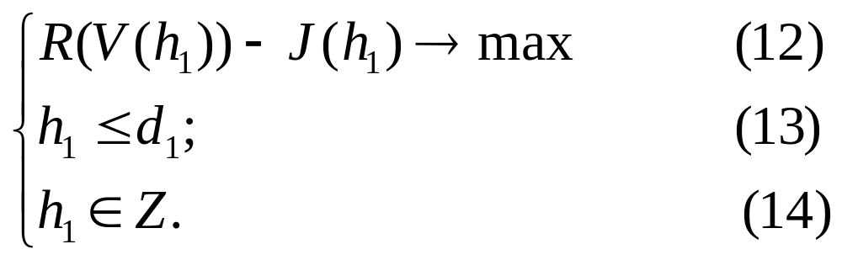
Complexity in the Case of Tandem Two-Machine Line
(λ₁, μ₁, u₁)
(λ₂, μ₂, u₂)
(λ*, μ*, u*)
Proposition 4. If the functions R(V) and J(h) are represented by oracles, the buffers allocation problem for tandem lines is NP-hard, even in the case of two identical machines.
Proof is based on reduction from Partition problem, similar to that of Cheng and Kovalyov (2002).

Slide 17
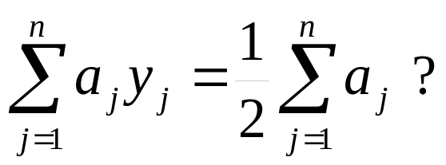
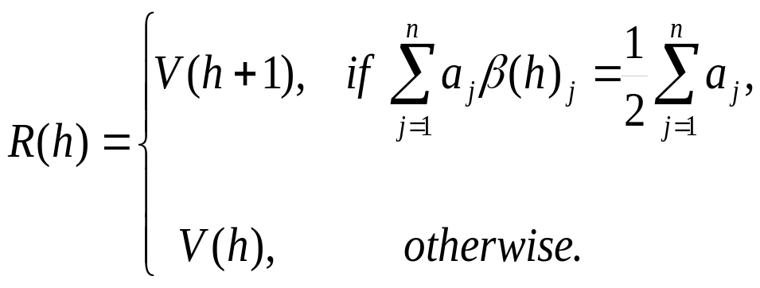
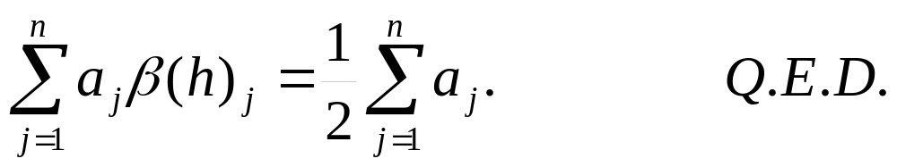
Partition problem: given n positive integers a₁,a₂,...,a_{n}, is there a Boolean vector (y₁,y₂,...,y_{n})∈{0,1}^{n} such that
Buffer capacity allocation problem: n=1, T_{am}=1 and λ_{i}=μ_{i}=u_{i}=1, i= 1,2.
Let d:= 2^{n}-1 and β(h) is the binary representation of h using n bits.
Assume buffer cost J(h)=V(h) and revenue function
V(h) is increasing, so ϕ(h) = T_{am} R(h) - J(h) = R(h) - V(h) > 0 iff

Slide 18
Conclusions
The following buffers allocation problems are NP-hard:
knapsack-type problem with upper-bounded buffers cost for series-parallel lines
knapsack-type problem with lower-bounded production rate for series-parallel lines
profit maximization problem for tandem production lines with oracle representation of revenue and cost functions.

Slide 19
Open Questions
What is the complexity status of computing V(h) for lines with multiple machines?
Are there non-approximability thresholds for problems considered above?
What is the complexity status of knapsack-type problems for the tandem lines?

Slide 20
Thank you for attention!

Slide 21
System States and Probabilities
System state may be expressed by the triple (α₁,α₂,x):
α_{i} =0 if machine i is under repair,
α_{i} =1 if it is operational.
x∈ [0,h] is the amount of buffer capacity used
Let A_{i} be the binary random variable for the state of machine I
Let X be the random variable for the amount of buffer used.
Probabilities of boundary states at time t:
Pα₁α₂(0,t)=P{(A₁, A₂,X)=(α₁,α₂,0) at time t},
Pα₁α₂(h,t)=P{(A₁, A₂,X)=(α₁,α₂,h) at time t},
fα₁α₂(x,t)=∂Fα₁α₂(x,t)/∂x,
Fα₁α₂(x,t)=P{(A₁ ,A₂ ,X), A₁=α₁, A₂=α₂, X < x at time t }.
Asymptotic steady-state distributions:
Pα₁α₂ (0)=lim_{t→∞} P α₁α₂(0,t), Pα₁α₂(h)=lim_{t→∞} P α₁α₂(h,t),
fα₁α₂ (x)=lim_{t→∞} fα₁α₂ (x,t).

Slide 22
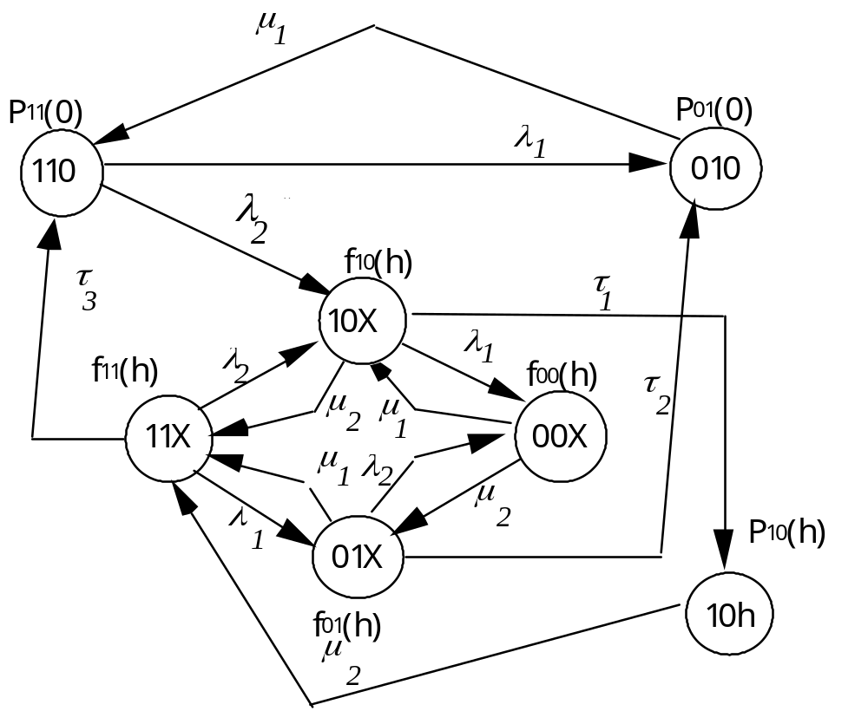
Markov Model for Two Machines in Series

Slide 23
Steady-State Distributions
Steady-state distribution is found analytically by solving Kolmogorov equations
0 =λ₁f₁₀(x)+ λ₂f₀₁(x)-(μ₁+μ₂)f₀₀(x),
-u₂ ∂f₀₁ (x)/∂x=λ₁f₁₁(x)+ μ₂f₀₀(x)-(μ₁+λ₂)f₀₁(x),
u₁ ∂f₁₀(x)/∂x=λ₂f₁₁ (x)+μ₁f₀₀ (x)-(λ₁+μ₂)f₁₀(x),
(u₁-u₂)∂f₁₁ (x)/∂x=μ₁f₀₁(x)+μ₂f₁₀(x)-(λ₁+λ₂)f₁₁(x).
and equations on probabilities for boundary states.

Slide 24
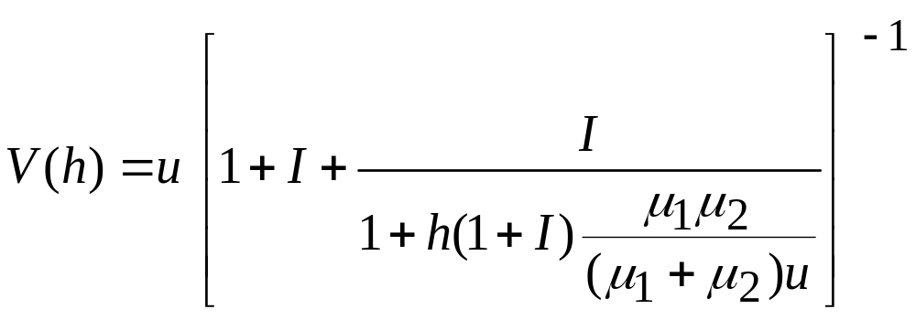
The Average Production Rate
The case u=u₁=u₂, μ₁=μ₂ and λ₁=λ₂.
Denote I =μ₁/λ₁=μ₂/λ₂.

