Slide 1



Margin
+1
-1
Support Vector
$$w^{T}x+b=1$$
$$w^{T}x+b=0$$
$w^{T}x+b=−$1
Hyperplane

Slide 2
Input
X1
X2
X3
X4
Xn
Weights
W1
W2
W3
W4
Wn
b
Bias
Output
Y

Slide 3



Margin
Xm
Xn
$$w1x1+w2x2+b=1$$
$$w1x1+w2x2+b=0$$
$w1x1+w2x2+b=−$1

Slide 4
Margin
W
Xp
Xq
$$w1x1+w2x2+b=1$$
$$w1x1+w2x2+b=0$$
$w1x1+w2x2+b=−$1

Slide 5
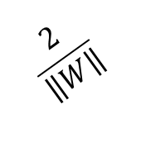
Margin
$$\frac{2}{\left\|W\right\|}$$
W
Xm
Xn
$$w1x1+w2x2+b=1$$
$$w1x1+w2x2+b=0$$
$w1x1+w2x2+b=−$1

Slide 6
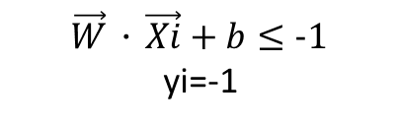
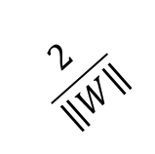
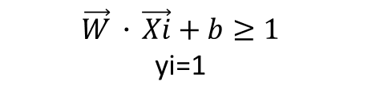

$$\vec{W}．\vec{Xi}+b≥1$$
yi=1
Margin
$$\frac{2}{\left\|W\right\|}$$
$$\vec{W}．\vec{Xi}+b≤−1$$
yi=-1
$$w^{T}x+b=1$$
$$w^{T}x+b=0$$
$w^{T}x+b=−$1

Slide 7
Margin
+1
-1
Support Vector
$$w^{T}x+b=1$$
$$w^{T}x+b=0$$
$w^{T}x+b=−$1
Hyperplane

Slide 8



+1
$$ε$$
$$ε=1−yi(\vec{W}．\vec{Xi}+b)$$
$$ε≥0$$
-1
$$ε$$
$$w^{T}x+b=1$$
$$w^{T}x+b=0$$
$w^{T}x+b=−$1

Slide 9
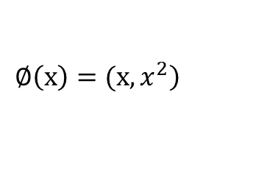
一維轉二維
$$\left.∅\left(x\right)=(x,x^{2}\right)$$

