Slide 1
捲積特性
捲積加速運算

Slide 2
Convolution
5 * 5 * 3
3 * 3 * 3
3 * 3

Slide 3
0 | 0 | 0 | 0 | 0 | 0 | 0
0 |  |  |  |  |  | 0
0 |  |  |  |  |  | 0
0 |  |  |  |  |  | 0
0 |  |  |  |  |  | 0
0 |  |  |  |  |  | 0
0 | 0 | 0 | 0 | 0 | 0 | 0
Convolution
3 * 3 Filter
5 * 5 Feature Map
7 * 7 Input

Slide 5
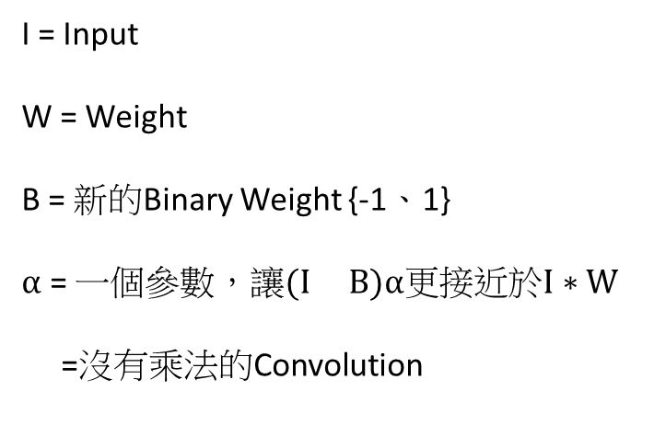

$$I∗W≈(I B)α$$
I = Input
W = Weight
B = 新的Binary Weight {-1、1}
$α$ = 一個參數，讓$(I B)α$更接近於$I∗W$
=沒有乘法的Convolution

Slide 6








J($B,α)={||W−αB||}^{2}$
J($B,α)=(W−αB){(W−αB)}^{T}$
J($B,α)=$ $(W−αB)$($W^{T}−$ $α^{T}B^{T}$)
J($B,α)=W^{T}W−$ 2$αBW^{T}$ $+ α^{2}BB^{T}$
J($B,α)=C−$ 2$αBW^{T}$ $+ α^{2}N$
$\frac{∂J}{∂α}=C−$ 2$αBW^{T}$ $+α^{2}N$
-2$BW^{T}+2αN$ = 0
$α^{1}$= $\frac{BW^{T}}{N}$ = $\frac{W^{T}sign(W)}{N}$ = $\frac{1}{N}{||W||}_{L1}$

Slide 7
-0.2 | 2.3 | -2.3 | 5.6 | -4.5 | 3.2
5.9 | 3.6 | -9.8 | 3.6 | -3.3 | -2.4
-4.2 | 3.2 | 2.7 | 2.8 | -9.7 | 3.1
2.1 | -6.3 | -6.2 | -4.5 | -8.4 | -6.2
-3.5 | 1.5 | -3.4 | 4.5 | -6.8 | 3.4
-3.8 | 6.4 | 5.4 | 5.1 | 6.7 | 2.8
-1 | 1 | -1 | 1 | 1 | -1 | -1 | 1 | 1
-1 | -1 | -1 | 1 | -1 | 1 | 1 | 1 | 1
Xnor
1 | -1 | 1 | 1 | -1 | -1 | -1 | 1 | 1
-1 | 1 | -1 | 1 | -1 | 1
1 | 1 | -1 | 1 | -1 | -1
-1 | 1 | 1 | 1 | -1 | 1
1 | -1 | -1 | -1 | -1 | -1
-1 | 1 | -1 | 1 | -1 | 1
-1 | 1 | 1 | 1 | 1 | 1
-1 | -1 | -1
1 | -1 | 1
1 | 1 | 1
= 1

Slide 8
0 | 1 | 0 | 1 | 1 | 0 | 0 | 1 | 1
0 | 0 | 0 | 1 | 0 | 1 | 1 | 1 | 1
Xnor
1 | 0 | 1 | 1 | 0 | 0 | 0 | 1 | 1

Slide 9
Conv
Bnorm
Act
Pooling
CNN
Bnorm
Act
Conv
Pooling
Xnor-Net

