Slide 1
G Code Manager
Piotr „PiDi” Demski
p.demski@veritech.pl

Slide 2
Table of contents
GCM Basics
Quick Start
Where to report bugs

Slide 3
GCM Basics

Slide 4
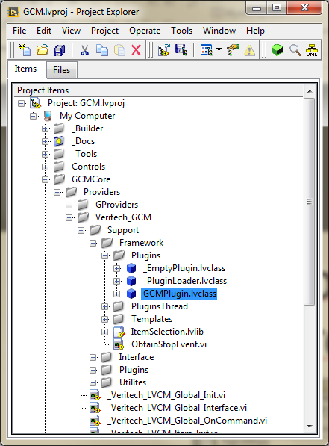
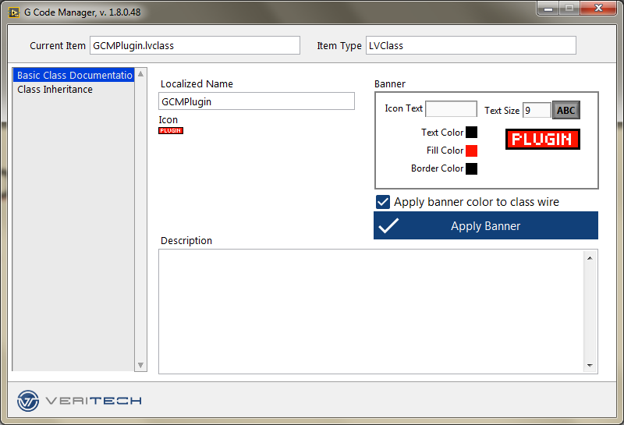
Idea
To make common operations with LV Project Items more accessible

Slide 5
HOW
Immediate access to any properties, like icon, documentation, inheritance tree...
Non-blocking windows
Using Project Providers framework
CLICK!

Slide 6
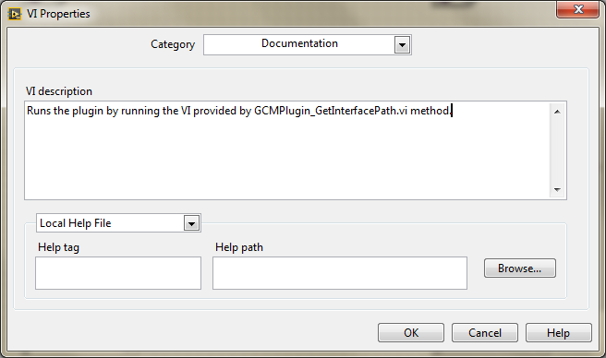
What
Basic VI documentation
The VI properties window is modal…

Slide 7
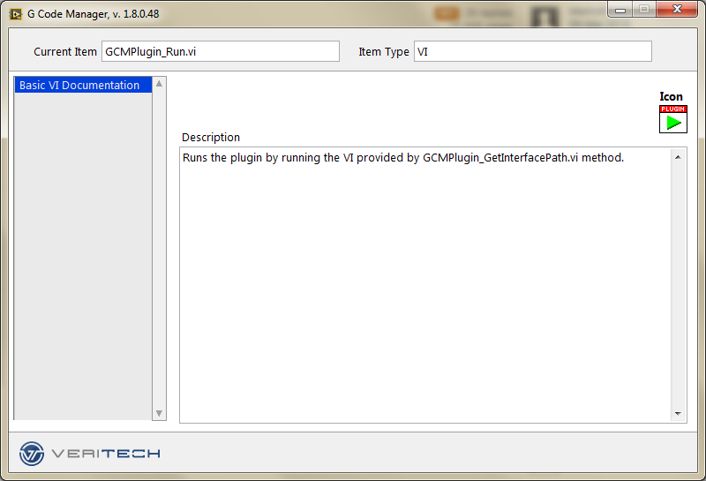
WHAT
Double-click for Icon Editor
Basic VI documentation plugin
Available for VIs/controls
Non-modal window!
Description

Slide 8
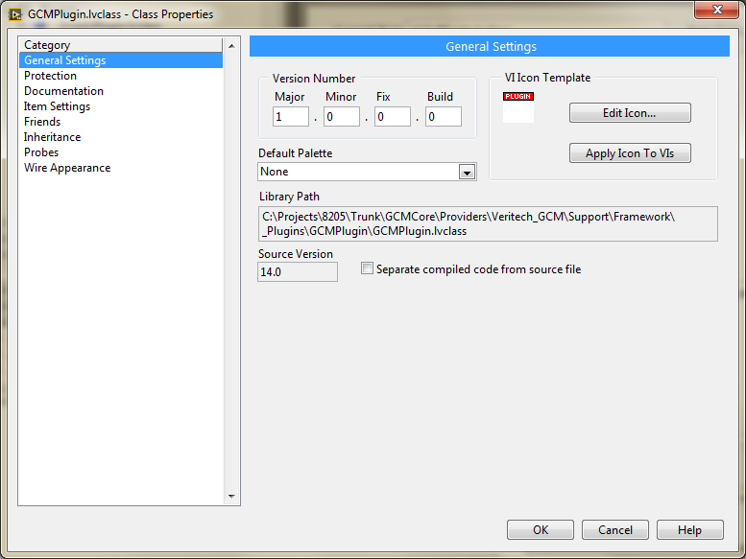
What
Basic class documentation
The class properties window is modal
And it can take ages to load

Slide 9
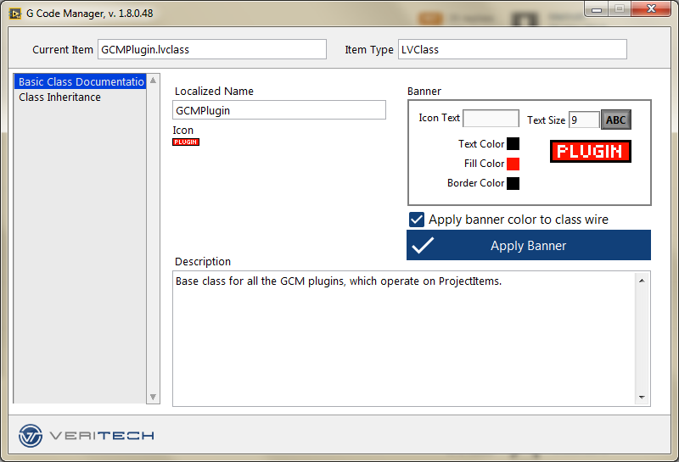
WHAT
Basic Class Documentation plugin
Available for classes
Non-modal window!
No loading time!
Double-click for Icon Editor
Simple banner editor
Description

Slide 10
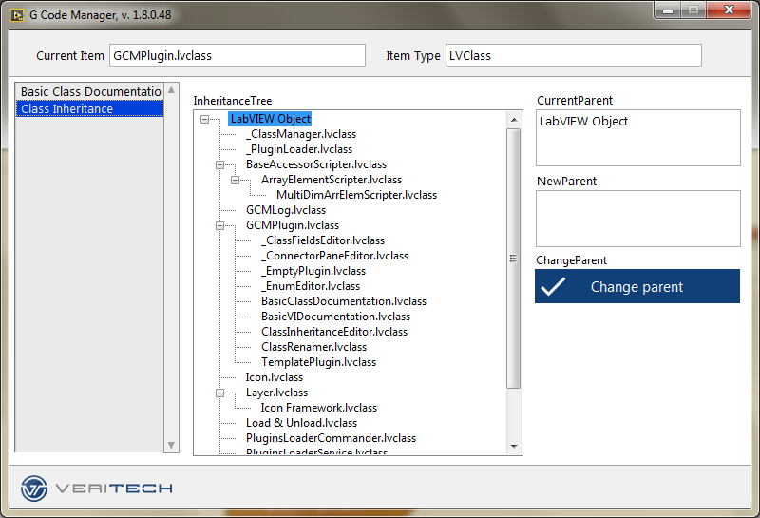
WHAT
Class Inheritance plugin
Available for classes
Non-modal window!
No loading time!

Slide 11
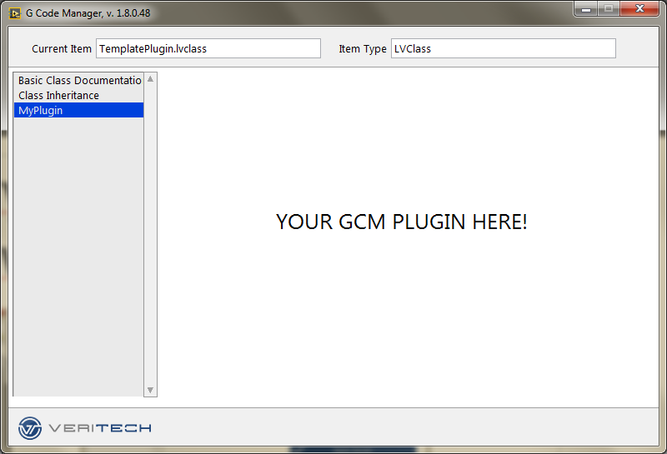
The goal
To give everyone an easy way to customize their working environment

Slide 12
THE FUTURE
Stabilizing the core
This tool was made using some internal LV APIs which are not fully tested and documented
It is in very early stage when it comes to stability
It may cause LV to crash!
I strongly advise using source control – if you’re not using one, do not even install this tool!
Extending basic functionality
Mirroring most important items from VIs/Classes property windows
Giving everyone the opportunity to add their plugins
Creating one-click tool to create the new plugin
Keeping the plugin API as simple as it is now

Slide 13
Quick Start

Slide 14
Important notice
This tool was made using some internal LV APIs which are not fully tested and documented
It is in very early stage when it comes to stability
It may cause LV to crash!
I strongly advise using source control – if you’re not using one, do not even install this tool!

Slide 15
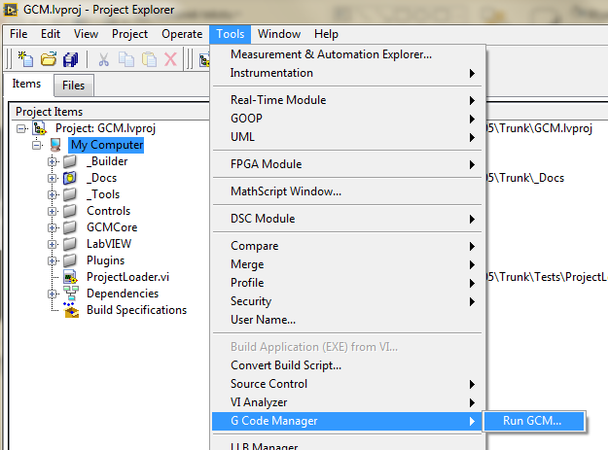
Opening GCM
In the Project Explorer window click on the Tools menu, then select G Code Manager -> Run GCM…

Slide 16
PluginS

Slide 17
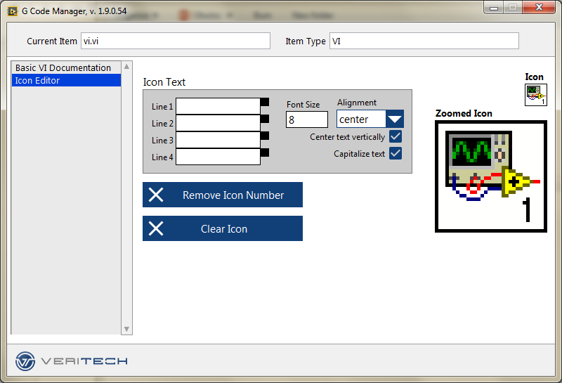
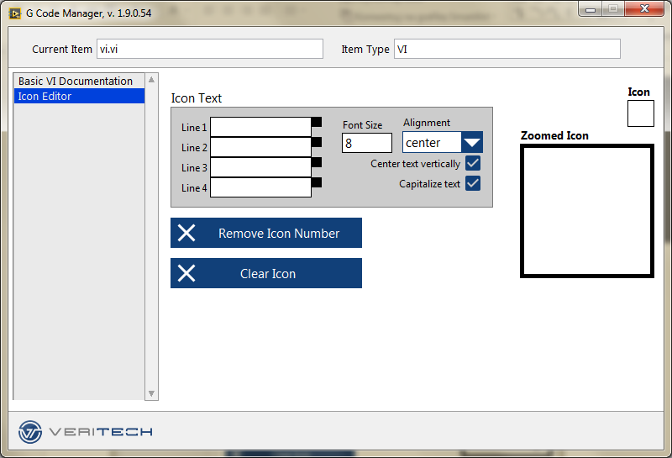
Icon Editor – VI
Click Clear Icon to remove current VI icon

Slide 18
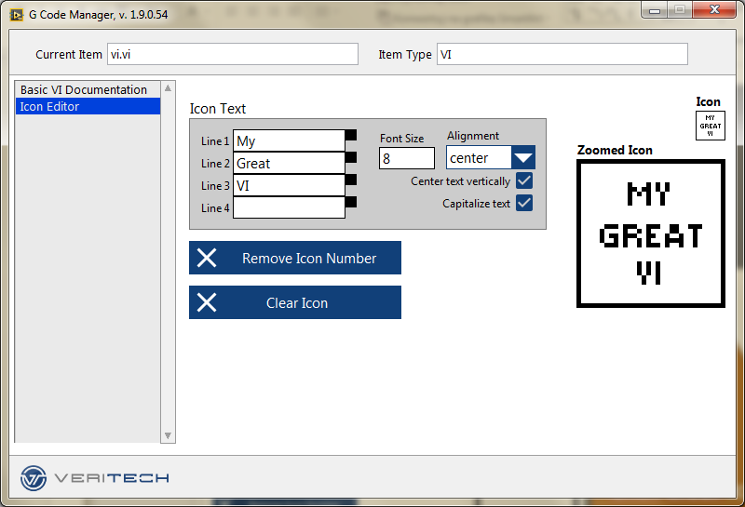
Icon Editor – VI
Edit VI text

Slide 19
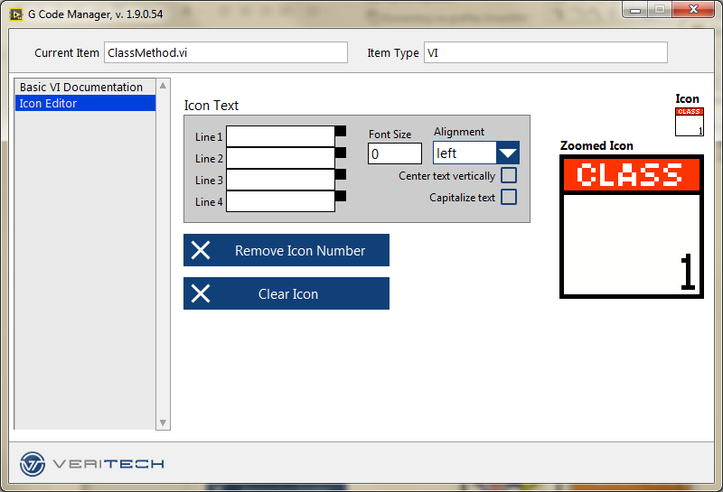
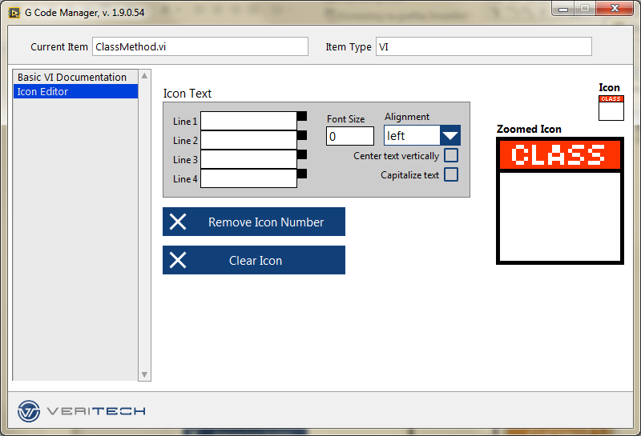
Icon Editor – Class member VI
Click Clear Icon to remove current VI icon; the class banner (NI_Library layer) will be preserved

Slide 20
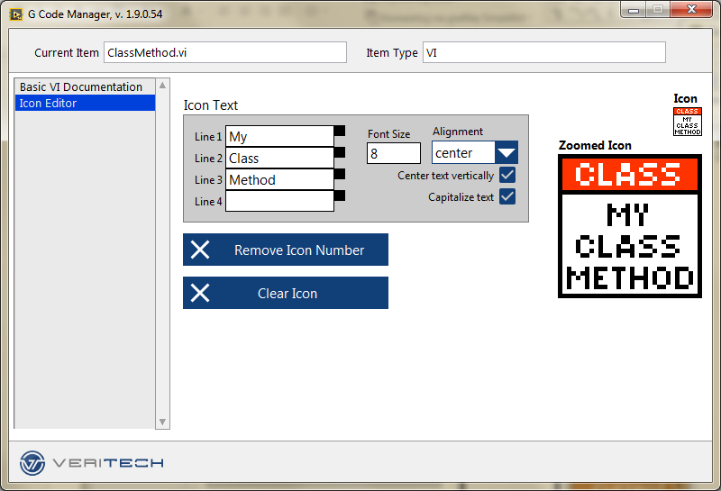
Icon Editor – Class member VI
Edit VI text

Slide 21
Creating plugins

Slide 22
Your own plugin
Create your own plugin: copy the template
From:
<LV>\resource\Framework\Providers\Veritech_GCM\Support\Templates\TemplatePlugin
To:
<LV>\resource\Framework\Providers\Veritech_GCM\Support\Plugins
Tip: do this from project window to preserve the dependecy to GCMPlugin class (create new project, add TemplatePlugin, then copy it using right-click menu)
Edit the plugin VIs, do whatever you want with your Project Items!
Interesting points are marked in bookmark manager with #GCMTemplatePlugin

Slide 23
Your own plugin
Edit GCMPlugin_GetPluginName.vi, so it returns proper name for your plugin.
Edit GCMPlugin_IsSupportingItem.vi, so it return True if the item is supported by your plugin
e.g. If your plugin supports editing VI description, you should check if VI Reference provided to IsSupportingItem.vi is valid.
Edit GCMPlugin_GetInterfacePath.vi, so it returns the path to your plugin interface VI. GCM will show this VIs Front Panel when the plugin is selected by User.
Edit your Interface VI:
Check the #GCMTemplatePlugin tags
Refer to GCM Plugin Workflow to see when the events are fired.

Slide 24
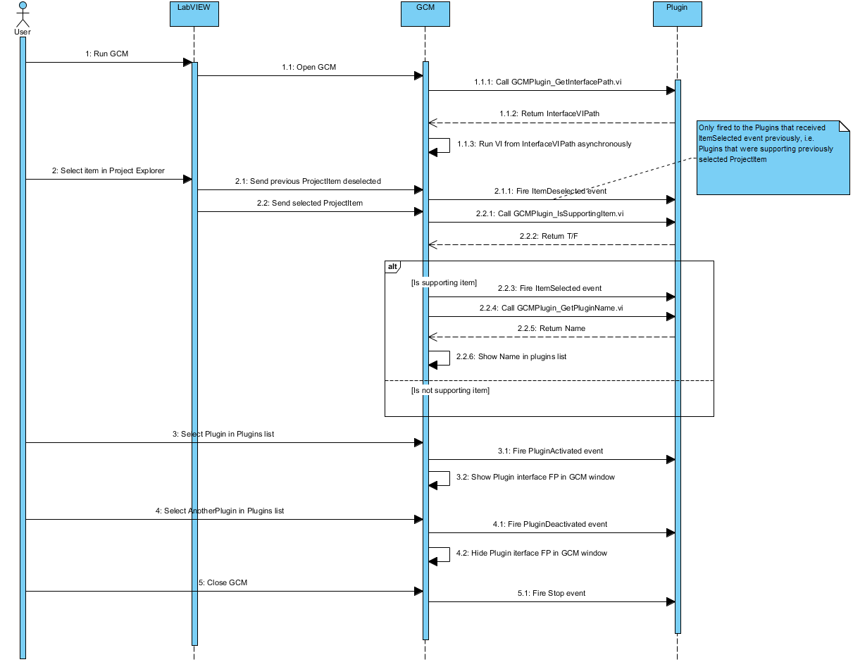
GCM Plugin Workflow

Slide 25
Where to report bugs

Slide 26
Where to report bugs
If you have any problems with this tool, please report it in the lavag topic: https://lavag.org/topic/19548-g-code-manager/
You can also contact me directly at p.demski@veritech.pl

Slide 27
Thank you
Piotr „PiDi” Demski
p.demski@veritech.pl

