Slide 1
第8章 中央处理器（2）
第一讲 中央处理器概述
第二讲 单周期数据通路的设计
第三讲 单周期控制器的设计
第四讲 多周期处理器的设计
第五讲 流水线处理器设计
第六讲 流水线冒险及其处理
第七讲 高级流水线技术
Notes:
Start X:40

Slide 2
第五讲 流水线数据通路和控制
主 要 内 容
日常生活中的流水线处理例子：洗衣服
单周期处理器模型和流水线性能比较
什么样的指令集适合于流水线方式执行
如何设计流水线数据通路
  以RV32I子集来说明
如何设计流水线控制逻辑
  分析每条指令执行过程中的控制信号
  给出控制器设计过程
流水线冒险的概念

Slide 3
一个日常生活中的例子—洗衣服
Laundry Example
  A, B, C, D四个人每人有一批衣服需要 wash, dry, fold
  Washer takes 30 minutes
  Dryer takes 40 minutes
  “Folder” takes 20 minutes
A
B
C
D
洗衣店只有一台洗衣机，一台干衣机，一个负责folder的员工。
如果让你来管理洗衣店，你会如何安排？
Pipelining: It’s Natural !

Slide 4
Sequential Laundry（串行方式）
6 PM
7
8
9
10
11
Midnight
Time
30
40
20
30
40
20
30
40
20
30
40
20
T
a
s
k
O
r
d
e
r
A
B
C
D
串行方式下， 4 批衣服需要花费 6 小时（4x(30+40+20)=360分钟）
N批衣服，需花费的时间为Nx(30+40+20) = 90N
如果用流水线方式洗衣服，则花多少时间呢?

Slide 5
Pipelined Laundry: (Start work ASAP)
6 PM
7
8
9
10
11
Midnight
Time
30
40
40
40
40
20
T
a
s
k
O
r
d
e
r
串行为90分钟x4=6小时
N批则为90xN分钟
A
B
流水线方式下，需30+4x40+20
=210分 (3.5小时)
如果有N批衣服呢？
30+Nx40+20分钟
假定每一步时间均衡，当N很大的时候，流水线比串行方式提高约3倍！
C
D
流水方式下，所用时间主要与最长阶段的时间有关！

Slide 6
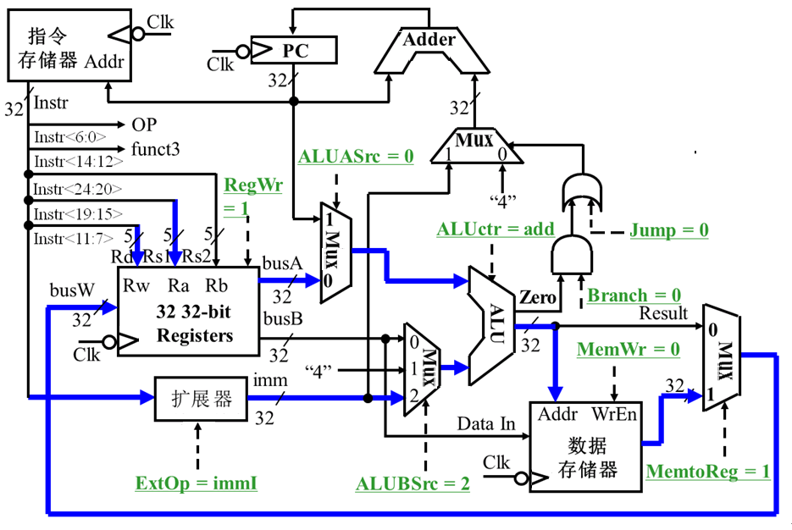
回顾：单周期数据通路中的关键路径
Load操作：
R[rd] ← M[R[rs1]+imm]
寄存器组和理想存储器的定时方式
  写操作时，作为时序逻辑电路。即：
    时钟到达前，输入需setup；时钟到达后经Clk-to-Q，写入数据到达输出端
  读操作时，作为组合逻辑电路。即：
    地址有效后经过 “access time”，输出开始有效
Critical Path (Load Operation) =
PC’s prop time (Clk-to-Q) +
Instruction Memory’s Access Time +
Register File’s Access Time +
ALU to Perform a 32-bit Add +
Data Memory Access Time +
Setup Time for Register File Write +
Clock Skew
Notes:
Now with the clocking methodology back in your mind, we can think about how the critical path of our “abstract” datapath may look like.
One thing to keep in mind about the Register File and Ideal Memory (points to both Instruction and Data) is that the Clock input is a factor ONLY during the write operation.
For read operation, the CLK input is not a factor. The register file and the ideal memory behave as if they are combinational logic.
That is you apply an address to the input, then after certain delay, which we called access time, the output is valid.
We will come back to these points (point to the “behave” bullets) later in this lecture.
But for now, let’s look at this “abstract” datapath’s critical path which occurs when the datapath tries to execute the Load instruction.
The time it takes to execute the load instruction are the sum of:
(a) The PC’s clock-to-Q time.
(b) The instruction memory access time.
(c) The time it takes to read the register file.
(d) The ALU delay in calculating the Data Memory Address.
(e) The time it takes to read the Data Memory.
(f) And finally, the setup time for the register file and clock skew.
+3 = 21 (Y:01)
Complement:
Clock skew(B-40):

Slide 7
复习：Load指令的5个阶段
阶段1
阶段2
阶段 3
阶段 4
阶段5
Ifetch
Reg/Dec
Exec
Mem
Wr
Ifetch (取指) : 取指令并计算PC+4 (用到哪些部件？)
Reg/Dec (取数和译码) : 取数同时译码 (用到哪些部件？)
Exec (执行) : 计算内存单元地址 (用到哪些部件？)
Mem (读存储器) : 从数据存储器中读 (用到哪些部件？)
Wr(写寄存器): 将数据写到寄存器中 (用到哪些部件？)
  指令存储器、Adder
寄存器堆读口、指令译码器
这里寄存器堆的读口和写口可看成两个不同的部件。
  扩展器、ALU
数据存储器
  寄存器堆写口
指令的执行过程是否和“洗衣”过程类似？是否可以采用类似方式来执行指令呢？
Notes:
As shown here, each of these five steps will take one clock cycle to complete.
And in pipeline terminology, each step is referred to as one stage of the pipeline.
+1 = 8 min. (X:48)

Slide 8
单周期指令模型与流水模型的性能比较
假定以下每步操作所花时间为：
    取指：2ns
    寄存器读：1ns
    ALU操作：2ns
    存储器读：2ns
    寄存器写：1ns
单周期模型
  每条指令在一个时钟周期内完成
  时钟周期等于最长的lw指令的执行时间，即：8ns
  串行执行时，N条指令的执行时间为：8Nns
流水线性能
  时钟周期等于最长阶段所花时间为：2ns
  每条指令的执行时间为： 2nsx5=10ns
  N条指令的执行时间为：(4+N)x2ns
  在N很大时，比串行方式提高约 4 倍
  若各阶段操作均衡(例如，各阶段都是2ns)，则提高倍数为5倍。
Load指令执行时间总计为：8ns
(假定控制单元、PC访问、信号传递等没有延迟)
流水线方式下，单条指令执行时间不能缩短，但能大大提高指令吞吐率！

Slide 9
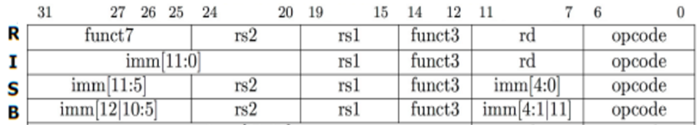
流水线指令集的设计
具有什么特征的指令集有利于流水线执行呢？
  长度尽量一致，有利于简化取指令和指令译码操作
    RV32I指令32位，下址计算方便: PC+4
    X86指令从1字节到17字节不等，使取指部件极其复杂
  格式少，且源寄存器位置相同，有利于在指令未知时就可取操作数
    RV32I指令的rs1和rs2编码位置固定，在指令译码时就可读其值
    若位置随指令不同而不同，则需先确定指令类型才能取寄存器编号
  load / Store指令才能访存，有利于减少操作步骤，规整流水线
    lw/sw指令的地址计算和运算指令的执行步骤规整在同一个周期
    X86运算类指令的操作数可为内存数据，需计算地址、访存、执行
  内存中”对齐”存放，有利于减少访存次数和流水线的规整
  总之，规整、简单和一致等特性有利于指令的流水线执行

Slide 10
R-type指令的4个阶段
例：add rd, rs1, rs2
Cycle 1
Cycle 2
Cycle 3
Cycle 4
R-type
Ifetch
Reg/Dec
Exec
Wr
Ifetch: 取指令并计算PC+4（写入PC）
Reg/Dec: 从寄存器（rs1和rs2）取数，同时指令在译码器进行译码
Exec: 在ALU中对操作数进行计算
Wr: ALU计算的结果写到寄存器（rd）
Notes:
Well, so far so good. Let’s take a look at the R-type instructions.
The R-type instruction does NOT access data memory so it only takes four clock cycles, or in our new pipeline terminology, four stages to complete.
The Ifetch and Reg/Dec stages are identical to the Load instructions. Well they have to be because at this point, we do not know we have a R-type instruction yet.
Instead of calculating the effective address during the Exec stage, the R-type instruction will use the ALU to operate on the register operands.
The result of this ALU operation is written back to the register file during the Wr back stage.
+1 = 15 min. (55)

Slide 11
Load指令的流水线
Cycle 1
Cycle 2
Cycle 3
Cycle 4
Cycle 5
Cycle 6
Cycle 7
Clock
1st lw
Ifetch
Reg/Dec
Exec
Mem
Wr
2nd lw
Ifetch
Reg/Dec
Exec
Mem
Wr
3rd lw
Ifetch
Reg/Dec
Exec
Mem
Wr
4rd lw
Ifetch
Reg/Dec
Exec
Mem
Wr
5rd lw
Ifetch
Reg/Dec
Exec
Mem
Wr
每个周期有五个功能部件同时在工作
后面指令在前面完成取指后马上开始
每个load指令仍然需要五个周期完成
但是，吞吐率(throughput)提高许多，理想情况下：
  每个周期有一条指令进入流水线
  每个周期都有一条指令完成
  每条指令的有效周期(CPI)为1
多周期中第二周期投机只能给一个指令用，或者lw/sw或者beq。流水线中可取消投机而不影响CPI
Notes:
For the load instructions, the five independent functional units in the pipeline datapath are:
(a) Instruction Memory for the Ifetch stage.
(b) Register File’s Read ports for the Reg/Decode stage.
(c) ALU for the Exec stage. (d) Data memory for the Mem stage.
(e) And finally Register File’s write port for the Write Back stage.
Notice that I have treated Register File’s read and write ports as separate functional units because the register file we have allows us to read and write at the same time.
Notice that as soon as the 1st load finishes its Ifetch stage, it no longer needs the Instruction Memory. Consequently, the 2nd load can start using the Instruction Memory (2nd Ifetch).
Furthermore, since each functional unit is only used ONCE per instruction, we will not have any conflict down the pipeline (Exec-Ifet, Mem-Exec, Wr-Mem) either.
I will show you the interaction between instructions in the pipelined datapath later. But for now, I want to point out the performance advantages of pipelining.
If these 3 load instructions are to be executed by the multiple cycle processor, it will take 15 cycles. But with pipelining, it only takes 7 cycles. This (7 cycles), however, is not the best way to look at the performance advantages of pipelining.
A better way to look at this is that we have one instruction enters the pipeline every cycle so we will have one instruction coming out of the pipeline (Wr stages) every cycle.
Consequently, the “effective” (or average) number of cycles per instruction is now ONE even though it takes a total of 5 cycles to complete each instruction.
+3 = 14 min. (X:54)

Slide 12
含R-type和 Load 指令的流水线
Cycle 1
Cycle 2
Cycle 3
Cycle 4
Cycle 5
Cycle 6
Cycle 7
Cycle 8
Cycle 9
Clock
R-type
Ifetch
Reg/Dec
Exec
Wr
We have a problem!
R-type
Ifetch
Reg/Dec
Exec
Wr
Load
Ifetch
Reg/Dec
Exec
Mem
Wr
R-type
Ifetch
Reg/Dec
Exec
Wr
R-type
Ifetch
Reg/Dec
Exec
Wr
上述流水线有个问题: 两条指令试图同时写寄存器，因为
  Load在第5阶段用寄存器写口
  R-type在第4 阶段用寄存器写口
把一个功能部件同时被多条指令使用的现象称为结构冒险(Struture Hazard)
为了流水线能顺利工作，规定：
  每个功能部件每条指令只能用一次（如：写口不能用两次或以上）
  每个功能部件必须在相同的阶段被使用（如：写口总是在第五阶段被使用）
或称为资源冲突！
Notes:
What happened if we try to pipeline the R-type instructions with the Load instructions?
Well, we have a problem here!!!
We end up having two instructions trying to write to the register file at the same time!
Why do we have this problem (the write “bubble”)?
Well, the reason for this problem is that there is something I forget to tell you.
+1 = 16 min. (X:56)

Slide 13
R-type的Wr操作延后一个周期执行
NOP!
1
2
3
4
5
R-type
Ifetch
Reg/Dec
Exec
Mem
Wr
加一个NOP阶段以延迟“写”操作:
  把“写”操作安排在第5阶段, 这样使R-Type的Mem阶段为空NOP
Clock
Cycle 1
Cycle 2
Cycle 3
Cycle 4
Cycle 5
Cycle 6
Cycle 7
Cycle 8
Cycle 9
R-type
Ifetch
Reg/Dec
Exec
Mem
Wr
R-type
Ifetch
Reg/Dec
Exec
Mem
Wr
Load
Ifetch
Reg/Dec
Exec
Mem
Wr
R-type
Ifetch
Reg/Dec
Exec
Mem
Wr
R-type
Ifetch
Reg/Dec
Exec
Mem
Wr
这样使流水线中的每条指令都有相同多个阶段!
Notes:
Well one thing we can do is to add a “Nop” stage to the R-type instruction pipeline to delay its register file write by one cycle.
Now the R-type instruction ALSO uses the register file’s witer port at its 5th stage so we eliminate the write conflict with the load instruction.
This is a much simpler solution as far as the control logic is concerned. As far as performance is concerned, we also gets back to having one instruction completes per cycle.
This is kind of like promoting socialism: by making each individual R-type instruction takes 5 cycles instead of 4 cycles to finish, our overall performance is actually better off.
The reason for this higher performance is that we end up having a more efficient pipeline.
+1 = 20 min. (Y:00)

Slide 14
Store指令的四个阶段
例：sw rs2, rs1(imm12)
Cycle 1
Cycle 2
Cycle 3
Cycle 4
NOP!
Store
Ifetch
Reg/Dec
Exec
Mem
Wr
Ifetch：取指令并计算PC+4 （写入PC）
Reg/Dec： 从寄存器（rs1）取数，同时指令在译码器进行译码
Exec：12位立即数（imm12）符号扩展后与寄存器值（ rs1 ）相加，计算主存地址
Mem：将寄存器（rs2）读出的数据写到主存
Wr: 加一个空的写阶段，使流水线更规整！
Notes:
Let’s continue our lecture by looking at the store instruction.
Once again, the Ifetch and Reg/Decode stages are the same as all other instructions.
The Exec stage of the store instruction calculates the memory address.
Once the address is calculated, the store instruction will write the data it read from the register file back at the Reg/Decode stage into the data memory during the Mem stage.
Notice that unlike the load instruction which takes five cycles to accomplish its task, the Store instruction only takes four cycles or four pipe stages.
In order to keep our pipeline diagram looks more uniform, however, we will keep the Wr stage for the store instruction in the pipeline diagram.
But keep in mind that as far as the pipelined control and pipelined datapath are concerned, the store instruction requires NOTHING to be done once it finishes its Mem stage.
+2 = 27 min. (Y:07)

Slide 15
I-type的运算类型指令
例：ori rd, rs1,imm12
NOP!
1
2
3
4
5
Ifetch
Reg/Dec
Exec
Mem
Wr
Ifetch：取指令并计算PC+4 （写入PC）
Reg/Dec： 从寄存器（rs1）取数，同时指令在译码器进行译码
Exec：使用ALU完成12位立即数（imm12）符号扩展后与寄存器值（ rs1 ）的运算（or）
Mem：空阶段
Wr: ALU计算的结果写到寄存器（rd）
Notes:
Well one thing we can do is to add a “Nop” stage to the R-type instruction pipeline to delay its register file write by one cycle.
Now the R-type instruction ALSO uses the register file’s witer port at its 5th stage so we eliminate the write conflict with the load instruction.
This is a much simpler solution as far as the control logic is concerned. As far as performance is concerned, we also gets back to having one instruction completes per cycle.
This is kind of like promoting socialism: by making each individual R-type instruction takes 5 cycles instead of 4 cycles to finish, our overall performance is actually better off.
The reason for this higher performance is that we end up having a more efficient pipeline.
+1 = 20 min. (Y:00)

Slide 16
U-type的运算类型指令
例：lui rd, imm20
NOP!
1
2
3
4
5
U-type
Ifetch
Reg/Dec
Exec
Mem
Wr
Ifetch：取指令并计算PC+4 （写入PC）
Reg/Dec： 指令在译码器进行译码
Exec：将20位立即数（imm20）末尾补0后形成32位数据直接送到ALU输出端
Mem：空阶段
Wr: ALU输出端的结果写到寄存器（rd）
Notes:
Well one thing we can do is to add a “Nop” stage to the R-type instruction pipeline to delay its register file write by one cycle.
Now the R-type instruction ALSO uses the register file’s witer port at its 5th stage so we eliminate the write conflict with the load instruction.
This is a much simpler solution as far as the control logic is concerned. As far as performance is concerned, we also gets back to having one instruction completes per cycle.
This is kind of like promoting socialism: by making each individual R-type instruction takes 5 cycles instead of 4 cycles to finish, our overall performance is actually better off.
The reason for this higher performance is that we end up having a more efficient pipeline.
+1 = 20 min. (Y:00)

Slide 17
Beq的四个阶段
例：beq rs1, rs2, imm12
Cycle 1
Cycle 2
Cycle 3
Cycle 4
NOP!
Beq
Ifetch
Reg/Dec
Exec
Mem
Wr
Ifetch: 取指令并计算PC+4 （写入PC，但后续可能需要修改PC）
Reg/Dec:从寄存器（rs1，rs2）取数，同时指令在译码器进行译码
Exec: 执行阶段
  ALU中比较两个寄存器（rs1，rs2）的大小（做减法）
  Adder中计算转移地址（PC+SEXT（imm12）<<1）
Mem: 如果比较相等, 则：
  转移目标地址写到PC
Wr: 加一个空写阶段，使流水线更规整！
Notes:
Well similar to the store instruction, the branch instruction only consists of four pipe stages.
Ifetch and Reg/decode are the same as all other instructions because we do not know what instruction we have at this point. We have not finish decoding the instruction yet.
During the Execute stage of the pipeline, the BEQ instruction will use the ALU to compare the two register operands it fetched during the Reg/Dec stage.
At the same time, a separate adder is used to calculate the branch target address.
This is difference from M-cycle processor where target address is calculated by ALU but at the 2nd cycle.
If the registers we compared during the Execute stage (point to the last bullet) have the same value, the branch is taken.
That is, the branch target address we calculated earlier (last bullet) will be written into the Program Counter.
Once again, similar to the Store instruction, the BEQ instruction will require NEITHER the pipelined control nor the pipelined datapath to do ANY thing once it finishes its Mem stage.
With all these talk about pipelined datapath and pipelined control, let’s take a look at how the pipelined datapath looks like.
+2 = 29 min. (Y:09)

Slide 18
J型的四个阶段
例：jal rd, imm20
Cycle 1
Cycle 2
Cycle 3
Cycle 4
jal
Ifetch
Reg/Dec
Exec
Mem
Wr
Ifetch: 取指令并计算PC+4 （写入PC ，但后续肯定需要修改PC ）
Reg/Dec:从寄存器取数，同时指令在译码器进行译码
Exec: 执行阶段
  ALU中计算PC+4（准备写入rd）
  Adder中计算转移地址（PC+SEXT（imm20）<<1）
Mem:把转移地址写入PC
Wr: 把ALU运算结果（PC+4）写入rd，
按照上述方式，把所有指令都按照最复杂的“load”指令所需的五个阶段来划分，不需要的阶段加一个“NOP”操作
Notes:
Well similar to the store instruction, the branch instruction only consists of four pipe stages.
Ifetch and Reg/decode are the same as all other instructions because we do not know what instruction we have at this point. We have not finish decoding the instruction yet.
During the Execute stage of the pipeline, the BEQ instruction will use the ALU to compare the two register operands it fetched during the Reg/Dec stage.
At the same time, a separate adder is used to calculate the branch target address.
This is difference from M-cycle processor where target address is calculated by ALU but at the 2nd cycle.
If the registers we compared during the Execute stage (point to the last bullet) have the same value, the branch is taken.
That is, the branch target address we calculated earlier (last bullet) will be written into the Program Counter.
Once again, similar to the Store instruction, the BEQ instruction will require NEITHER the pipelined control nor the pipelined datapath to do ANY thing once it finishes its Mem stage.
With all these talk about pipelined datapath and pipelined control, let’s take a look at how the pipelined datapath looks like.
+2 = 29 min. (Y:09)

Slide 19
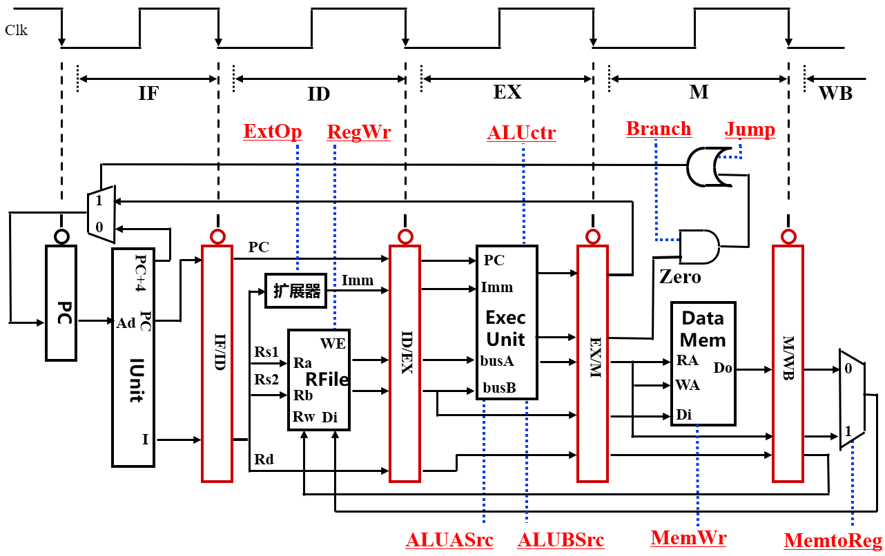
A Pipelined Datapath（五阶段流水线数据通路）
Clock-to-Q delay
不包含控制逻辑
WB段的执行逻辑包含Rfile的写口！
为何要这些寄存器？
保存每个周期执行的结果!
属于内部寄存器，对程序员透明，无需作为现场保存！
下面介绍每条指令在流水线通路中的执行过程
Notes:
The pipelined datapath consists of combination logic blocks separated by pipeline registers. If you get rid of all these registers (not the PC), this pipelined datapath is reduced to the single-cycle datapath.
This should give you extra incentive to do a good job on your single cycle processor design homework because you can build your pipeline design based on your single cycle design.
Anyway, the registers mark the beginning and the end of a pipe stage.
In the multiple clock cycle lecture, I recommended that the best way to think about a logic clock cycle is that it begins slightly after the clock tick and ends right at the next clock tick.
For example here, the Reg/Decode stage begins slightly after this clock tick when the output of the IF/ID register has stabilized to its new value AND ends RIGHT at the next clock tick when the output of the register file is clocked into the ID/Exec register.
At the end of the Reg/Decode stage, the register output that just clocked into the ID/Exec register has NOT yet propagate to the register output yet. It takes a Clk-to-Q delay.
When the new value we just clocked in (points to the clock tick) has propagate to the register output, then we have reach the beginning of the Exec stage.
Notice that the Wr stage of the pipeline starts here (last cycle) but there is no corresponding datapath underneath it because the Wr stage of the pipeline is handled by the same part of the pipeline that handles the Register Read stage.
This part of the datapath (Reg File) is the only part that is used by more than one stage of the pipeline. This is OK because the register file has independent Read and Write ports.
More specifically, the Reg/Decode stage of the pipeline uses the register file’s read port while the Write Back stage of the pipeline uses the register file’s write port.
+3 = 32 min. (Y:12)

Slide 20
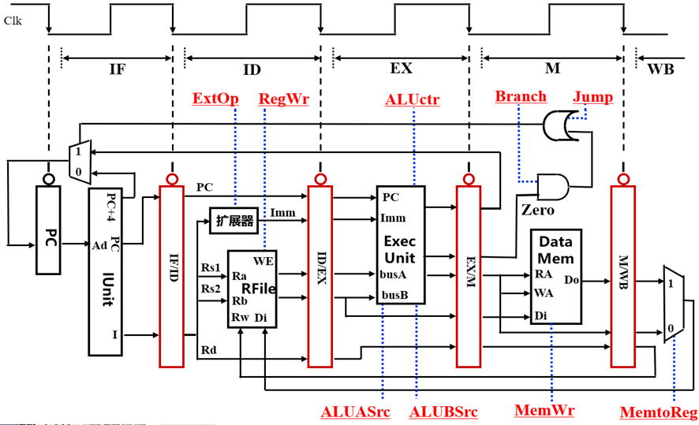
取指令（IF）阶段
第10单元指令: lw x8, 0x100(x9) 功能：R[x8] <- M[R[x9]+SEXT(0x100)]
You are here!
下一目标：设计IUnit（功能是啥？）
Notes:
The pipelined datapath consists of combination logic blocks separated by pipeline registers. If you get rid of all these registers (not the PC), this pipelined datapath is reduced to the single-cycle datapath.
This should give you extra incentive to do a good job on your single cycle processor design homework because you can build your pipeline design based on your single cycle design.
Anyway, the registers mark the beginning and the end of a pipe stage.
In the multiple clock cycle lecture, I recommended that the best way to think about a logic clock cycle is that it begins slightly after the clock tick and ends right at the next clock tick.
For example here, the Reg/Decode stage begins slightly after this clock tick when the output of the IF/ID register has stabilized to its new value AND ends RIGHT at the next clock tick when the output of the register file is clocked into the ID/Exec register.
At the end of the Reg/Decode stage, the register output that just clocked into the ID/Exec register has NOT yet propagate to the register output yet. It takes a Clk-to-Q delay.
When the new value we just clocked in (points to the clock tick) has propagate to the register output, then we have reach the beginning of the Exec stage.
Notice that the Wr stage of the pipeline starts here (last cycle) but there is no corresponding datapath underneath it because the Wr stage of the pipeline is handled by the same part of the pipeline that handles the Register Read stage.
This part of the datapath (Reg File) is the only part that is used by more than one stage of the pipeline. This is OK because the register file has independent Read and Write ports.
More specifically, the Reg/Decode stage of the pipeline uses the register file’s read port while the Write Back stage of the pipeline uses the register file’s write port.
+3 = 32 min. (Y:12)

Slide 21
取指令部件 IUnit的设计
第10单元指令: : lw x8, 0x100(x9) 随后的指令在14号单元中！
取指部件功能
You are here!
Instr <- Mem[PC]
PC<- PC+4
Clk
IF
ID
开始从14号单元取指！
1
0
这里MUX的控制信号由其他阶段产生！
“4”
流水段寄存器用来存放各阶段的执行结果
总是在下个时钟到来后的Clock-to-Q输出
Adder
PC = 14
10
IF/ID: lw x8, 0x100 (x9)
Address
PC 新值（14） ≠旧输出（10）
Instruction
Memory
应把哪些信息存到流水段寄存器IF/ID中？
Instruction
应保存后面阶段用到的指令和PC的值！
取指阶段有哪些控制信号？
不需控制信号，因为每条指令执行功能一样，是确定的，无需根据指令的不同来控制执行不同的操作！
指令在随后阶段被送出译码！
PC用来计算转移目标地址
Notes:
Let’s assume the Load instruction we are following is in memory location TEN, 10.
So the Ifetch stage begins shortly after the first clock tick when the value 10 appears on the Program Counter register output.
This is used as the address to access the Instruction Memory and at the same time it is fed to the adder so it can be increment by four.
At the end of the Ifetch stage, this clock tick will clock the output of the instruction memory, which is the Load instruction, into the If/ID pipeline register.
As the same time, the PC plus 4 value, that is 14 in this case, will be clocked into the PC.
Notice that the picture here shows the stage of the pipeline at the END of the Ifetch stage (you are here) so the number 14, even though is already latched into the register, will not appear at the PC output until Clk-to-Q time later.
Similarly, the load instruction we just clocked into the IF/ID register will NOT appear at the register output until a Clk-toQ delay after this clock.
And when it appears at the IF/iD register output, we will be in the Reg/Decode stage.
+2 = 35 min. (Y:15)

Slide 22
译码/取数（Reg/Dec）阶段
第10单元指令: lw x8, 0x100(x9) 功能：R[x8] <- M[R[x9]+SEXT(0x100)]
You are here!
RegWr是WB段的控制信号
指令还要存ID/EX中吗？
不要，只要存以下信息：
R[Rs1], R[Rs2], Rd, Imm, PC
该阶段有哪些控制信号？
ExtOP用于控制扩展器对立即数进行扩展。 ExtOP=000
Notes:
This picture shows the state of the pipeline at the end of Load’s Reg/Decode stage.
All the datapath has to do is read register (Ra and busA) R2 from the register file.
As the same time, we need to pass the Immediate field of the instruction onto the next stage (ID/Exec) register because the immediate field is needed for address calculation.
Let’s concentrate on the load instruction (point to the 1st bullet) going down the pipe and ignore what is in the PC and IF/ID registers for now.
Since we are here (Your are Here), Register R2 and Imm16 have already clocked into ID/Exec register but they have not yet appeared at the register’s output.
+1 = 36 min. (Y:16)

Slide 23
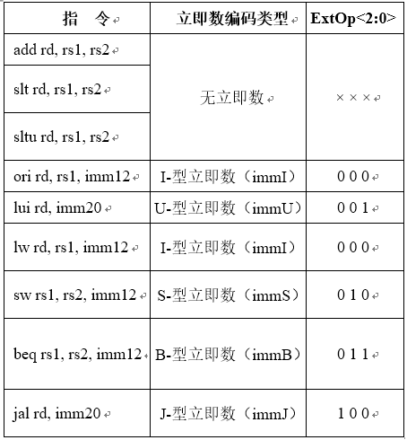
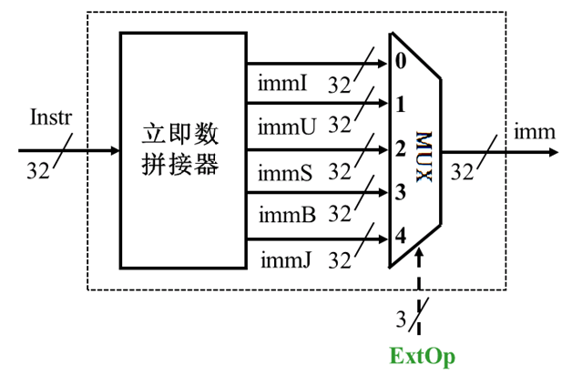
译码/取数（Reg/Dec）阶段
该阶段仅一个控制信号：ExtOP
You are here!
RegWr是WB段的控制信号
扩展器
Notes:
This picture shows the state of the pipeline at the end of Load’s Reg/Decode stage.
All the datapath has to do is read register (Ra and busA) R2 from the register file.
As the same time, we need to pass the Immediate field of the instruction onto the next stage (ID/Exec) register because the immediate field is needed for address calculation.
Let’s concentrate on the load instruction (point to the 1st bullet) going down the pipe and ignore what is in the PC and IF/ID registers for now.
Since we are here (Your are Here), Register R2 and Imm16 have already clocked into ID/Exec register but they have not yet appeared at the register’s output.
+1 = 36 min. (Y:16)

Slide 24
Load指令的地址计算阶段
第10单元指令: lw x8, 0x100(x9) 功能：R[x8] <- M[R[x9]+SEXT(0x100)]
You are here!
Zero
目的寄存器Rd不传递下去会怎样？
连接到错误的目的地址，指令执行错误！
下一目标：设计执行部件(Exec Unit)
Notes:
If we wait a little bit longer (beginning of Exe), Register R2 and Imm16 will appear at the ID/Exec register output and we are now in the Exec stage where we will calculate the Memory Address for the load instruction.
Notice that besides calculating the Load’s Memory Address, we also need to pass the Rt field (RegDst = 0) of the instruction down the pipeline.
The reason is that we will need to use Rt field later on to specify which register to write to when we reach the end of the Load pipeline.
Also notice that this is the first stage of the pipeline that requires any control signals.
We will talk more about this (Rt field and other control signals) later but for now, let’s expand this part of the datapath and take a closer look at what is going on.
+2 = 38 min. (Y:18)

Slide 25
执行部件（Exec Unit）的设计
执行部件功能是：ALU运算及内存地址和转移目标地址的计算
You are here!
Clk
EX
M
PC
32
Target
Adder
32
1
busA
Zero
ID/Ex
32
0
EX/M
ALUout
busB
ALU
32
0
32
“4”
1
Imm
32
2
32
2
4
ALUASrc
ALUBSrc
ALUctr
Notes:
At the beginning of the Exec cycle, ID/Exec register’s output will be stabilized to Register R2 (bus A) and Imm16.
By setting the control signals ExtOp and ALUSrc to 1s, the 16-bit immediate field will be sign extended to 32 bits and pass onto the ALU.
The ALU then add (ALUOp = Add) this sign extended version of the Immediate field to Register 2 (busA) to form the memory address.
By the end of the Exec cycle (you are here), the ALU output will be valid and will be stored into the Exec/Mem pipeline register.
This Memory Address (Exec/Mem) will appear at the output of the Exec/Mem register a Clk-to-Q time after this clock tick (you are here).
+1 = 39 min. (Y:19)

Slide 26
执行部件（Exec Unit）的设计：lw和sw
执行部件功能是：ALU计算内存地址
You are here!
Clk
EX
M
PC
32
Target
Adder
32
1
busA
Zero
ID/Ex
32
0
EX/M
ALUout
busB
ALU
32
0
32
“4”
1
Imm
32
2
32
2
4
ALUASrc=0
ALUBSrc=2
ALUctr=add
Notes:
At the beginning of the Exec cycle, ID/Exec register’s output will be stabilized to Register R2 (bus A) and Imm16.
By setting the control signals ExtOp and ALUSrc to 1s, the 16-bit immediate field will be sign extended to 32 bits and pass onto the ALU.
The ALU then add (ALUOp = Add) this sign extended version of the Immediate field to Register 2 (busA) to form the memory address.
By the end of the Exec cycle (you are here), the ALU output will be valid and will be stored into the Exec/Mem pipeline register.
This Memory Address (Exec/Mem) will appear at the output of the Exec/Mem register a Clk-to-Q time after this clock tick (you are here).
+1 = 39 min. (Y:19)

Slide 27
执行部件（Exec Unit）的设计：ori指令（I型）
执行部件功能是：ALU运算（or）
You are here!
Clk
EX
M
PC
32
Target
Adder
32
1
busA
Zero
ID/Ex
32
0
EX/M
ALUout
busB
ALU
32
0
32
“4”
1
Imm
32
2
32
2
4
ALUASrc=0
ALUBSrc=2
ALUctr=or
Notes:
At the beginning of the Exec cycle, ID/Exec register’s output will be stabilized to Register R2 (bus A) and Imm16.
By setting the control signals ExtOp and ALUSrc to 1s, the 16-bit immediate field will be sign extended to 32 bits and pass onto the ALU.
The ALU then add (ALUOp = Add) this sign extended version of the Immediate field to Register 2 (busA) to form the memory address.
By the end of the Exec cycle (you are here), the ALU output will be valid and will be stored into the Exec/Mem pipeline register.
This Memory Address (Exec/Mem) will appear at the output of the Exec/Mem register a Clk-to-Q time after this clock tick (you are here).
+1 = 39 min. (Y:19)

Slide 28
执行部件（Exec Unit）的设计：R型指令
执行部件功能是：ALU运算
You are here!
Clk
EX
M
PC
32
Target
Adder
32
1
busA
Zero
ID/Ex
32
0
EX/M
ALUout
busB
ALU
32
0
32
“4”
1
Imm
32
2
32
2
4
ALUASrc=0
ALUBSrc=0
ALUctr=? （与funct3有关）
Notes:
At the beginning of the Exec cycle, ID/Exec register’s output will be stabilized to Register R2 (bus A) and Imm16.
By setting the control signals ExtOp and ALUSrc to 1s, the 16-bit immediate field will be sign extended to 32 bits and pass onto the ALU.
The ALU then add (ALUOp = Add) this sign extended version of the Immediate field to Register 2 (busA) to form the memory address.
By the end of the Exec cycle (you are here), the ALU output will be valid and will be stored into the Exec/Mem pipeline register.
This Memory Address (Exec/Mem) will appear at the output of the Exec/Mem register a Clk-to-Q time after this clock tick (you are here).
+1 = 39 min. (Y:19)

Slide 29
执行部件（Exec Unit）的设计：U型指令
执行部件功能是：把立即数继续往下传递
You are here!
Clk
EX
M
PC
32
Target
Adder
32
1
busA
Zero
ID/Ex
32
0
EX/M
ALUout
busB
ALU
32
0
32
“4”
1
Imm
32
2
32
2
4
ALUASrc=x
ALUBSrc=2
ALUctr=srcB
Notes:
At the beginning of the Exec cycle, ID/Exec register’s output will be stabilized to Register R2 (bus A) and Imm16.
By setting the control signals ExtOp and ALUSrc to 1s, the 16-bit immediate field will be sign extended to 32 bits and pass onto the ALU.
The ALU then add (ALUOp = Add) this sign extended version of the Immediate field to Register 2 (busA) to form the memory address.
By the end of the Exec cycle (you are here), the ALU output will be valid and will be stored into the Exec/Mem pipeline register.
This Memory Address (Exec/Mem) will appear at the output of the Exec/Mem register a Clk-to-Q time after this clock tick (you are here).
+1 = 39 min. (Y:19)

Slide 30
执行部件（Exec Unit）的设计：B型指令
执行部件功能是：ALU运算判0，转移目标地址的计算
You are here!
Clk
EX
M
PC
32
Target
Adder
32
1
busA
Zero
ID/Ex
32
0
EX/M
ALUout
busB
ALU
32
0
32
“4”
1
Imm
32
2
32
2
4
ALUASrc=0
ALUBSrc=0
ALUctr=sub
Notes:
At the beginning of the Exec cycle, ID/Exec register’s output will be stabilized to Register R2 (bus A) and Imm16.
By setting the control signals ExtOp and ALUSrc to 1s, the 16-bit immediate field will be sign extended to 32 bits and pass onto the ALU.
The ALU then add (ALUOp = Add) this sign extended version of the Immediate field to Register 2 (busA) to form the memory address.
By the end of the Exec cycle (you are here), the ALU output will be valid and will be stored into the Exec/Mem pipeline register.
This Memory Address (Exec/Mem) will appear at the output of the Exec/Mem register a Clk-to-Q time after this clock tick (you are here).
+1 = 39 min. (Y:19)

Slide 31
执行部件（Exec Unit）的设计：J型指令
执行部件功能是：ALU运算和转移目标地址的计算
You are here!
Clk
EX
M
PC
32
Target
Adder
32
1
busA
Zero
ID/Ex
32
0
EX/M
ALUout
busB
ALU
32
0
32
“4”
1
Imm
32
2
32
2
4
ALUASrc=1
ALUBSrc=1
ALUctr=add
Notes:
At the beginning of the Exec cycle, ID/Exec register’s output will be stabilized to Register R2 (bus A) and Imm16.
By setting the control signals ExtOp and ALUSrc to 1s, the 16-bit immediate field will be sign extended to 32 bits and pass onto the ALU.
The ALU then add (ALUOp = Add) this sign extended version of the Immediate field to Register 2 (busA) to form the memory address.
By the end of the Exec cycle (you are here), the ALU output will be valid and will be stored into the Exec/Mem pipeline register.
This Memory Address (Exec/Mem) will appear at the output of the Exec/Mem register a Clk-to-Q time after this clock tick (you are here).
+1 = 39 min. (Y:19)

Slide 32
Load指令的存储器读(M)周期
第10单元指令: lw x8, 0x100(x9) 功能：R[x8] <- M[R[x9]+SEXT(0x100)]
以最长操作为准设计时钟周期：Cycle > T_{read}
You are here!
比较洗衣流水线，指令流水有什么不同？
洗衣流程不能反向进行，但
该阶段有反向数据流，可能会引起冒险！以后介绍。
Load指令控制信号：Branch=0、Jump=0、MemWr=0
其他指令？B-型: Branch=1， J-型: Jump=1， S-型: MemWr=1
Notes:
And it will be used to read the Data Memory (RA).
By setting the clock cycle time longer than the data memory read access time, we can guarantee the memory output (Do) will be stable by the end of the Mem cycle (you are here).
And this clock tick will trigger the Mem/Wr register to latch in Load’s data.
We have to pass the Load instruction’s Rt field down the pipeline one more time because we still have not use it yet.
+1 = 40 min. (Y:20)

Slide 33
Load指令的回写（Write Back）阶段
You are here!
第10单元指令: lw x8, 0x100(x9) 功能：R[x8] <- M[R[x9]+SEXT(0x100)]
RegWr是WB段的控制信号
该阶段有反向数据流，可能会引起冒险！以后介绍。
Load控制信号：MemtoReg=1、RegWr=1。其他指令呢？
R-型、I-型运算、U-型、J-型: MemtoReg=0、RegWr=1 ; B-型、S-型: MemtoReg=x、RegWr=0
Notes:
The Rt filed of the load instruction will be used in the Register Write back stage of the pipeline (Wr) to specified the register (Rw) where the load data is written.
Since we are writing the load’s data into the register file, the control signal MemtoReg and RegWr must be set to 1.
So this finishes the grand tour of how a load instruction flows through the datapath.
But how about control signals?
+1 = 41 min. (Y:21)

Slide 34
流水线中的Control Signals如何获得?
主要考察: 第N阶段的控制信号，它取决于是某条指令的某个阶段。
  N = ID、EX、M、WB (只有这四个阶段有控制信号）
  例: Load的EX段的控制信号 = Func (Load’s EX)
为什么取指令阶段没有控制信号?
IF阶段的功能对每条指令来说都一样
Notes:
The key observation about the control signals is that the control signals at Stage N depends ONLY on the instruction that is currently in Stage N, where N is either Exec, Mem, or Wr (points to the control signals at each stage, especially RegWr at Wr stage).
Notice that I did not mention anything about the Ifet and Dec stage because there cannot be any instruction dependent control signals at these two stages. Why?
Because at these two stages (Ifetch and Dec) we do not know what instructions we have yet: we have just fetch the instruction (Ifetch) and is still in the process of decoding it (Dec).
Here is an example of this rule (1st bullet). During the Load instruction’s Exec stage, the control signals (ExtOp, ALUSrc, ALUOp) in the Exec stage are set this way because this is the setting required to do the right things for Load instruction's Exec stage.
Since the control signals depend ONLY on the instruction that is currently in that stage of the pipeline (1st Bullet), the control is very similar to the Controller for the single cycle processor.
The difference is that after we generate the control signals, we need to pipeline them so they are applied to the correct stage of the pipeline (Exec, Mem, an Wr) when the instruction reaches that stage.
Let me show you what I mean by this.
+2 = 43 min. (Y:23)

Slide 35
Load指令:流水线中的控制信号
在取数/译码（ID）阶段产生本指令所有控制信号
  ID信号 (ExtOp) 在当前周期中使用
  EX信号 (ALUAScr, ALUBSrc, ...) 在1个周期后使用
  M信号 (MemWr, Branch, ...) 在2个周期后使用
  WB信号 (MemtoReg, RegWr) 在3个周期后使用
所以，控制信号也要保存在流水段寄存器中！
ID
EX
M
WB
ExtOp
ALUASrc
ALUASrc
ALUBSrc
ALUBsrc
Main
Control
ALUctr
ALUctr
MemWr
MemWr
IF/ID Register
ID/Ex Register
MemWr
Ex/Mem Register
Mem/Wr Register
Branch
Branch
Branch
Jump
Jump
Jump
MemtoReg
MemtoReg
MemtoReg
MemtoReg
RegWr
RegWr
RegWr
RegWr
各流水段部件在一个时钟内完成某条指令的某个阶段的工作！
在下个时钟到达时，把执行结果以及前面传递来的后面各阶段要用到的所有数据（如：指令、立即数、目的寄存器等）和控制信号保存到流水线寄存器中！
Notes:
The main control here is identical to the one in the single cycle processor. It generate all the control
signals necessary for a given instruction during that instruction’s Reg/Decode stage.
All these control signals will be saved in the ID/Exec pipeline register at the end of the Reg/Decode cycle.
The control signals for the Exec stage (ALUSrc, ... etc.) come from the output of the ID/Exec register. That is they are delayed ONE cycle from the cycle they are generated.
The rest of the control signals that are not used during the Exec stage is passed down the pipeline and saved in the Exec/Mem register.
The control signals for the Mem stage (MemWr, Branch) come from the output of the Exec/Mem register. That is they are delayed two cycles from the cycle they are generated.
Finally, the control signals for the Wr stage (MemtoReg & RegWr) come from the output of the Exec/Wr register: they are delayed three cycles from the cycle they are generated.
+2 = 45 min. (Y:45)

Slide 36
流水线中的Control Signals
通过对前面流水线数据通路的分析，得知：
  PC需要写使能吗？
  流水段寄存器需要写使能吗？
  IF阶段没有控制信号
  ID阶段 ExtOp (扩展操作)：除R-型外的所有指令都需要控制
  EX阶段的控制信号有三个
    ALUASrc (ALU的A口来源)：1- 来源于PC；0- 来源于BusA
    ALUBSrc (ALU的B口来源)：0- BusB；1- “4”；2- Imm
    ALUctr (控制ALU执行不同的操作) ： 4位编码
  M阶段的控制信号有三个
    MemWr (DM的写信号)：Store指令时为1，其他指令为0
    Branch (是否为B-型指令)：B-型指令时为1，其他指令为0
    Jump(是否为J-型指令)：J-型指令时为1，其他指令为0
  Wr阶段的控制信号有两个
    MemtoReg (寄存器的写入源)：1- ALU输出；0- DM输出
    RegWr (寄存器堆写信号)：结果写寄存器的指令都为1，其他指令为0
  每个时钟都会改变PC，故不需要!
  每个时钟都会改变流水段寄存器，故不需要!
Notes:
The key observation about the control signals is that the control signals at Stage N depends ONLY on the instruction that is currently in Stage N, where N is either Exec, Mem, or Wr (points to the control signals at each stage, especially RegWr at Wr stage).
Notice that I did not mention anything about the Ifet and Dec stage because there cannot be any instruction dependent control signals at these two stages. Why?
Because at these two stages (Ifetch and Dec) we do not know what instructions we have yet: we have just fetch the instruction (Ifetch) and is still in the process of decoding it (Dec).
Here is an example of this rule (1st bullet). During the Load instruction’s Exec stage, the control signals (ExtOp, ALUSrc, ALUOp) in the Exec stage are set this way because this is the setting required to do the right things for Load instruction's Exec stage.
Since the control signals depend ONLY on the instruction that is currently in that stage of the pipeline (1st Bullet), the control is very similar to the Controller for the single cycle processor.
The difference is that after we generate the control signals, we need to pipeline them so they are applied to the correct stage of the pipeline (Exec, Mem, an Wr) when the instruction reaches that stage.
Let me show you what I mean by this.
+2 = 43 min. (Y:23)

Slide 37
控制逻辑的设计
流水线控制逻辑的设计
  每条指令的控制信号在该指令执行期间变不变？
  （单周期和多周期时各是怎样的情况？）
  与单周期还是多周期的控制逻辑设计类似？
  （单周期和多周期控制逻辑各是怎样设计的？）
  设计过程
    用真值表建立指令和控制信号之间的关系
    写出每个控制信号的逻辑表达式
  控制逻辑的输出（控制信号）在ID阶段生成，并存放在ID/EX流水段寄存器中，然后每来一个时钟跟着指令传送到下一级流水段寄存器
  某时刻在不同阶段同时执行不同指令，不同的指令得到不同控制信号
不变！
单周期！
忘记单周期和多周期控制器设计的同学，复习一下！

Slide 38
流水线举例：考察流水线DataPath的数据流动情况
Cycle 1
Cycle 2
Cycle 3
Cycle 4
Cycle 5
Cycle 6
Cycle 7
Cycle 8
Clock
0: Load
IF
ID
EX
M
WB
4: R-type
IF
ID
EX
M
WB
8: Store
IF
ID
EX
M
WB
12: Beq (target is 1000)
IF
ID
EX
M
WB
考察以下几个点的情况：
End of
Cycle 4
End of
Cycle 5
End of
Cycle 6
End of
Cycle 7
End of Cycle 4: Load’s Mem, R-type’s Exec, Store’s Reg, Beq’s Ifetch
End of Cycle 5: Load’s Wr, R-type’s Mem, Store’s Exec, Beq’s Reg
End of Cycle 6: R-type’s Wr, Store’s Mem, Beq’s Exec
End of Cycle 7: Store’s Wr, Beq’s Mem
注意：最开始的时刻，所有流水段寄存器初始化为0！！！
说明：后面仅考察数据流动情况，控制信号随数据同步流动不再说明。
Notes:
Well, let’s look at a more complex example so I can show you how different instructions at different stages of execution can be processed by our pipelined datapath simultaneously.
Let’s consider the following instruction sequence: Load, R-type, Store, and then Branch on equal to target address 1000.
In the next four slides, I will show you the state of the datapath at the end of Cycle 4, Cycle 5, Cycle 6 and Cycle 7.
First let’s take a look at the end of Cycle 4 where:
(a) The Load instruction has just finished its Mem stage.
(b) The R-type instruction has just finished its Exec stage.
(c) The Store instruction has just finished its Register Fetch slash Instruction Decode stage.
(d) And finally, the Branch instruction has just finish fetching the instruction.
Remember now, the next four pictures we will be looking at are at the end of a clock cycle. That is right at the clock tick.
+2 = 59 min. (Y:39)

Slide 39
第一周期结束时的状态：
0: Load’s IF
0: Lw’s IF
NULL
NULL
NULL
NULL
ExtOp=0
ALUctr=0
Jump=0
RegWr=0
Branch=0
Clk
1
0
PC
PC
PC+4
Imm
PC = 4
Ext
Imm
Rs1
busA
Zero
Data
Mem
A
Ra
busB
IF/ID: Lw Instruction
Exec
Unit
RA
Do
ID/EX: Store’s busA & B
M/WB: Load’s Dout
IUnit
Rb
EX/M: R-type’s Result
1
Rs2
RFile
WA
Di
Mux
Rw
Di
I
0
Rd
ALUASrc=0
ALUBSrc=0
Clk
MemtoReg=0
MemWr=0
Notes:
So the internal value of the register has just been updated BUT the output of the register, due to the Clock-to-Q delay, has NOT been changed to reflect the new internal value.
The output of the register will still has the value from the cycle that has just ended.
For example, look at Ifetch stage of the pipeline. The output of PC will still have the values of 12, the location of the Branch instruction even though PC has been updated to 16.
Furthermore, the IF/ID register’s internal value have already been updated to the Branch instruction even though its output still contains the Store instruction so that we can read the registers (Ra and Rb) for the store instruction and store their values into the ID/Ex register.
In order to get ready for calculating the store address, we also needs to pass the immediate field to the next stage.
At the end of Cycle 4, the Exec stage of the pipeline have just completed the ALUOp for the R-type instruction so the ALU output is stored into the Exec/Mem register.
Notice that for R-type instruction, the Rd field of the instruction is used to specify the destination register so the RegDst control signal must be set to 1 to pass Rd down the pipe.
The Mem stage of the pipeline have just completed the data memory read access for the load instruction so the data to be loaded can be found in the Mem/Wr register.
In the pipeline diagram, I did not show any instruction prior to the load instruction so we do NOT have any instruction in the Wr stage yet (MemtoReg=X, RegWr=0).
So far so good. Let’s take a look at what happened at the next clock cycle.
+3 = 62 min. (Y:42)

Slide 40
第二周期结束时的状态：
4: R-type’s IF 0: Load’s ID
4: R-type’s IF
0: Load’s ID
NULL
NULL
NULL
ExtOp=000
ALUctr=0
Jump=0
RegWr=0
Branch=0
Clk
1
0
PC
PC
PC+4
Imm
PC = 8
Ext
Imm
Rs1
busA
Zero
Data
Mem
A
Ra
busB
IF/ID: Rtype Instruction
Exec
Unit
RA
Do
Rb
M/WB: Load’s Dout
IUnit
ID/EX: Lw’s busA & B
EX/M: R-type’s Result
1
Rs2
RFile
WA
Di
Mux
Rw
Di
I
0
Rd
ALUASrc=0
ALUBSrc=0
Clk
MemtoReg=0
MemWr=0
Notes:
So the internal value of the register has just been updated BUT the output of the register, due to the Clock-to-Q delay, has NOT been changed to reflect the new internal value.
The output of the register will still has the value from the cycle that has just ended.
For example, look at Ifetch stage of the pipeline. The output of PC will still have the values of 12, the location of the Branch instruction even though PC has been updated to 16.
Furthermore, the IF/ID register’s internal value have already been updated to the Branch instruction even though its output still contains the Store instruction so that we can read the registers (Ra and Rb) for the store instruction and store their values into the ID/Ex register.
In order to get ready for calculating the store address, we also needs to pass the immediate field to the next stage.
At the end of Cycle 4, the Exec stage of the pipeline have just completed the ALUOp for the R-type instruction so the ALU output is stored into the Exec/Mem register.
Notice that for R-type instruction, the Rd field of the instruction is used to specify the destination register so the RegDst control signal must be set to 1 to pass Rd down the pipe.
The Mem stage of the pipeline have just completed the data memory read access for the load instruction so the data to be loaded can be found in the Mem/Wr register.
In the pipeline diagram, I did not show any instruction prior to the load instruction so we do NOT have any instruction in the Wr stage yet (MemtoReg=X, RegWr=0).
So far so good. Let’s take a look at what happened at the next clock cycle.
+3 = 62 min. (Y:42)

Slide 41
第三周期结束时的状态：
8: Store’s IF 4: R-type’s ID 0: Load’s EX
8: Store’s IF
4: R-type’s ID
0: Load’s EX
NULL
NULL
ExtOp=xxx
ALUctr=add
Jump=0
RegWr=0
Branch=0
Clk
1
0
PC
PC
PC+4
Imm
PC = 12
Ext
Imm
Rs1
busA
Zero
Data
Mem
A
Ra
busB
IF/ID: Store Instruction
Exec
Unit
RA
Do
ID/EX:Rtype’s busA & B
M/WB: Load’s Dout
IUnit
Rb
EX/M: Lw’s Result
1
Rs2
RFile
WA
Di
Mux
Rw
Di
I
0
Rd
ALUASrc=0
ALUBSrc=2
Clk
MemtoReg=0
MemWr=0
Notes:
So the internal value of the register has just been updated BUT the output of the register, due to the Clock-to-Q delay, has NOT been changed to reflect the new internal value.
The output of the register will still has the value from the cycle that has just ended.
For example, look at Ifetch stage of the pipeline. The output of PC will still have the values of 12, the location of the Branch instruction even though PC has been updated to 16.
Furthermore, the IF/ID register’s internal value have already been updated to the Branch instruction even though its output still contains the Store instruction so that we can read the registers (Ra and Rb) for the store instruction and store their values into the ID/Ex register.
In order to get ready for calculating the store address, we also needs to pass the immediate field to the next stage.
At the end of Cycle 4, the Exec stage of the pipeline have just completed the ALUOp for the R-type instruction so the ALU output is stored into the Exec/Mem register.
Notice that for R-type instruction, the Rd field of the instruction is used to specify the destination register so the RegDst control signal must be set to 1 to pass Rd down the pipe.
The Mem stage of the pipeline have just completed the data memory read access for the load instruction so the data to be loaded can be found in the Mem/Wr register.
In the pipeline diagram, I did not show any instruction prior to the load instruction so we do NOT have any instruction in the Wr stage yet (MemtoReg=X, RegWr=0).
So far so good. Let’s take a look at what happened at the next clock cycle.
+3 = 62 min. (Y:42)

Slide 42
第四周期结束时的状态：
12: Beq’s IF
8: Store’s ID
4: R-type’s EX
0: Load’s M
NULL
ExtOp=010
ALUctr=R-型
Jump=0
RegWr=0
Branch=0
Clk
1
0
PC
PC
PC+4
Imm
PC = 16
Ext
Imm
Rs1
busA
Zero
Data
Mem
A
Ra
busB
IF/ID: Beq Instruction
Exec
Unit
RA
Do
ID/EX: Store’s busA & B
M/WB: Load’s Dout
IUnit
Rb
EX/M: R-type’s Result
1
Rs2
RFile
WA
Di
Mux
Rw
Di
I
0
Rd
ALUASrc=0
ALUBSrc=0
Clk
MemtoReg=0
MemWr=0
Notes:
So the internal value of the register has just been updated BUT the output of the register, due to the Clock-to-Q delay, has NOT been changed to reflect the new internal value.
The output of the register will still has the value from the cycle that has just ended.
For example, look at Ifetch stage of the pipeline. The output of PC will still have the values of 12, the location of the Branch instruction even though PC has been updated to 16.
Furthermore, the IF/ID register’s internal value have already been updated to the Branch instruction even though its output still contains the Store instruction so that we can read the registers (Ra and Rb) for the store instruction and store their values into the ID/Ex register.
In order to get ready for calculating the store address, we also needs to pass the immediate field to the next stage.
At the end of Cycle 4, the Exec stage of the pipeline have just completed the ALUOp for the R-type instruction so the ALU output is stored into the Exec/Mem register.
Notice that for R-type instruction, the Rd field of the instruction is used to specify the destination register so the RegDst control signal must be set to 1 to pass Rd down the pipe.
The Mem stage of the pipeline have just completed the data memory read access for the load instruction so the data to be loaded can be found in the Mem/Wr register.
In the pipeline diagram, I did not show any instruction prior to the load instruction so we do NOT have any instruction in the Wr stage yet (MemtoReg=X, RegWr=0).
So far so good. Let’s take a look at what happened at the next clock cycle.
+3 = 62 min. (Y:42)

Slide 43
第五周期结束时的状态：
0: Load’s WB
16: ?’s IF
12: Beq’s Reg
8: Store’s Exec
4: R-type’s Mem
ExtOp=010
ALUctr=add
Jump=0
RegWr=1
Branch=0
Clk
1
0
PC
PC
PC+4
Imm
PC = 20
Ext
Imm
Rs1
busA
Zero
Data
Mem
A
Ra
busB
IF/ID: ?? Instruction
Exec
Unit
RA
Do
ID/EX:Beq’s busA & B
IUnit
Rb
EX/M: Store’s Result
M/WB: Rtype’s Dout
Rs2
1
RFile
WA
Mux
Rw
Di
Di
I
0
Rd
同一周期寄存器有读和写，可能吗？
ALUASrc=0
ALUBSrc=2
Clk
MemtoReg=1
利用时钟上升和下降沿两次触发，能做到前半周期写，后半周期读
MemWr=0
寄存器的写口和读口可看成是独立的两个部件！
Notes:
So the internal value of the register has just been updated BUT the output of the register, due to the Clock-to-Q delay, has NOT been changed to reflect the new internal value.
The output of the register will still has the value from the cycle that has just ended.
For example, look at Ifetch stage of the pipeline. The output of PC will still have the values of 12, the location of the Branch instruction even though PC has been updated to 16.
Furthermore, the IF/ID register’s internal value have already been updated to the Branch instruction even though its output still contains the Store instruction so that we can read the registers (Ra and Rb) for the store instruction and store their values into the ID/Ex register.
In order to get ready for calculating the store address, we also needs to pass the immediate field to the next stage.
At the end of Cycle 4, the Exec stage of the pipeline have just completed the ALUOp for the R-type instruction so the ALU output is stored into the Exec/Mem register.
Notice that for R-type instruction, the Rd field of the instruction is used to specify the destination register so the RegDst control signal must be set to 1 to pass Rd down the pipe.
The Mem stage of the pipeline have just completed the data memory read access for the load instruction so the data to be loaded can be found in the Mem/Wr register.
In the pipeline diagram, I did not show any instruction prior to the load instruction so we do NOT have any instruction in the Wr stage yet (MemtoReg=X, RegWr=0).
So far so good. Let’s take a look at what happened at the next clock cycle.
+3 = 62 min. (Y:42)

Slide 44
第六周期结束时的状态：
20: ?’s IF
16: ?’s ID
12: Beq’s EX
8: Store’s M
4:R-type’s WB
ExtOp=xxx
ALUctr=sub
Jump=0
RegWr=1
Branch=0
Clk
1
0
PC
PC
PC+4
Imm
PC = 24
Ext
Imm
Rs1
busA
Zero
Data
Mem
A
Ra
busB
IF/ID: ?? Instruction
Exec
Unit
RA
Do
Rb
IUnit
ID/EX: ??’s busA & B
EX/M:Beq’s Result
M/WB: Store’s Dout
Rs2
1
RFile
WA
Mux
Rw
Di
Di
I
0
Rd
ALUASrc=0
ALUBSrc=0
Clk
MemtoReg=0
MemWr=1

Slide 45
第七周期结束时的状态：
24: ?’s IF
20: ?’s ID
16: ?’s EX
12: Beq’s M
8: Store’s WB
ExtOp=xxx
ALUctr=R-型
Jump=0
RegWr=0
Branch=1
Clk
1
0
PC
PC
PC+4
Imm
PC = target
Ext
Imm
Rs1
busA
Zero
Data
Mem
A
Ra
busB
IF/ID: ?? Instruction
Exec
Unit
RA
Do
Rb
IUnit
ID/EX:??’s busA & B
EX/M: ??’s Result
M/WB: Beq’s Dout
Rs2
1
RFile
WA
Mux
Rw
Di
Di
假定相等，
则Zero=1
转移目标地址送PC!
I
0
Rd
ALUASrc=0
ALUBSrc=0
Clk
这里出现反向数据流!
转移目标地址反向送给PC可能会导致控制冒险！
MemtoReg=x
MemWr=0

Slide 46
总结前面的流水线执行过程
Cycle 1
Cycle 2
Cycle 3
Cycle 4
Cycle 5
Cycle 6
Cycle 7
Cycle 8
Clock
0: Load
Ifetch
Reg/Dec
Exec
Mem
Wr
4: R-type
Ifetch
Reg/Dec
Exec
Mem
Wr
8: Store
Ifetch
Reg/Dec
Exec
Mem
Wr
12: beq (target is 1000)
Ifetch
Reg/Dec
Exec
Mem
Wr
16: R-type
Ifetch
Reg/Dec
Exec
Mem
Wr
20: R-type
Ifetch
Reg/Dec
Exec
Mem
Wr
24: R-type
Ifetch
Reg/Dec
Exec
Mem
1000: Target of Br
Ifetch
Reg/Dec
Exec
回忆刚才的过程：
  beq指令何时确定是否转移？转移目标地址在第几周期计算出来？
    如果beq指令执行结果是需要转移（称为taken），则流水线会怎样？
  Load指令何时能把数据写到寄存器？第几周期开始写数据？
    如果后面R-Type的操作数是load指令目标寄存器的内容，则流水线怎样？

Slide 47
转移分支指令(Branch)引起的“延迟”现象
Cycle 4
Cycle 5
Cycle 6
Cycle 7
Cycle 8
Cycle 9
Cycle 10
Cycle 11
Clk
12: beq
(target is 1000)
Ifetch
Reg/Dec
Exec
Mem
Wr
16: R-type
Ifetch
Reg/Dec
Exec
Mem
Wr
20: R-type
Ifetch
Reg/Dec
Exec
Mem
Wr
24: R-type
Ifetch
Reg/Dec
Exec
Mem
Wr
1000: Target of beq
Ifetch
Reg/Dec
Exec
Mem
Wr
虽然beq指令在第四周期取出，但:
  第六周期得到Zero和转移目标地址
  转移目标地址在第七周期才被送到PC的输入端
  第八周期才能取出目标地址处的指令执行
  结果：在取目标指令之前，已有三条指令被取出，取错了三条指令！
这种现象称为控制冒险（Control Hazard ）
（注：也称为分支冒险或转移冒险（Branch Hazard） ）
BACK
Notes:
Notice that although the branch instruction is fetched during Cycle 4, its target address is NOT written into the Program Counter until the end of clock Cycle 7.
Consequently, the branch target instruction is not fetched until clock Cycle 8.
In other words, there is a 3-instruction delay between the branch instruction is issued and the branch effect is felt in the program.
This is referred to as Branch Hazard in the text book.
And as we will show in the next lecture, by clever design techniques, we can reduce the delay to ONE instruction.
That is if the branch instruction in Location 12 is issued in Cycle 4, we will only execute one more sequential instruction (Location 16) before the branch target is executed.
+2 = 71 min. (Y:51)

Slide 48
装入指令(Load)引起的“延迟”现象
Cycle 1
Cycle 2
Cycle 3
Cycle 4
Cycle 5
Cycle 6
Cycle 7
Cycle 8
Clock
0: Load
Ifetch
Reg/Dec
Exec
Mem
Wr
Plus 1
Ifetch
Reg/Dec
Exec
Mem
Wr
Plus 2
Ifetch
Reg/Dec
Exec
Mem
Wr
Plus 3
Ifetch
Reg/Dec
Exec
Mem
Wr
R-Type
Ifetch
Reg/Dec
Exec
Mem
Wr
尽管Load指令在第一周期就被取出，但:
  数据在第五周期结束才被写入寄存器
  到第六周期写入的数据才能被用
  结果：如果随后指令要用到Load的数据的话，就需延迟三条指令！
这种现象被称为 数据冒险 (Data Hazard) 或数据相关(Data Dependency )
Notes:
Similarly, although the load instruction is fetched during cycle 1, the data is not written into the register file until the end of Cycle 5.
Consequently, the earliest time we can read this value from the register file is in Cycle 6.
In other words, there is a 3-instruction delay between the load instruction and the instruction that can use the result of the load.
This is referred to as Data Hazard in the text book.
We will show in the next lecture that by clever design techniques, we can reduce this delay to ONE instruction.
That is if the load instruction is issued in Cycle 1, the instruction comes right next to it (Plus 1) cannot use the result of this load but the next-next instruction (Plus 2) can.
+2 = 73 min. (Y:53)

Slide 49
流水线中的“竞争”问题

Slide 50
Load指令:流水线中的控制信号
在取数/译码（ID）阶段产生本指令所有控制信号
  ID信号 (ExtOp) 在当前周期中使用
  EX信号 (ALUAScr, ALUBSrc, ...) 在1个周期后使用
  M信号 (MemWr, Branch, ...) 在2个周期后使用
  WB信号 (MemtoReg, RegWr) 在3个周期后使用
(这里是否会有问题？)
控制信号也要保存在流水段寄存器中！
Rd和Data在RegWr后到达咋办？
ID
EX
M
WB
ExtOp
ALUASrc
同样，这里也有问题！
ALUASrc
ALUBSrc
ALUBsrc
Main
Control
ALUctr
ALUctr
Rd
MemWr
MemWr
IF/ID Register
ID/Ex Register
MemWr
Ex/Mem Register
Mem/Wr Register
Branch
Branch
Branch
Data
Jump
Jump
Jump
MemtoReg
MemtoReg
MemtoReg
MemtoReg
RegWr
RegWr
RegWr
RegWr
保存在流水段寄存器中的信息（包括前面阶段传递来或执行的结果及控制信号）一起被传递到下一个流水段！
Notes:
The main control here is identical to the one in the single cycle processor. It generate all the control
signals necessary for a given instruction during that instruction’s Reg/Decode stage.
All these control signals will be saved in the ID/Exec pipeline register at the end of the Reg/Decode cycle.
The control signals for the Exec stage (ALUSrc, ... etc.) come from the output of the ID/Exec register. That is they are delayed ONE cycle from the cycle they are generated.
The rest of the control signals that are not used during the Exec stage is passed down the pipeline and saved in the Exec/Mem register.
The control signals for the Mem stage (MemWr, Branch) come from the output of the Exec/Mem register. That is they are delayed two cycles from the cycle they are generated.
Finally, the control signals for the Wr stage (MemtoReg & RegWr) come from the output of the Exec/Wr register: they are delayed three cycles from the cycle they are generated.
+2 = 45 min. (Y:45)

Slide 51
WB阶段的开始: 存在一个实际的问题！
Clk
Clk
RegAdr
WrAdr
RegWr
MemWr
RegWr’s Clk-to-Q
MemWr’s Clk-to-Q
RegAdr’s Clk-to-Q
WrAdr’s Clk-to-Q
RegWr
MemWr
M/WB
EX/M
RegAdr
Reg
File
WrAdr
Data
Memory
Data
Data
在流水线中存在地址 和 写使能之间的“竞争”问题
  WB段开始时若RegAdr’s(Rd)Clk-to-Q > RegWr’s Clk-to-Q, 则错写寄存器！
  M阶段开始时若WrAdr’s Clk-to-Q > MemWr’s Clk-to-Q, 则错写存储器！
Notes:
Let’s focus our attention to the beginning of the Wr stage and see what happens there.
Recalled from our pipelined datapath that at the beginning of the Register Write back cycle, the register address, that is Rw, will come from the output of the Mem/Wr pipeline register.
From our pipeline control discussion, we also know that the register write enable signal (RegWr) will also come from the pipeline register Mem/Wr.
Consequently, at the beginning of the Register Wr stage, we can have a problem if the RegAdr’s Clock-to-Q time is longer than the RegWr’s clock to Q time.
Because in that case, RegWr can be asserted BEFORE the register specifier (RegAdr) is settled to its final value and cause us to write to the wrong register.
Similarly, we can have a problem at the beginning of the Memory Access stage if the Clock-to-Q time of the memory Write address is longer than the MemWr’s clock-to-q time.
In either case, we have a race condition between the address lines and the write enable control signal.
Did anybody remember how did we prevent this (address and write enable) race condition in our multiple cycle design?
+2 = 52 min. (Y:32)

Slide 52
流水线中的“竞争”问题
多周期中解决 Addr 和 WrEn之间竞争问题的方法:
  在第 N周期结束时，让Addr信号有效
  在第 N + 1周期让WrEn有效
上述方法在流水线设计中不能用，因为：
  每个周期必须能够写Register
  每个周期必须能够写Memory
保证Addr信号在WriteEnable信号之前到达
Clock
Store
Ifetch
Reg/Dec
Exec
Mem
Wr
Store
Ifetch
Reg/Dec
Exec
Mem
Wr
R-type
Ifetch
Reg/Dec
Exec
Mem
Wr
如何解决?
R-type
Ifetch
Reg/Dec
Exec
Mem
Wr
Notes:
Well in our multiple cycle design, we prevent the race condition between the write address lines and the write enable signal by:
(a) Making sure the address is stable by the end of a given cycle, say Cycle N.
(b) Then we assert the write enable line to write the memory 1 cycle later (Cycle N +1).
In other words, it will take us two cycles (Cycle N and Cycle N + 1) to write anything.
This approach, however, cannot be used in the pipeline design because we must be able to write the register file every cycle when we have consecutive R-type instructions.
Similarly, we must be able to write the data memory every cycle when we encounter consecutive store instructions.
So we need to look for a solution that is different from the multiple cycle implementation.
+2 = 54 min. (Y:34)

Slide 53
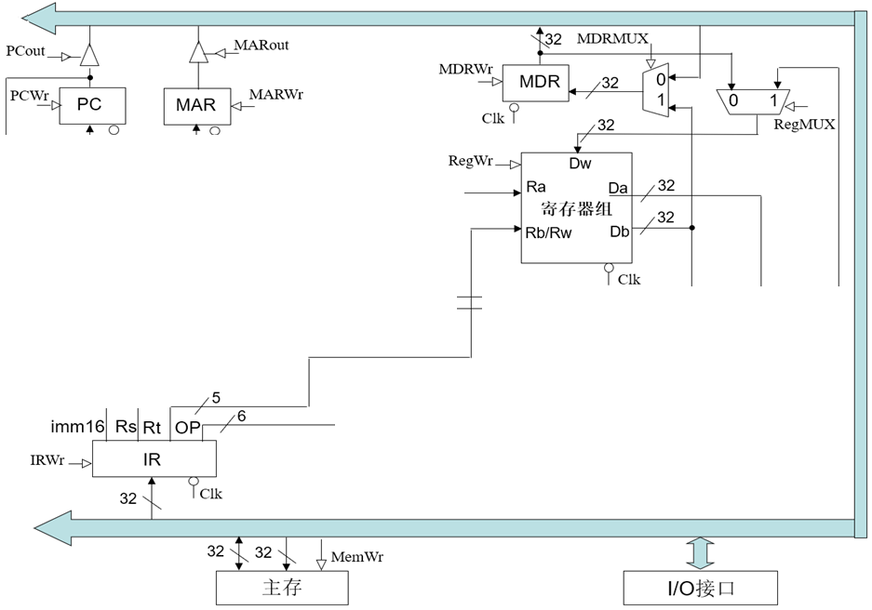
回顾：多周期处理器中的Store指令
BACK
（6）Store指令：地址已投机计算，还需两个时钟周期，记为 swExec、swFinish状态
将Rt的内容写入MDR，再将MDR的内容写入投机计算好的主存单元中（地址在MAR中）。
swExec：MDRMUX=1、MDRWr=1、 MARout=1、PCout=0、 MemWr=0 、其他写使能信号全部为0。
swFinish：MARout=1、PCout=0、MemWr=1、其他写使能信号全部为0。

Slide 54
寄存器组的同步和存储器的同步
解决方案: 将Write Enable和时钟信号相“与”
  须由电路专家确保不会发生“定时错误”（即：能合理设计“Clock”!）
Clk
1. Addr, Data和 WrEn 必须在Clk边沿到来后至少稳定一个 set-up时间
2. Clk高电平时间 大于 写入时间
I_Addr
I_WrEn
C_WrEn
Actual write
WrEn
WrEn
C_WrEn
Address
Data
Reg File
or
Memory
I_WrEn
等价于
Clk
Address
I_Addr
Reg File
or
Memory
Data
I_Data
相当于单周期通路中的理想寄存器和理想存储器
Notes:
The solution we have is to AND the write enable signal to the clock input.
The Write Enable signal to register file or memory is probably the ONLY place where you as a logic designer can gate (AND) the clock with a control signal.
This is the place where you need to take off your logic designer’s hat and put on an electrical engineer’s hat to make sure by ANDING the write enable signal to the clock signal, you are NOT violating any timing consideration.
One obvious thing you should check is that the clock high time must be greater than the write access time because the C_WrEn signal will only be high during the clock high time.
After the circuit designer have taken a good look at this block and make sure no timing constraint is violated, he or she will create a symbol like this and give it to the logic designer.
And he probably will tell the logic designer something like: “Hey, don’t change anything in this block without first asking me.” The logic designer can then use it just like any logic element.
What we created here (the box) is what in the industry is called Synchronized SRAM if this block is the Data Memory. Or Synchronized Register File if this block is the Register File.
The synchronized memory and register file should be no stranger to you guys because I have already shown you how they can be used in the Single Cycle Datapath lecture.
All you have to do is make sure the address, data, and write enable signal are stable at least one set-up time before the clock tick.
The actual write will occur at the cycle following the clock edge that captures the WrEn=1.
+3 = 57 min. (Y:37)

Slide 55
第五讲小结
指令的执行可以像洗衣服一样，用流水线方式进行
  均衡时指令吞吐率提高N倍，但不能缩短一条指令的执行时间
  流水段数以最复杂指令所需步骤数为准（有些指令的某些阶段为空操作），每个阶段的宽度以最复杂阶段所需时间为准（尽量调整使各阶段均衡）
以Load指令为准，分为五个阶段
  取指令段(IF)
    取指令、计算PC+4（IUnit：Instruction Memory、Adder）
  译码/读寄存器(ID)段
    指令译码、立即数扩展（Extender）、读Rs和Rt（寄存器读口）
  执行(EX)段
    计算转移目标地址、ALU运算（ALU、Adder）
  存储器(M)段
    读或写存储单元（Data Memory）
  写回寄存器(WB)段
    ALU结果或从DM读出数据写到寄存器（寄存器写口）
流水线控制器的实现
  ID段生成所有控制信号，并随指令执行过程信息同步向后续阶段流动
  与单周期处理器的控制器的实现方法一样，无需采用有限状态机
流水线冒险：结构冒险、控制冒险、数据冒险
（下一讲主要介绍解决流水线冒险的数据通路如何设计）

Slide 56
第六讲 流水线冒险的处理
主 要 内 容
流水线冒险的几种类型
数据冒险的现象和对策
  数据冒险的种类
    相关的数据是ALU结果：可以通过转发解决
    相关的数据是DM读出的内容：随后的指令需被阻塞一个时钟
  数据冒险和转发
    转发检测 / 转发控制
  数据冒险和阻塞
    阻塞检测 / 阻塞控制
控制冒险的现象和对策
  静态分支预测技术
  动态分支预测技术
  缩短分支延迟技术
流水线中对异常和中断的处理

Slide 57
总结：流水线的三种冲突/冒险（Hazard）情况
Hazards：指流水线遇到无法正确执行后续指令或执行了不该执行的指令
  Structural hazards (hardware resource conflicts):
  现象：同一个部件同时被不同指令所使用
    一个部件每条指令只能使用1次，且只能在特定周期使用
    设置多个部件，以避免冲突。如指令存储器IM 和数据存储器DM分开
  Data hazards (data dependencies):
  现象：后面指令用到前面指令结果数据时，前面指令的结果还没产生
    采用转发(Forwarding/Bypassing)技术
    Load-use冒险需要一次阻塞(stall)
    编译程序优化指令顺序
  Control (Branch) hazards (changes in program flow):
  现象：转移或异常改变执行流程，后继指令在目标地址产生前已被取出
    采用静态或动态分支预测
    编译程序优化指令顺序(分支延迟)
SKIP

Slide 58
Structural Hazard（结构冒险）现象
Time (clock cycles)
Load
Mem
Reg
ALU
Mem
Reg
Instr 1
Mem
Reg
ALU
Mem
Reg
Instr 2
Mem
Reg
ALU
Mem
Reg
Instr 3
Mem
Reg
ALU
Mem
Reg
Instr 4
Mem
Reg
ALU
Mem
Reg
只有一个存储器时，在Load指令取数据同时又取指令的话，则发生冲突！
如果不对寄存器堆的写口和读口独立设置的话，则发生冲突！
结构冒险也称硬件资源冲突：同一个执行部件被多条指令使用。

Slide 59
Structural Hazard的解决方法
为了避免结构冒险，规定流水线数据通路中功能部件的设置原则为：
每个部件在特定的阶段被用！（如：ALU总在第三阶段被用！）
将Instruction Memory (Im) 和 Data Memory (Dm)分开
将寄存器读口和写口独立开来
Time (clock cycles)
I
n
s
t
r.
O
r
d
e
r
Load
Im
Reg
ALU
Dm
Reg
Instr 1
Im
Reg
ALU
Dm
Reg
BACK
Instr 2
Im
Reg
ALU
Dm
Reg
Instr 3
Im
Reg
ALU
Dm
Reg
Instr 4
Im
Reg
ALU
Dm
Reg

Slide 60
Data Hazard现象
以下指令序列中，寄存器r1会发生数据冒险
add r1 ,r2,r3
想一下，哪条指令的r1是老的值？
哪条是新的值？
sub r4, r1 ,r3
and r6, r1 ,r7
画出流水线图能很清楚理解！
or r8, r1 ,r9
xor r10, r1 ,r11

Slide 61
Data Hazard on r1
Time (clock cycles)
读r1时，add指令正在执行加法(EX段)，老值!
IF
ID
EX
M
WB
读r1时，add指令正在传递加法结果(M段), 老值!
add r1,r2,r3
Im
Reg
ALU
Dm
Reg
读r1时，add指令正在写加法结果到r1(WB段), 老值!
I
n
s
t
r.
O
r
d
e
r
sub r4,r1,r3
Im
Reg
ALU
Dm
Reg
and r6,r1,r7
Im
Reg
ALU
Dm
Reg
or r8,r1,r9
Im
Reg
ALU
Dm
Reg
xor r10,r1,r11
Im
Reg
ALU
Dm
Reg
读r1时，add指令已经把加法结果写到r1, 新值

Slide 62
Data Hazard现象
所以——
最后一条指令的r1才是新的值！
add r1 ,r2,r3
如何解决这个问题？
sub r4, r1 ,r3
and r6, r1 ,r7
补充：三类数据冒险现象
RAW: 写后读（基本流水线中经常发生，如上例）
WAR：读后写（基本流水线中不会发生，乱序执行时会发生）
WAW：写后写（基本流水线中不会发生，乱序执行时会发生）
or r8, r1 ,r9
xor r10, r1 ,r11
本讲介绍基本流水线，所以仅考虑RAW冒险

Slide 63
数据冒险的解决方法
方法1：硬件阻塞（stall）
方法2：软件插入“NOP”指令
方法3：合理实现寄存器堆的读/写操作（不能解决所有数据冒险）
方法4：转发（Forwarding或Bypassing 旁路）技术
    若相关数据是ALU结果，则如何？
    可通过转发解决
    若相关数据是上条指令DM读出内容，则如何？
    不能通过转发解决，随后指令需被阻塞一个时钟 或 加NOP指令
    称为Load-use数据冒险！
方法5：编译优化：调整指令顺序（不能解决所有数据冒险）
实现“转发”和“阻塞” 要修改数据通路：
（1）检测何时需要“转发”，并控制实现“转发”
（2）检测何时需要“阻塞”，并控制实现“阻塞”

Slide 64
方案1: 在硬件上采取措施，使相关指令延迟执行
硬件上通过阻塞(stall)方式阻止后续指令执行，延迟到有新值以后！
这种做法称为流水线阻塞，也称为插入“气泡Bubble”
Time (clock cycles)
IF
ID
EX
M
WB
add r1,r2,r3
Im
Reg
ALU
Dm
Reg
I
n
s
t
r.
O
r
d
e
r
stall
Im
bubble
bubble
bubble
bubble
stall
Im
bubble
bubble
bubble
bubble
stall
Im
bubble
bubble
bubble
bubble
sub r4,r1,r3
Im
Reg
Dm
Reg
ALU
and r6,r1,r7
Im
Reg
Dm
ALU
缺点：控制比较复杂，需要改数据通路；指令被延迟三个时钟执行。
Notes:
The same instruction means the same one as the first instruction add r1, r2, r3 . So the remaining instructions are not affected.

Slide 65
方案 2: 软件上插入无关指令
由编译器插入三条NOP指令，浪费三条指令的空间和时间，是最差的做法。
好处：数据通路简单，即无需改数据通路。
Time (clock cycles)
IF
ID
EX
M
WB
add r1,r2,r3
Im
Reg
ALU
Dm
Reg
I
n
s
t
r.
O
r
d
e
r
nop
Im
Reg
ALU
Dm
Reg
nop
Im
Reg
ALU
Dm
Reg
nop
Im
Reg
ALU
Dm
Reg
sub r4,r1,r3
Im
Reg
Dm
Reg
ALU
and r6,r1,r7
Im
Reg
ALU
Dm
与方案1比，哪个更快？
一样，都是多三个时钟周期！

Slide 66
方案3: 同一周期内寄存器堆先写后读
寄存器堆的读口和写口是相互独立的部件！
Time (clock cycles)
IF
ID
EX
M
WB
add r1,r2,r3
Im
Reg
ALU
Dm
Reg
I
n
s
t
r.
O
r
d
e
r
sub r4,r1,r3
Im
Reg
ALU
Dm
Reg
and r6,r1,r7
Im
Reg
ALU
Dm
Reg
or r8,r1,r9
Im
Reg
ALU
Dm
Reg
xor r10,r1,r11
Im
Reg
ALU
Dm
Reg
寄存器写口/读口分别在前/后半周期进行操作，使写入数据被直接读出
若同一个时钟内前面指令写入的数据正好是后面指令所读数据，则不会发生数据冒险
但是，只能解决部分数据冒险！

Slide 67
方案4: 利用DataPath中的中间数据：转发+阻塞
仔细观察后发现：流水段寄存器中已有需要的值r1！
Time (clock cycles)
IF
ID
EX
M
WB
add r1,r2,r3
Im
Reg
ALU
Dm
Reg
I
n
s
t
r.
O
r
d
e
r
sub r4,r1,r3
Im
Reg
ALU
Dm
Reg
and r6,r1,r7
Im
Reg
ALU
Dm
Reg
or r8,r1,r9
Im
Reg
ALU
Dm
Reg
xor r10,r1,r11
Im
Reg
ALU
Dm
Reg
把数据从流水段寄存器中直接取到ALU的输入端
称为转发（Forwading）或旁路（Bypassing）

Slide 68
回顾: Load指令引起的延迟现象
Cycle 1
Cycle 2
Cycle 3
Cycle 4
Cycle 5
Cycle 6
Cycle 7
Cycle 8
Clock
I0: Load
Ifetch
Reg/Dec
Exec
Mem
Wr
Plus 1
Ifetch
Reg/Dec
Exec
Mem
Wr
Plus 2
Ifetch
Reg/Dec
Exec
Mem
Wr
Plus 3
Ifetch
Reg/Dec
Exec
Mem
Wr
若不采用转发，在何时才能使用Load指令的结果？
Plus 4
Ifetch
Reg/Dec
Exec
Mem
Wr
Load指令最早在哪个流水线寄存器中开始有后续指令需要的值？
实际上，在第四周期结束时，数据在流水段寄存器中已经有值。
采用数据转发技术可以使load指令后面第二条指令得到所需的值
但不能解决load指令和随后第一条指令间的数据冒险，要延迟执行一条指令！
这种load指令和随后指令间的数据冒险，称为“装入- 使用数据冒险(load- use Data Hazard)”

Slide 69
“Forwarding”技术使Load-use冒险只需延迟一个周期
Time (clock cycles)
IF
ID
EX
M
WB
lw r1, 0(r2)
Im
Reg
ALU
Dm
Reg
I
n
s
t
r.
O
r
d
e
r
sub r7,r1,r3
Im
Reg
ALU
Dm
Reg
and r6,r1,r7
Im
Reg
ALU
Dm
Reg
or r8,r1,r9
Im
Reg
ALU
Dm
Reg
采用“转发”后仅第二条指令 SUB r7,r1,r3 不能按时执行！
发生“装入- 使用数据冒险”时，需要对load后的指令阻塞一个时钟周期！
数据冒险处理最佳方案：“转发” + “Load-use阻塞”

Slide 70
方案5：编译器进行指令顺序调整来解决数据冒险
以下源程序可生成两种不同的代码，优化的代码可避免Load阻塞
a = b + c;
d = e – f;
假定 a, b, c, d ,e, f 在内存
编译器的优化很重要！
Slow code:
lw t2, b
lw t3, c
add t1, t2, t3
sw t1, a
lw t5, e
lw t6, f
sub t4, t5, t6
sw t4, d
Fast code:
lw t2, b
lw t3, c
lw t5, e
add t1, t2, t3
lw t6, f
sw t1, a
sub t4, t5, t6
sw t4, d
调整后
如果硬件不支持阻塞处理的话，则编译器可以将顺序调整和插入NOP指令结合起来，在找不到可插入的指令时，插入NOP指令！

Slide 71
编译器优化以避免阻塞的情况调查:
由此可见，优化调度后load阻塞现象大约降低了1/2~1/3
BACK

Slide 72
Control Hazard的解决方法
方法1：硬件上阻塞（stall）分支指令后三条指令的执行
方法2：软件上插入三条“NOP”指令
（以上两种方法的效率太低，需结合分支预测进行）
方法3：分支预测（Predict）
  简单（静态）预测：
    总是预测条件不满足(not taken)，即：继续执行分支指令的后续指令
  动态预测：
    根据程序执行的历史情况进行动态预测调整
注：流水线控制必须确保被错误预测指令的执行结果不能生效，而且要能从正
确的分支地址处重新启动流水线工作
方法4：延迟分支（Delayed branch）（通过编译程序优化指令顺序！）
  把分支指令前面与分支指令无关的指令调到分支指令后执行，也称延迟转移
另一种控制冒险：异常或中断控制冒险的处理

Slide 73
方案1: 在硬件上采取措施，使相关指令延迟执行
硬件上通过阻塞(stall)方式阻止后续指令执行，延迟到分支指令能够确定是否转移以后！——使接下来三条指令清0或 其操作信号清0，以插入三条NOP指令
Time (clock cycles)
IF
ID
EX
M
WB
beq r1,r2,12
Im
Reg
ALU
Dm
Reg
I
n
s
t
r.
O
r
d
e
r
stall
Im
bubble
bubble
bubble
bubble
stall
Im
bubble
bubble
bubble
bubble
stall
Im
bubble
bubble
bubble
bubble
？？？？？
Im
Reg
Dm
Reg
ALU
缺点：控制比较复杂，需要改数据通路；指令被延迟三个时钟执行。
Notes:
The same instruction means the same one as the first instruction add r1, r2, r3 . So the remaining instructions are not affected.

Slide 74
方案 2: 软件上插入无关指令
由编译器插入三条NOP指令，延迟到分支指令能够确定是否转移有新值以后再执行后续有效的指令！浪费三条指令的空间和时间，是最差的做法。
好处：数据通路简单，即无需改数据通路。
Time (clock cycles)
IF
ID
EX
M
WB
beq r1,r2,12
Im
Reg
ALU
Dm
Reg
I
n
s
t
r.
O
r
d
e
r
nop
Im
Reg
ALU
Dm
Reg
nop
Im
Reg
ALU
Dm
Reg
nop
Im
Reg
ALU
Dm
Reg
？？？？？
Im
Reg
Dm
Reg
ALU
与方案1比，哪个更快？
一样，都是多三个时钟周期！

Slide 75
方案3: 分支预测——简单（静态）分支预测方法
基本做法
  总预测条件不满足(not taken)，即：继续执行分支指令的后续指令
    可加启发式规则：
    在特定情况下总是预测满足(taken)，其他情况总是预测不满足
    如：循环顶部（底部）分支总是预测为不满足（满足）。能达65%-85%的预测准确率
  预测失败时，需把流水线中三条错误预测指令丢弃掉
    将被丢弃指令的控制信号值或指令设置为0
    （注：涉及到当时在IF、ID和EX三个阶段的指令）
性能
  如果转移概率是50%，则预测正确率仅有50%
预测错误的代价
  预测错误的代价与何时能确定是否转移有关。越早确定代价越少
  是否可以把“是否转移”的确定工作提前，而不等到MEM阶段才确定？
可以！
SKIP
那最早可以提前到哪个阶段呢？

Slide 76
预测指令失败情况
Cycle 4
Cycle 5
Cycle 6
Cycle 7
Cycle 8
Cycle 9
Cycle 10
Cycle 11
Clk
12: Beq
(target is 1000)
Ifetch
Reg/Dec
Exec
Mem
Wr
16: R-type
Ifetch
Reg/Dec
Exec
Mem
Wr
20: R-type
Ifetch
Reg/Dec
Exec
Mem
Wr
24: R-type
Ifetch
Reg/Dec
Exec
Mem
Wr
1000: Target of Br
Ifetch
Reg/Dec
Exec
Mem
Wr
虽然Beq指令在第四周期取出，但:
  “是否转移”在M阶段确定，目标地址在第七周期才被送到PC输入端
  第八周期才取出目标地址处的指令执行
  结果：在取目标指令之前，已有三条指令被取出，取错了三条指令！
发生转移时，要在流水线中清除Beq后面的三条指令，分别在EX 、ID、 IF段中
延迟损失时间片C：发生转移时，给流水线带来的延迟损失
这里 C=3
BACK
Notes:
Notice that although the branch instruction is fetched during Cycle 4, its target address is NOT written into the Program Counter until the end of clock Cycle 7.
Consequently, the branch target instruction is not fetched until clock Cycle 8.
In other words, there is a 3-instruction delay between the branch instruction is issued and the branch effect is felt in the program.
This is referred to as Branch Hazard in the text book.
And as we will show in the next lecture, by clever design techniques, we can reduce the delay to ONE instruction.
That is if the branch instruction in Location 12 is issued in Cycle 4, we will only execute one more sequential instruction (Location 16) before the branch target is executed.
+2 = 71 min. (Y:51)

Slide 77
方案3: 分支预测——简单（静态）分支预测方法
缩短分支延迟，减少错误预测代价
  可以将 “转移地址计算”和“分支条件判断”操作调整到ID阶段来缩短延迟
    将转移地址生成从M阶段移到ID阶段，可以吗？为什么？
    （可以：IF/ID流水段寄存器中已有PC的值，ID段已有扩展后立即数Imm）
    将“判0”操作从EX阶段移到ID阶段，可以吗？为什么？
    （用逻辑运算(如，先按位异或，再结果各位相或)直接比较Rs1和Rs2的值）
    （简单判断用逻辑运算，复杂判断可以用专门指令生成条件码）
    （许多条件判断都很简单）
预测错误的检测和处理（称为“冲刷、冲洗” -- Flush）
  如果原来预测不转移
  但是发现Branch=1并且Zero=1时，说明预测失败
  预测失败 (条件满足) 时，需要完成以下两件事（延迟损失时间片C=1时）：
    将转移目标地址->PC
    清除IF段中取出的指令，即：将IF/ID中的指令字清0，转变为nop指令
原来要清除三条指令，调整后只需要清除一条指令，因而只延迟一个时钟周期，每次预测错误减少了两个周期的代价！
即：这里 C=1

Slide 78
方案3: 分支预测——动态分支预测方法
简单的静态分支预测方法的预测成功率不高，应考虑动态预测
动态预测基本思想：
  利用最近转移发生的情况，来预测下一次可能转移还是不转移
  根据实际情况来调整预测，能达90+%的预测准确率
  转移发生的历史情况记录在BHT中（有多个不同的名称）
    分支历史记录表BHT（Branch History Table）
    分支预测缓冲BPB（Branch Prediction Buffer）
    分支目标缓冲BTB（Branch Target Buffer）
  每个表项由分支指令地址低位作索引，故在IF阶段就可以取到预测位
    低位地址相同的分支指令共享一个表项，所以，可能取的是其他分支指令的预测位。会不会有问题？
    由于仅用于预测，所以不影响执行结果
现在几乎所有的处理器都采用动态预测（dynamic predictor）
SKIP

Slide 79
分支历史记录表BHT（或BTB、BPB）
分支历史记录表BHT
最初BHT为空
分支指令地址
=？
分支指令地址
预测位
转移目标地址
①
查找
转移取
顺序取
查找时发现都不相等，则“未命中”
未命中说明什么？
指令预取器
④ 修正
②
预测
说明以前没有执行过该分支指令
加入新项
③
选择
控制逻辑
命中与否
指令执行
实际执行情况
  命中时：
  根据预测位，选择“转移取”还是“顺序取”
  未命中时：
  加入新项，并填入指令地址和转移目标地址、初始化预测位
BACK

Slide 80
方案4： 延迟分支（分支延迟时间片的调度）
属于静态调度技术，由编译程序重排指令顺序来实现
基本思想：
  把分支指令前面的与分支指令无关的指令调到分支指令后面执行，以填充延迟时间片（也称分支延迟槽Branch Delay slot），不够时用nop操作填充
举例：如何对以下程序段进行分支延迟调度？
（假定时间片C=2）
若C=1，则可以：
lw $1, 0($2)
lw $3, 0($2)
add $6, $4, $2
beq $3, $5, 4
add $3, $3,$2
sw $1, 0($2)
……
lw $3, 0($2)
add $6, $4, $2
beq $3, $5, 4
lw $1, 0($2)
nop
add $3, $3,$2
sw $1, 0($2)
lw $3, 0($2)
add $6, $4, $2
beq $3, $5, 4
lw $1, 0($2)
add $3, $3,$2
sw $1, 0($2)
……
调度后
调度后可能带来其他问题：产生新的load-use数据冒险
调度后，降低了分支延迟损失

Slide 81
另一种控制冒险：异常和中断
异常和中断会改变程序的执行流程
某条指令发现异常时，后面多条指令已被取到流水线中正在执行
  例如ALU指令发现“溢出”时，已经到EX阶段结束了，此时，它后面已有两条指令进入流水线了
流水线数据通路如何处理异常? (举例说明)
  假设指令add r1,r2,r3产生了溢出
  处理思路：
    清除add指令以及后面的所有已在流水线中的指令
    关中断（将中断允许触发器清0）
    保存PC或PC-4（断点） 到 EPC
    将异常/中断处理程序首地址送PC
BACK

Slide 82
三种处理器实现方式的比较
单周期、多周期、流水线三种方式比较
假设各主要功能单元的操作时间为：
存储单元：200ps
ALU和加法器：100ps
寄存器堆（读 / 写）：50ps
假设MUX、控制单元、PC、扩展器和传输线路都没有延迟，指令组成为：
25%取数、10%存数、52%ALU、11%分支、2%跳转，则下面实现方式中，
哪个更快？快多少？
（1）单周期：每条指令在一个固定长度的时钟周期内完成
（2）多周期：每类指令时钟数为取数-5，存数-4，ALU-4，分支-3，跳转-3
（3）流水线：每条指令分取指令、取数/译码、执行、存储器存取、写回五阶段
（假定没有结构冒险，数据冒险采用转发处理，分支延迟槽为1，预测准确率
为75%；无条件跳转指令的更新地址工作也在ID段完成。不考虑流水段寄
存器延时，不考虑异常、中断和访存缺失引起的流水线冒险）

Slide 83
三种处理器实现方式的比较
解：CPU执行时间 = 指令条数 x CPI x 时钟周期长度
三种方式指令条数都一样，所以只要比较CPI和时钟周期长度即可。
各指令类型要求的时间长度为：

Slide 84
三种处理器实现方式的比较
对于单周期方式：
时钟周期将由最长指令来决定，应该是load指令，为600ps
所以，N条指令的执行时间为600N(ps)
对于多周期方式：
时钟周期将取功能部件最长所需时间，应该是存取操作，为200ps
根据各类指令的频度，计算平均时钟周期数为：
CPU时钟周期=5x25%+4x10%+4x52%+3x11%+3x2%=4.12
所以， N条指令的执行时间为4.12x200xN=824N(ps)
对于流水线方式：
Load指令：当发生Load-use依赖时，执行时间为2个时钟，否则1个时钟，
故平均执行时间为1.5个时钟；
Store、ALU指令：1个时钟；
Branch指令：预测成功时，1个时钟，预测错误时，2个时钟，
所以：平均约为：.75x1+.25x2=1.25个；
Jump指令：2个时钟（总要等到译码阶段结束才能得到转移地址）
平均CPI为：1.5x25%+1x10%+1x52%+1.25x11%+2x2%=1.17
所以， N条指令的执行时间为1.17x200xN=234N(ps)

Slide 85
第六讲小结
流水线冒险的几种类型：
  资源冲突、数据相关、控制相关（改变指令流的执行方向）
数据冒险的现象和对策
  数据冒险的种类
    相关的数据是ALU结果，可以通过转发解决
    相关的数据是DM读出的内容，随后的指令被阻塞一个时钟
  数据冒险和转发
    转发检测 / 转发控制
  数据冒险和阻塞
    阻塞检测 / 阻塞控制
控制冒险的现象和对策
  静态分支预测技术
  缩短分支延迟技术
  动态分支预测技术
异常和中断是一种特殊的控制冒险

Slide 86
第七讲 高级流水线技术
高性能流水线 - 指令级并行(ILP)技术
  超流水线
  多发射流水线
    静态多发射（VLIW处理器 + 编译器静态调度）
    动态多发射（超标量处理器 + 动态流水线调度）
静态多发射（VLIW-超长指令字）
  编译器静态推测完成“指令打包”和“冒险处理”
  RV32I 2-发射流水线数据通路
  循环展开指令调度
  IA-64的EPIC技术
动态多发射
  动态多发射流水线的通用模型
  动态多发射流水线的执行模式
    按序发射、按序完成
    按序发射、乱序完成
    乱序发射、乱序完成

Slide 87
提高性能措施—实现指令级并行
N段流水线说明一个时钟周期内最多有几条指令同时并行执行？
实现指令流内部的并行流水线称为指令级并行（ILP）
有两种指令级并行策略
  超流水线（Super- pipelining）
    级数更多的流水线
    理想情况下，流水线的加速比与流水段的数目成正比
    （即：理想情况下，流水段越多，时钟周期越短，指令吞吐率越高）
    但是，它会增加开销，且是有极限的！可以怎样突破极限呢？
  多发射流水线（Multiple issue pipelining ）
    多条指令(如整数运算、浮点运算、装入/存储等) 同时启动并独立运行
    前提：有多个执行部件。如：定点、浮点、乘/除、取数/存数部件等
    结果：能达到小于1的CPI，定义CPI的倒数为IPC
    （例如：理想的四路多发射流水线的IPC为4）
    需要实现以下两个主要任务
      指令打包：分析每个周期发射多少条？哪些指令可以同时发射？
      冒险处理：由编译器静态调整指令或在运行时由硬件处理
    实现上述两个主要任务的基础—推测技术
    两种实现方法
      静态多发射：由编译器在编译时静态完成指令打包和冒险处理
      动态多发射：由硬件在执行时动态完成指令打包和冒险处理
N条！故N越大并行度越高！
CPI =？
CPI =1
增加的开销体现在哪里？
流水段寄存器！
一条流水线变成多条流水线！

Slide 88
实现多发射技术的基础—推测
推测技术：由编译器或处理器猜测指令执行结果，并以此调整指令执行顺序，使指令的执行能达到最大可能的并行
  指令打包的决策依赖于“推测”的结果
    可根据指令间的相关性来进行推测
      与前面指令不相关的指令可以提前执行
    可对分支指令进行推测
      可提前执行分支目标处的指令
    预测仅是“猜测”，可能推测错误，故需有推测错误检测和回滚机制
    推测错误时，会增加额外开销
  有“软件推测”和“硬件推测”两种
    软件推测：编译器通过推测来静态重排指令（一定要正确！）
    硬件推测：处理器在运行时通过推测来动态调度指令

Slide 89
静态多发射处理器
由编译器在编译时进行相关性分析和静态分支预测，以静态完成“指令打包”和“冒险处理”
  指令打包（将同时发射的多条指令合并到一个长指令中）
    将同一个时钟周期内发射的多个指令看成是一条多个操作的长指令，称为一个“发射包”
    “静态多发射”也被称为“超长指令字”（VLIW-Very Long Instruction Word），采用这种技术的处理器被称为VLIW处理器
    在同一个周期内发射的指令类型是受硬件限制的（举例:干洗/水洗）
    例如，只能是一条ALU指令/分支指令、一条Load/Store指令
    IA-64采用这种方法，Intel称其为EPIC（Explicitly Parallel Instruction Computer—显式并行指令计算机）
  冒险处理（主要是数据冒险和控制冒险）
    做法1：完全由编译器通过代码调度和插入nop指令来消除所有冒险，无需硬件实现冒险检测和流水线阻塞
    做法2：由编译器通过静态分支预测和代码调度来消除同时发射指令间内部依赖，由硬件检测数据冒险并进行流水线阻塞
即：保证打包指令内部不会出现冒险！

Slide 90
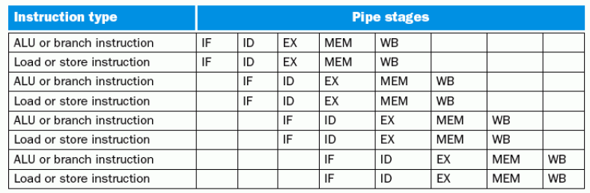
静态多发射处理器实例
实例：RV32I 指令集的静态多发射----2发射处理器
要使RV32I能够同时处理两条流水线，数据通路需要做哪些改进？
1. 同时要能取并译码两条指令，怎么办？
将两条指令打包成64位长指令，前面为ALU/Branch，后面为lw/sw
没有配对指令时，就用nop指令代替
将64位长指令中的两个操作码同时送到控制器（指令译码器）进行译码
2. 两条指令同时要读两个寄存器或写寄存器（和lw配对时） ，怎么办？
增加两个读口和一个写口
3. 两条指令同时要使用ALU进行运算 ，怎么办？
增加一个ALU（包括两组输入总线和一组输出总线）

Slide 91
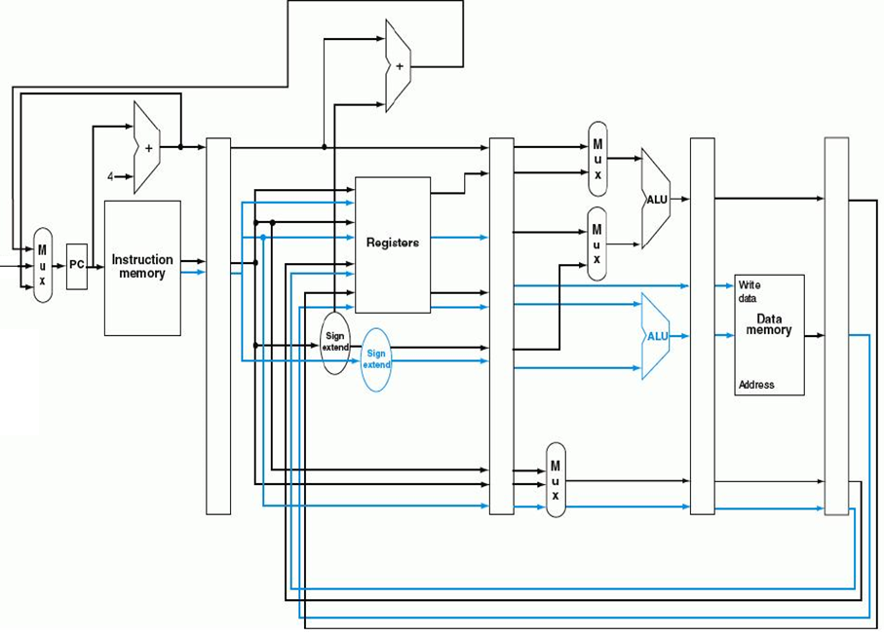
2发射流水线数据通路（蓝色是增加部分）
需增加额外加法器或ALU
ALU/分支指令在ALU运算时，
Load/Store指令要计算地址
指令成对放在64位对齐内存区域，前面是ALU/分支指令。若不能成对，则用nop代替缺失指令，每次取两条指令，同时对两条指令译码
数据通路如何修改以保证控制信号是正确的？
流水段寄存器要增宽，控制信号分别传送。
同时需为ALU和lw/sw指令读寄存器，同时需为ALU运算和Load结果写寄存器

Slide 92
2发射流水线的特点
优点：潜在性能将提高大约2倍 （实际上达不到！为什么？ ）
缺点：
  为消除结构冒险，需增加额外部件
  增加了潜在的由于数据冒险和控制冒险导致的性能损失
    例1：对于Load-use数据冒险
      单发射流水线：只有一条指令延迟
      2发射流水线：有一个周期（即2条指令）延迟
    例2：对于ALU-Load/Store数据冒险
      单发射流水线：可用“转发”技术使ALU结果直接转发到Load/Store指令的EX阶段
      2发射流水线：两条指令同时进行，ALU的结果不能直接转发，因而不能提供给与其配对的Load/Store指令使用，只能延迟一个周期
为更有效地利用多发射处理器的并行性，必须有更强大的编译器，能够充分消除指令间的依赖关系，使指令序列达到最大的并行性！

Slide 93
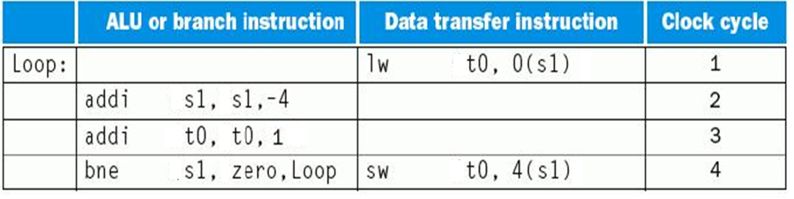
例：2发射指令调度
前三条和后两条各具有相关性
可把第四条指令调到第一条后面
sw指令是否有问题？怎么办？
以下是一段循环代码段
  Loop: lw t0, 0(s1)
  addi t0, t0, 1
  sw t0, 0(s1)
  addi s1, s1, -4
  bne s1, zero, Loop
(能看出这段程序的功能吗？)
为了能在2发射流水线中有效执行，该怎样重新排列指令
  调度方案如下：没有指令配对时，用nop指令代替
s1减4，故sw指令偏移改为4
循环内进行的是数组访问！
能否把addi和lw配成一对？
寄存器s1被同时读，且读后写，产生WAR冒险，取决于寄存器如何设计。
存在Load-use冒险！
addi s1, s1, -4 ？
一个循环内，五条指令在四个时钟内完成，实际CPI为0.8，即: IPC=1.25
在循环中访问数组的更好的调度技术是“循环展开”

Slide 94
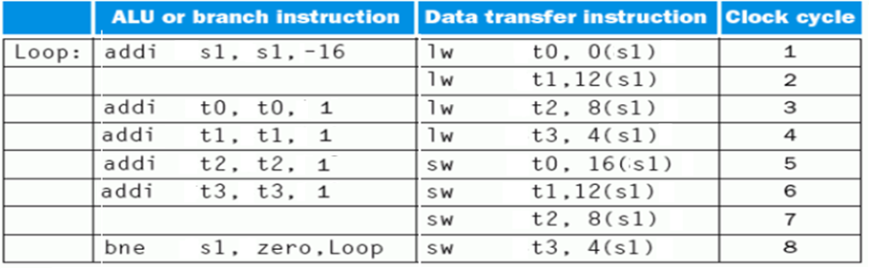
用“循环展开”技术进行指令调度
基本思想：展开循环体，生成多个副本，在展开的指令中统筹调度
上例采用“循环展开”后的指令序列是什么？
  为简化起见，假定循环执行次数是4的倍数
  “循环展开”4次后循环内指令（lw, addi, sw）各有4条，再加1条addi（循环控制变量计算）和1条bne，共14条指令
  指令最佳调度序列如下：
14条指令用了8个时钟，CPI达到8/14=0.57。
需要用到“重命名寄存器”技术，多用了三个临时寄存器t1,t2,t3，消除了名字依赖关系（非真实依赖，只是寄存器名相同而已）
代价是什么？
多用了三个临时寄存器，并增加了代码大小（存储空间变大）
好处：充分利用并行，并消除部分循环分支！

Slide 95
用“循环展开”技术进行指令调度
为何第一条指令将s1减16？
因为假设展开前循环总次数是4的倍数。展开后的一次循环就访问了4次数组，本来s1就该减掉4*4=16，只是现在提前一次性减掉了
不同lw和sw指令偏移为何不同？

Slide 96
循环展开后的偏移量
第一条指令将s1减16，指令执行后，s1的值变成了循环结束时s1的值
所以循环体内各数组元素的访问指令的偏移量依次为：
  16 - 数组元素1，12 - 数组元素2 ，8 - 数组元素3，4 - 数组元素4
高地址
为什么第一个周期中的lw指令的偏移量为0?
数组元素1
$s1
因为第一个周期中的lw指令进行地址计算时，addi指令的执行结果还没有写到s1中，所以，此时s1中还是原来的值。
数组元素2
数组元素3
数组元素4
为什么第一条addi t0指令不放在第二周期?
数组元素5
为了避免load-use数据冒险！
$s1-16
新的$S1
当循环次数不是4的倍数时这样做就有问题！
可见：编译器和机器结构密切相关！系统程序员必须非常了解机器结构！编译器的好坏直接影响程序执行快慢！

Slide 97
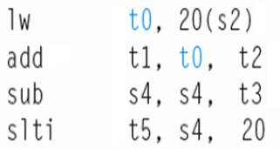
动态多发射处理器
由硬件在执行时动态完成指令打包或冒险处理
通常被称为超标量处理器（Superscalar）
  同一个时钟动态发射多条指令，一个周期内可执行一条以上指令
与VLIW处理器的不同点：
  VLIW处理器：与机器结构密切相关，在结构有差异的机器上要重新编译
  超标量处理器：编译器仅进行指令顺序调整（还是串行序列），不进行指令打包，而是由硬件根据机器结构决定同时发射哪几条指令。因此，编译后的代码能够被不同结构的机器正确执行
超标量处理器多结合动态流水线调度（Dynamic pipeline scheduling）技术
  通过指令相关性检测和动态分支预测等手段，投机性地不按指令顺序执行，当发生流水线阻塞时，可以到后面找指令来执行
  举例说明动态流水线调度技术：
左边指令序列中，哪条指令可以提前执行？
sub指令可提前到add指令前执行
如果不将sub调到前面，则会影响slti指令的执行，而且还会发生load-use冒险

Slide 98
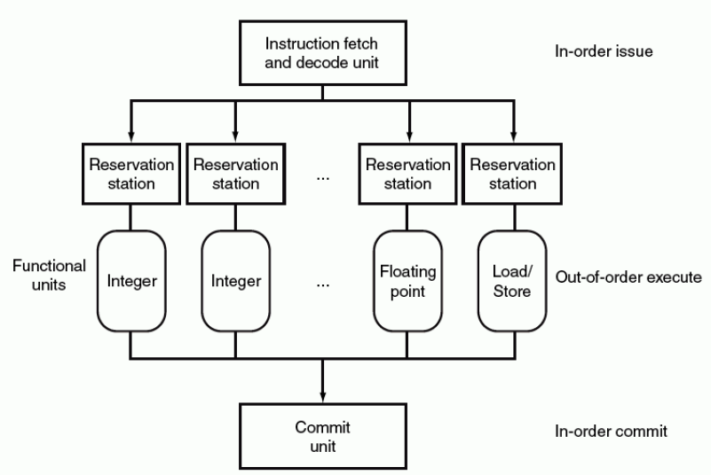
动态流水线调度的通用模型
动态流水线的一个重要思想：在等待解决阻塞时，到后面找指令提前执行！
动态流水线的通用模型：
  一个指令预取和译码单元：有序发射
  多个并列执行的功能单元：乱序执行
  一个提交单元：有序提交
每个功能单元有各自的保留站
用于保存操作数和操作命令
功能单元，用于完成指令的具体功能
提交单元缓存所有已完成的指令结果，直到该结果能安全写回到寄存器或存储器，也称为Reorder Buffer
指令的结果也可在Reorder Buffer中被“转发”

Slide 99
功能单元的性能
功能：用来执行特定类型的操作
性能：每个功能单元具有基本的操作性能，用两个周期数来刻画
  执行周期（Latency）：完成特定操作所花的周期数
  发射时间（Issue Time）：连续、独立操作之间的最短周期数
  以下是Pentium III 算术功能部件的性能
从上述图中看出
    整数加、整数乘、浮点加、装入、存储这5种部件是流水化的
    浮点乘部件是部分流水化
    整数除和浮点除是完全没有流水化
CPU设计的一个原则：有限的芯片空间应该在各功能部件之间进行平衡！尽量让大多数资源用于最关键的操作（对大量基准程序进行评估）
从上述图中能否看出，哪些是最重要的操作？哪些是不常用的？
  整数加法和乘法、浮点数加法和乘法是重要的操作
  除法相对来说不太常用，而且本身难以实现流水线

Slide 100
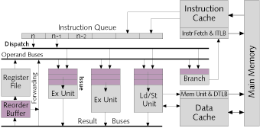
动态流水线的几种执行模式
根据动态流水线指令发射和完成顺序，可分为三种执行模式：
  按序发射按序完成（Pentium）
  按序发射无序完成（Pentium II和Pentium III）
  无序发射无序完成（Pentium 4）
保守的是顺序完成，好处：
简化异常检测及其处理
能在被推测指令完成前得知推测结果的正确性
写回条件：与前面的所有指令结果不相关、并预测正确
ReOrder Buffer 重排序缓冲: 用于保存已完成的指令结果，等待在可能时写回寄存器堆
保留站：存放操作数和操作命令

Slide 101
第七讲小结
有以下两种指令级并行(ILP)技术（即：高性能流水线形式）
  超流水线：更多的流水线级数
  多发射流水线：同时发射多个指令，有多条流水线同时进行
    静态多发射（VLIW处理器+编译器静态调度）
    动态多发射（超标量处理器+动态流水线调度）
静态多发射（VLIW（超长指令字）处理器）
  由编译器静态推测来完成“指令打包”和“冒险处理”
  MIPS 2-发射Datapath中有2个执行部件，将2条指令打包，并同时译码执行
  采用循环展开进行指令调度，能得到很好的性能
  IA-64采用VLIW技术，Intel称其为EPIC技术，3条指令打包
动态多发射（超标量处理器）
  指令执行时由硬件动态推测，多个执行部件，同时发射多个指令到执行部件
  3种动态多发射流水线的执行模式
    按序发射按序完成、按序发射无序完成、无序发射无序完成

Slide 102
本章第5~7讲总结1
指令流水线的设计
  将每条指令的执行规整化为若干个同样的流水阶段
  每个流水阶段的执行时间一样，都等于一个时钟
  理想情况下，每个时钟有一条指令进入流水线，也有一条指令执行结束
  每个流水段中的部件都是组合逻辑加寄存器，组合逻辑中产生的结果在时钟到来时被存储到寄存器（如：程序计数器、条件码寄存器、流水线寄存器等）。
  每两个相邻流水段之间的流水线寄存器，用以记录所有在后面阶段要用到的各种信息，有哪些呢？
    指令的代码、本条指令地址(PC)、扩展后的立即数、参加运算的操作数、指令运算结果、指令异常信息、寄存器读口地址、寄存器写口地址(Rd)、存储器地址等。
  指令译码得到的控制信号通过流水线寄存器传送到后面各个流水段中

Slide 103
本章第5~7讲总结2
单周期, 多周期 和 流水线比较
Cycle 1
Cycle 2
Clk
Single Cycle Implementation:
Load
Store
Waste
Cycle 1
Cycle 2
Cycle 3
Cycle 4
Cycle 5
Cycle 6
Cycle 7
Cycle 8
Cycle 9
Cycle 10
Clk
Multiple Cycle Implementation:
Load
Store
R-type
Ifetch
Reg
Exec
Mem
Wr
Ifetch
Reg
Exec
Mem
Ifetch
Pipeline Implementation:
Load
Ifetch
Reg
Exec
Mem
Wr
Store
Ifetch
Reg
Exec
Mem
Wr
R-type
Ifetch
Reg
Exec
Mem
Wr
Notes:
Here are the timing diagrams showing the differences between the single cycle, multiple cycle, and pipeline implementations.
For example, in the pipeline implementation, we can finish executing the Load, Store, and R-type instruction sequence in seven cycles.
In the multiple clock cycle implementation, however, we cannot start executing the store until Cycle 6 because we must wait for the load instruction to complete.
Similarly, we cannot start the execution of the R-type instruction until the store instruction has completed its execution in Cycle 9.
In the Single Cycle implementation, the cycle time is set to accommodate the longest instruction, the Load instruction.
Consequently, the cycle time for the Single Cycle implementation can be five times longer than the multiple cycle implementation.
But may be more importantly, since the cycle time has to be long enough for the load instruction, it is too long for the store instruction so the last part of the cycle here is wasted.
+2 = 77 min. (X:57)

Slide 104
本章第5~7讲总结3
指令流水线的局限性
  并不是每条指令都有相同多个流水段
  并不是每个流水段都一样长
  随着流水线深度的增加，流水线寄存器的额外开销比例也增大
  指令在资源冲突、数据相关或控制相关时会发生流水线冒险
指令流水线的执行效率
  吞吐率：比非流水线方式下大大提高
  指令执行时间：相对于非流水线方式，一条指令的执行时间延长了
提高流水线指令效率的高级流水线技术
  超流水线：级数更多的流水线
  多发射流水线：同时发射多条指令的流水线
    静态多发射：VLIW结构、编译器静态推测
    动态多发射：超标量结构、硬件动态推测调度

Slide 105
本章第5~7讲总结4
结构冒险（资源冲突）：多条指令同时使用同一个功能部件
  规定每个功能部件在一条指令中只能被用一次
  规定每个功能部件只能在某个特定的阶段被用
  指令存储器(Code Cache)和数据存储器(Data Cache)分开
数据冒险（数据相关）：前面指令的结果是后面指令的操作数
  软件阻塞：（如：编译器）在后面的数据相关指令前插入nop指令
  硬件阻塞：在后面数据相关指令的特定流水段插入“气泡”以“阻塞”指令继续执行，直到取得所需数据为止
  “转发”（旁路）：把前面指令执行过程中得到的数据直接传送到后面指令相应的流水段中。
  对于load-use，采用“阻塞加转发”的方式解决数据冒险

Slide 106
本章第5~7讲总结5
控制冒险（控制相关）：返回指令、分支指令等可能改变顺序增量的PC值，由于获取转移目标地址的时间较长，使得在目标地址产生前已经有指令被取到流水线中，如果已经取出执行的指令不是正确的指令，则发生控制冒险。
  软件阻塞：（如：编译器）在控制相关指令后面插入nop指令
  硬件阻塞：在控制相关指令后面的指令被取出前插入“气泡”，使流水线停顿若干时钟，直到控制相关指令得到正确的PC值为止
  采用“分支预测”技术。简单（静态）地预测每次分支结果都一样，或根据分支指令执行历史进行动态预测，动态预测能达到90%以上的成功率
  采用延迟分支技术。将前面一条与分支指令无关的指令放到分支指令后面执行，这样，流水线不会发生阻塞现象。这种对指令顺序进行调整的工作在程序编译阶段完成
  异常和中断是一种特殊的控制冒险，在流水线中的异常/中断机制的实现具有挑战性

