Slide 1
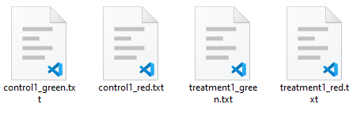
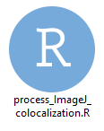
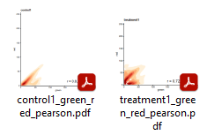
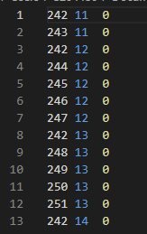
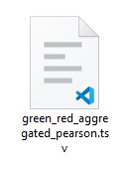

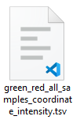
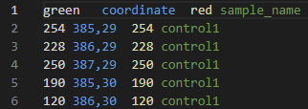
Input: A list of txt files containing XY coordinates and pixel intensity
Output: A list of 2D density plots in pdf for each sample, and two summary tables with coordinates and pixel intensity for each sample and Pearson stats.

Slide 2
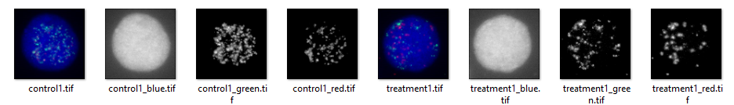
Important notes!!!
Before using ImageJ to extract pixel coordinates and corresponding pixel intensity, RGB composite images should be converted to single-color channel, greyscale images. We have an R script to do so.
Saved XY coordinate files from ImageJ should be named properly. We recommend this format: sample_channel.txt
Importantly, each sample should have 2 (and only 2) txt files for 2 channels. And no other txt files are allowed in the same folder to run the R script.

Slide 3
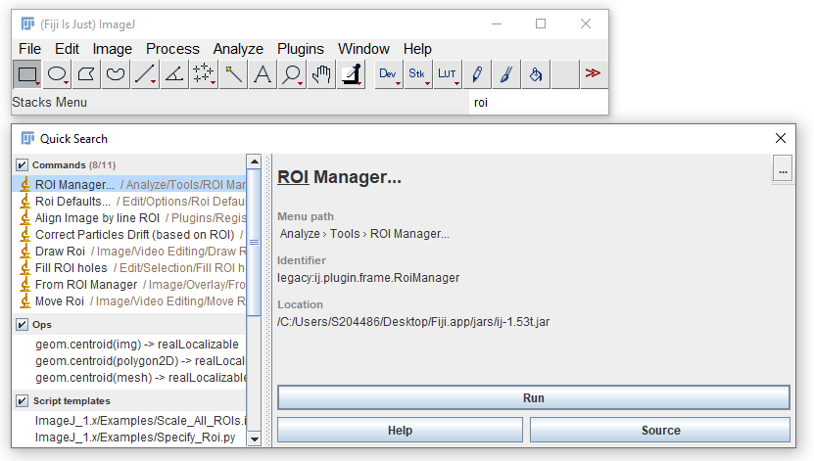
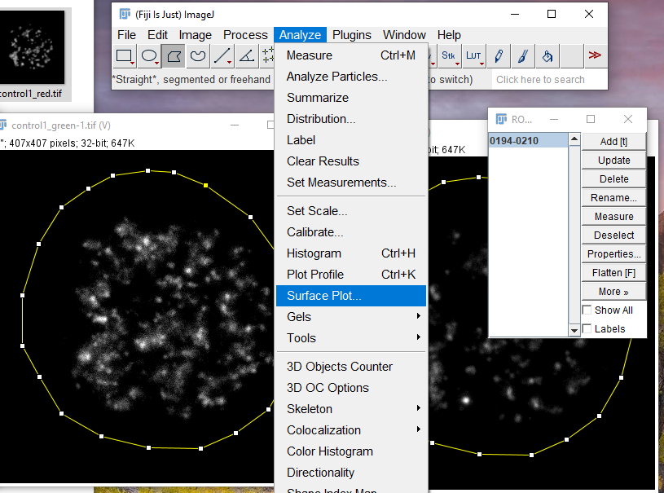
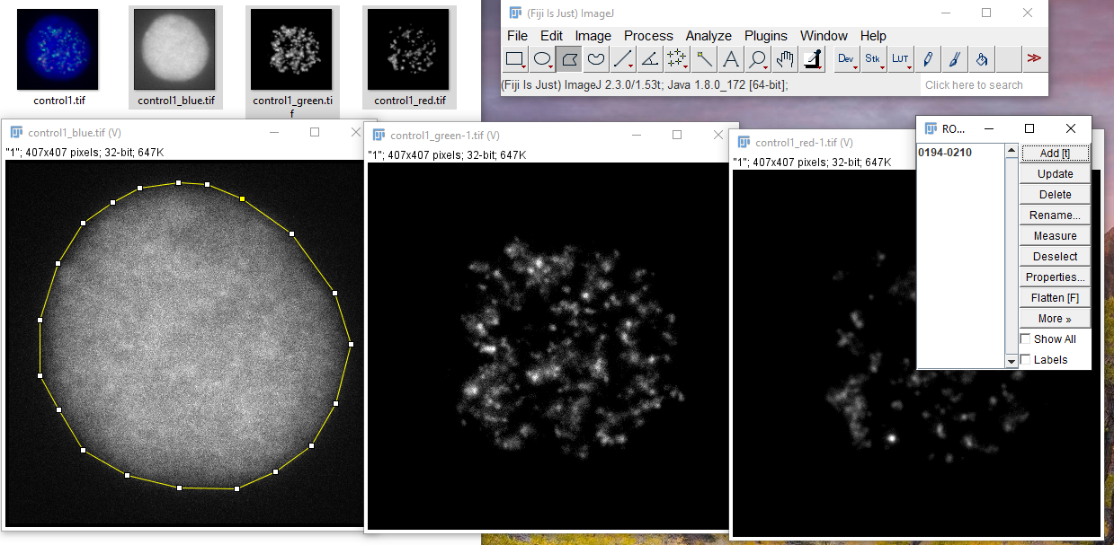
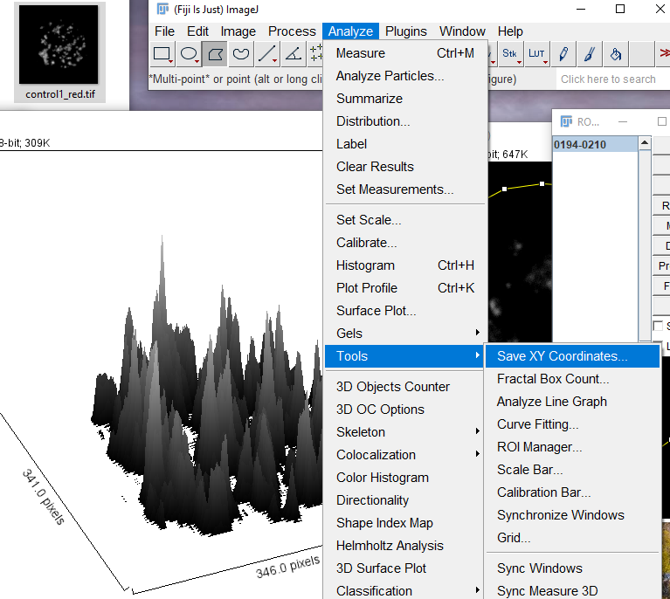
1. Open ROI manager
3. Apply ROI to the desired channels, run Analyze – Surface plot
2. Draw ROI, click “add” to save the ROI, so that you can apply the same ROI in other channels
4. Save XY coordinates and pixel intensity data by Analyze – Tools – Save XY coordinates

