Slide 1
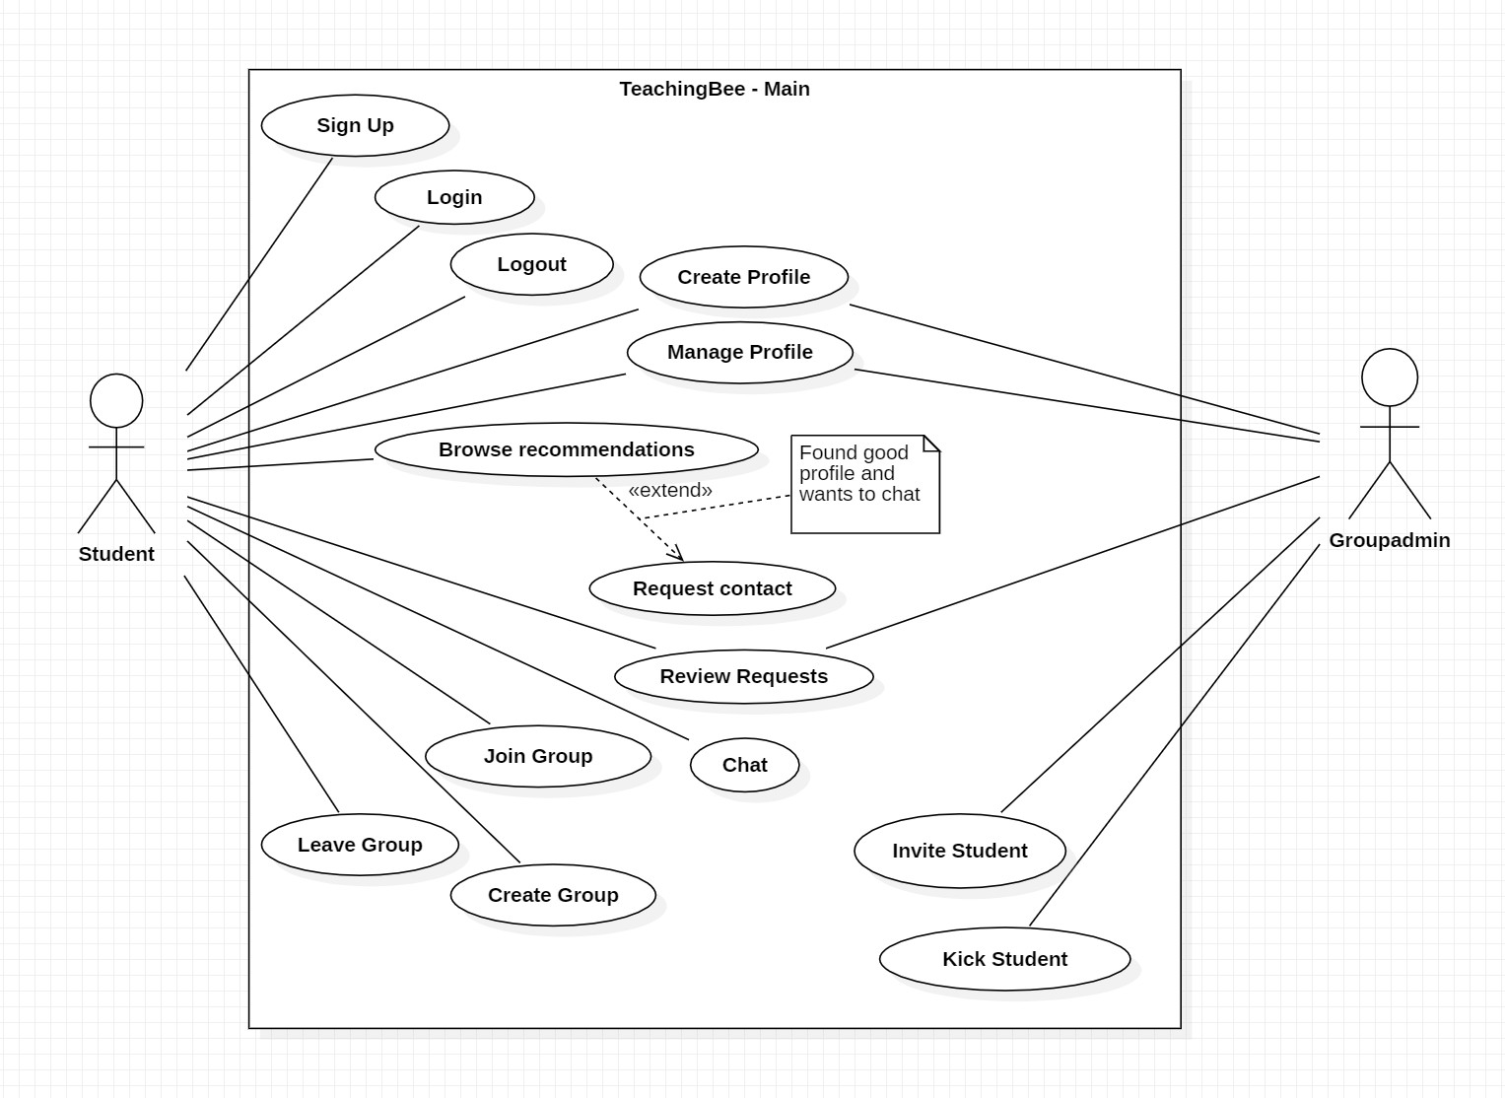
Use Case Diagram – Documentation
Gruppe 5
Use Case Diagram - Documentation
Disclaimer:
In the following we always referred to the user as “he”. This was only for the sake of simplicity and no discrimination or harm was intended. We want to state that we include students of every gender.

Slide 2
Gruppe 5
Use Case Diagram - Documentation
Name | Sign Up
Actor(s) | Student
Trigger | Student wants to use the app and logs in for the first time.
Description | The student must enter his personal information to create an account. This only happens once.
Main Scenario | Step 1 | Provide login information.
 | Step 2 | Enter personal information.
 | Step 3 | Submit the data.
Preconditions | There is no account tied to the supplied log in data.
Postconditions | Student has created an account.
Name | Log In
Actor(s) | Student
Trigger | Student wants to enter the app and he already has an account.
Description | Student wants to enter the app. He is then asked to enter his login information (email, password). If the Data is correct, he is logged in.
Main Scenario | Step 1 | Provide login information.
Preconditions | Student already has an account.
Postconditions | Student is logged in.
Name | Log Out
Actor(s) | Student
Trigger | User wants to log out.
Description | User wants to log out the service.
Main Scenario | Step 1 | Click on “log out”.
 | Step 2 | Close the page.
Preconditions | Student is logged in.
Postconditions | Student is logged out.

Slide 3
Gruppe 5
Use Case Diagram - Documentation
Name | Create Profile
Actor(s) | Student, Groupadmin
Trigger | Student wants to create a student profile. Group wants to create a group profile.
Description | The Student and Group create profile about their interests and information that will later be used in the matchmaking.
Main Scenario | Step 1 | Is asked to create his profile.
 | Step 2 | Enter profile information.
 | Step 3 | Click “Save”.
Alternative Scenario | Step 1 | Is asked to create a group profile.
 | Step 2 | Enter profile information.
 | Step 3 | Click “Save”.
Preconditions | User has just created his account or user has just created a group.
Postconditions | The Student / Group has a profile.
Name | Manage Profile
Actor(s) | Student, Groupadmin
Trigger | Student wants to manage its created student profile. Group wants to manage an already created group profile.
Description | The actors manage their profile by editing, deleting, or adding information.
Main Scenario | Step 1 | Open profile information.
 | Step 2 | Change profile information.
 | Step 3 | Submit new information.
Preconditions | Student is logged in.
Postconditions | Student or group profile is updated.

Slide 4
Gruppe 5
Use Case Diagram - Documentation
Name | Browse recommendations
Actor(s) | Student
Trigger | Student wants to look for compatible students/groups.
Description | Student wants to find new study partners or a new study group. He therefore browses the recommendations until he finds one or multiple. He then might send a request for further contact.
Main Scenario | Step 1 | Open the browse tab.
 | Step 2 | Browse through the profiles.
 | Step 3 | Choose a profile.
Extension | Step 1 | Inspect the profile.
 | Step 2 | Send the request.
Preconditions | Student is logged in.
Postconditions | Student has requested contact to one or multiple students/ groups.
Name | Join Group
Actor(s) | Student
Trigger | Student has received an invitation for a study group and he wants to enter.
Description | Student has received an invitation for a study group and he wants to join. He now joins the group.
Main Scenario | Step 1 | Open the chat.
 | Step 2 | Click on “Join Group”.
Preconditions | User has received an invitation from another student that he has matched with earlier.
Postconditions | User has joined a new study group.

Slide 5
Gruppe 5
Use Case Diagram - Documentation
Name | Create Group
Actor(s) | Student
Trigger | Some students with the same interests want to communicate and learn the same theme.
Description | One student creates a group with a group profile and maybe some first members.
Main Scenario | Step 1 | Click the “create group” button.
 | Step 2 | Enter a group name.
 | Step 3 | Insert some describing data for the group profile.
 | Step 4 | Click the “create group” button.
Preconditions | Student is logged in. Student has a profile with learning preferences.
Postconditions | New group is created.
Name | Leave Group
Actor(s) | Student
Trigger | The student has no longer a need for the group.
Description | A student leaves the group.
Main Scenario | Step 1 | Click the “leave group” button.
 | Step 2 | Confirm the action.
Preconditions | Student is logged in. Student is a member of a group
Postconditions | Student is not a member of the group.
Name | Review Requests
Actor(s) | Student, Groupadmin
Trigger | A student or group has received a request.
Description | The Student or Groupadmin reviews the requests. He then decides whether to accept the request or not.
Main Scenario | Step 1 | Open chat with request.
 | Step 2 | Accept or refuse the request.
Preconditions | Student is logged in. He has received a request for contact or for a group he is the admin of.
Postconditions | The request is resolved.

Slide 6
Gruppe 5
Use Case Diagram - Documentation
Name | Chat
Actor(s) | Student
Trigger | The student wants to chat with a contact or group.
Description | The student wants to chat with a contact or group. He enters the chat and reads/ sends messages.
Main Scenario | Step 1 | Open a chat.
 | Step 2 | Read and write messages.
Preconditions | The student is logged in. The student has a chat with at least contact/ group.
Postconditions | The student has chatted with someone.
Name | Invite Student
Actor(s) | Groupadmin
Trigger | The student wants to invite one of his contacts to a group he is admin of.
Description | The student wants to invite one of his contacts to a group he is admin of. Then he sends an invitation to the contact.
Main Scenario | Step 1 | Open the group.
 | Step 2 | Click on “Add Member”.
 | Step 3 | Chose a contact from his contact list.
 | Step 4 | Send an invitation.
Preconditions | Student is logged in. Student is admin of a group. Student has at least one free contact.
Postconditions | The contact has received an invitation.

Slide 7
Gruppe 5
Use Case Diagram - Documentation
Name | Kick Student
Actor(s) | Groupadmin
Trigger | The Groupadmin wants to kick a Group member.
Description | The Groupadmin wants to kick a Group member. He choses the member from the group member list and clicks on “kick member”.
Main Scenario | Step 1 | Open Group info.
 | Step 2 | Choose member.
 | Step 3 | Click on “Kick member”.
Preconditions | The student is logged in. The student is the admin of a group with at least one member besides the admin.
Postconditions | The second student is no longer a member of the group.

