Slide 1
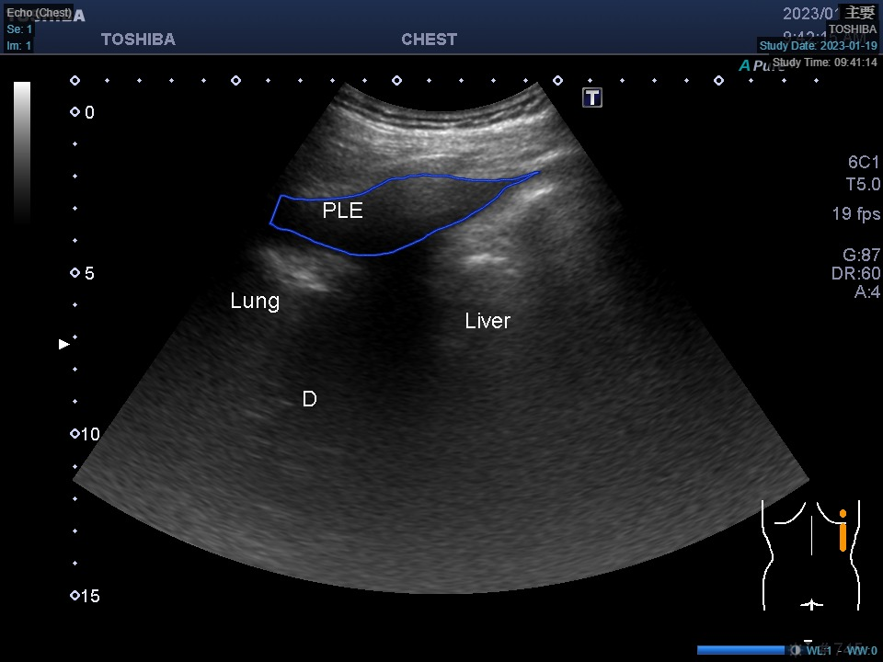
0
120
360
480
600
720
840
960
240
Width//2-105, 90
Width//2+105, 90
90
330, 170
640, 170
180
960 x 720
360
185, 370
775, 370
80, height-200
Width-80, height-200
540
630
230, height-85
Width//2, height-75
Width-230, height-85
720

Slide 2
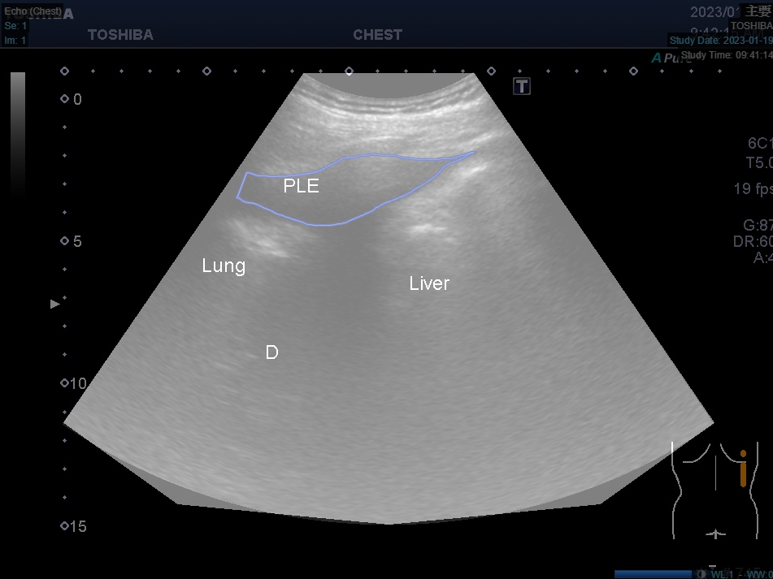

Slide 3
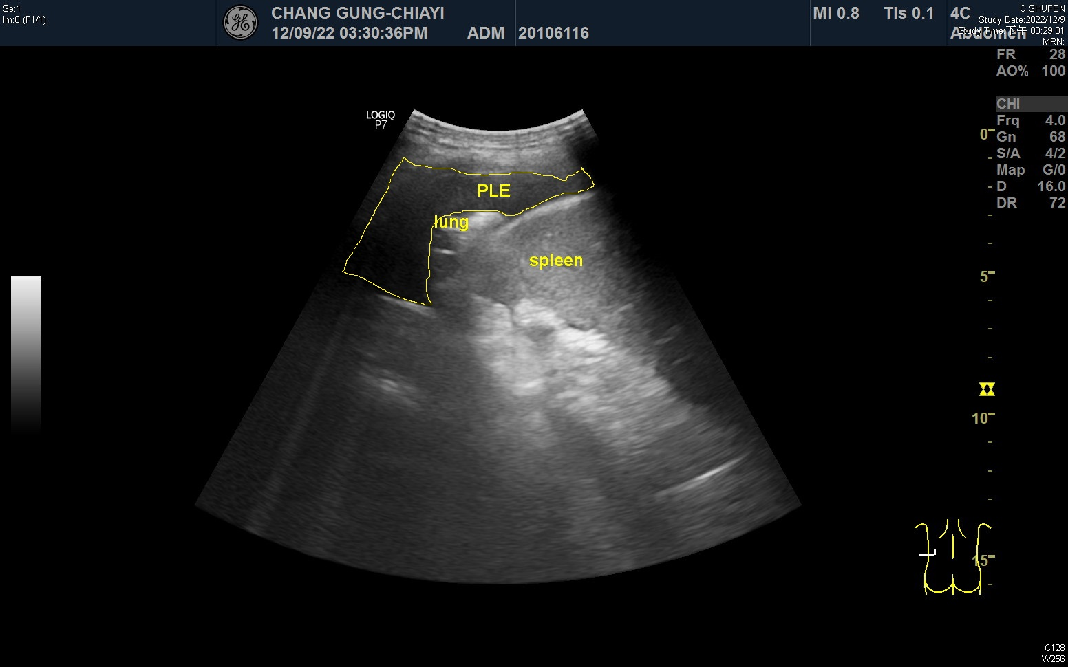
0
120
240
360
480
600
720
840
960
0
90
370, 118
525, 118
180
350, 170
545, 170
For 43， 67
360
240, 405
655, 405
450
540
180, 540
720, 540
630
320, 630
460, 630
600, 630
720

Slide 4
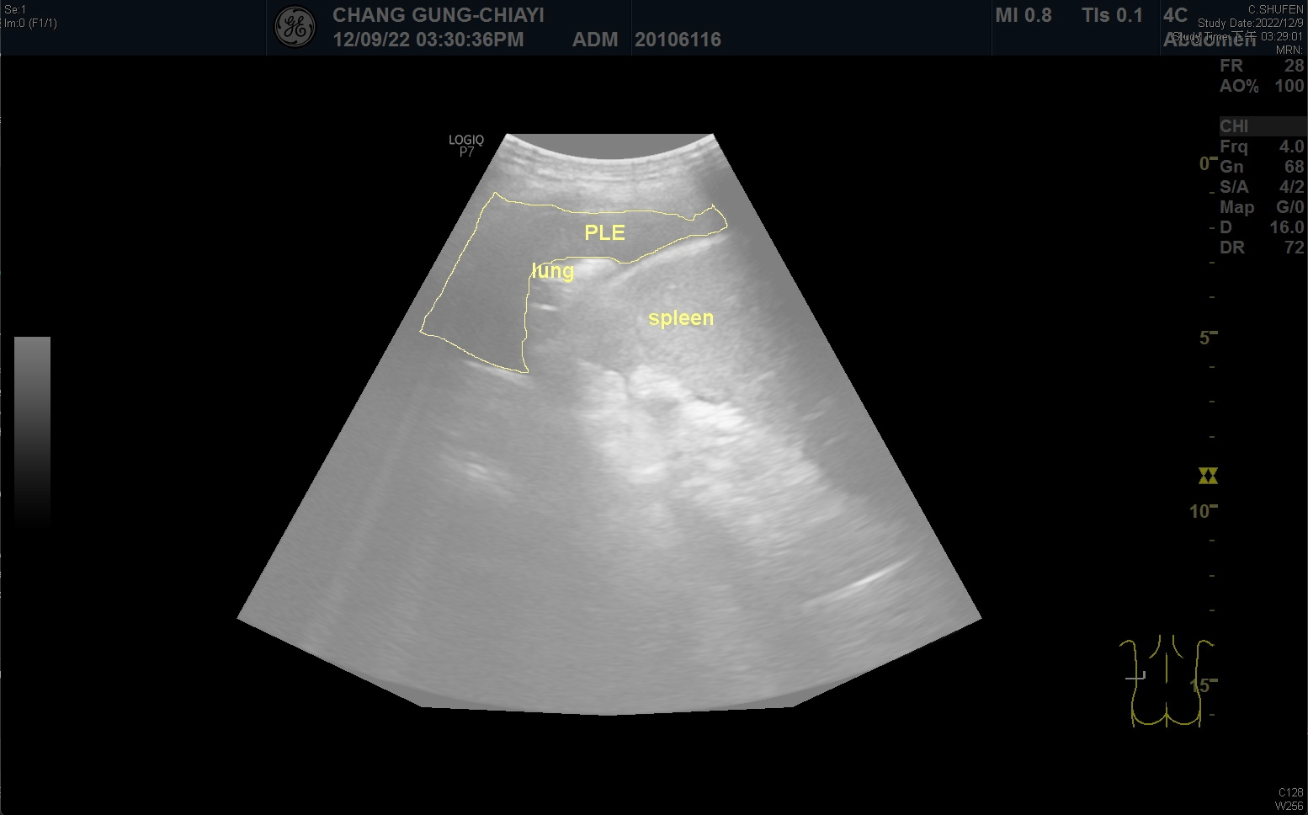

Slide 5
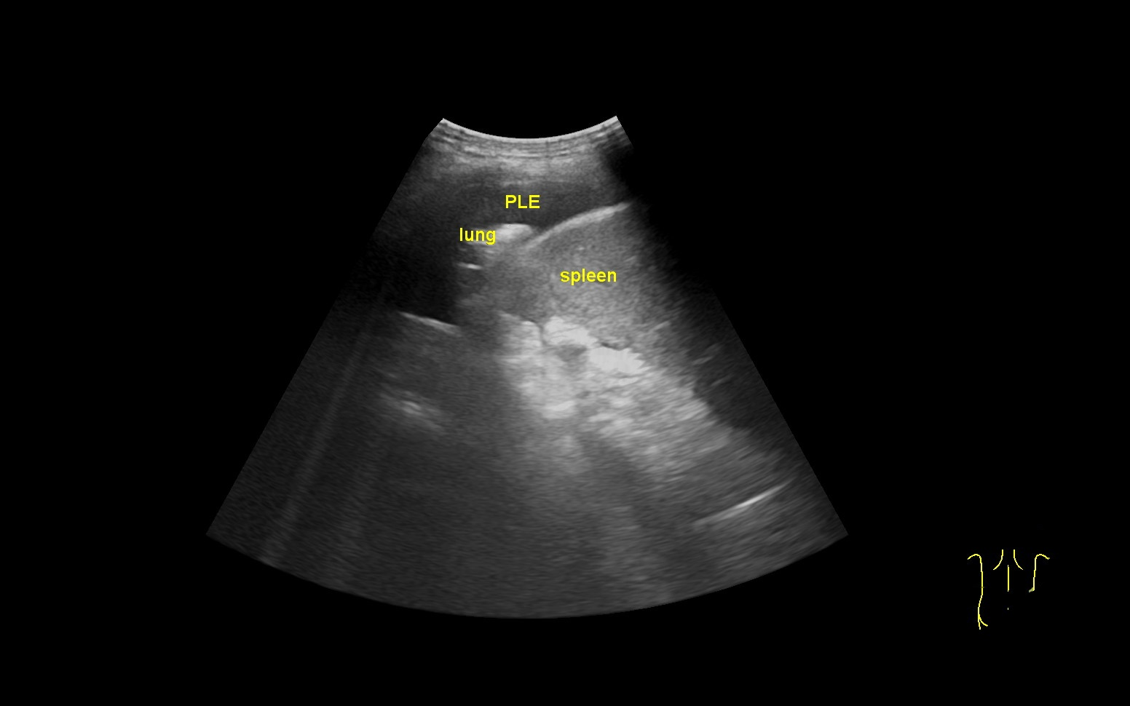

Slide 7
0
194
388
582
776
970
1164
1358
1552
0
121.25
600, 160
845, 160
242.5
For 43， 67
1552 x 970
485
727.5
280, 735
1165, 735
848.75
500, 840
720, 850
940, 840
970

