Slide 1
Credit

Slide 2
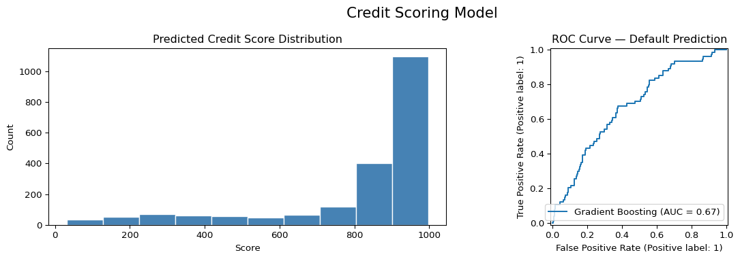
<class 'pandas.core.frame.DataFrame'> RangeIndex: 2000 entries, 0 to 1999 Data columns (total 7 columns): # Column Non-Null Count Dtype --- ------ -------------- ----- 0 Age 2000 non-null int32 1 Annual_Income 2000 non-null float64 2 Credit_History 2000 non-null int32 3 Existing_Debt 2000 non-null float64 4 Employment_Status 2000 non-null int64 5 Num_Loans 2000 non-null int32 6 Default 2000 non-null int32 dtypes: float64(2), int32(4), int64(1) memory usage: 78.3 KB None Top 10 Age Annual_Income Credit_History Existing_Debt Employment_Status \ 0 56 42000.0 2 7400.0 0 1 69 73700.0 7 12600.0 1 2 46 51800.0 2 0.0 1 3 32 28200.0 7 6000.0 1 4 60 26500.0 17 11200.0 1 Num_Loans Default 0 6 0 1 1 0 2 5 0 3 0 0 4 4 0 Bottom 10 Age Annual_Income Credit_History Existing_Debt Employment_Status \ 1995 63 91400.0 16 11000.0 1 1996 67 22900.0 17 20100.0 0 1997 69 30700.0 11 29100.0 1 1998 24 55900.0 7 2700.0 0 1999 20 49900.0 1 6600.0 1 Num_Loans Default 1995 7 0 1996 2 1 1997 7 0 1998 7 0 1999 4 0 Default rate: 18.4% AUC-ROC: 0.672 precision recall f1-score support No Default 0.83 0.91 0.87 326 Default 0.32 0.18 0.23 74 accuracy 0.78 400 macro avg 0.57 0.54 0.55 400 weighted avg 0.74 0.78 0.75 400

