Slide 1

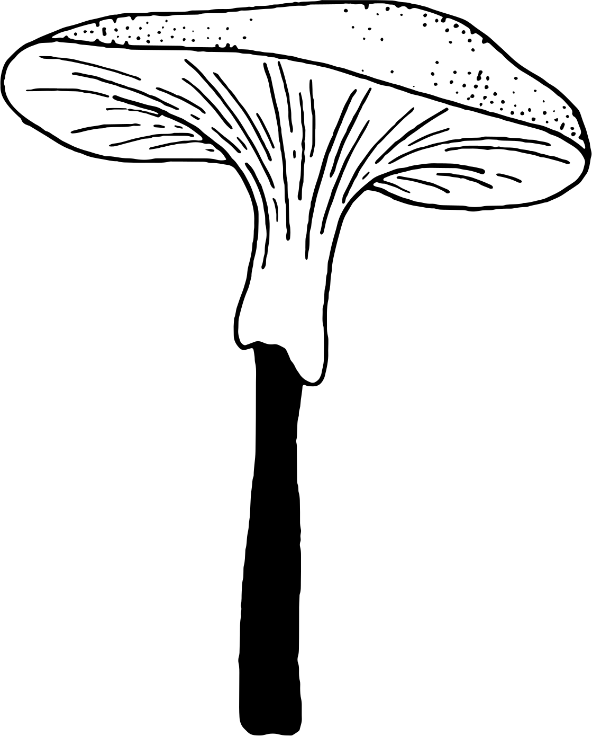
Mushroom Classification Project
19 December 2021
Aishah Alanazi &Hussain Alsultan and Shaikha Saud

Slide 2
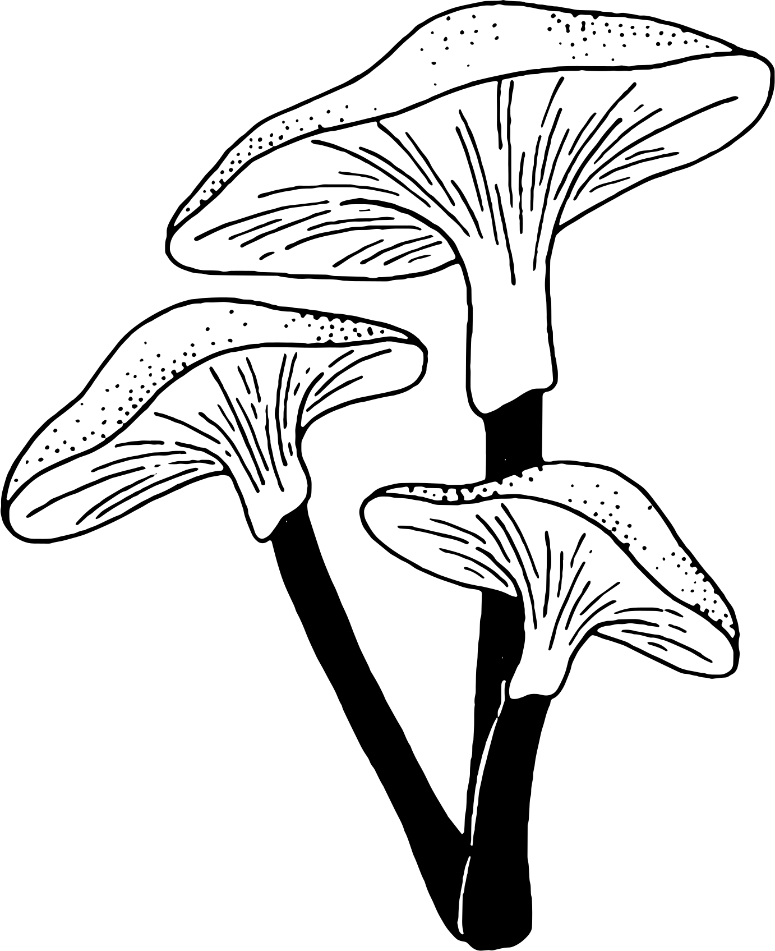
Table of contents:
Introduction
Methodology
Dataset
Data Analysis
Classification Models
Tools
Conclusion

Slide 3
Introduction
Mushrooms exists naturally in different types in diverse environments and different shapes, it can be recognized with some common features. Mushrooms are common for their vast usages medical, nutritional and therapeutical properties. However, some types are known for their toxicity. Which causes huge number of fatal accidents yearly, because of misidentification. Creating a model that recognizes the edible types of mushrooms can safe many precious lives.

Slide 4
Methodology
Problem Understanding
Load Data
EDA
Feature Engineering
Results & Insights
Classification

Slide 5
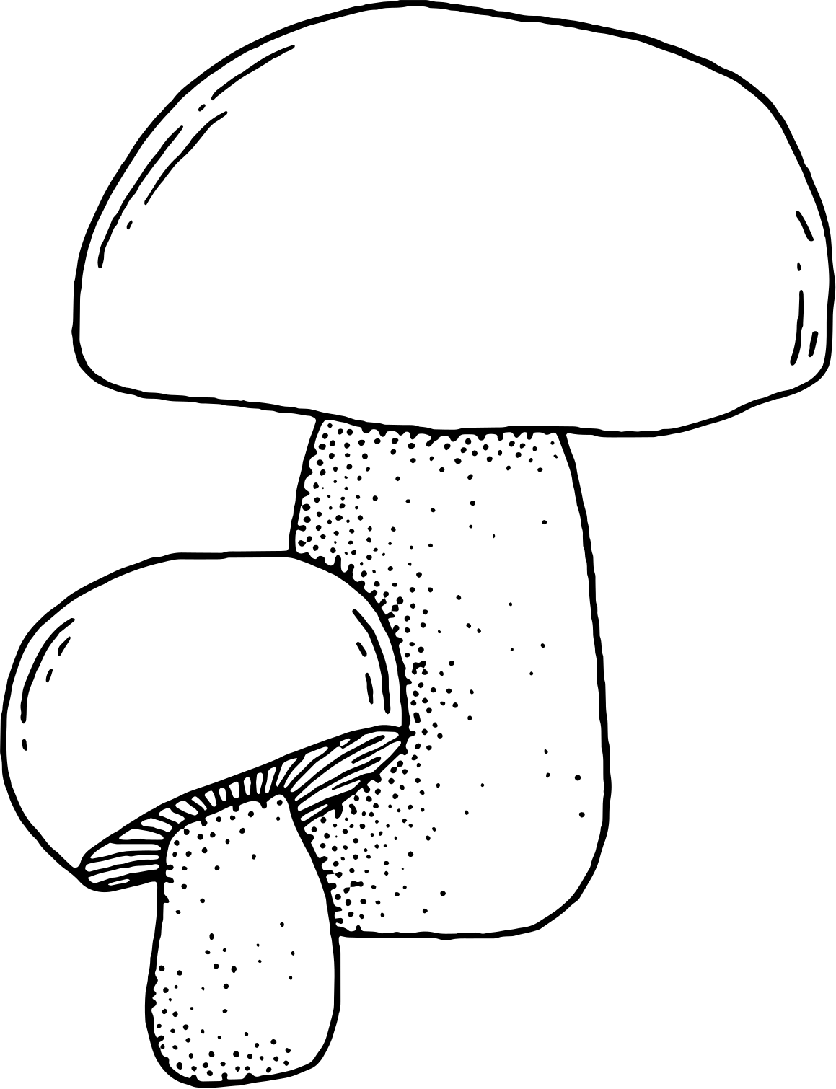
Dataset
Source
Kaggel
Record
8124 rows
Feature
23 columns
Target columns
1- edible 2- poisonous

Slide 6
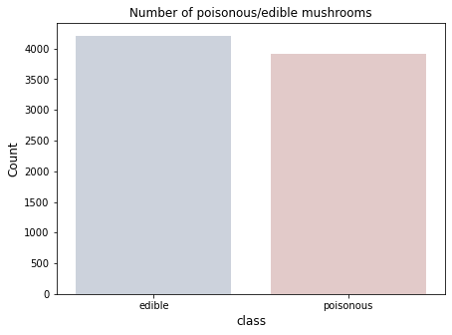
Data Analysis
How many poisonous and edible mushrooms?
No imbalance

Slide 7
Data Analysis
Identify weather mushrooms are edible or poisonous based on
Cap-shape
Stalk-root
Gill-color
Gill-attachment
Stalk-color-
below-ring
Stalk-color-
above-ring
Odor
Ring-type

Slide 8
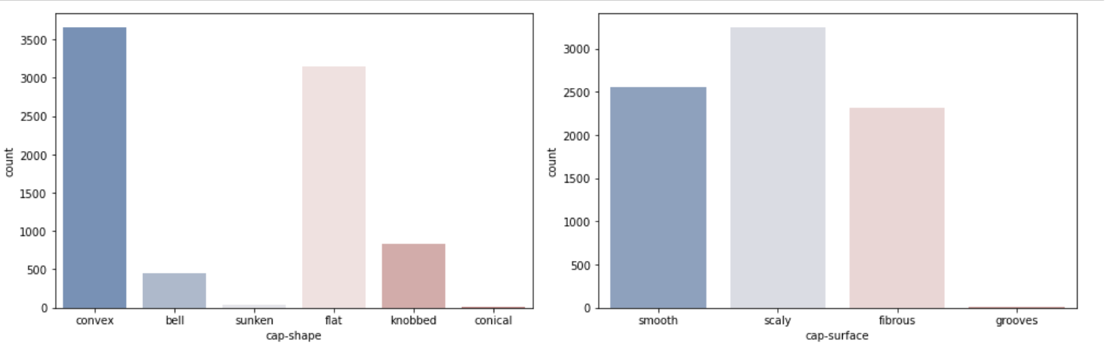
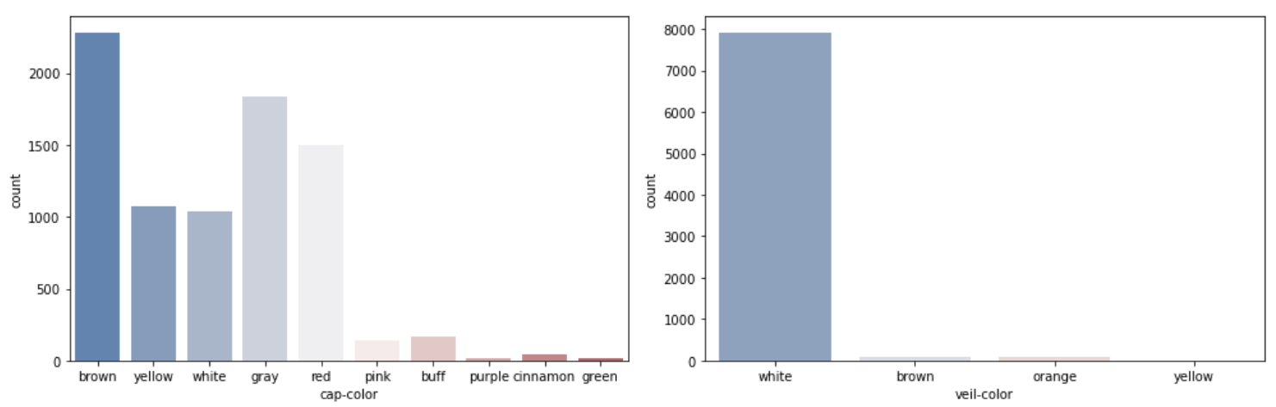
Data Analysis
Edible and poisonous mushrooms based on cap-shape
Edible and poisonous mushrooms based on cap-surface
Edible and poisonous mushrooms based on cap-color
Edible and poisonous mushrooms based on veil-color

Slide 9
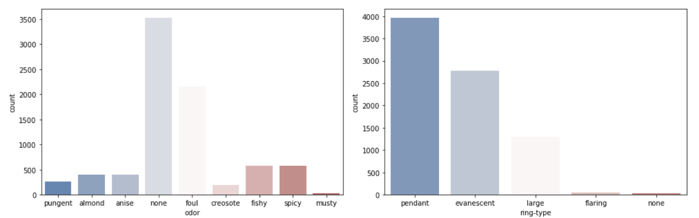
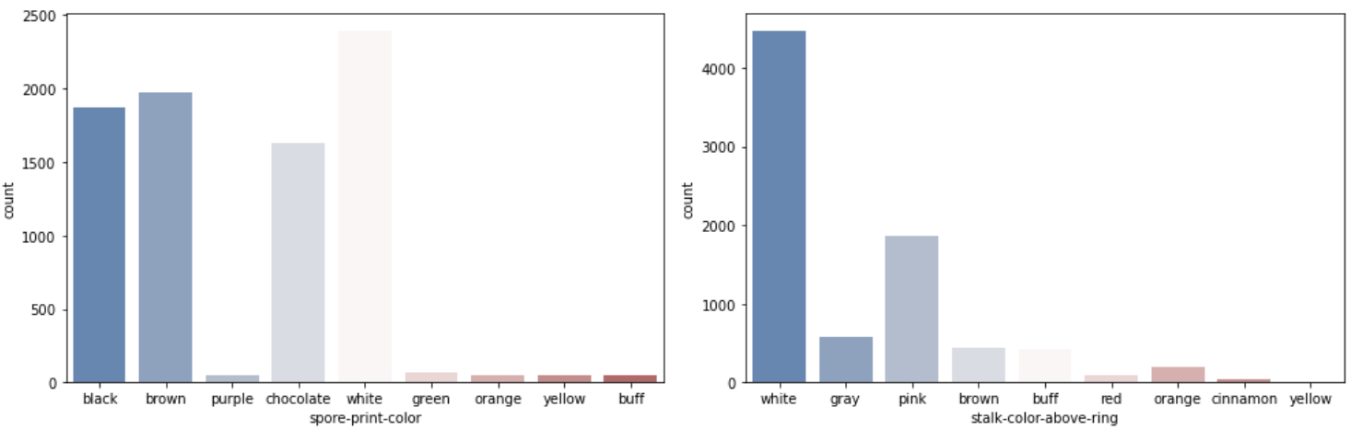
Data Analysis
Edible and poisonous mushrooms based on odor
Edible and poisonous mushrooms based on ring-type
Edible and poisonous mushrooms based on spore-print-color
Edible and poisonous mushrooms based on stalk-color-above-ring

Slide 10
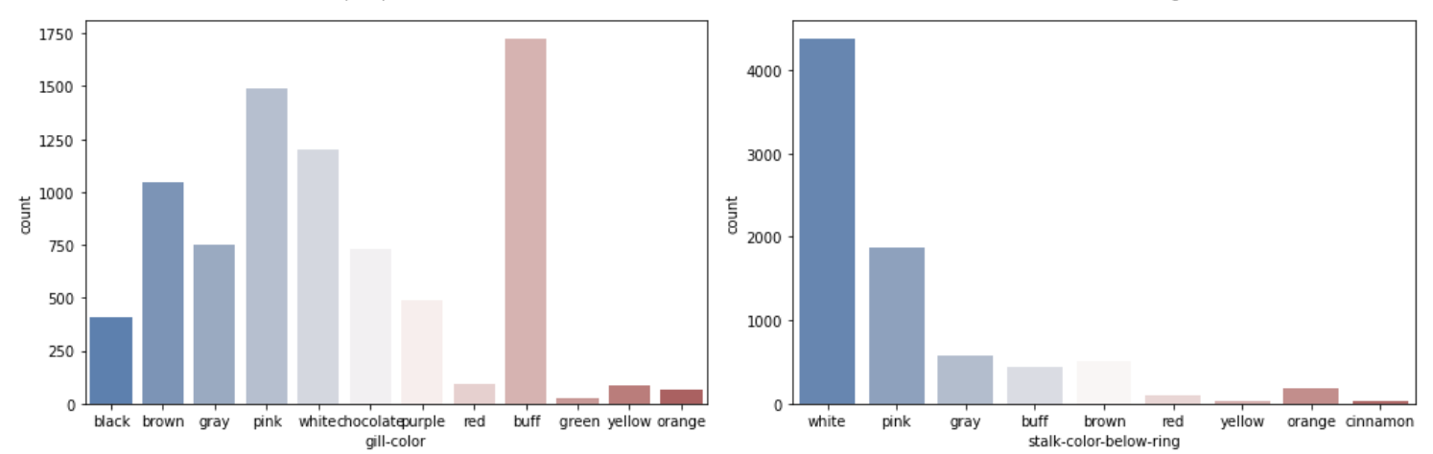
Data Analysis
Edible and poisonous mushrooms based on gill-color
Edible and poisonous mushrooms based on gill-color stalk-color-below-ring

Slide 11
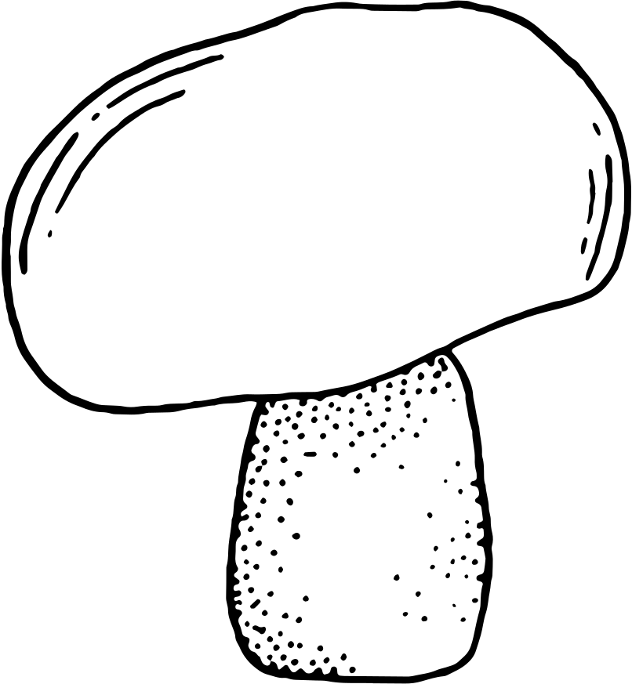
Classification Models
K-NearestNeighbour
Random Forest Classifier
Decision Tree
Logistic Regression
Naive Bayes
Support Vector Classifier
Extreme Gradient Boost

Slide 12
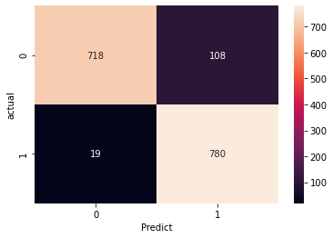
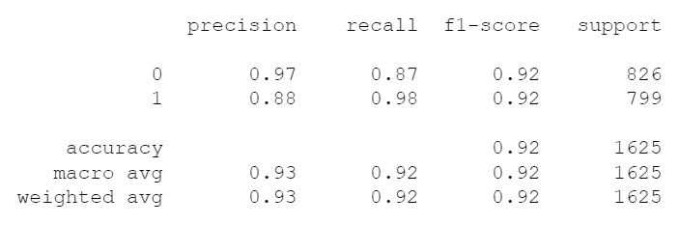
K-Nearest Neighbour

Slide 13
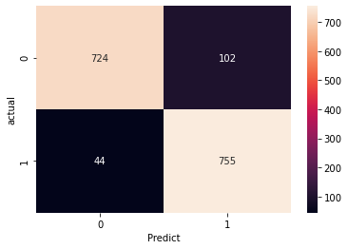
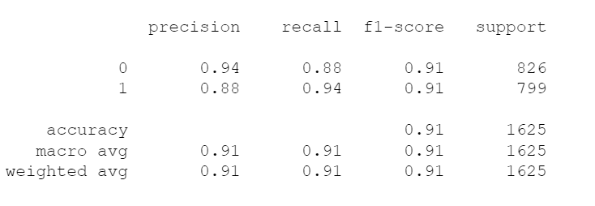
Random Forest

Slide 14
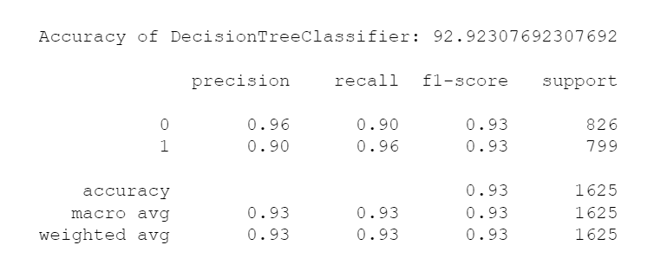
Decision Tree

Slide 15
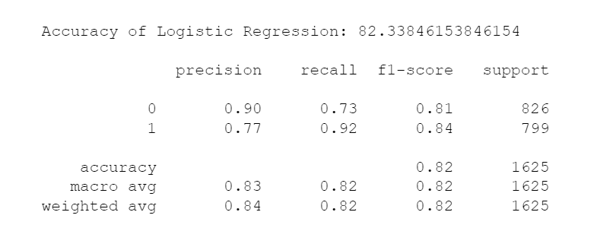
Logistic Regression

Slide 16
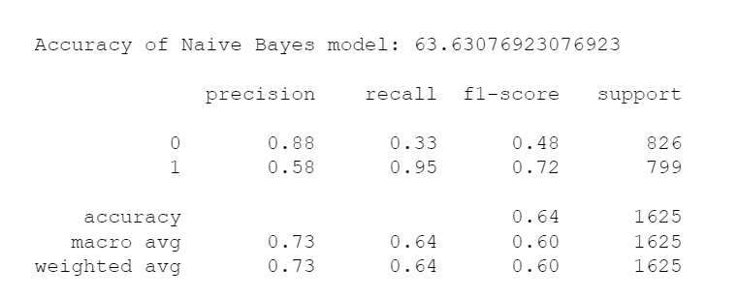
Naive Bayes

Slide 17
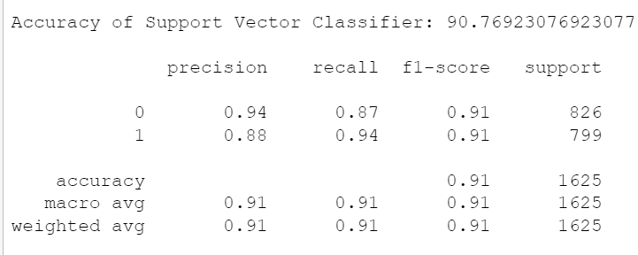
Support Vector Classifier

Slide 18
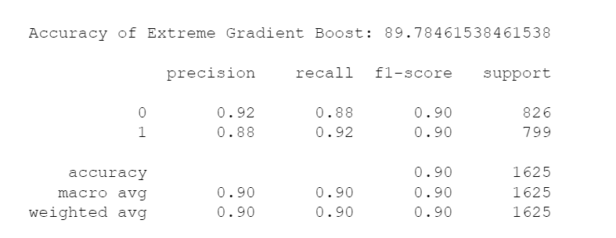
Extreme Gradient Boost

Slide 19
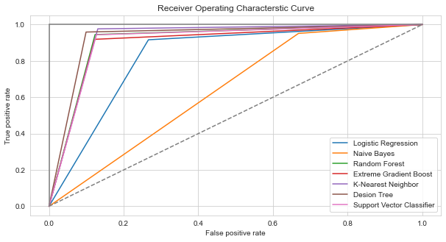
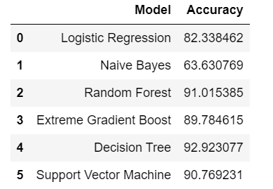
Receiver Operating Characterstic Curve

Slide 20
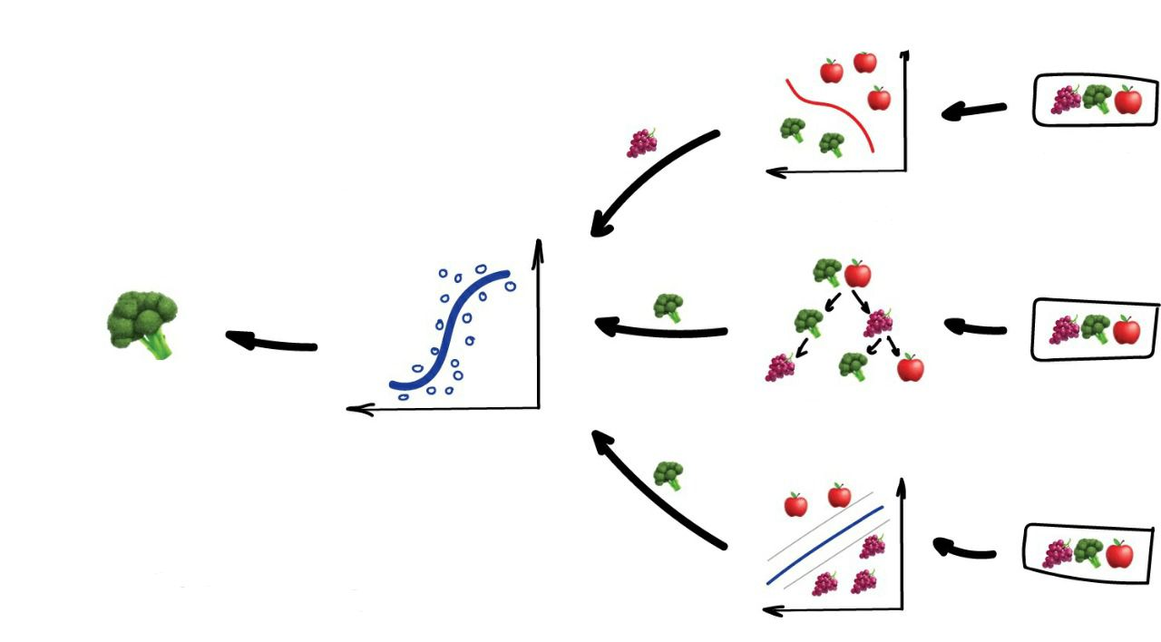
Ensembling

Slide 21
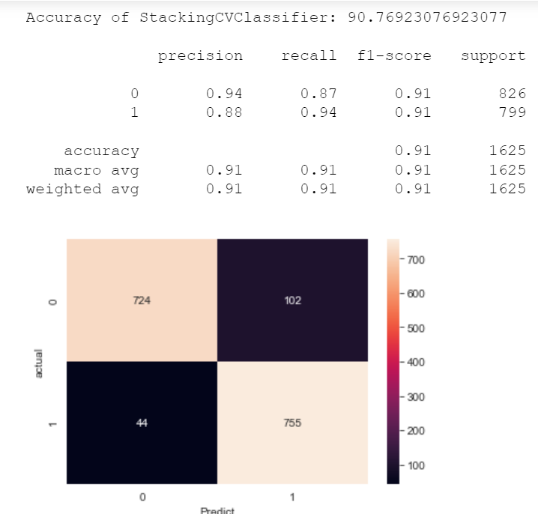
Ensembling
Xgb + nb + SVC

Slide 22
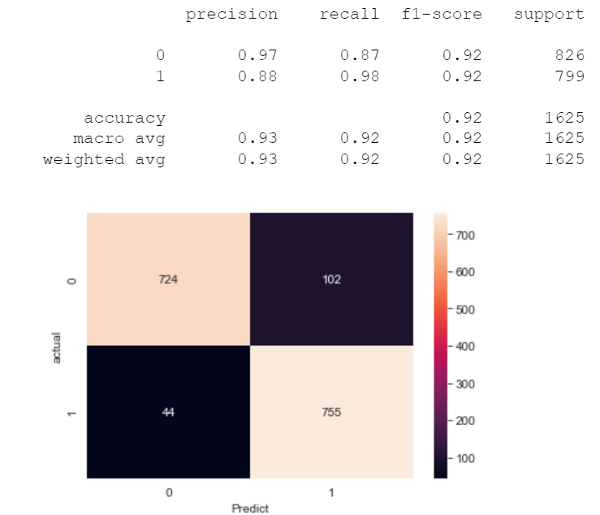
Ensembling
Nb + knn + SVC

Slide 23
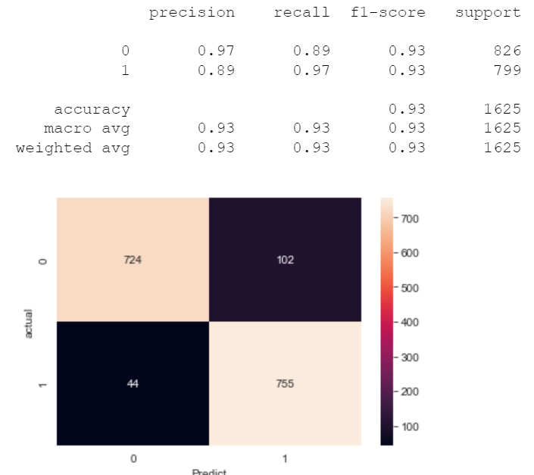
Ensembling
Xgb + knn + nb + SVC + Lr

Slide 24
Tools
Libraries : pandas, numpy , matplotlib, seaborn, plotly , sklearn
Softwares : Trello, GitHub, Jupyter , VSCode , Word & PowerPoint , Zoom
Conclusion
We discussed the most relevant features that can be identified to determine whether mushrooms are edible or poisonous. Implementing models that identify these important features can save companies time and money as well as saving precious lives.

Slide 25
Thank You!
Any Question?

