Slide 1

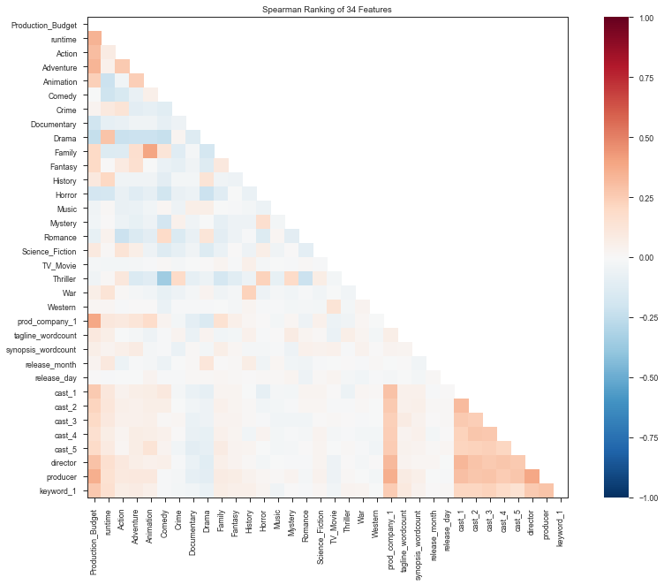
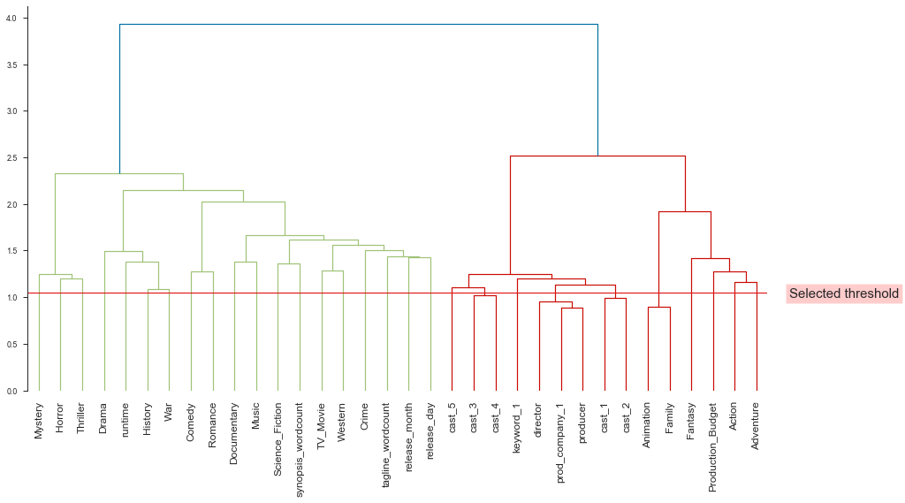
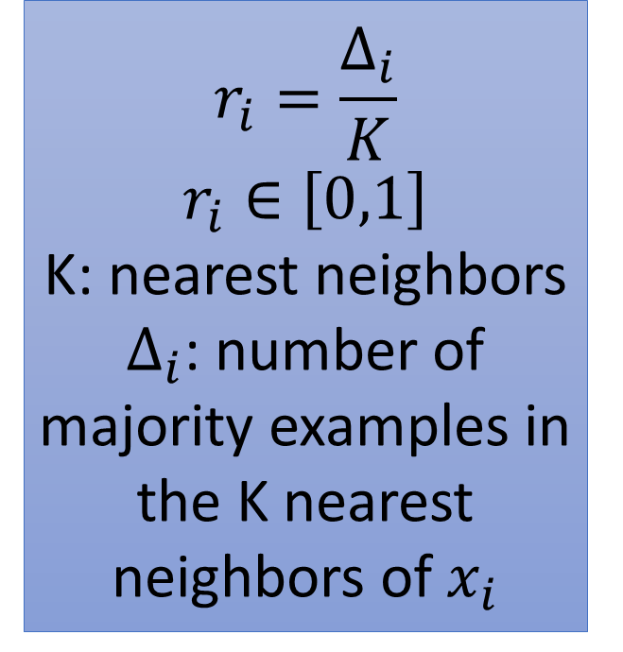


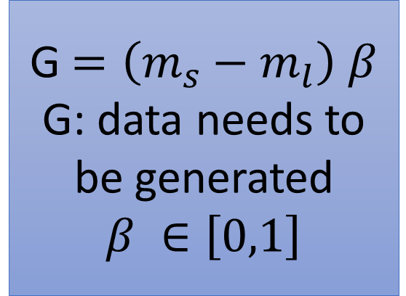


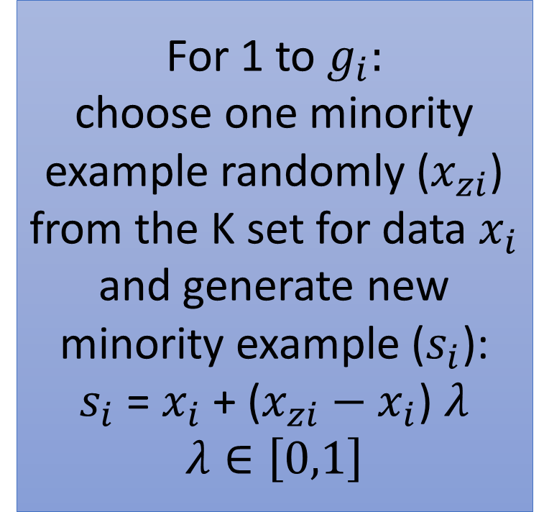
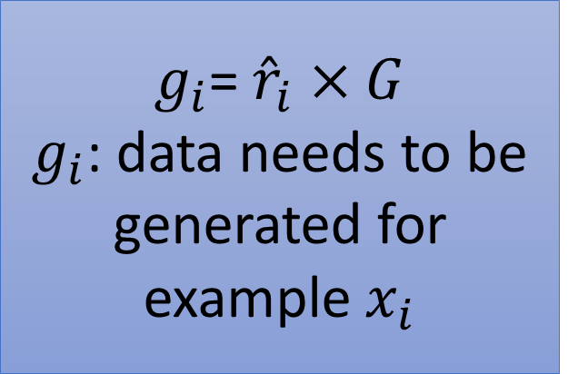

Early Prediction of Movie Success
with High Cardinal Imbalanced Data
Sina Balkhi, Max Ou, Urvi Chauhan, Saboora M. Roshan, and Greg Mori
Introduction
Results and Discussion Cont.
Problem Statement
Collecting, cleaning, and preparing movie dataset
Predicting success of movies before their release
Evaluating and Comparing different models
Literature Review
Cinema Ensemble Model (CEM) with accuracy of 58.5%
Movie Investor Assurance System (MIAS) with accuracy of 73%
Movie success prediction with accuracy of 61% (Random Forest)
Materials and Methods
Data Collection and Preparation
2697 movies and 41 features (80% train set and 20% validation set )
Collecting data from TMDb and removing production country
Collecting budget and revenue features from The Numbers and keyword features from Kaggle
Imputing missing values in runtime feature with the mean of movie runtimes
Encoding categorical features using three methods:
CatBoost
Leave One Out
Weight of Evidence
IV: Information Value
Target labeling
WOE = $\ln\left(\frac{Event\%}{Non Event\%}\right) IV= \sum{\left(Event\%−Non Event\%\right)×\text{WOE}}$
worldwide gross revenue > budget: label 1
worldwide gross revenue < budget: label 0
Handling Imbalanced Data with three Oversampling Methods:
SMOTE
ADASYN
Weight balancing
ADASYN Method:
$$r_{i}=\frac{∆_{i}}{K}$$
$$r_{i}∈\left[0,1\right]$$
K: nearest neighbors
$∆_{i}$: number of majority examples in the K nearest neighbors of $x_{i}$
$$d=\frac{m_{s}}{m_{l}}$$
$m_{s}$: number of minority class data
$m_{l}$: number of majority class data
$d$: degree of class imbalance
$$d<d_{th}$$
$$d_{th}:thereshold$$
G $=\left(m_{s}−m_{l}\right) β$
G: data needs to be generated
$$β ∈\left[0,1\right]$$
Final Table
YES
$g_{i}$= ${\hat{r}}_{i}$ $×G$
$g_{i}$: data needs to be generated for example $x_{i}$
For 1 to $g_{i}:$
choose one minority example randomly ($x_{zi}$) from the K set for data $x_{i}$ and generate new minority example ($s_{i}$):
$s_{i}$ = $x_{i}$ + ($x_{zi}−x_{i}$) $λ$
$$λ∈\left[0,1\right]$$
Conclusion and Future Scope
$${\hat{r}}_{i}= \frac{r_{i}}{\sum_{i=0}^{m_{s}}{r_{i}}}$$
SMOTE Method:
Features of new minority data (r) = T’s features + (T’s features – n’s features) $×$ rand (0,1)
Compute K neighbors for each minority class data T
Pick one data (n) randomly from neighbors
Classification Methods
Gaussian Naïve Bayes
$\hat{y}= \underset{k∈\{1,…, K\}}{argmax}{P(C_{k})}\prod_{i=1}^{n}{P(\left.x_{i}\right|C_{k})}$
Random Forest
$\hat{y}$ = $\frac{1}{m}\sum_{j=1}^{m}{\sum_{i=1}^{n}{W_{j}}}(x_{i} , \acute{x})$ $y_{i}$
Support Vector Machine
Cost function: $\left[\frac{1}{n}\sum_{i=1}^{n}{max⁡(0,1−y_{i}(w.x_{i}−b))}\right]$
References
K. Lee, J. Park, I. Kim et al. “Predicting movie success with machine learning techniques:
ways to improve accuracy”, Journal of Information Systems Frontiers, Vol. 20, Issue. 3, pp. 577-588,
June 2018, [Online]. Available: https://doi.org/10.1007/s10796-016-9689-z
M. T. Lash and K. Zhao, “Early Predictions of Movie Success: The Who, What, and When of Profitability,” Journal of Management Information Systems, Vol. 33, No. 3, pp. 874–903, [Online]. Available: https://doi.org/10.1080/07421222.2016.1243969
R. Dhir, A. Raj, “Movie Success Prediction using Machine Learning Algorithms and their Comparison,” 2018 First International Conference on Secure Cyber Computing and Communication (ICSCCC), Jalandhar, India, Dec. 15-17, 2018
Results and Discussion
Contact Information: sbalkhi@sfu.ca, uchauhan@sfu.ca, maxo@sfu.ca, sabooram@sfu.ca, and mori@cs.sfu.ca

