Slide 1
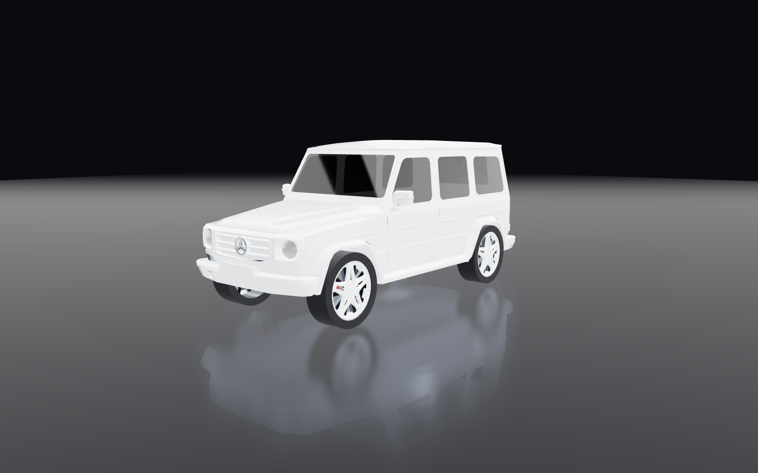
AUTOVERSE
See your car before
you change a thing.
A 3D car configurator where every part is fitted by measuring the car, wired to five machine learning features that each answer a question an owner actually has.
autoverse-two.vercel.app
Notes:
AutoVerse is a 3D car configurator plus five machine learning features. The promise in one line: see your own car modified, faithfully, before you spend anything.

Slide 2
Why it exists
Plausible is not the same as true.
Wheels found by geometry
130 of 612 materials in the models are literally named “material”. Names cannot be trusted, so nothing depends on them.
Exhausts placed on the valance
It started with one car and one question: what would it look like lowered, on different wheels? The obvious answer was to photograph it and ask an image model.
What came back was always convincing and never right. The proportions drifted. The wheels sat where wheels usually sit, not where they sit on that car. It was a picture of a car like mine.
So everything here is measured rather than imagined.
Measured per car, so a tip tucks under a Corvette and a Hilux without either being special-cased.
Paint kept off the lamps
The lamps are found first, then everything else takes colour.
A scan that admits doubt
Below a measured confidence floor the damage model says nothing rather than guessing.
Notes:
This is the thesis slide. The failure of AI photo editing is the reason the project exists, and every engineering decision follows from it.

Slide 3
What is in it
Six places to go, each answering a real question
01
Customise
02
Discover
03
Value
Build it in 3D
Find the right car
What it is worth
Paint, wheels, stance, exhaust, lights — priced in ₹
166 Indian models, matched on what you need
Gradient boosted trees, R² 0.947
04
Identify
05
Repair
06
Garage
What car is that
What will it cost
Everything you saved
Recognised from a photo, on your device
Damage named by a trained model, then costed
Builds, wishlist, recently viewed
Notes:
The menu was renamed so each item says what it does rather than how it works.

Slide 4

✦
THE LANDING PAGE
A real car, turning
Not a render. The same 3D engine the configurator uses.
Fifteen cars cycle through the hero, each one loaded and measured live
Click any name to bring that car forward
The next model downloads while the current one is still on screen, so the swap never stalls
Everything below scrolls in on reveal, and honours a reduced-motion preference
Notes:
The hero is the product demonstrating itself rather than a picture of it.

Slide 5
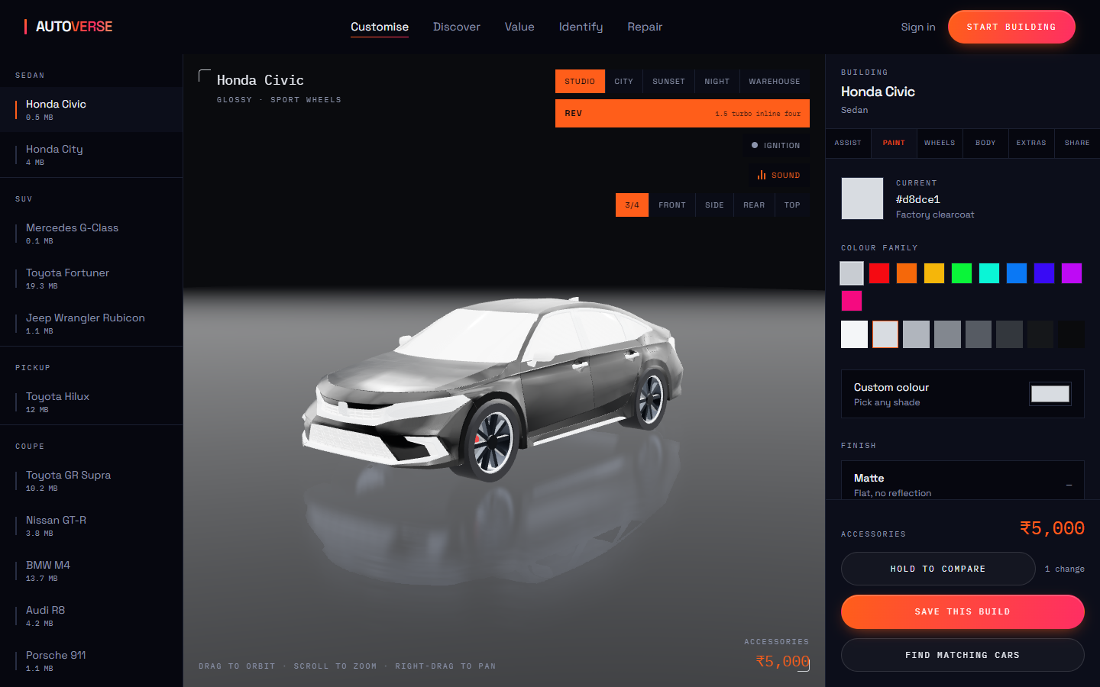
01
CUSTOMISE
The configurator
Fifteen cars, six panels of controls, every part priced.
Parts are fitted by measuring each model, not by trusting mesh names
Five rooms to stand the car in: studio, city, sunset, night, warehouse
Four camera presets, plus free orbit, zoom and pan
A running total in rupees, and a count of what you have changed
Hold to compare snaps back to factory so you can see the difference
Notes:
The centrepiece. Left: the garage. Middle: the car. Right: the controls.

Slide 6
02
CUSTOMISE / PAINT
Paint that behaves
Colour, finish, and a surface you can calibrate.
Nine colour families plus a full custom picker
Matte, gloss and metallic, each changing how light actually lands
Metalness, roughness and clearcoat exposed for anyone who wants them
Headlights, tail lights, chrome and glass keep their factory look — they are found by measurement first, then left alone
Notes:
Painting the lamps was the original giveaway that a configurator is fake. The lamps are detected geometrically and excluded.

Slide 7
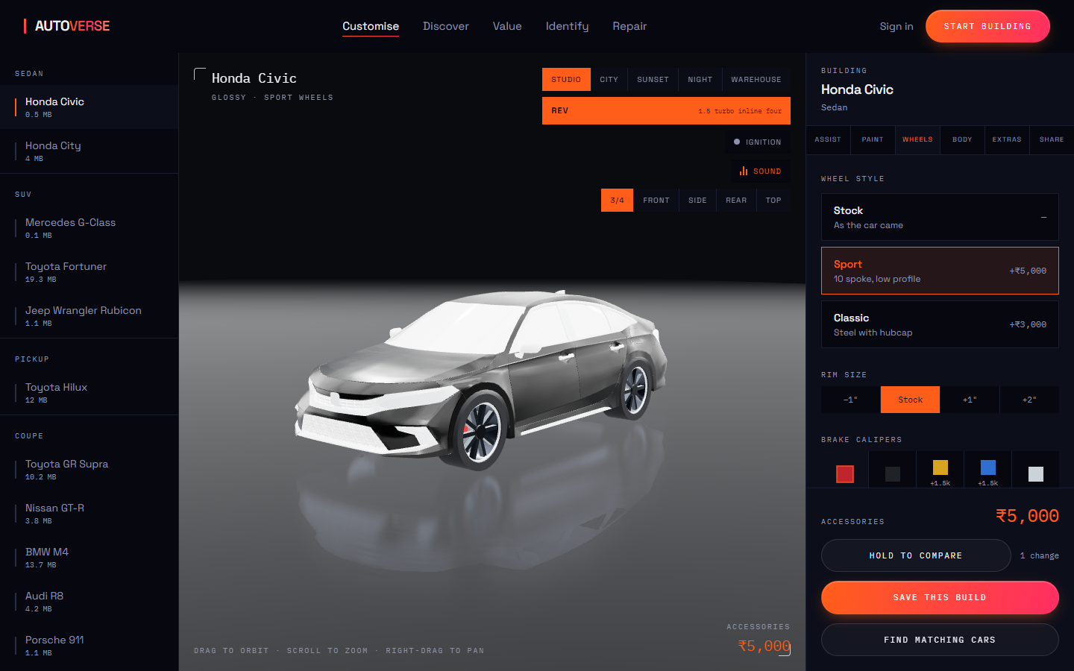
03
CUSTOMISE / WHEELS
Wheels, stance, calipers
Found by geometry, so they drop into the right arches.
Sport and classic designs, built from the dimensions measured on that car
Plus-sizing trades sidewall for rim, exactly as fitting bigger alloys does
Ride height is a fraction of how far that body can drop before it meets the road
Brake calipers in five finishes — the one modification visible through the spokes
Notes:
Wheel detection is the heart of the project: mirrored pairs, wheelbase checks, centre one radius above the ground.

Slide 8
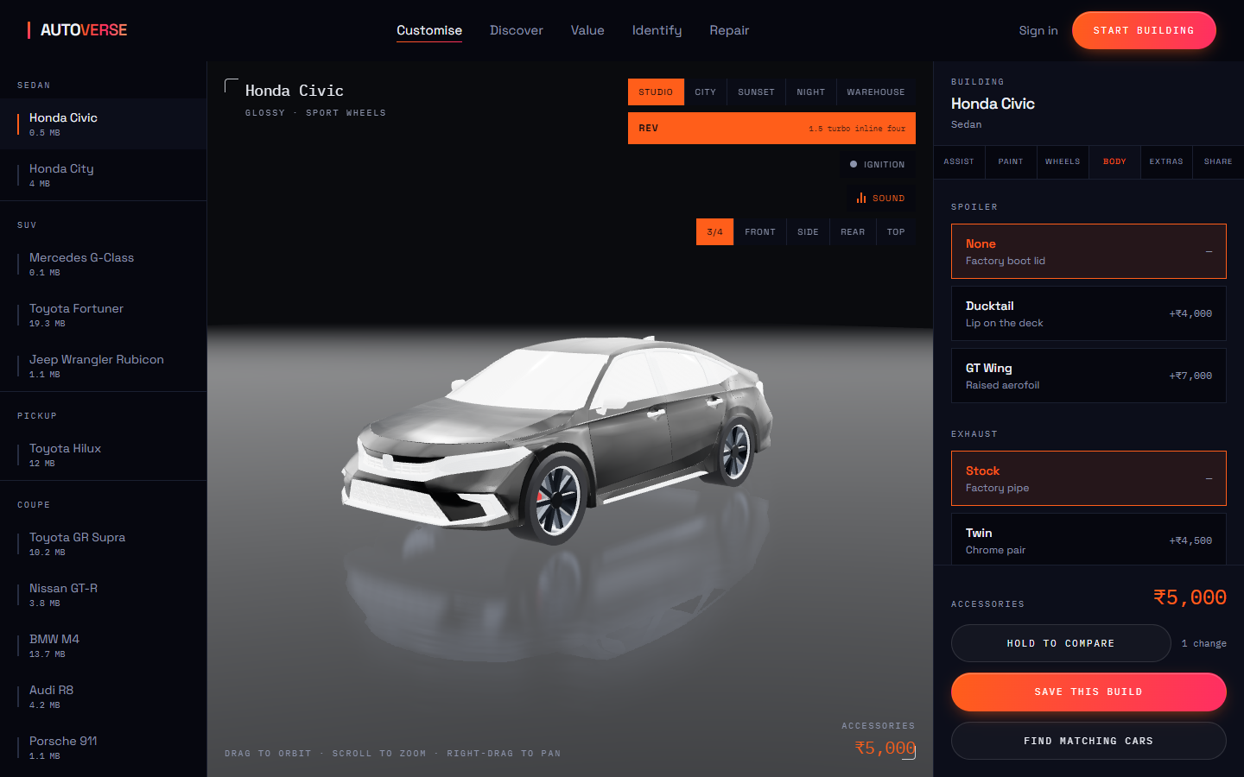
04
CUSTOMISE / BODY
Spoiler, exhaust, wrap
Placed against the car, not at a guessed offset.
A spoiler is raycast onto the boot lid, so it lands on the panel
Exhaust tips sit under the measured rear valance and inboard of its corners
Twin, quad, centre and carbon layouts, sized as a fraction of the car
Wraps are injected into the shader, so they work on models with no UV map
Notes:
The exhaust used to hang in the air behind the bumper. It is now measured against the valance on every car.

Slide 9
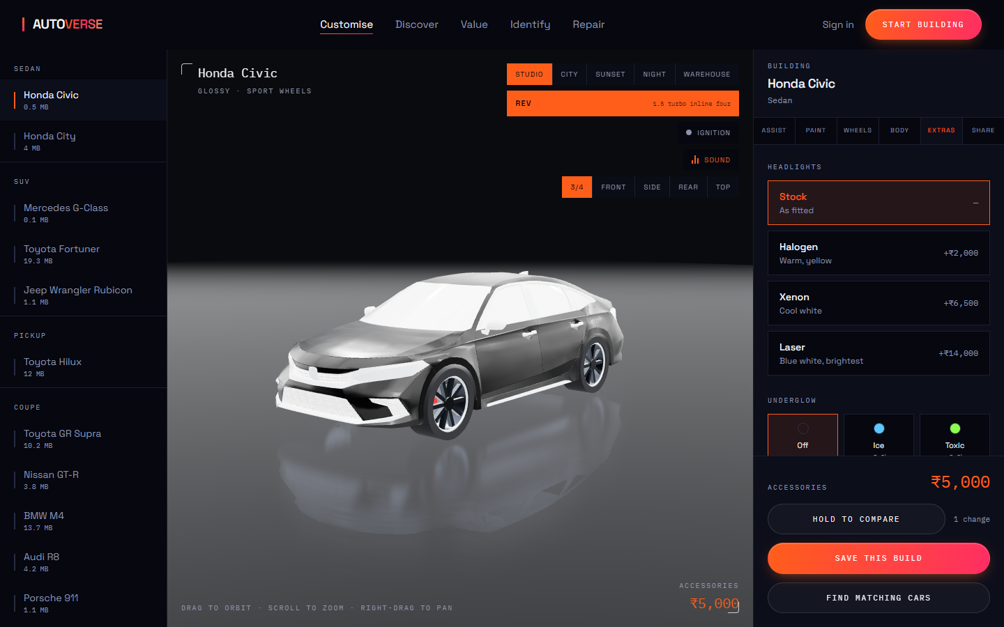
05
CUSTOMISE / EXTRAS
Lights, glow, tint, decals
A beam through the nose, because every lamp is a different size.
Halogen, xenon and laser, thrown as real light down the road rather than drawn as a lamp
Underglow in five colours, staying with the road when the body is lowered
Window tint from clear to 5%, judged against how the glass arrived
Decals placed by clicking the car; they travel with the panel they landed on
Notes:
Headlight units differ wildly between models, so what is drawn is the beam, which reads correctly on all of them.

Slide 10
06
CUSTOMISE / ASSIST
Describe it, or say it
Thirteen settings move from a handful of words.
Seven themes: cyberpunk, luxury, track, murdered out, off-road, sleeper, sunset
It shows which words it matched on, and what came second
A colour named outright wins over the theme — “red track car” is a track build, in red
Speak it instead: the same matcher with the keyboard removed
Deliberately not a language model — instant, offline, free, and it can show its working
Notes:
Worth saying plainly in an interview: this is keyword scoring, chosen over an LLM for reasons that hold up.

Slide 11
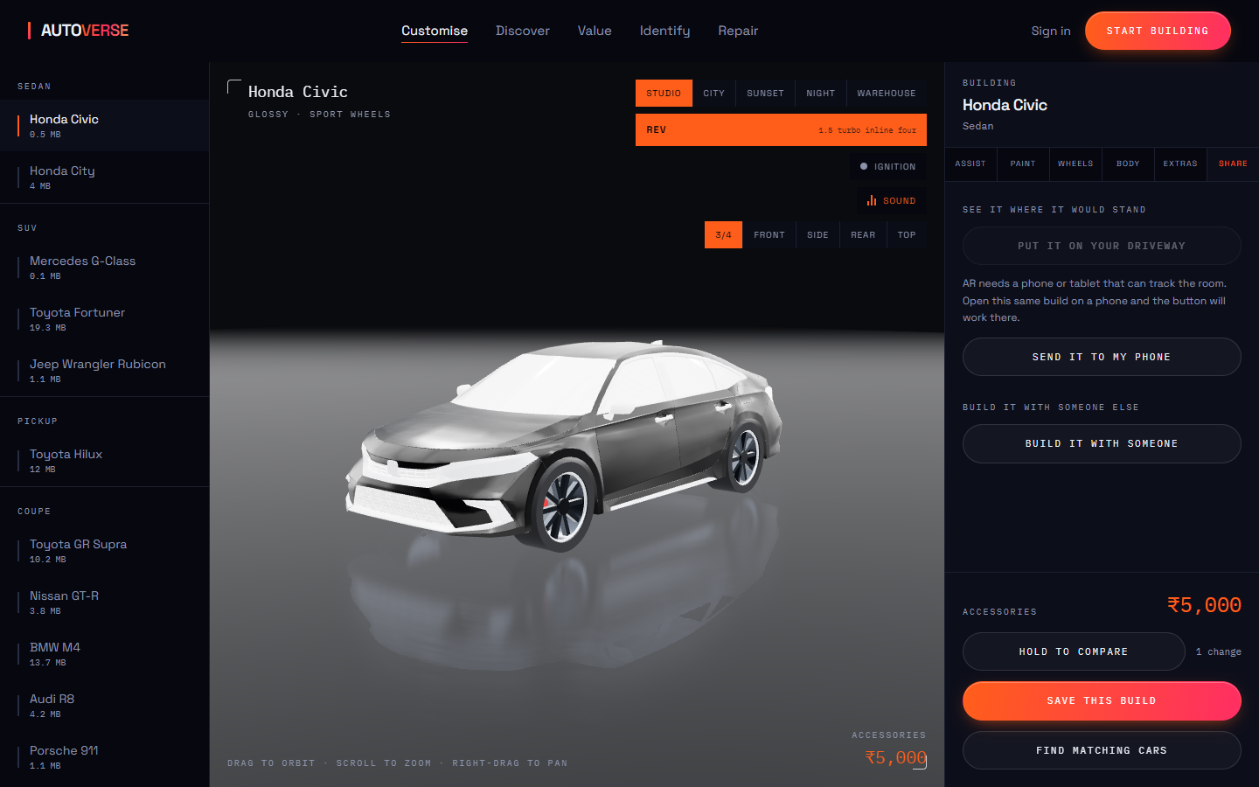
07
CUSTOMISE / SHARE
On your driveway, or with a friend
The build leaves the screen.
AR stands the car in front of you at 4.6 m — its real length
Android uses WebXR; iOS exports the car to USDZ and opens Apple’s viewer
Both are handed the same clone, so wheels, stance and paint all come
On a laptop it offers a QR code, because the whole build travels in the link
Or open a room: send the link and either of you changing anything moves it for both
Notes:
AR is the one feature tested against the real world — if the proportions were wrong you would see it against a real doorway.

Slide 12
CUSTOMISE / SOUND
Every car has its own engine
The rev button does not play a recording. Firing frequency is rpm × half the cylinder count, so the note comes out of the specification itself.
At 3000 rpm
300 Hz
250
200
150
100
V12
V10
V8
Straight six
Four
Layout changes the character
Forced induction is modelled
The rotary breaks the rule
A cross-plane V8 fires unevenly across its banks. That half-order content is exactly why a Corvette burbles where an M4’s straight six is hard and smooth.
A turbo spools behind the revs and releases on lift. A supercharger is belt driven, so its whine tracks rpm exactly.
A 13B has no cylinders — two chambers, order 2, nine thousand rpm. It is the one engine the cylinder rule does not describe.
Notes:
A V12 sits an octave above a straight six because it fires twice as often. That is arithmetic, not a sample library.

Slide 13
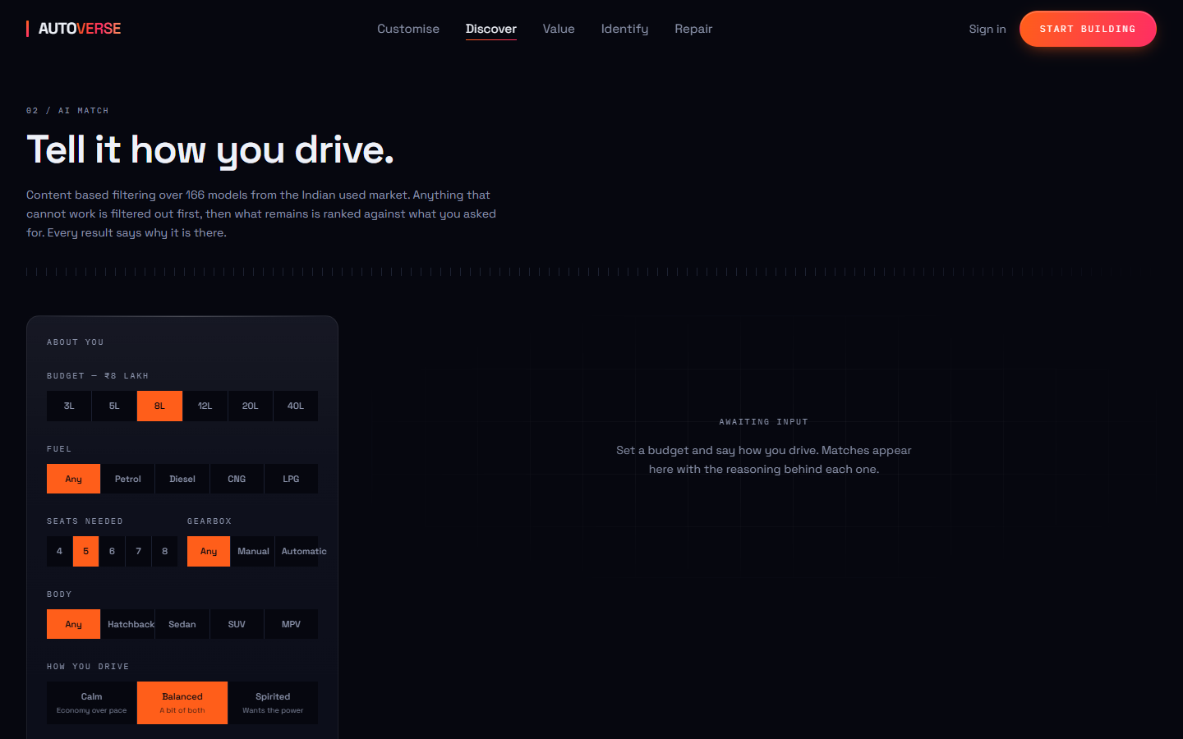
02
DISCOVER
Find the right car
166 Indian models, matched on what you actually need.
Content-based filtering: hard filters first, then weighted distance
Budget, body style, fuel, transmission, seats and use
Every result explains why it matched, rather than appearing as a score
Each comes with accessory suggestions suited to that segment
Trained on Indian listings, priced in rupees throughout
Notes:
Rebuilt from naive score-matching to content-based filtering on an Indian dataset.

Slide 14

03
VALUE
What a used car is worth
R² 0.947, and it shows you its range rather than one number.
Gradient boosted trees, chosen by comparison against ridge and random forest
Age, kilometres, power, engine, mileage, seats, fuel and transmission
Two quantile models give a confidence band, measured at 70.9% coverage
Typically 13.7% out — stated, rather than hidden behind a single figure
Depreciation charted over the years ahead
Notes:
Showing the interval matters: a valuation with no range is a guess wearing a suit.

Slide 15
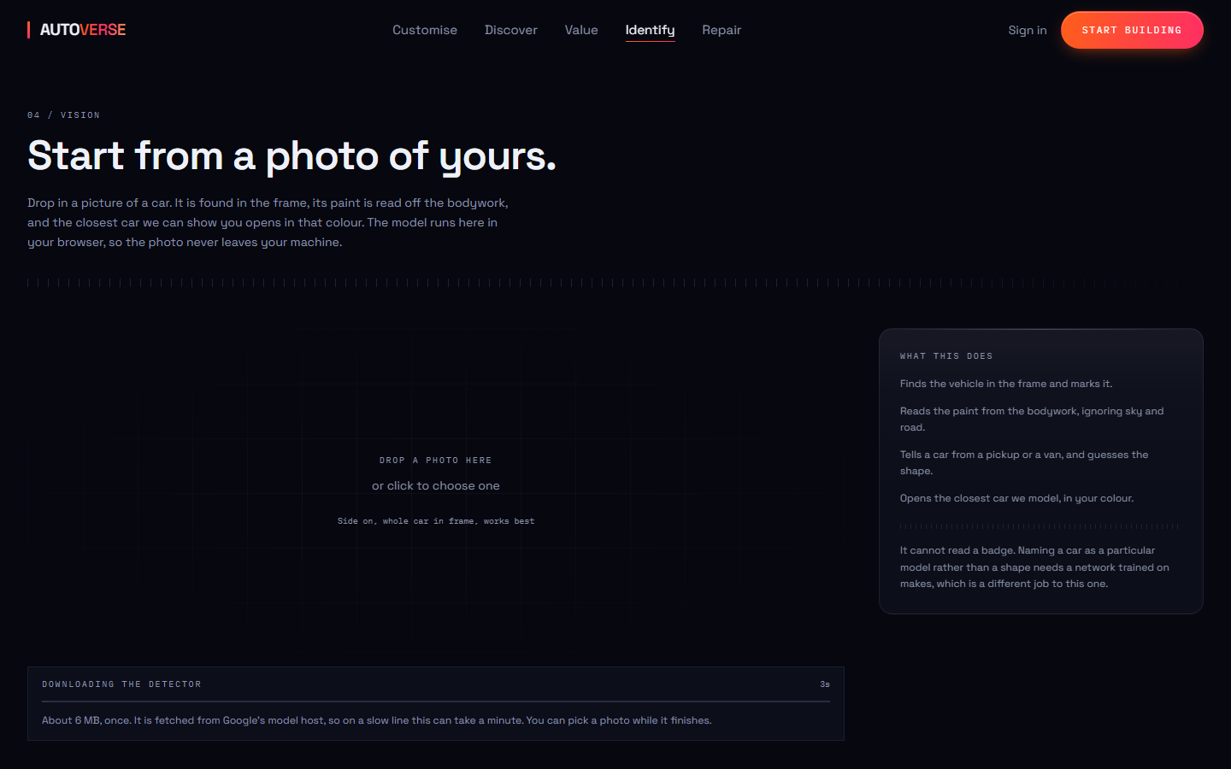
04
IDENTIFY
What car is that
Recognised from a photo, without the photo leaving your phone.
SSD-MobileNetV2 running in the browser through TensorFlow.js
Finds the car, then reads its paint colour from the bodywork
Colour is measured by chromaticity, so shade and sunlight do not fool it
Matches it against the garage and offers to open that car, in that colour
Nothing is uploaded — the model comes to the picture
Notes:
Running vision client-side is a privacy decision and a hosting-cost decision at once.

Slide 16

05
REPAIR
What the damage will cost
83.0% on 2,026 photographs it had never seen.
MobileNetV2 with a trained head, slid across the photo to find where
Six damage types: dent, scratch, crack, glass shatter, lamp broken, flat tyre
Trained on damage regions, plus undamaged panels, so it can say “nothing here”
Below a measured confidence floor it stays quiet instead of guessing
Then costs the repair by segment and shows what it does to resale
Notes:
The hand-written scan this replaced flagged the grille on a clean car. It had no concept of an intact panel; this one does, at 86.5%.

Slide 17
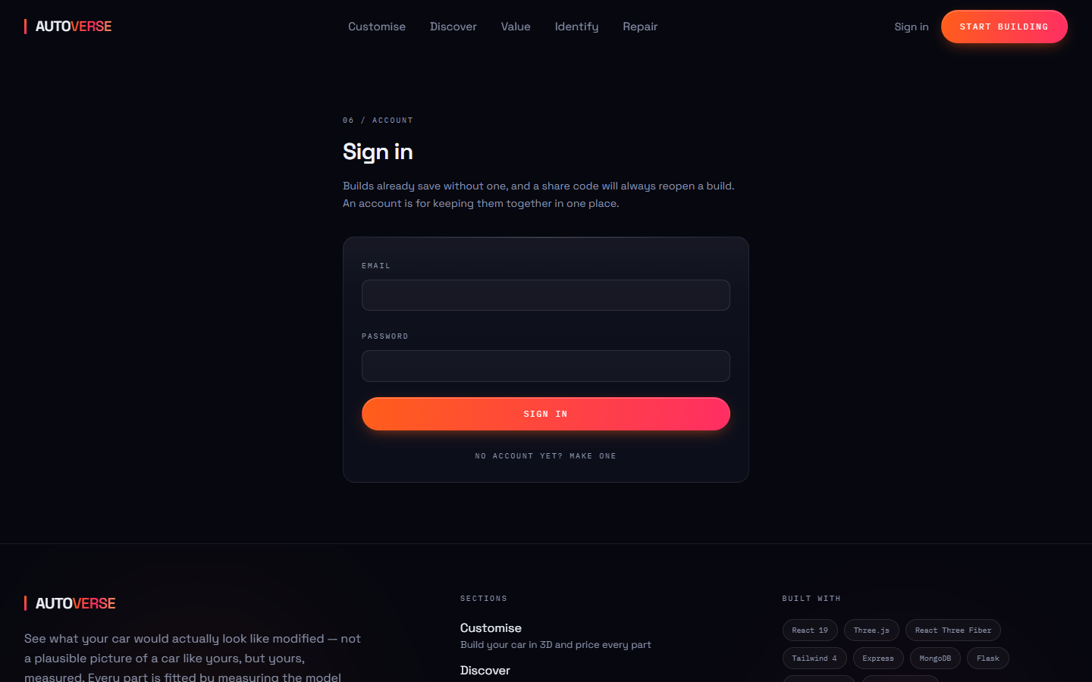
06
GARAGE
Saved, and shareable
An account gathers your builds. It never gates them.
Builds save without signing in, and a share code still reopens one
Signed in, they gather in a garage alongside a wishlist and recently viewed
Passwords are bcrypt hashed and excluded from every query by default
An unknown email returns the identical message to a wrong password, so the site cannot be used to discover who has an account
24 checks cover it, including every security rule above
Notes:
Signing in is additive. Nothing that worked before an account now demands one.

Slide 18
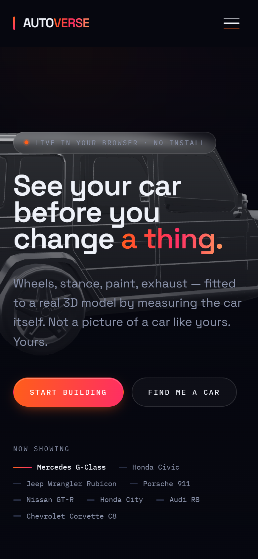
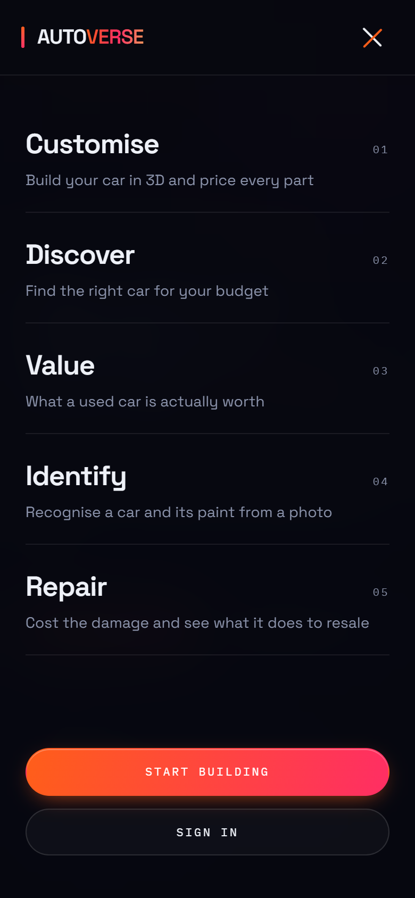
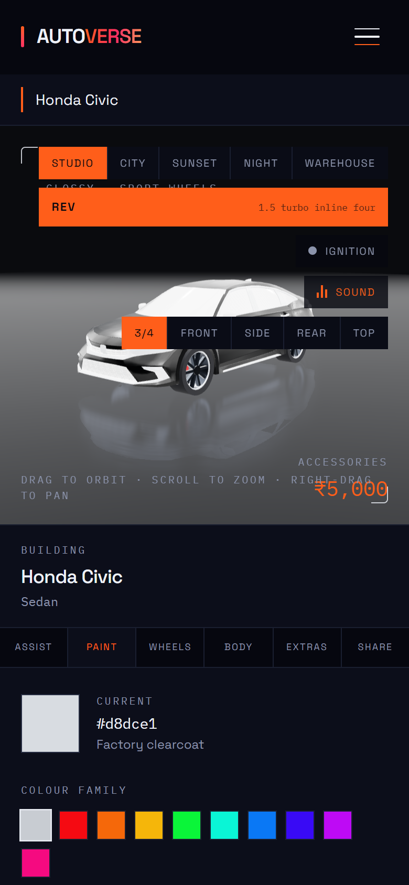
ON A PHONE
The same thing, not a cut-down one
The configurator, the 3D, the vision models and AR all run on a phone. AR is the one feature that is better there.
Every menu item carries its explanation in the drawer, because a one-word label is least likely to be understood on a small screen.
Notes:
Verified at 375 px: no horizontal overflow anywhere, and the drawer locks the page behind it.

Slide 19
MEASURED, NOT CLAIMED
The machine learning, with its real numbers
0.947
83.0%
166
0
R² on valuation
damage accuracy
models matched
photos uploaded
with a measured 70.9% interval coverage
over 2,026 held-out crops
Indian market, real prices
every vision model runs on your device
Damage model, per class — recall on photographs it never trained on
97.8%
96.8%
86.5%
85.9%
84.1%
71.6%
64.6%
Flat tyre
Glass shatter
Undamaged
Lamp broken
Scratch
Dent
Crack
Undamaged is the number that matters. The hand-written scan this replaced had no concept of an intact panel, which is why it flagged the grille on a clean car.
Notes:
Every figure here is from a held-out set, not from training.

Slide 20
HOW IT IS BUILT
Four services, one repository
Frontend
API
React 19, Vite, Tailwind 4
Express, MongoDB
three.js and react-three-fiber for the 3D, Framer Motion for everything that moves, TensorFlow.js for vision
Accounts, saved builds and share codes. WebSocket rooms for the shared garage
ML service
In the browser
Flask, scikit-learn
TensorFlow.js
The recommender and the valuation, trained offline and served
Car detection and damage classification, so no photograph is uploaded
The geometry lives in plain modules with no three.js import, so command-line checkers run byte for byte the same code as the browser. That is how a placement bug is caught across eighteen models instead of in one screenshot.
Notes:
Eleven roadmap phases, all complete. Around 90 automated checks across the suites.

Slide 21
SAID OUT LOUD
What it does not do
A project whose whole argument is fidelity does not get to be vague about its own limits.
Damage is a classifier, not a detector
Voice recognition leaves the device
It is slid across the photo, so the smallest thing it can point at is one window. It will not outline a scratch.
Chrome does it on Google’s servers. Every other model here runs locally, and the panel says which is which.
One car’s lamps cannot be found
The damage data is non-commercial
The Porsche’s rear is a single piece 0.79 of the car’s height, so there is no separate lamp to leave unpainted.
CarDD is licensed for research and education. Fine for a portfolio; commercial use would need retraining.
Notes:
Stating the limits is the point, not an apology for it.

Slide 22
Pick a car. Change everything.
See it properly.
autoverse-two.vercel.app
Fifteen cars · five ML features · nothing to install
Notes:
All eleven roadmap phases complete.

