Slide 1
Breast Cancer Detection Project
Team Presentation

Slide 2
Agenda
1. Project Overview
2. Task 1: Data Preprocessing & EDA
3. Task 2: Baseline Models
4. Task 3: Hyperparameter Tuning
5. Conclusion & Recommendations

Slide 3
Project Overview
Goal: Detect breast cancer using ML models on WDBC dataset.
Dataset: 569 samples (212 malignant, 357 benign).
Models: SVM, MLP, GRU-SVM (optional).

Slide 4
Task 1: Data Preprocessing & EDA
- Dropped unnecessary columns (id, Unnamed:32).
- Encoded labels (M=1, B=0).
- Standardized features.
- EDA: Correlation heatmap, histograms.

Slide 5
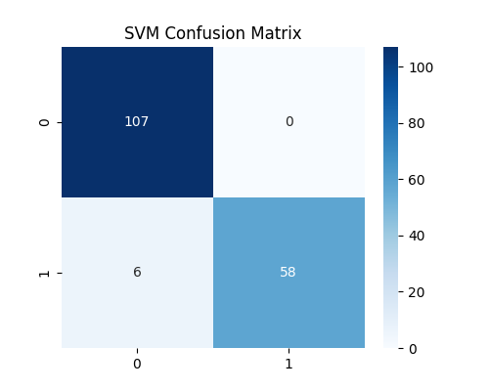
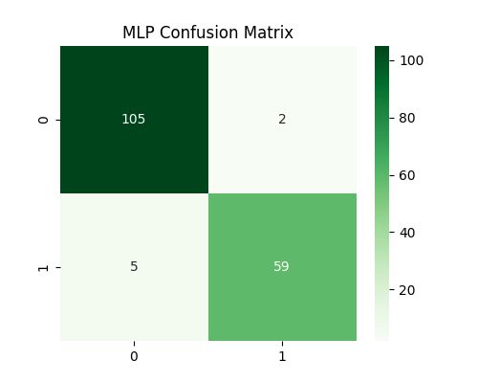
SVM and MLP Confusion Matrices

Slide 6
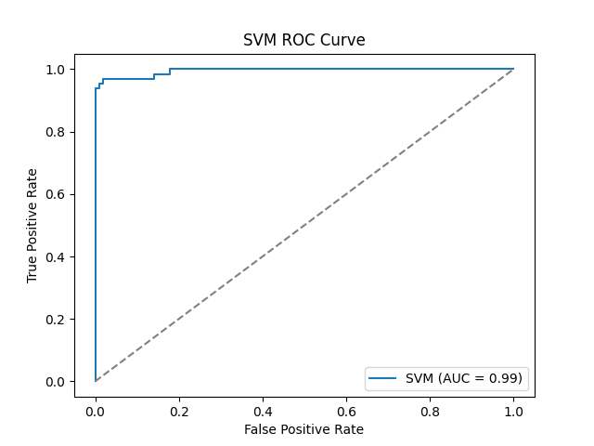

SVM and MLP ROC Curves

Slide 7
Conclusion & Recommendations
- All models achieved >95% accuracy.
- MLP performed best (~99%).
- Hyperparameter tuning improved robustness.
- Future work: Try CNN, LSTM models.

Slide 8
References
- Original paper: On Breast Cancer Detection
- Dataset: WDBC (UCI Repository)
- Libraries: scikit-learn, matplotlib, seaborn

