Slide 1





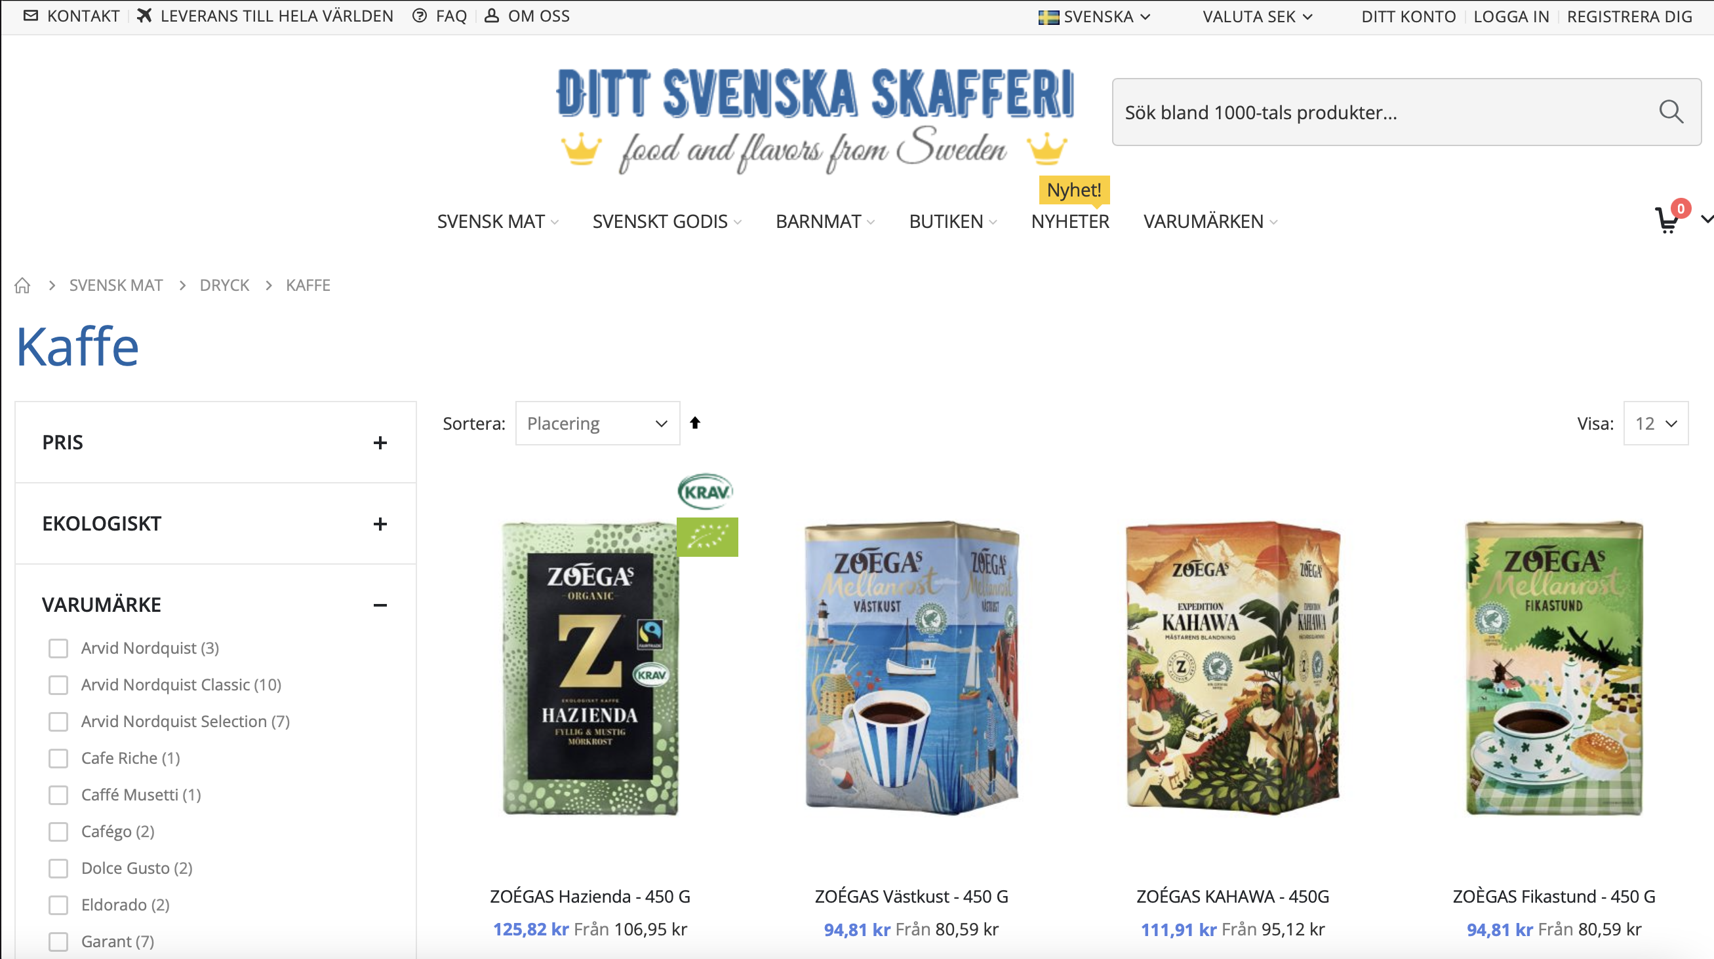


Client server/application
Web scraping with
Scrapy & Selenium
User & Review
SQLite Database
Coffee
Database

