Slide 1
ASSIGNMENT 1
SUBMITTED BY GROUP 5

Slide 2
MULTIPLEXING
Whenever the bandwidth of a medium linking two devices is greater than the bandwidth needs of the devices, the link can be shared. Multiplexing is the set of techniques that allows the (simultaneous) transmission of multiple signals across a single data link. As data and telecommunications use increases, so does traffic.
Tow types of multiplexing
:
Frequency-Division Multiplexing
Synchronous Time-Division Multiplexing

Slide 3
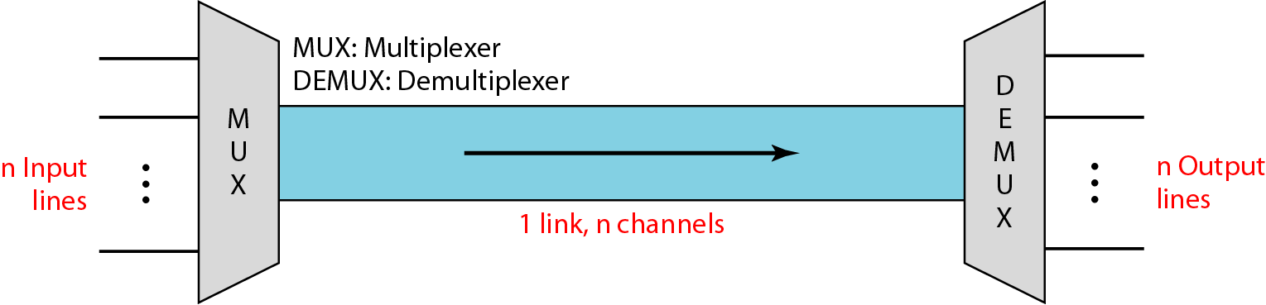
Figure 6.1 Dividing a link into channels

Slide 4
Frequency Division Multiplex
Separation of spectrum into smaller frequency bands
Channel gets band of the spectrum for the whole time
Advantages:
no dynamic coordination needed
works also for analog signals
Disadvantages:
waste of bandwidth if traffic distributed unevenly
inflexible
guard spaces
Channels
k_{i}
k₃
k₄
k₅
k₆
t

Slide 5

Note
FDM is an analog multiplexing technique that combines analog signals.
It uses the concept of modulation

Slide 6
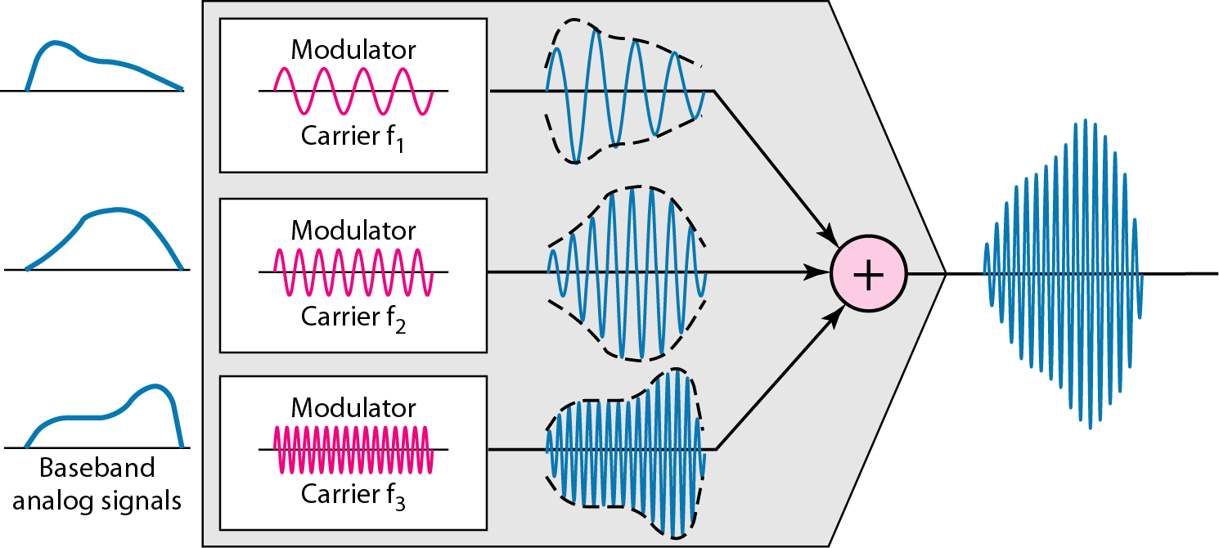
Figure 6.4 FDM process

Slide 7
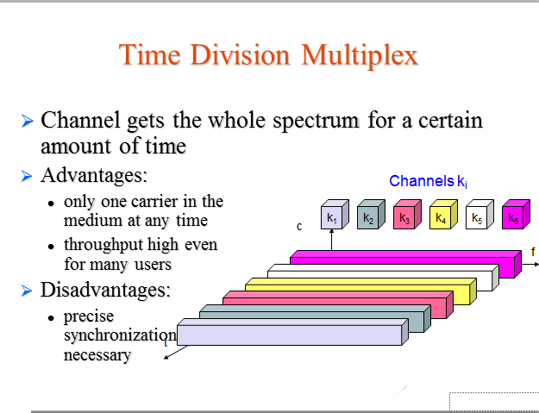

Slide 8
Note
TDM is a digital multiplexing technique for combining several low-rate digital channels into one high-rate one.

Slide 9
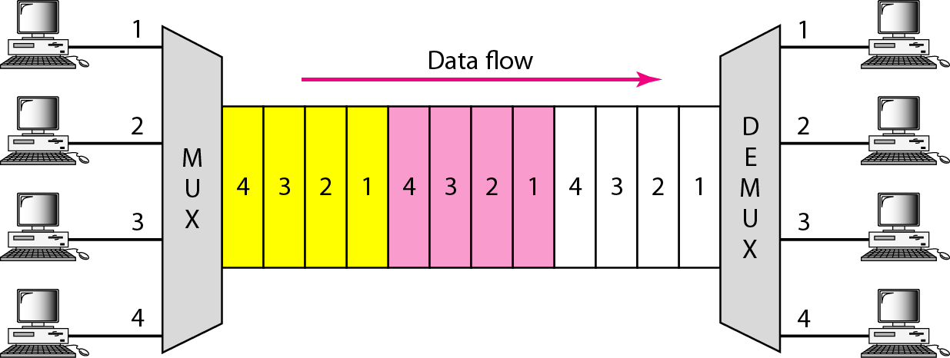
Figure 6.12 Time Division Multiplexing (TDM)

Slide 10
Why FDM is for analog signals and TDM is for digital signals?
FDM stnds for frequency division multiplexing and it is used only in case of analog signals because analog signals are continuous in nature and the signal have frequency.
TDM-stands for time division multiplexing and it is used only in case of digital signals because digital signals are discrete in nature and are in the form of 0 and 1s. and are time dependent.

Slide 11
CODE DIVISION MULTIPLE ACCESS(CDMA)

Slide 12
Code Division Multiple Access (CDMA) is a sort of multiplexing that facilitates various signals to occupy a single transmission channel. It optimizes the use of available bandwidth. The technology is commonly used in ultra-high-frequency (UHF) cellular telephone systems, bands ranging between the 800-MHz and 1.9- GHz.

Slide 13
CDMA assigns a different code to each node.
Each node then uses its unique code to encode the data bits it sends.
Used mostly in wireless broadcast channels (cellular, satellite, etc)
In CDMA, one channel carries all transmissions simultaneously
Any station that wants to receive data from one of the other three multiplies the data on the channel by the code of the sender

Slide 14
CDMA
Let us assume we have four stations 1, 2, 3, and 4 connected to the same channel.
The data from station 1 are d l , from station 2 are d2, and so on.
The code assigned to the first station is c1, to the second is c2, and so on.
Assume that the assigned codes have two properties.
1. If we multiply each code by another we get 0.
2. If we multiply each code by itself, we get 4 (the number of stations).

Slide 15
CDMA
Let us see how the above four stations can send data using the same common channel, as shown in Figure.
Station 1 multiplies (a special kind of multiplication) its data by its code to get
d1.c1.
Station 2 multiplies its data by its code to get d2 . c2. And so on.
The data that go on the channel are the sum of all these terms, as shown in the box.

Slide 16
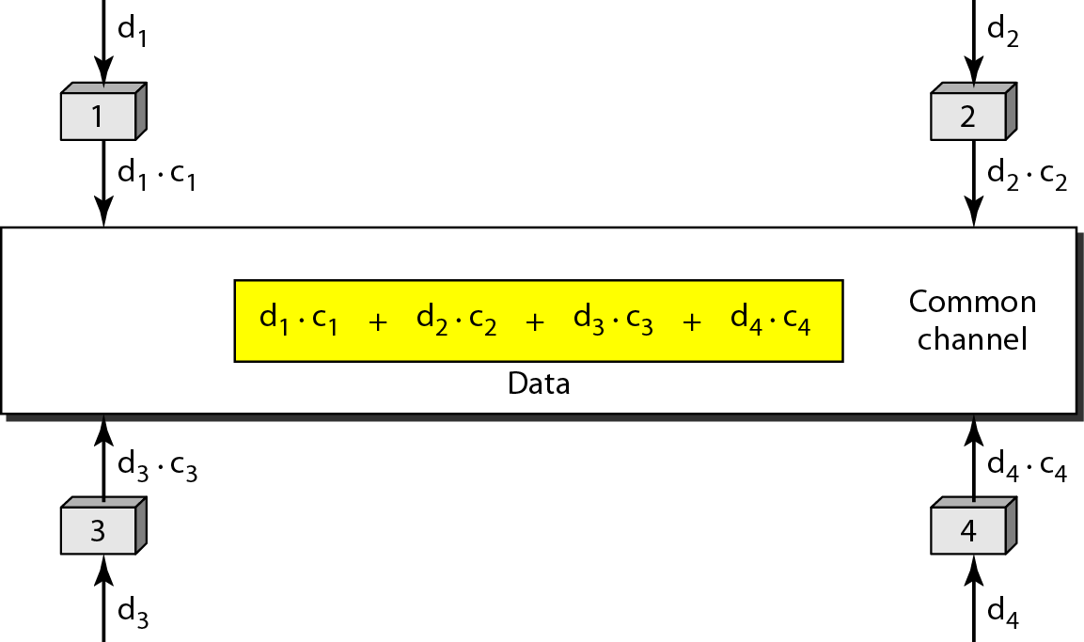
Figure Simple idea of communication with code

Slide 17
CDMA- chips
Chips
CDMA is based on coding theory.
Each station is assigned a code, which is a sequence of numbers called chips, as shown in Figure .
The codes are for the previous example.
They are called orthogonal sequences

Slide 18
Figure Chip sequences

Slide 19
CDMA
Chip sequences have the following properties:
1. Each sequence is made of N elements, where N is the number of stations.
2. If we multiply a sequence by a number, every element in the sequence is multiplied by that element. This is called multiplication of a sequence by a scalar. For example,
2. [+1 +1-1-1]=[+2+2-2-2]
3. If we multiply two equal sequences, element by element, and add the results, we get N, where N is the number of elements in the each sequence. This is called the inner product of two equal sequences.

Slide 20
CDMA- Data Representation
We follow these rules for encoding:
If a station needs to send a 0 bit, it encodes it as -1;
If it needs to send a 1 bit, it encodes it as +1.
When a station is idle, it sends no signal,
which is interpreted as a O.
These are shown in Figure .

Slide 21
Figure Data representation in CDMA

Slide 22
CDMA-Encoding and Decoding
As a example, we will study how four stations share the link during a 1-bit interval.
The procedure can easily be repeated for additional intervals.
We assume that stations 1 and 2 are sending a 0 bit and channel 4 is sending a 1 bit. Station 3 is silent.
The data at the sender site are translated to -1, -1, 0, and +1.

Slide 23
CDMA
Each station multiplies the corresponding
number by its chip (its orthogonal sequence), which is unique for each station.
The result is a new sequence which is sent to the channel.
The sequence on the channel is the sum of all four sequences as defined before.
Figure shows the situation.

Slide 24
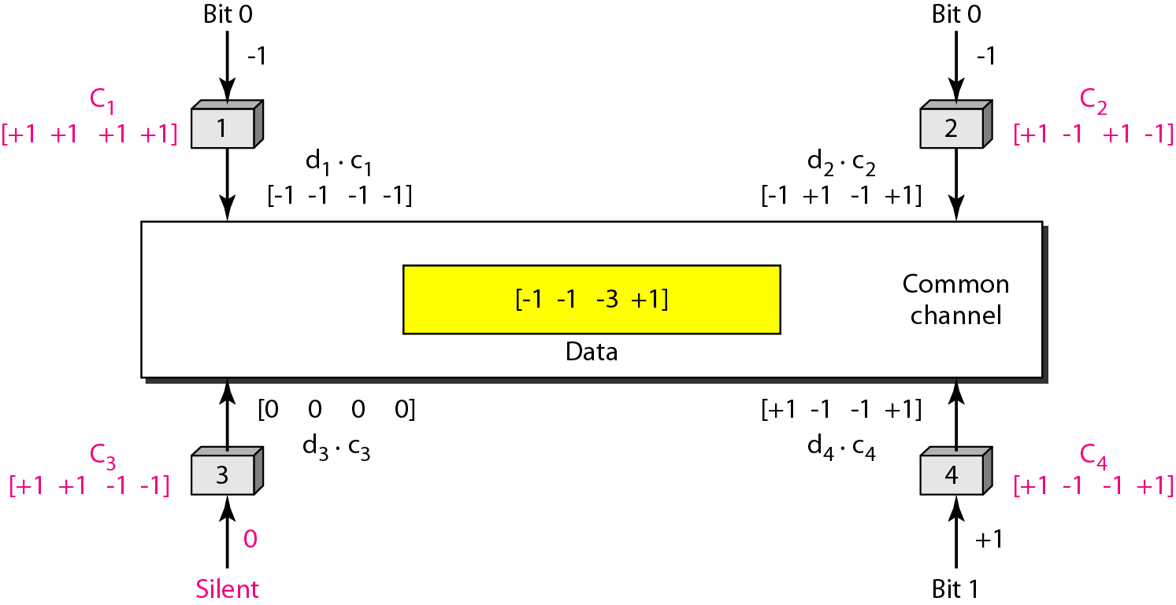
Figure Sharing channel in CDMA

Slide 25
CDMA
Signal Level
The process can be better understood if we show the digital signal produced by each
station and the data recovered at the destination.
The figure shows the corresponding signals for each station and the signal that is on the common channel.

Slide 26
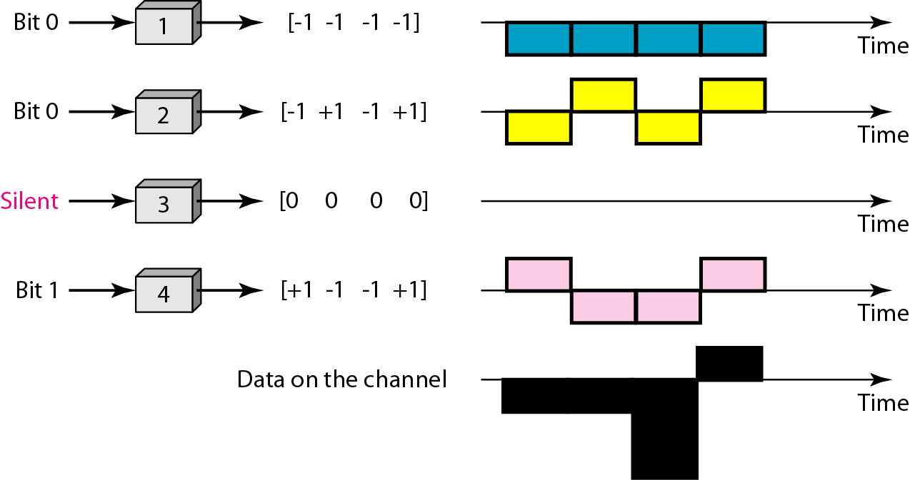
Figure Digital signal created by four stations in CDMA

Slide 27
Advantages:-
The main advantages of this technology are:
Fast Network deployment.
Reduced service interruptions.
Low Maintenance & operational cost.
Better system coverage flexibility
Higher capacity
Easy transition to mobile services.

Slide 28
MODULATION

Slide 29
“Modulation is a process of message signal and modulating is varied according to the carrier signal for transmission purpose. The message signal can varied in accordance to the carrier signal that is in terms of angular or amplitude. So we are modulating the signal.”

Slide 30
Advantages of Modulation:
With the help of modulation, we can increase the quality of reception.
We can also decrease the height of the antenna.
Avoid mixing of different frequency signals and increase the range of communication i.e. without modulation, we can transmit the message up to 100 meters and with modulation, we can transmit the message up to 150 meters.
Allow the flexibility for adjusting the bandwidth.

Slide 31
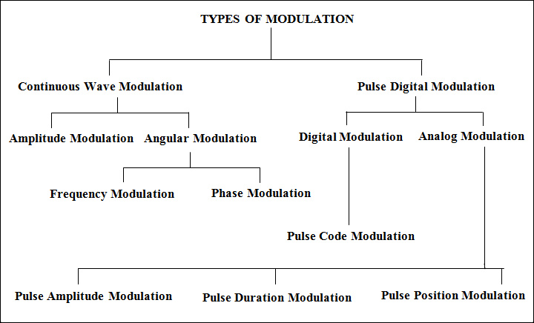

Slide 32
Angle Modulation:
In the angle modulation, again there are two different types of modulations.
Frequency modulation
Phase modulation.

Slide 33
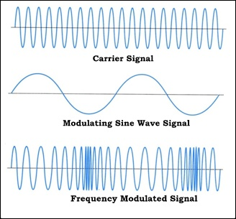
Frequency Modulation:
The process of carrier signal frequency is varied according to the message signal or modulation signal frequency by keeping the amplitude constant is called frequency modulation.

Slide 34
Advantages of Frequency Modulation:
Frequency modulation has more noise resistivity when compared to other modulation techniques. That’s why they are mainly used in broadcasting and radio communications
The frequency modulation is having greater resistance to rapid signal strength variation, which we will use in FM radios even while we are travelling and frequency modulation is also mainly used in mobile communication purposes.
For transmitting messages in frequency modulation, it does not require special equipments like linear amplifiers or repeaters and transmission levels or higher when compared to other modulation techniques.

Slide 35
Transmission rate is good for frequency modulation when compared to other modulation that is frequency modulation can transmit around 1200 to 2400 bits per second.
Frequency modulation has a special effect called capture effect in which high frequency signal will capture the channel and discard the low frequency or weak signals from interference.

Slide 36
Disadvantages of Frequency Modulation:
In the transmission section, we don’t need any special equipment but in the reception, we need more complicated demodulators for demodulating the carrier signal from message or modulating signal.
Frequency modulation cannot be used to find out the speed and velocity of a moving object. Static interferences are more when compared to phase modulation. Outside interference is one of the biggest disadvantages in the frequency modulation. There may be mixing because of nearby radio stations, pagers, construction walkie-talkies etc

Slide 37
To limit the bandwidth in the frequency modulation, we use some filter which will again introduce some distortions in the signal.
Transmitters and receiver should be in same channel and one free channel must be there between the systems.
Spectrum space is limit for the frequency modulation and careful controlling the deviation ration.

Slide 38
Applications of Frequency Modulation (FM)
Frequency modulation is used in radio’s which is very common in our daily life.
Frequency modulation is used in audio frequencies to synthesize sound.
For recording the video signals by VCR systems, frequency modulation is used for intermediate frequencies.
Used in applications of magnetic tape storage.

Slide 39
Phase Modulation:
In the phase modulation, we vary the carrier signal in accordance with the phase of the modulating signal or message signal by keeping the frequency constant. If the amplitude of message or modulating signal is huge then the phase shift will also be greater.

Slide 40
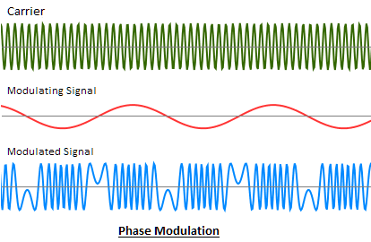

Slide 41
Advantages and Disadvantages of Phase Modulation:
The main advantage of phase modulation is that it has less interference from static, which is why we use this type of modulation in finding out the speed or velocity of a moving object. In frequency modulation, we cannot find out the velocity of moving object.
The main disadvantage is phase ambiguity comes if we increase the phase modulation index, and data loss is more and we need special equipment like frequency multiplier for increasing the phase modulation index.

Slide 42
Applications of Phase Modulation:
Phase modulation application is not different from frequency modulation. Phase modulation is also used in communication systems.
It may be used in binary phase shift keying.

Slide 43
Amplitude Modulation
In the amplitude modulation, amplitude of carrier signal wave is varied in accordance with the modulating or message signal by keeping the phase and frequency of the signals constant. The carrier signal frequency would be greater than the modulating signal frequency.
AM radio ranges in between 535 to 1705 kHz which is great
compared to frequency modulation, the Amplitude modulation is weak,
Bandwidth of amplitude modulation should be twice the frequency of modulating signal or message signal

Slide 44
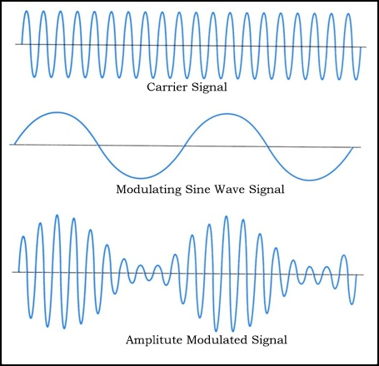

Slide 45
Advantages of Amplitude Modulation:
Because of amplitude modulation wavelength, AM signals can propagate longer distances.
For amplitude modulation, we use simple and low cost circuit; we don’t need any special equipment and complex circuits that are used in frequency modulation.
The Amplitude modulation receiver will be wider when compared to the FM receiver. Because, atmospheric propagation is good for amplitude modulated signals.
Bandwidths limit is also big advantage for Amplitude modulation, which doesn’t have in frequency modulation.

Slide 46
Transmitter and receiver are simple in Amplitude modulation. When we take a demodulation unit of AM receiver, it consists of RC filter and a diode which will demodulate the message signal or modulating signal from modulated AM signal, which is unlike in Frequency modulation.
Zero crossing in Amplitude modulation is equidistant.

Slide 47
Disadvantages of Amplitude Modulation:
Noise issue is more
Data loss is also more in amplitude modulation due to noise addition.
More power is required during modulation because Amplitude modulated signal frequency should be double than modulating signal or message signal frequency.
Sidebands are also transmitted during the transmission of carrier signal. More chances of getting different signal interfaces and adding of noise is more when compared to frequency modulation

Slide 48
Applications of Amplitude Modulation:
Used to carry message signals in early telephone lines.
Used to transmit Morse code using radio and other communication systems.
Used in Navy and Aviation for communications as AM signals can travel longer distances.
Widely used in amateur radio.

Slide 49
Pulse Code Modulation (PCM):

Slide 50
In the pulse code modulation, Analog Signal is reconstructed to digital signal for ease of transmission by using the analog signal samples. In technical terms, PCM will transmit the analog in a digital from, whose signal is sampled at regular intervals of time and quantized at same quantum levels to digital code. We know that digital code is nothing but binary code which consists of 1’s and 0’s that is logic1 and logic0. So we will transmit the digital data in the form of 1’s and 0’s. When the signal is received by the receiver, demodulator in the receiver will demodulate the binary signal back into pulses with same quantum levels like in modulator and these pulses are again used for regenerating the required analog signal.

Slide 51
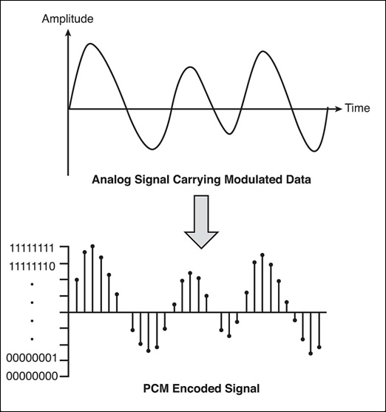

Slide 52
PCM
PCM consists of three steps to digitize an analog signal:
Sampling
Quantization
Binary encoding
Before we sample, we have to filter the signal to limit the maximum frequency of the signal as it affects the sampling rate.
Filtering should ensure that we do not distort the signal, ie remove high frequency components that affect the signal shape.

Slide 53
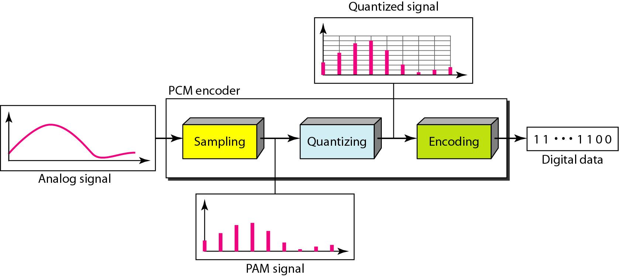
Figure 4.21 Components of PCM encoder

Slide 54
Sampling
Analog signal is sampled every T_{S} secs.
T_{s} is referred to as the sampling interval.
f_{s} = 1/T_{s} is called the sampling rate or sampling frequency.
There are 3 sampling methods:
Ideal - an impulse at each sampling instant
Natural - a pulse of short width with varying amplitude
Flattop - sample and hold, like natural but with single amplitude value
The process is referred to as pulse amplitude modulation PAM and the outcome is a signal with analog (non integer) values

Slide 55
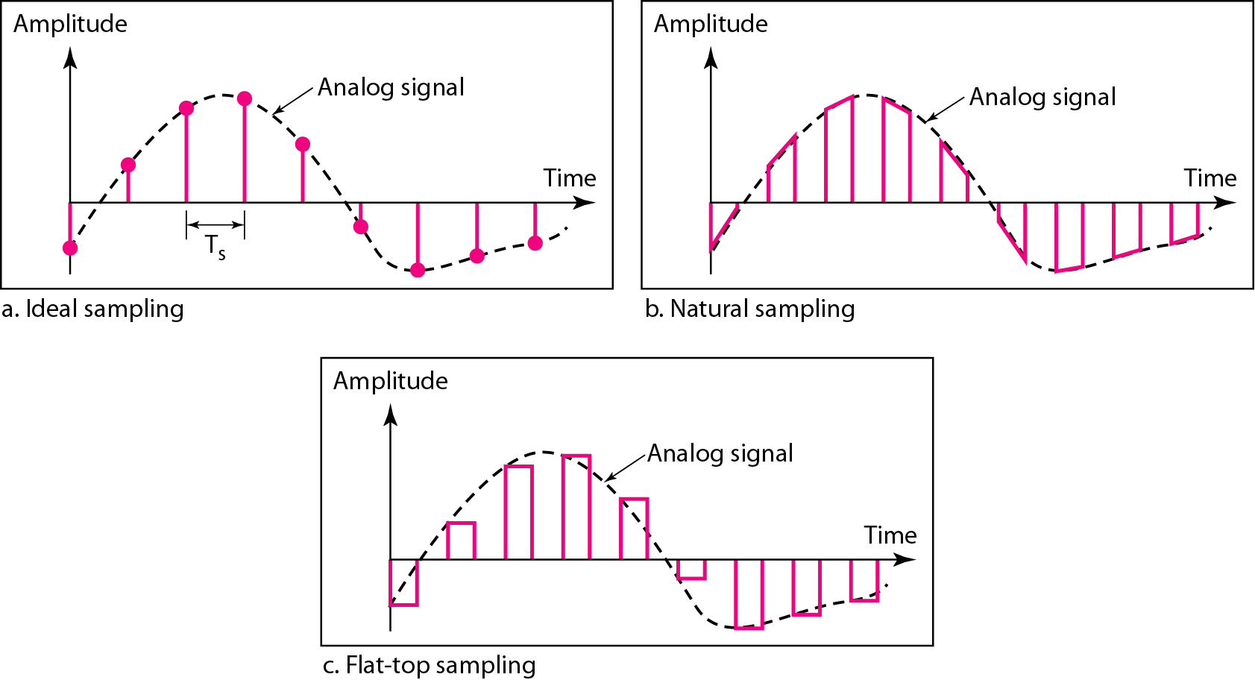
Figure 4.22 Three different sampling methods for PCM

Slide 56
Note
According to the Nyquist theorem, the sampling rate must be
at least 2 times the highest frequency contained in the signal.

Slide 57
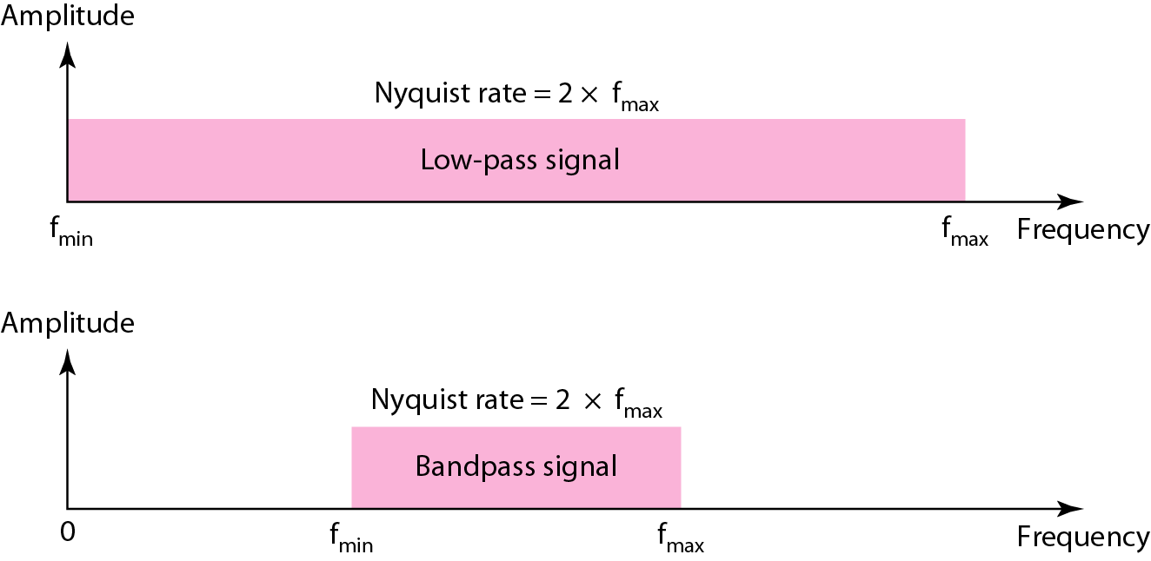
Figure 4.23 Nyquist sampling rate for low-pass and bandpass signals

Slide 58
Advantages of Pulse Code Modulation
Pulse code modulation will have low noise addition and data loss is also very low.
We can repeat the exact transmitted signal at the receiver. This is called repeatability. And we can retransmit the signal with any distortion loss also.
Pulse code modulation is used in music play back CD’s and also used in DVD for data storing whose sampling rate is bit higher.
Pulse code modulation can be used in storing the data.

Slide 59
Disadvantages of Pulse Code Modulation:
Specialized circuitry is required for transmitting and also for quantizing the samples at same quantized levels. We can do encoding using pulse code modulation but we need to have complex and special circuitry.
Pulse code modulation receivers are cost effective when we compared to other modulation receivers.
Developing pulse code modulation is bit complicated and checking the transmission quality is also difficult and takes more time.

Slide 60
Large bandwidth is required for pulse code modulation when compared to bandwidth used by the normal analog signals to transmit message.
Channel bandwidth should be more for digital encoding.
PCM systems are complicated when compared to analog modulation methods and other systems.
Decoding also needs special equipment’s and they are also too complex.

Slide 61
Applications of Pulse Code Modulation (PCM):
Pulse code modulation is used in telecommunication systems, air traffic control systems etc.
Pulse code modulation is used in compressing the data that is why it is used in storing data in optical disks like DVD, CDs etc. PCM is even used in the database management systems.
Pulse code modulation is used in mobile phones, normal telephones etc.
Remote controlled cars, planes, trains use pulse code modulations.

