Slide 1

Web Scraping

Slide 2




Libraries

Slide 3

Why:
Excellent documentation
Various plugins
Create custom pipelines and middleware's
Low CPU and memory usage
Well designed architecture
A plethora of available online resources
Issues:
Steep learning curve
Overkill for easy jobs
Not beginner-friendly

Slide 4
Environment and initial code
Virtual environment python 3.7
Scrapy version 1.6
Open Terminal and move to the reqired directory
scrapy startproject folderName(similar as website to scrap)
cd folderName
scrapy genspider UniqueName(cotainYouPlaningToGrab) URL(without-http/https)

Slide 5
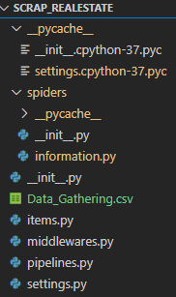
File structure
Self generated
Well managed
Well Documented
Cached files
Main code for scraping
Data scraped and saved
Extra setting and tuning files

