Slide 1
Display of Week 1 Work
Microsoft Office Packages

Slide 2
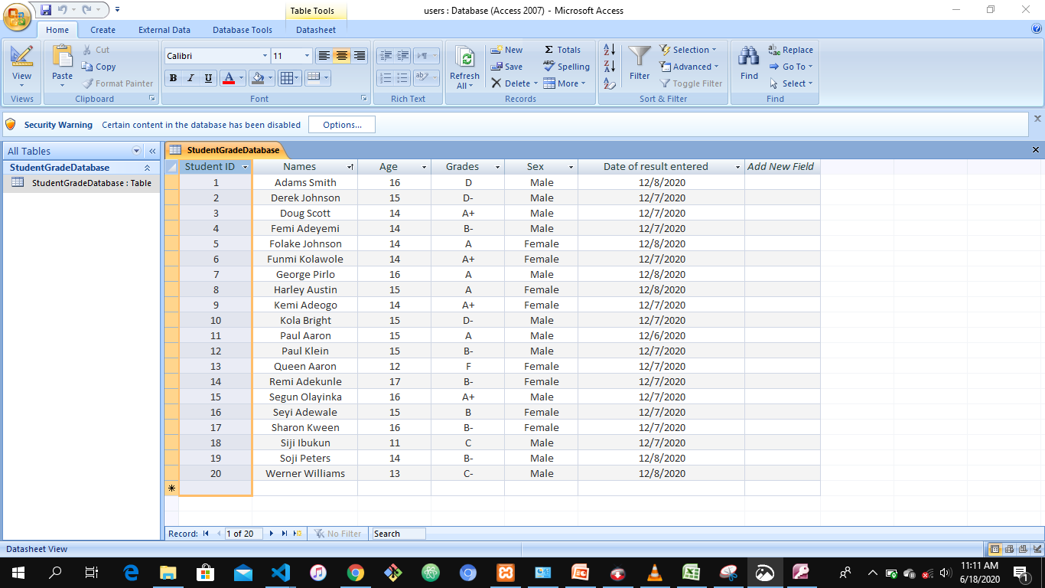
Microsoft Access Student ‘s Result

Slide 3
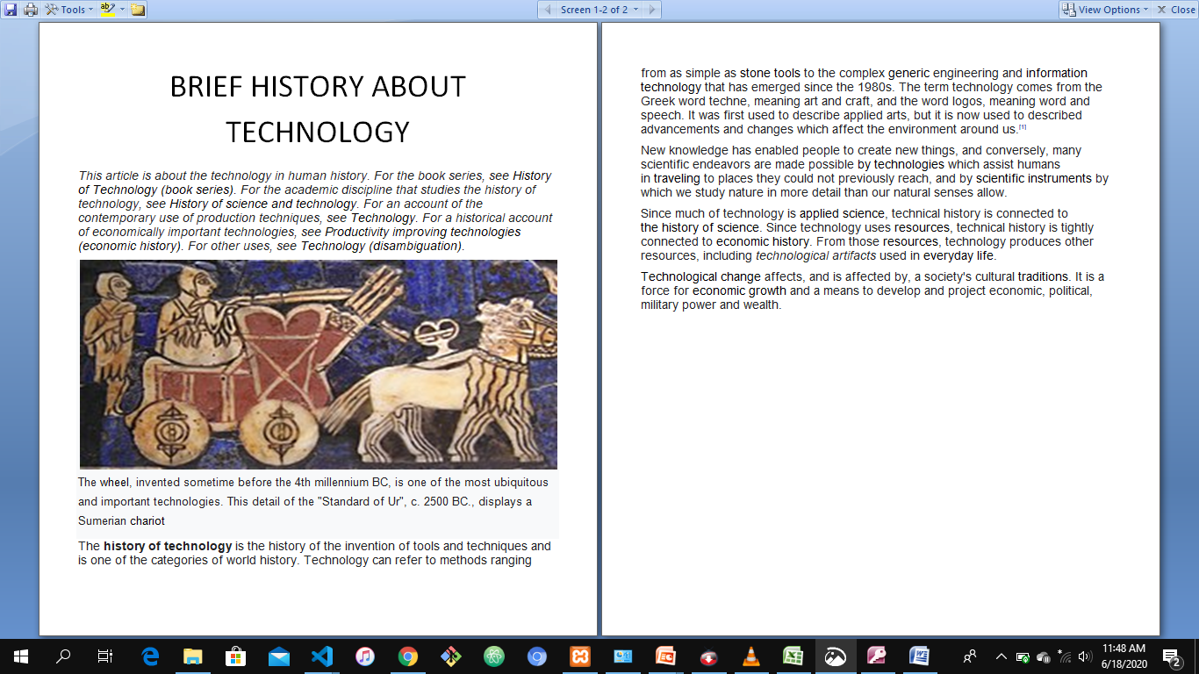
Microsoft Word Information on Brief History about technology

Slide 4
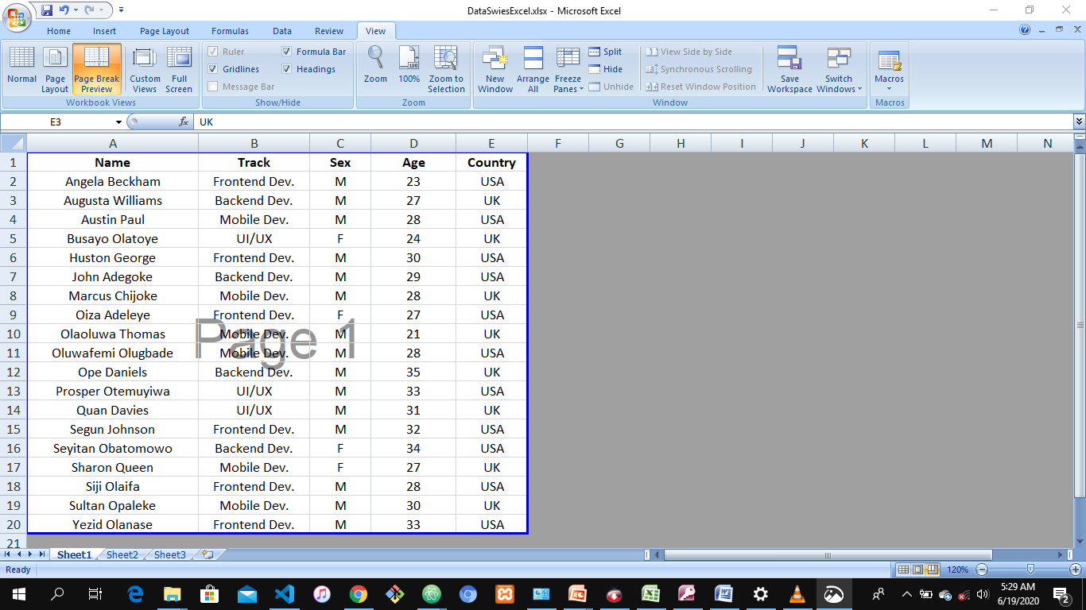
Microsoft Excel

Slide 5
THANK YOU

