Slide 1
INTRODUCTION
SIWES PRESENTATION
BY
OLAIFA OLUWASIJIBOMI
AT MCLORDS MOBILE SOLUTION LIMITED

Slide 2
ABOUT SIWES
The Student Industrial Work Experience Scheme (SIWES) was established by the industrial Training Fund (ITF) 1971 to enable students of tertiary institution have basic technical knowledge of industry works base on their course of study before the completion of their program in their respective institutions. It was established to solve the problem of lack of adequate practical skills preparatory for employment in industries by Nigeria graduates of tertiary institutions.
One of the primary goals of the SIWES is to help students integrate leadership development into experiential learning process. Students are expected to learn and develop basic non-profit leadership skills through a mentoring relationship with innovative non-profit leaders.

Slide 3
ABOUT COMPANY
McLords Mobile Solution Limited is a company based on I.T solutions and training. McLords Mobile Solution Limited is focused on course development, instructor training and facility expansion.
They tailor their training program to meet the needs of individual clients according to their professional background. The strength of the company lies in Human Resources which are continually rejuvenated by bringing in more hands which can make us live up to our name by being the foremost software development company in Nigeria. Leveraging current technology to provide simple solution to complex processes.
There are various department in the company such as:
Engineering department
Software development department
Data mining department
Web development department

Slide 4
WORKDONE
I was in web development section of the company.
This department was where my industrial training took place , I was exposed to the world of web development especially through creation of websites taking me step by step with pratical all through the process.During six month of the SIWES training I was able to acquire much knowledge on web development.I was able to use HTML5,CSS,Bootstrap4, Javascript and Php to achieve some tasks during this time.I was able to work some project during my training at Mclords Mobile Solution.

Slide 5
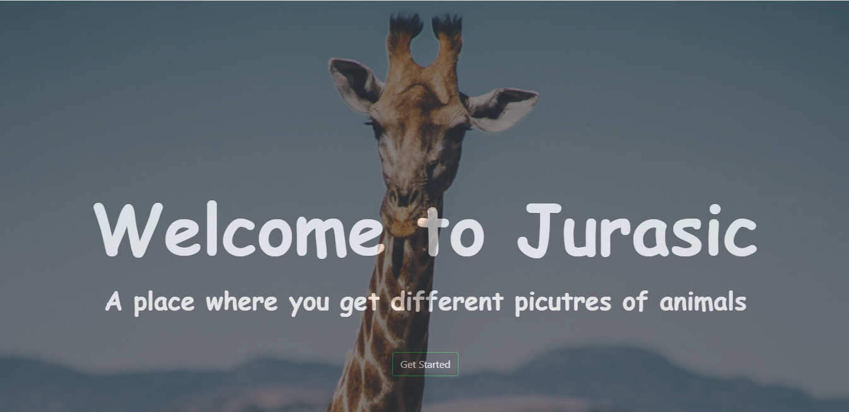
Jurasic Photo Search App
Jurasic Photo Search Application is an application which is used to search for animal pictures.

Slide 6

Car Registration System

Slide 7
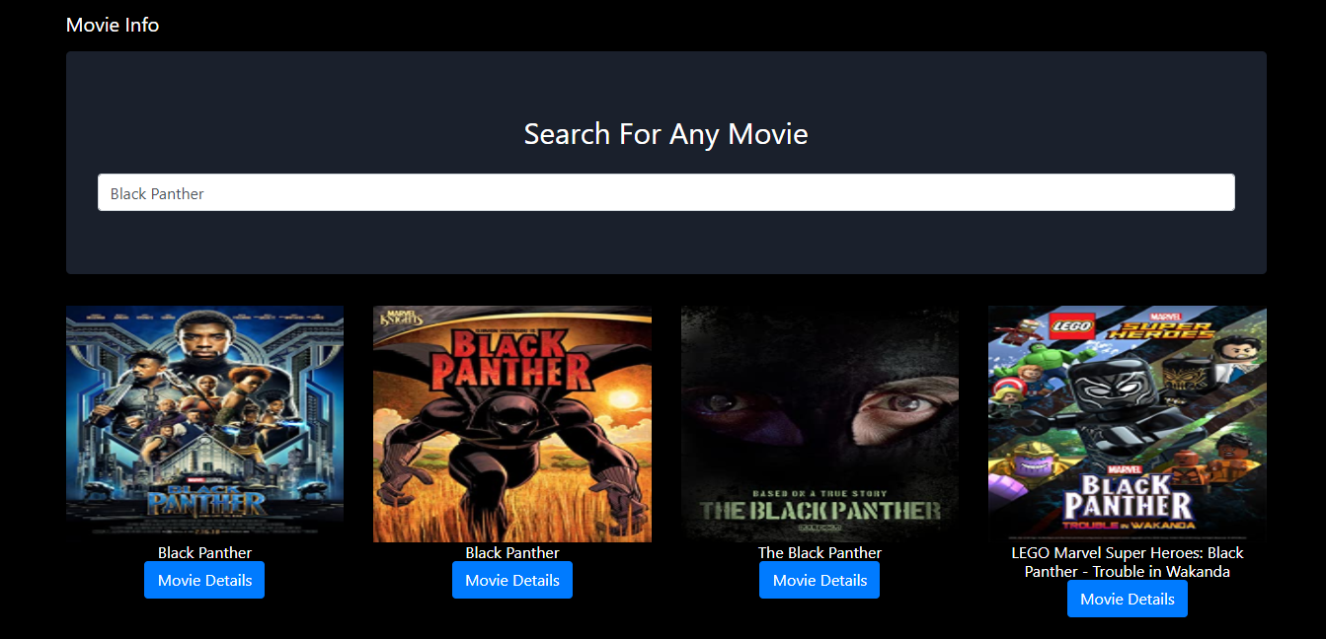
Showcase Movie Search

Slide 8
Summary
My six months Industrial Training at Mclords mobile solution limited was a huge success and a great time of acquiring new skills.During my training I was able to appreciate the aspect of web development more because I was able to set a goal for myself to build some applications. SIWES as a course has truly exposed me to the challenges faced in a growing I.T world that is dependent on programming.

Slide 9
THANK YOU

