Slide 1
Machine Learning 101
Session 2 – Linear Regression

Slide 2
Agenda
Recap Session 1
Basic process & concept of Machine Learning
Simple Linear Regression

Slide 3
Learning Target
Know the difference between Regression and Classification
Know how to use Linear Regression to deal with problems

Slide 4
Recap of Session 1
What is Machine Learning?
What type of Machine Learning applied to below examples (Supervised or Unsupervised)?
A robot is learning to sort garbage using visual identification. It sits all day picking out recyclable items from garbage as it passes on a conveyor belt. It places items such as glass, plastic and metal into 12 bins. Each item is labeled with an identification number on a sticker. Once a day, human experts examine the bins and inform the robot which items were improperly sorted. The robot uses this feedback to improve.
A learner that possesses visual highly developed visual and speech recognition capabilities could watch a large number of television shows to learn about human behavior. For example, a learner might be able to build a model that detects when people are smiling based on correlation of facial patterns and words such as "what are you smiling about?"

Slide 5
Classification vs Regression
Check the problem output
If output is a continuous numerical variable
For example: property price, population
If output is a categorical variable
For example: sweet strawberry; credit card yes or no

Slide 6
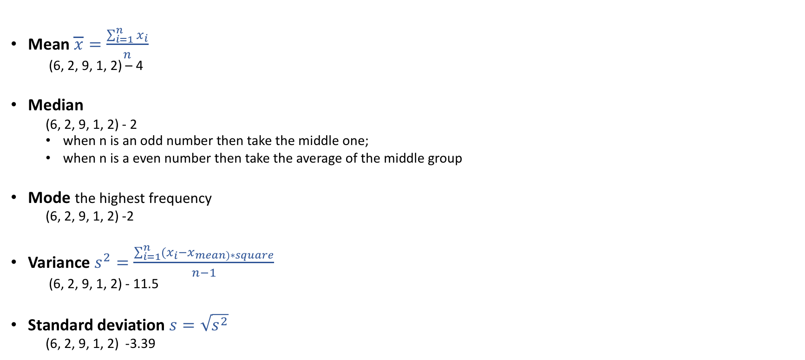
Statistics Measurements
Mean $\overline{x}=\frac{\sum_{i=1}^{n}{x_{i}}}{n}$
(6, 2, 9, 1, 2) – 4
Median
(6, 2, 9, 1, 2) - 2
when n is an odd number then take the middle one;
when n is a even number then take the average of the middle group
Mode the highest frequency
(6, 2, 9, 1, 2) -2
Variance $s^{2}=\frac{\sum_{i=1}^{n}{{(x}_{i}}−x_{mean)∗square}}{n−1}$
(6, 2, 9, 1, 2) - 11.5
Standard deviation $s=\sqrt{s^{2}}$
(6, 2, 9, 1, 2) -3.39

Slide 7
Simple Linear Regression
Contains 1 dependent variable (y - output) and 1 independent variable (x - input)
The relationship is one straight line
If the model contains more than 1 independent variables then that is multiple regression

Slide 8
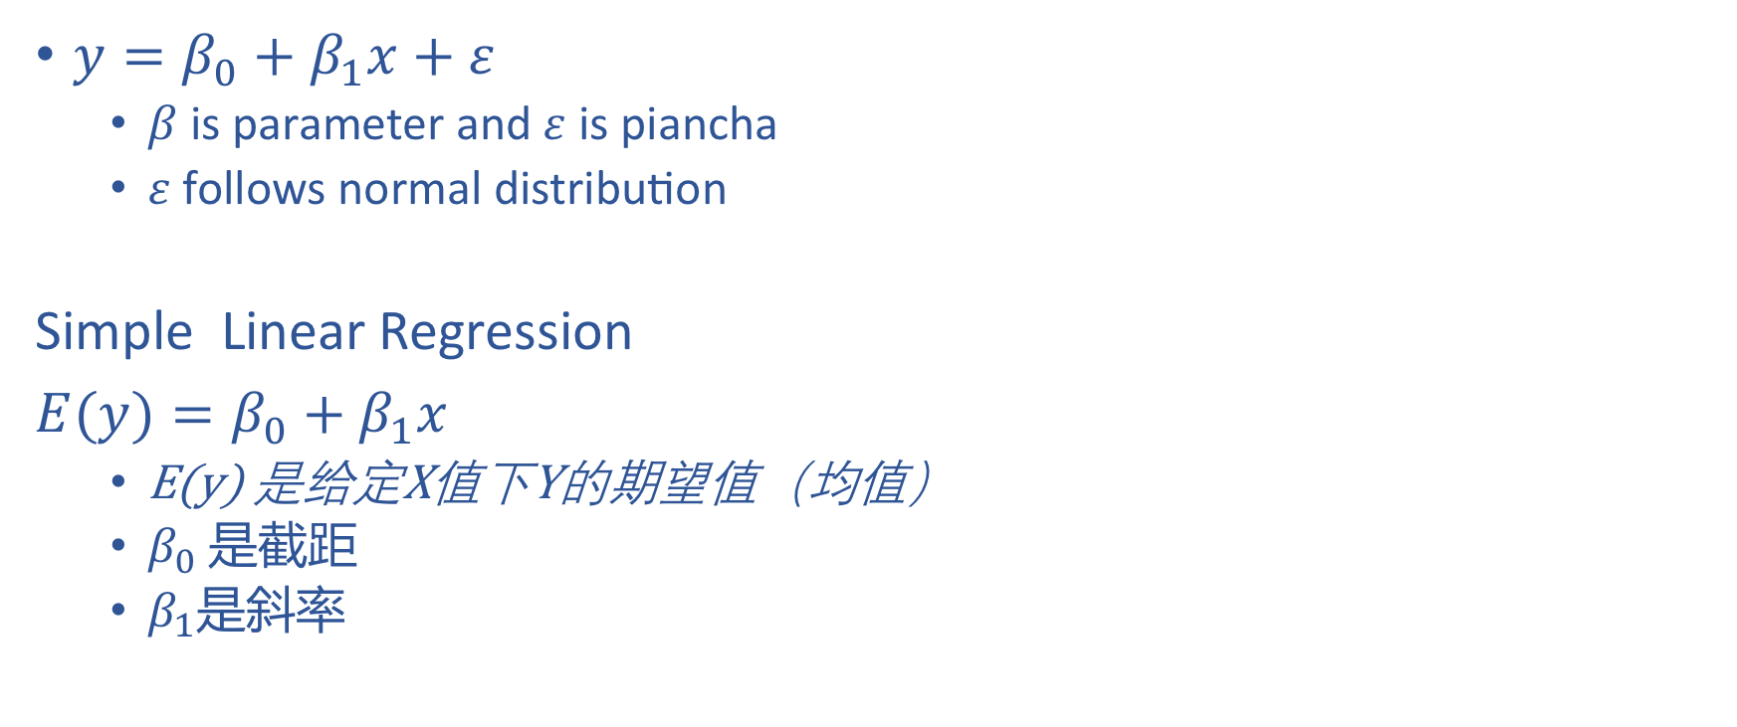
Simple Linear Regression
$y=β_{0}+β_{1}x+ε$
$β$ is parameter and $ε$ is piancha
$ε$ follows normal distribution
Simple Linear Regression
$E(y)=β_{0}+β_{1}x$
E(y) 是给定X值下Y的期望值（均值）
$β_{0}$ 是截距
$β_{1}$是斜率

Slide 9

3 Relationships
Positive Relationship - $β_{1}$ is a positive number
Negative Relationship - $β_{1}$ is a negative number
No Relationship - $β_{1}$ is 0

Slide 10

Estimated Regression Line
$\hat{y}=b_{0}+b_{1}x$
$\hat{y}$ is the estimated y
$b_{1}$ is the estimated xielv as we never know the actual $β_{1}$
Using a direct ‘Closed-form’ equation that directly computes the model parameters that best fit the model to the training set (i.e., the model parameters that minimize the cost function over the training set)
Using an iterative optimization approach, called Gradient Descent (GD), that gradually tweaks the model parameters to minimize the cost function over the training set, eventually converging to the same set of parameters as the first method.

Slide 11
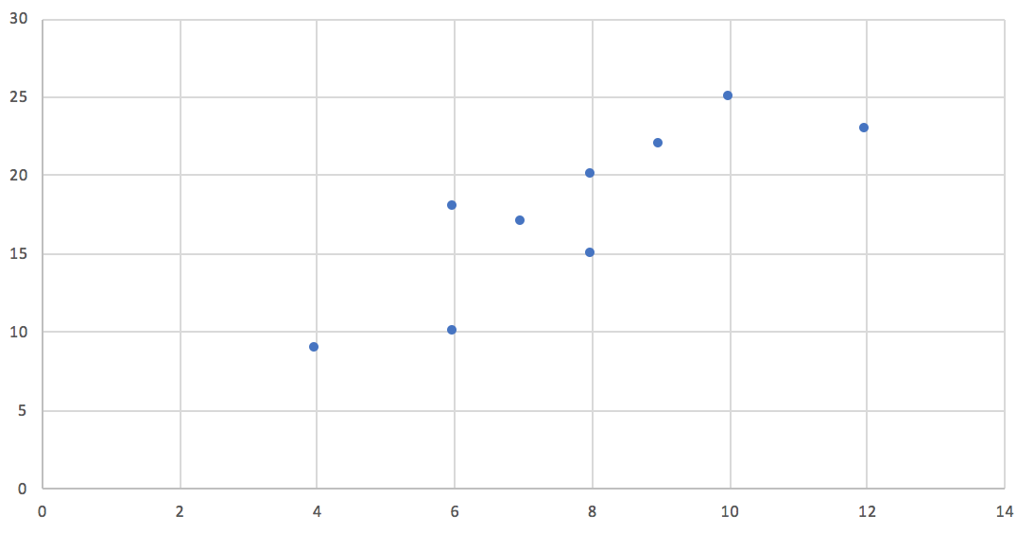
1 Example
Task – what is the relationship between number of TV ads and number of car sold
Ad ($) | 4 | 8 | 9 | 8 | 7 | 12 | 6 | 10 | 6
Sales ($) | 9 | 20 | 22 | 15 | 17 | 23 | 18 | 25 | 10
Sales($)
Ad($)

Slide 12
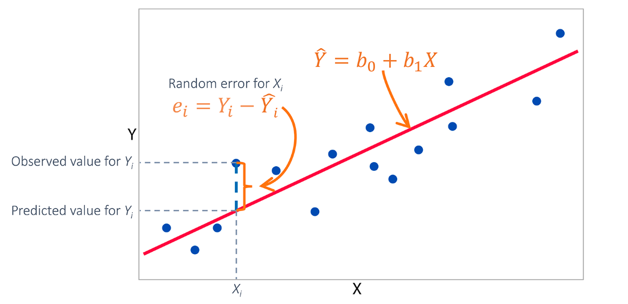
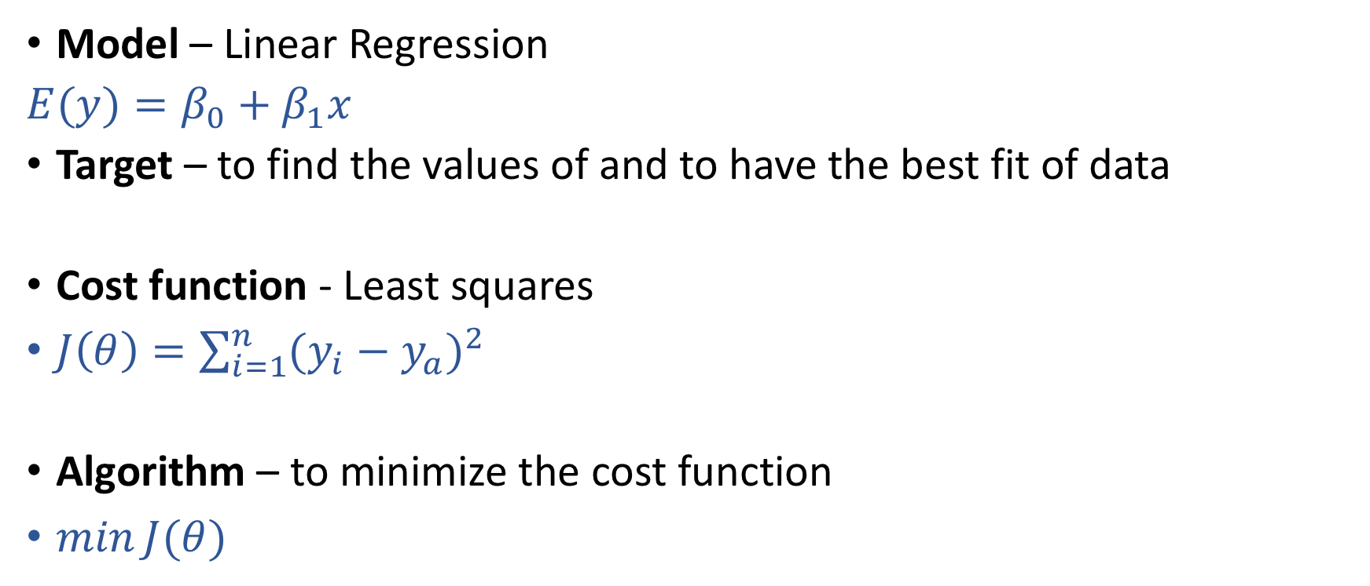
Linear Regression Key Components
Model – Linear Regression
$E(y)=β_{0}+β_{1}x$
Target – to find the values of and to have the best fit of data
Cost function - Least squares
$J\left(θ\right)=\sum_{i=1}^{n}{{(y_{i}−y_{a})}^{2}}$
Algorithm – to minimize the cost function
$\min{J(θ)}$

Slide 13
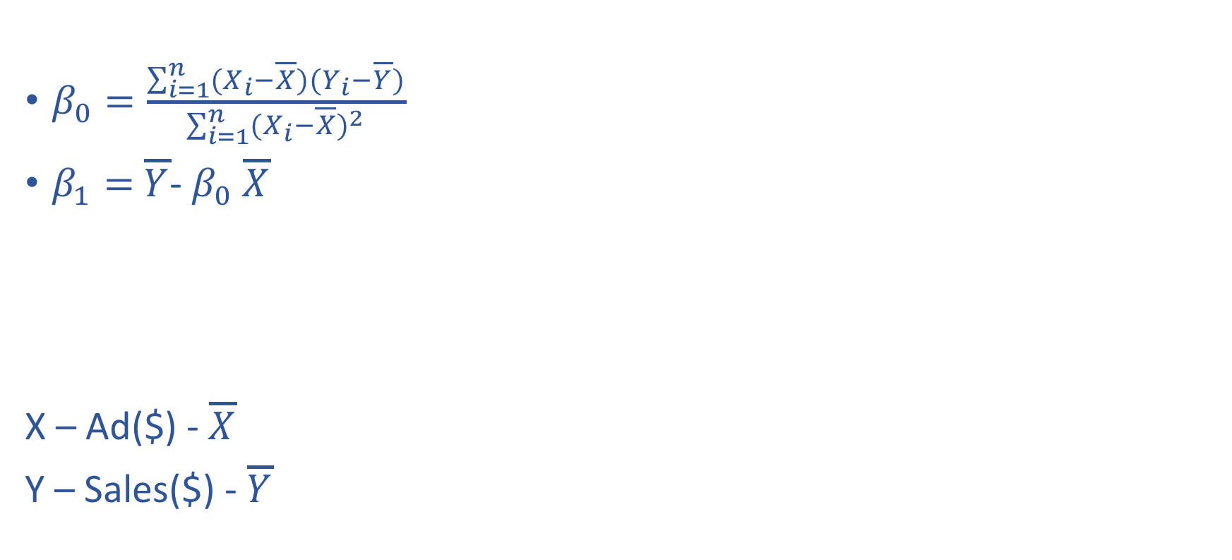
Calculation
$β_{0}=\frac{\sum_{i=1}^{n}{(X_{i}−\overline{X})(Y_{i}−\overline{Y})}}{\sum_{i=1}^{n}{{(X_{i}−\overline{X})}^{2}}}$
$β_{1}=$ $\overline{Y}$- $β_{0}$ $\overline{X}$
X – Ad($) - $\overline{X}$
Y – Sales($) - $\overline{Y}$
Ad ($) | 4 | 8 | 9 | 8 | 7 | 12 | 6 | 10 | 6
Sales ($) | 9 | 20 | 22 | 15 | 17 | 23 | 18 | 25 | 10

Slide 14
Output
If the customer is going to spent $20K on Ads, then what’s the predicted sales will be?

Slide 15
To do this in Python

Slide 16
Assignment

