Slide 1
Machine Learning 101
Session 3

Slide 2
Agenda
Recap Session 2 key points
What is Decision Tree
Example

Slide 3
Session 2 Key Points
What’s difference between Classification and Regression
In below example, what is independent variable?
What’s cost function?

Slide 4
Something you should know about Decision Tree
Where should I pick as my starting point for my tree?
How to measure the order of branches?
Does Decision Tree only predict classification / categorical output?

Slide 5
What is Decision Tree
Location
Same Location
Travel
Sport
Different Location
Not Match
Animals
Match
Not Match
Match
Not Match
Match
Not Match

Slide 6
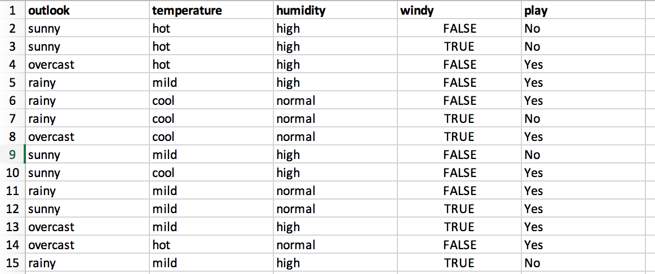
Where should I pick as my starting point for my tree?
Start from dependent variable - play

Slide 7
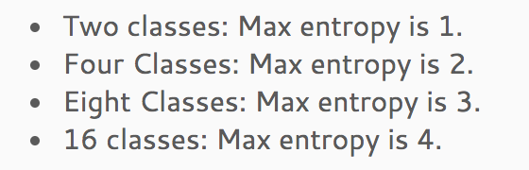
How to measure the order of branches?
Information Gain
Models use this metrics – ID3, C4.5 and C5.0
Key words: (2 class, could be more but the max number will be different)
Entropy – is a float between [0 , 1] – higher value means more uncertain
Conditional Entropy – is a float between [0 , 1] – higher value means more uncertain
Information Gain = Entropy – Conditional Entropy – float between [0,1] – higher value means this feature could bring more down on uncertainty
Gini index
Models use this metrics – CART
Key words:
Easy calculation compared with Information Gain – less log calculation
Gini index – smaller Gini index means higher certainty

Slide 8
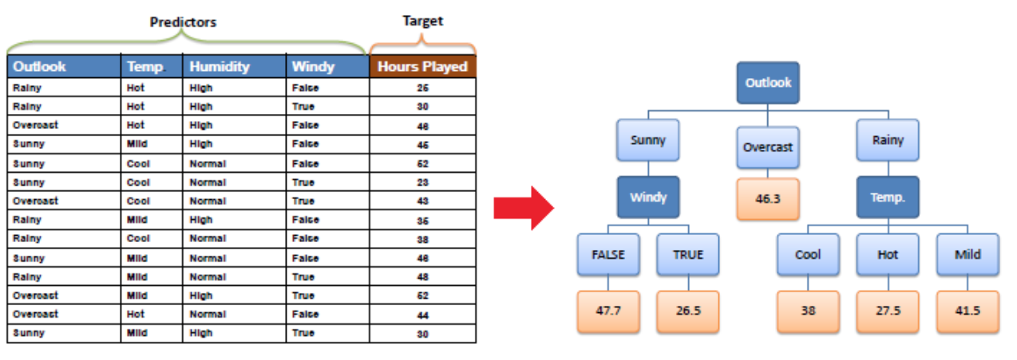
Does Decision Tree only predict classification / categorical output?
Classification Decision Tree - target variable can take a discrete set of values
Regression Decision Tree - target variable can take continuous values (typically real numbers)

Slide 9
Actual Example
Q&A

