Slide 1
Peer To Peer Video Chat
Deepak T S
Gaomeizhu Qu
Sijia Zhang
Vladimir Pchelin
Notes:
10/5/16
1
1

Slide 2
Introduction

Slide 3
Target
One to one video chat
Screen sharing
Sending files

Slide 4
Use cases
User: anyone who knows how to use mobile phone
Register using mobile number
Sending invitation to friends
One to one video chat
Screen sharing
Sending files
Use both front and back camera in single screen
Allow multi tasking with other apps in the same screen(Video chat on the go)

Slide 5
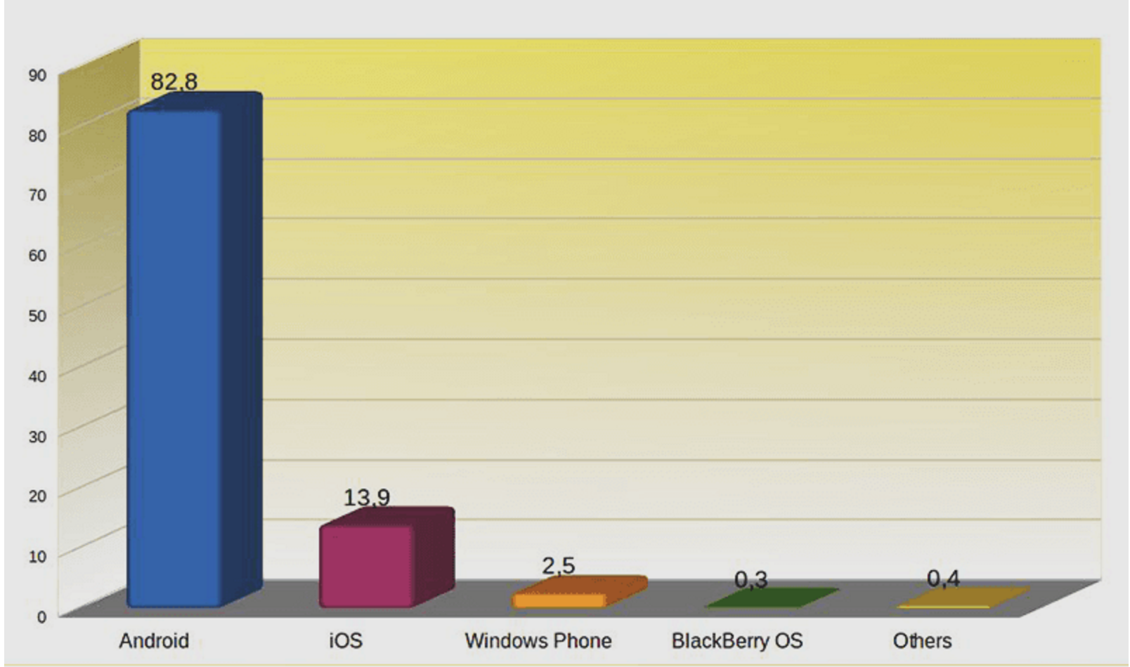
Platform: Android
Programming Language: Java(Java was much easier to study and apply)
Design style:
Distribution platforms:
Google Play Store
Market share:
Google is several steps ahead of other vendors in a number of sales, with 82.8% market share in the second quarter of 2015.

Slide 6
Technologies
Android Studio :
WebRTC :
Amazon AWS :
Github :

Slide 7
Plan
Sprint 1:
Sprint 2:
Sprint 3:
Demo:
Done

