Slide 1
Peer To Peer Video Chat
Deepak T S
Gaomeizhu Qu
Sijia Zhang
Notes:
10/10/16
1
1

Slide 2
Overview Of Sprint 1
To be able to build a video chat app.
Getting familiar with WebRTC technology.
Knowing how to use Android Studio.

Slide 3
App after Sprint 1
Peer to Peer Video connection established
Toggle between front and back camera
https://github.com/Yatko/video-chat

Slide 4
Targets decided after Sprint 1
Add login feature
Modify room feature
Create a Database to store data

Slide 5
Tasks Completed in Sprint 2

Slide 6
User Interface

Slide 7
Challenges we faced
Using both cameras at the same time is a Hardware related problem.
Possible only in Nexus 6, Samsung Galaxy Note 4 and HTC One M8.

Slide 9
Why Android?

Slide 10
Technologies
WebRTC
AWS
GitHub

Slide 11
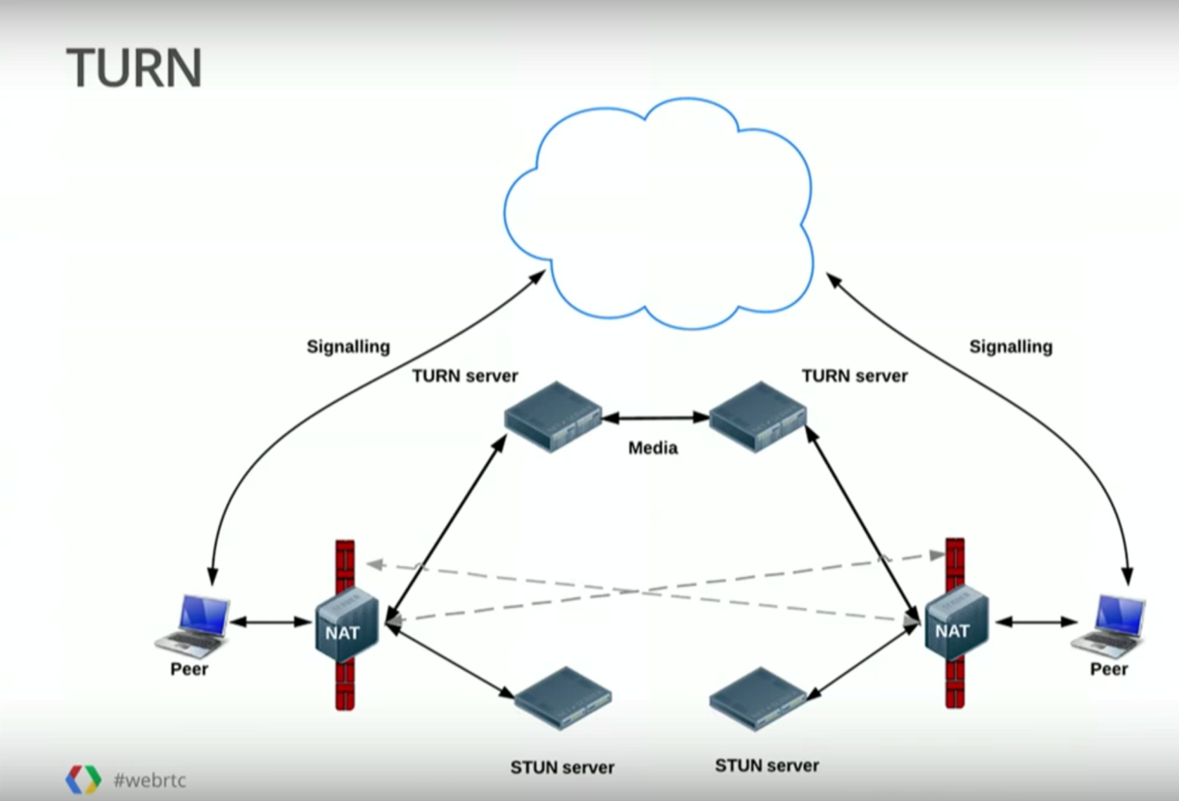
Why WebRTC?
Inbuilt functions for webcam usage
Use of STUN and TURN servers to avoid firewall problems
www.youtube.com/watch?v=p2HzZkd2A40

Slide 12
Plan
Sprint 1: Project introduction
Sprint 2: Figure out the structure of database and WebRTC and learn to use them.
Sprint 3: Combine each part of the technology.
Demo: Debug the entire program.
Done

Slide 13
THANK YOU
*
13

