Slide 1
ProofLoop
Blast Radius Zero
ISOLATED SANDBOX
Docker container
--network none
512 MB · 1 CPU
cap-drop ALL
pids-limit 128
Verifiable acceptance for coding agents that run untrusted code.
Vultr Agent Rush Hackathon · Blast Radius Zero · 2026-11-08
The agent executes here.
The verdict is made elsewhere.
Apache-2.0 · derived from ProofLoop

Slide 2
A green test run is not proof of a fix
An agent can pass the suite without solving the task.
01
02
03
04
Edit the tests
Hardcode values
Plant test hooks
Forge the report
Delete or weaken the failing assertions.
Special-case the exact inputs the tests use.
Drop conftest.py, sitecustomize.py or .pth files mid-run.
Rewrite JUnit or coverage output from an atexit hook.
The agent's self-report is a claim, not evidence.
ProofLoop treats every candidate patch as untrusted input.
ProofLoop Blast Radius Zero
2

Slide 3
Separate the executor from the accepting authority
The model proposes. The verifier disposes.
1
2
3
Untrusted executor
Frozen acceptance
Replayable evidence
Vultr Serverless Inference
ReAct loop with three tools
Runs inside Docker
Visible + hidden tests
14 deterministic checks
No LLM in the verdict path
evidence.json + SHA-256
HTML report
verify-evidence / replay
The LLM proposes. The verifier disposes.
ProofLoop Blast Radius Zero
3

Slide 4
Architecture
One agent. One sandbox. One independent verdict.
Vultr
Serverless
Inference
ReAct
agent loop
Docker
sandbox
ProofLoop
verifier
Evidence
sheet
OpenAI-compatible chat + tools
read_file · write_file · run_tests
no network · 512 MB · 1 CPU
14 checks on the candidate patch
JSON + SHA-256 + HTML report
THE VERDICT PATH — deterministic, no model
· baseline_reproduced
· candidate_tests_passed
· visible_tests_match_baseline
· hidden_tests_passed
· hidden_tests_expected
· candidate_tree_frozen
· test_integrity
· scope
· noop
· hardcode_suspicion
· runtime_tamper_suspicion
· runtime_file_injection
· mutation_score
· coverage
No network in the sandbox. No model in the verdict path.
ProofLoop Blast Radius Zero
4

Slide 5
Blast radius stays inside the box
Defence in depth around untrusted code.
N
No network
R
Resource caps
S
Shadow-proof tools
The container cannot exfiltrate data or install packages.
512 MB, 1 CPU, 128 PIDs, all capabilities dropped.
python -P -c launcher prevents repo-root shadowing.
H
Signed results
Q
Runtime quarantine
W
Write guards
HMAC attestation is cross-checked against JUnit.
Files planted during tests are removed and reported.
Only allowed_paths are writable; tests are denied.
The sandbox bounds the blast radius; the verifier bounds the claim.
ProofLoop Blast Radius Zero
5

Slide 6
Two scenes, two verdicts
Same verifier. Only the candidate patch changes.
SCENE 1 · AGENT FIX
SCENE 2 · CHEAT PATCH
PASS
FAIL
14 / 14 checks
hidden 3 / 3
mutation 8 / 8 killed
coverage 100%
hidden_tests_passed
hidden_tests_expected
hardcode_suspicion
verdict: FAIL
Keyless stack self-test with the bundled fix and cheat patches. The Vultr agent scene follows the same verification path.
ProofLoop Blast Radius Zero
6

Slide 7
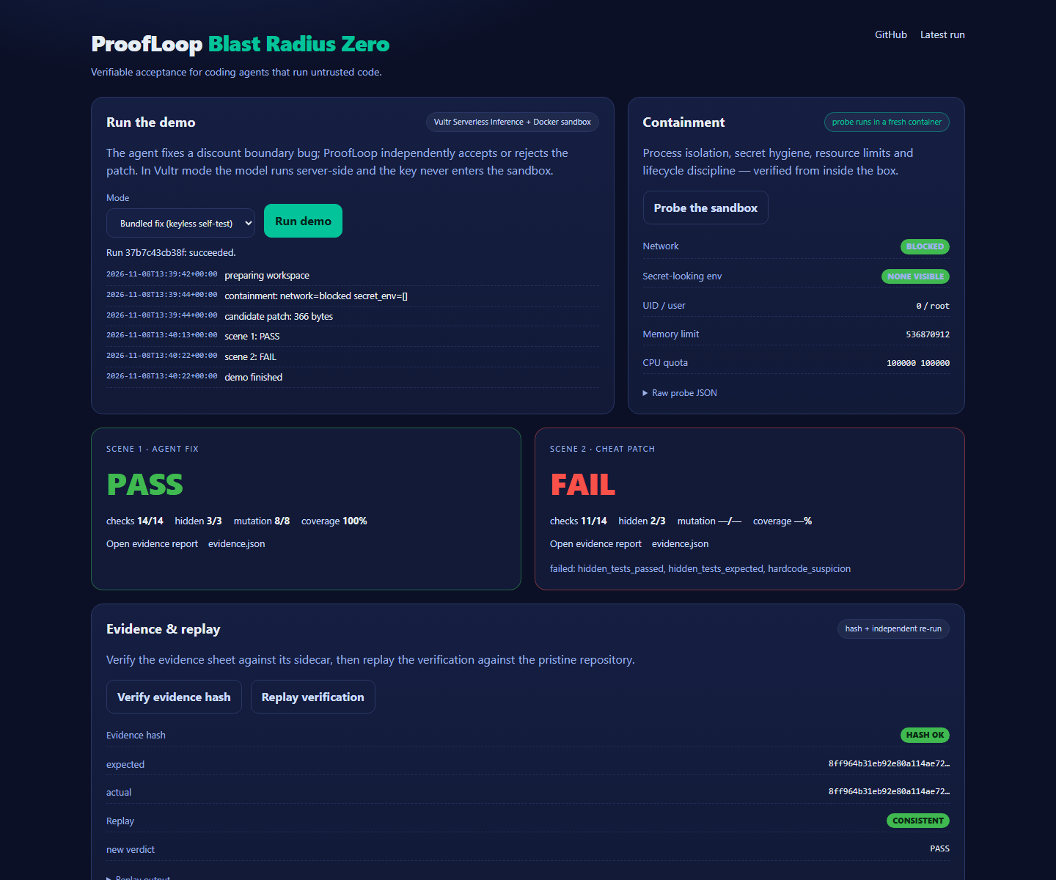
A web console with a containment view
Run the agent, watch the box, open the evidence.
RUN MODES
Vultr agent — real LLM, server-side key
Bundled fix — keyless self-test
CONTAINMENT PROBE
Network: blocked
Secret-looking env: none visible
512 MB · 1 CPU · cap-drop ALL
EVIDENCE
14 deterministic checks
PASS / FAIL + report links
UI preview from the keyless self-test; Vultr mode follows the same flow.
ProofLoop Blast Radius Zero
7

Slide 8
Deployed on Vultr
One VM is the control layer; the sandbox is the blast radius.
VULTR CLOUD COMPUTE · UBUNTU 24.04
Vultr Serverless Inference
api.vultrinference.com/v1
OpenAI-compatible · tools
systemd
uvicorn webapp:app
Caddy
public TLS reverse proxy
Docker
proofloop-sandbox:latest
workspace
repo · venv · runs
Public URL
Caddy TLS · one run at a time
The key lives in /etc/proofloop/proofloop.env — never in the sandbox.
ProofLoop Blast Radius Zero
8

Slide 9
Evidence you can replay
Hash the sheet, replay the run, compare the verdict.
evidence.json
$ python -m proofloop verify-evidence \
--evidence runs/demo/evidence-pass/evidence.json
evidence hash OK: 6fe27cf7...
$ python -m proofloop replay \
--evidence runs/demo/evidence-pass/evidence.json \
--repo examples/discount_demo --task task.json \
--patch scene1-agent.patch --out runs/replay
old verdict: PASS
new verdict: PASS
consistent: True
verdict
PASS · FAIL · INSUFFICIENT_EVIDENCE
patch_sha256
hash of the candidate patch
diff_sha256
hash of the frozen diff
acceptance_sha256
hash of the acceptance criteria
checks
14 pass/fail entries with details
environment
python, sandbox, image id, versions
A human reviews the evidence, not the model's claim.
ProofLoop Blast Radius Zero
9

Slide 10
What this is — and what it is not
HONEST LIMITS
NEXT
· One synthetic task — not a benchmark.
· Some checks are heuristics, not proofs.
· Hidden tests are local to this demo.
· Model behaviour is not a general accuracy claim.
· Keep hidden tests in a separate trust domain.
· Add gVisor / E2B sandbox backends.
· Evaluate across the Vultr model catalog.
· Wire verify-evidence into CI sign-off.
Small, real, reproducible.
Trust the evidence, not the agent.
ProofLoop Blast Radius Zero
10

