Slide 1
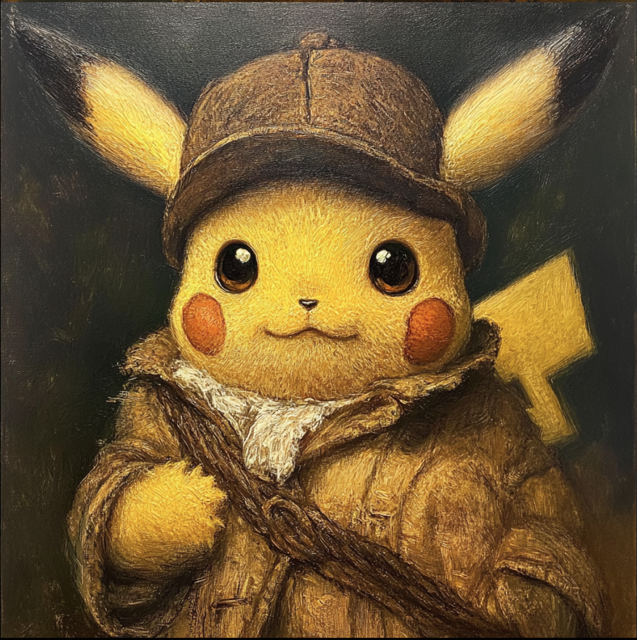
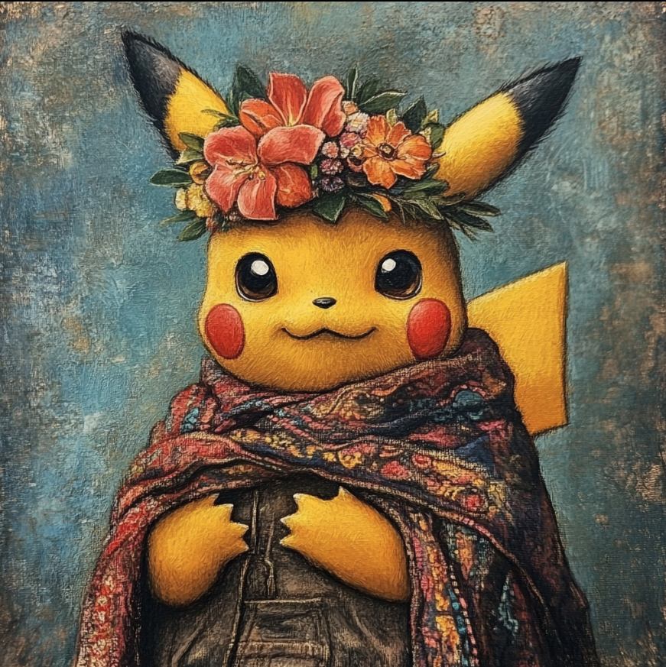
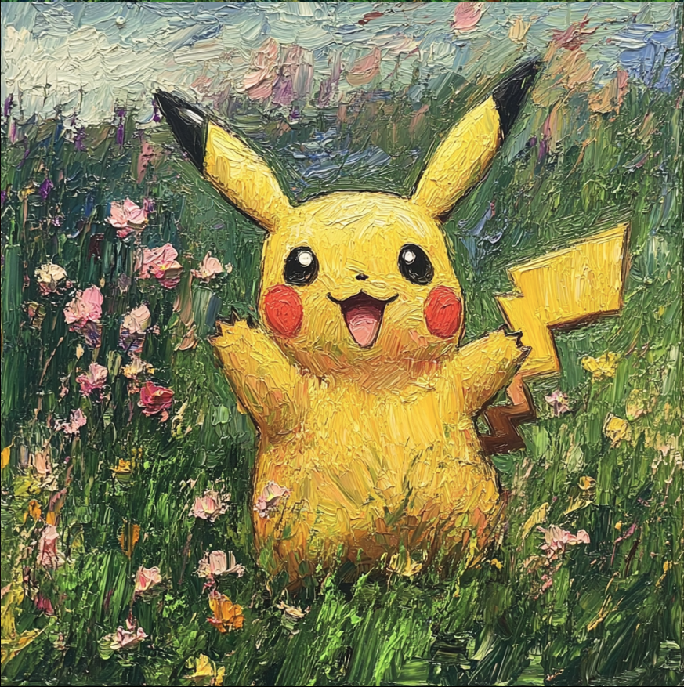
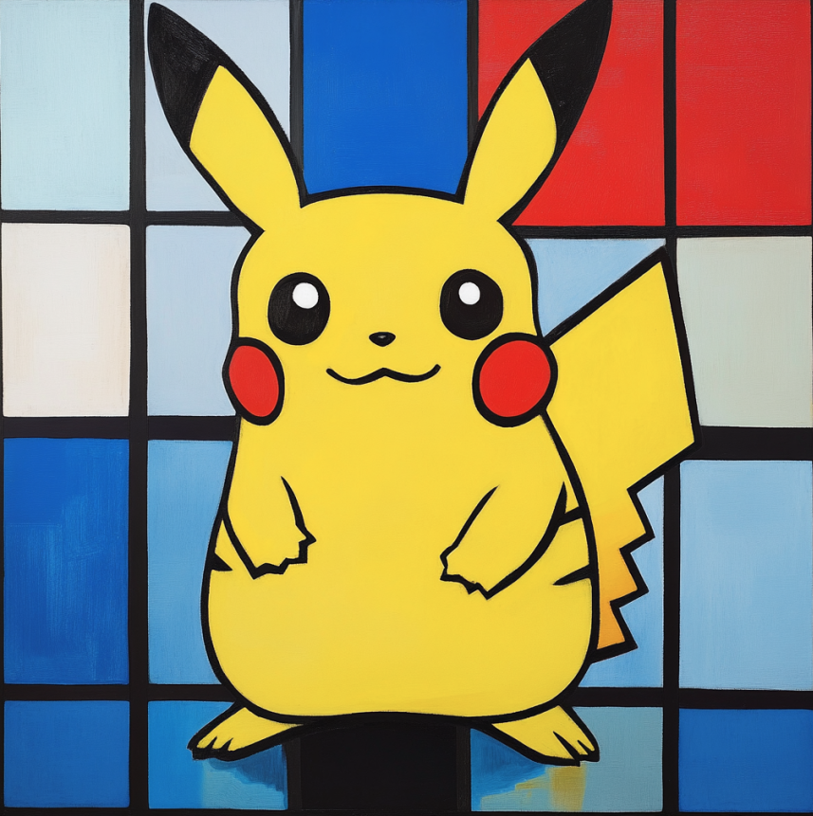
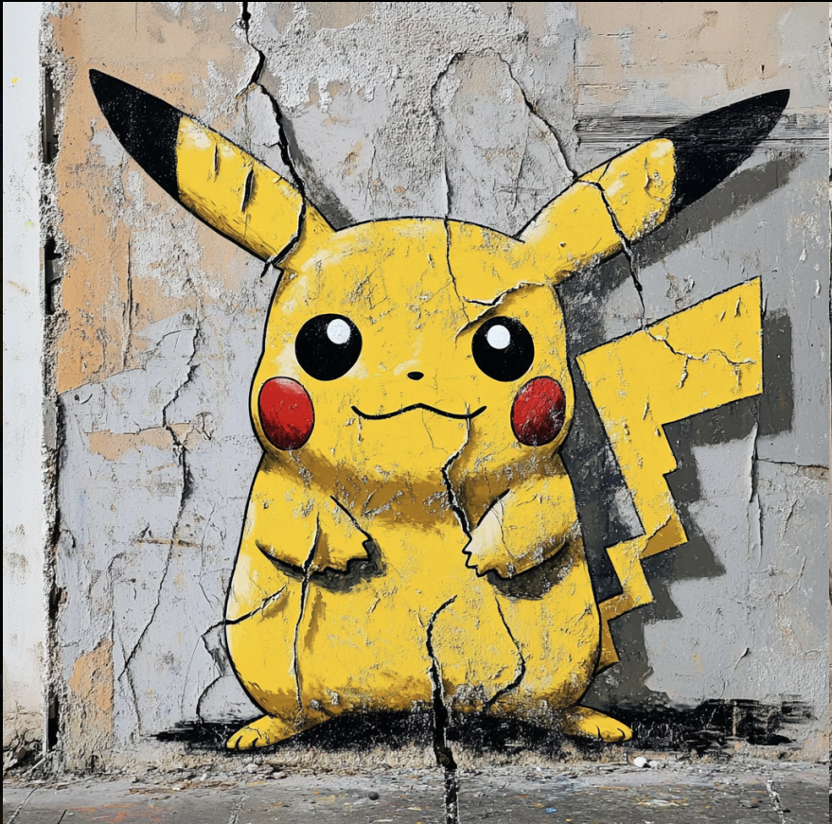
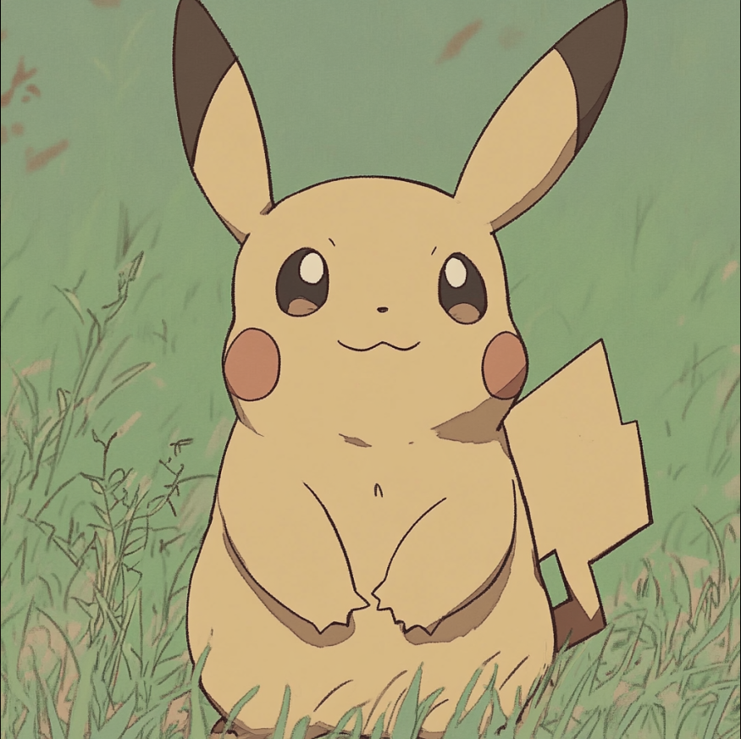
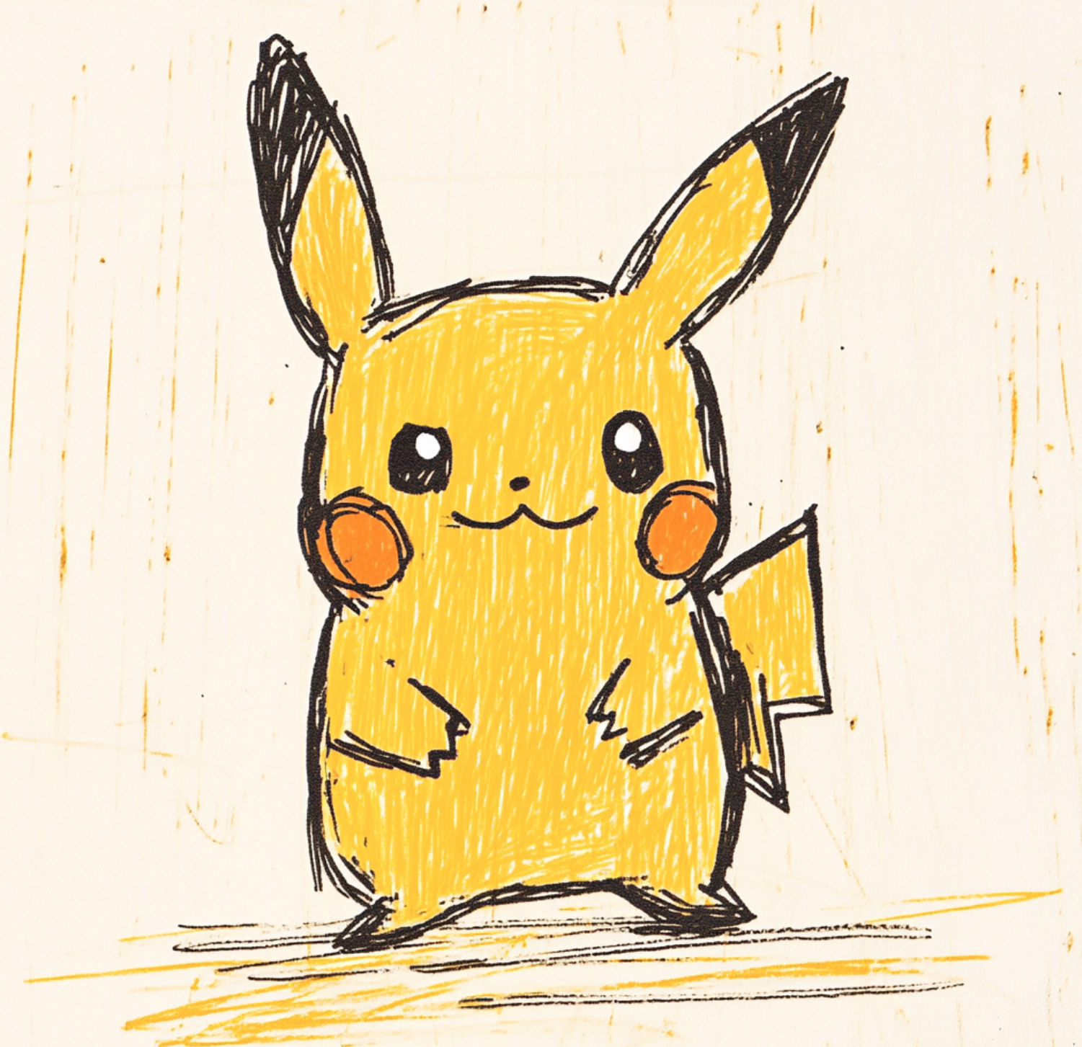
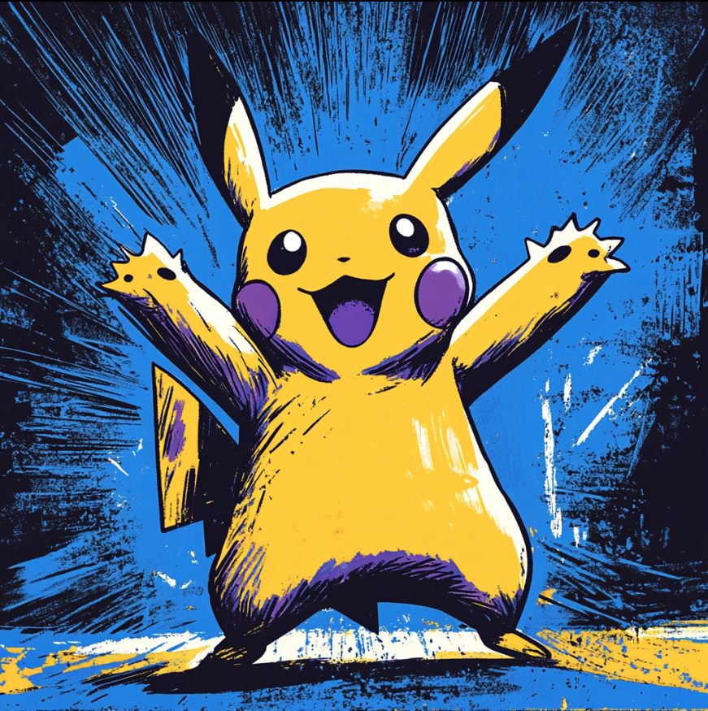
Pikachu, in the style of _______
All generated using Midjourney. Guess the answer!

Slide 2
Pikachu, in the style of _______
Rembrandt
Frida Kahlo
Monet
Mondrian
Banksy
sref 3925873398
(Like Studio Ghibli)
sref 4059834270
(children color book)
sref 1612582939

Slide 3
There are several ways you can control styles in Midjourney (An AI image generator)
Write style/artist names in the prompt
Art movement/Style names: Impressionism, Dadaism, Cyberpunk, …
Artist names: Picasso, Monet, …
Video/Game Companies: Disney, Nintendo, …
……
Use sref (style reference) code
Imagine that Picasso's artistic style exists somewhere within Midjourney's vast style universe. It's hidden behind a style code, something like #abcdefg000. It is a parameter you can put in the prompt to control style of image generated.
Even the AI developers don't know exactly which code matches which style
Users can experiment with random style codes and eventually find out which code represents Picasso
And then they can make this code public and call it “Picasso sref”
There’s an active community of users who search for and document these hidden styles

Slide 4
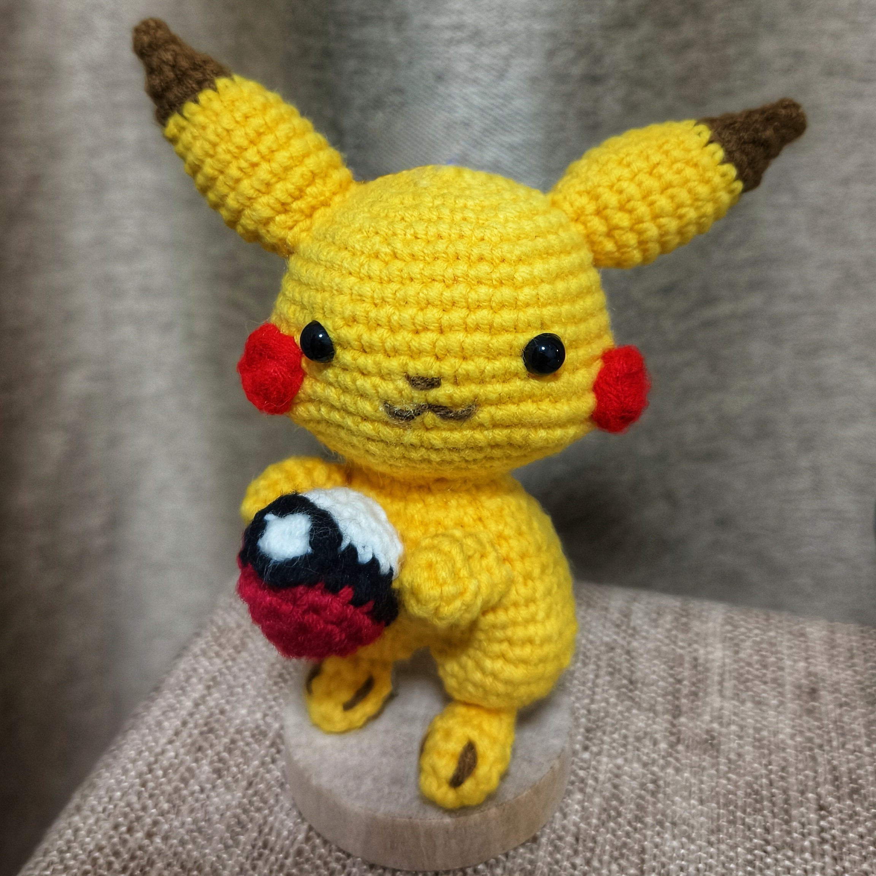
Credit to my friend
Xulin Liang

