Slide 1
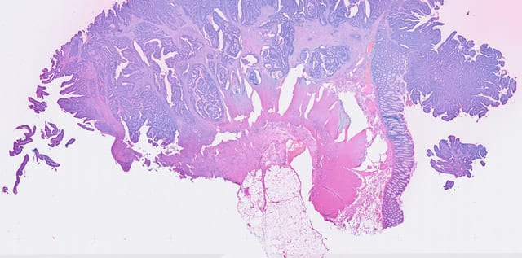
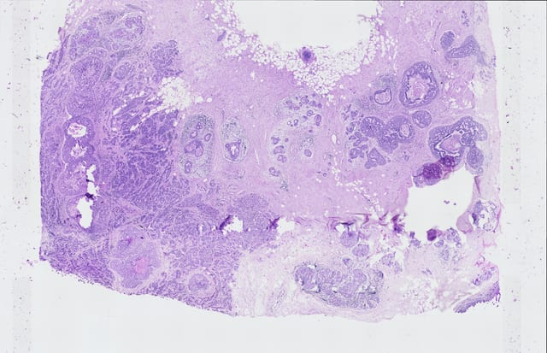
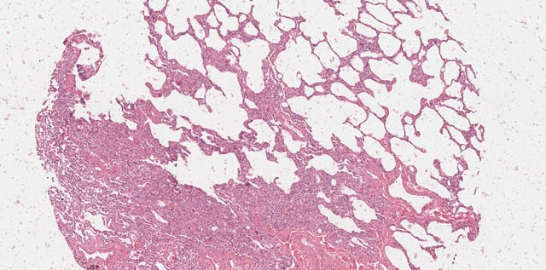
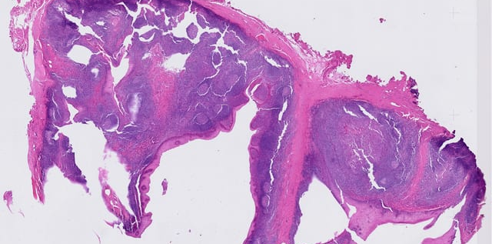
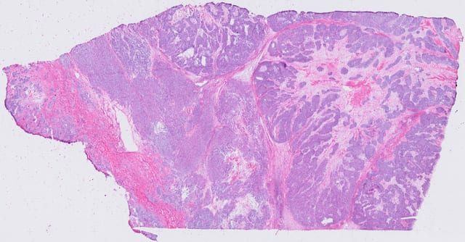
(a) 87 Xenium
datasets
(b) Pseudo-Visium
construction
(c) Seven super-
resolution methods
(d) Multi-level evaluation
Diverse tissues
and cohorts
Local Xenium tissue region
Cell-level comparison
Pseudo-Visium Y_{s}
Ground truth ↔ Prediction
One spot,
multiple cells
+ H&E
Gene-level
spatial fidelity
Cell-level
transcriptomic
fidelity
Unified benchmark
protocol
Per-gene Pearson
correlation
Per-cell Pearson
correlation
H&E image
FineST
Y
=
∑
X
STARS
Ground
truth
Ground
truth
s
i∈s
i
Prediction
Prediction
sCellST
Cell coordinates
Measured cells
Visium-like
spots
HISTEX
Within-spot
allocation
fidelity
Spot
aggregation
consistency
Same cell-level measurements
Hist2SR
DeepSpot2Cell
Pearson /
Spearman
∑
X̂
↔
Y
i∈s
i
s
Measured cell-level
expression
PanoSpace
Cell-level
ground truth
Pseudo-Visium
observation
sum
Ground
truth
Prediction
↔
Cells
X
cell
Y
s
Predicted cell
expression
Cell sum
Observed
Yₛ
Genes
Evaluation
ground truth
Model input
Evaluation subsets
Measured cell-level
ground truth
X̂
cell
HVG / SVG / HEG
20 / 50 / 100 genes
X
∈
ℝ
N
× G
Spot consistency ≠
cell-level recovery
cell
cell

