Slide 1
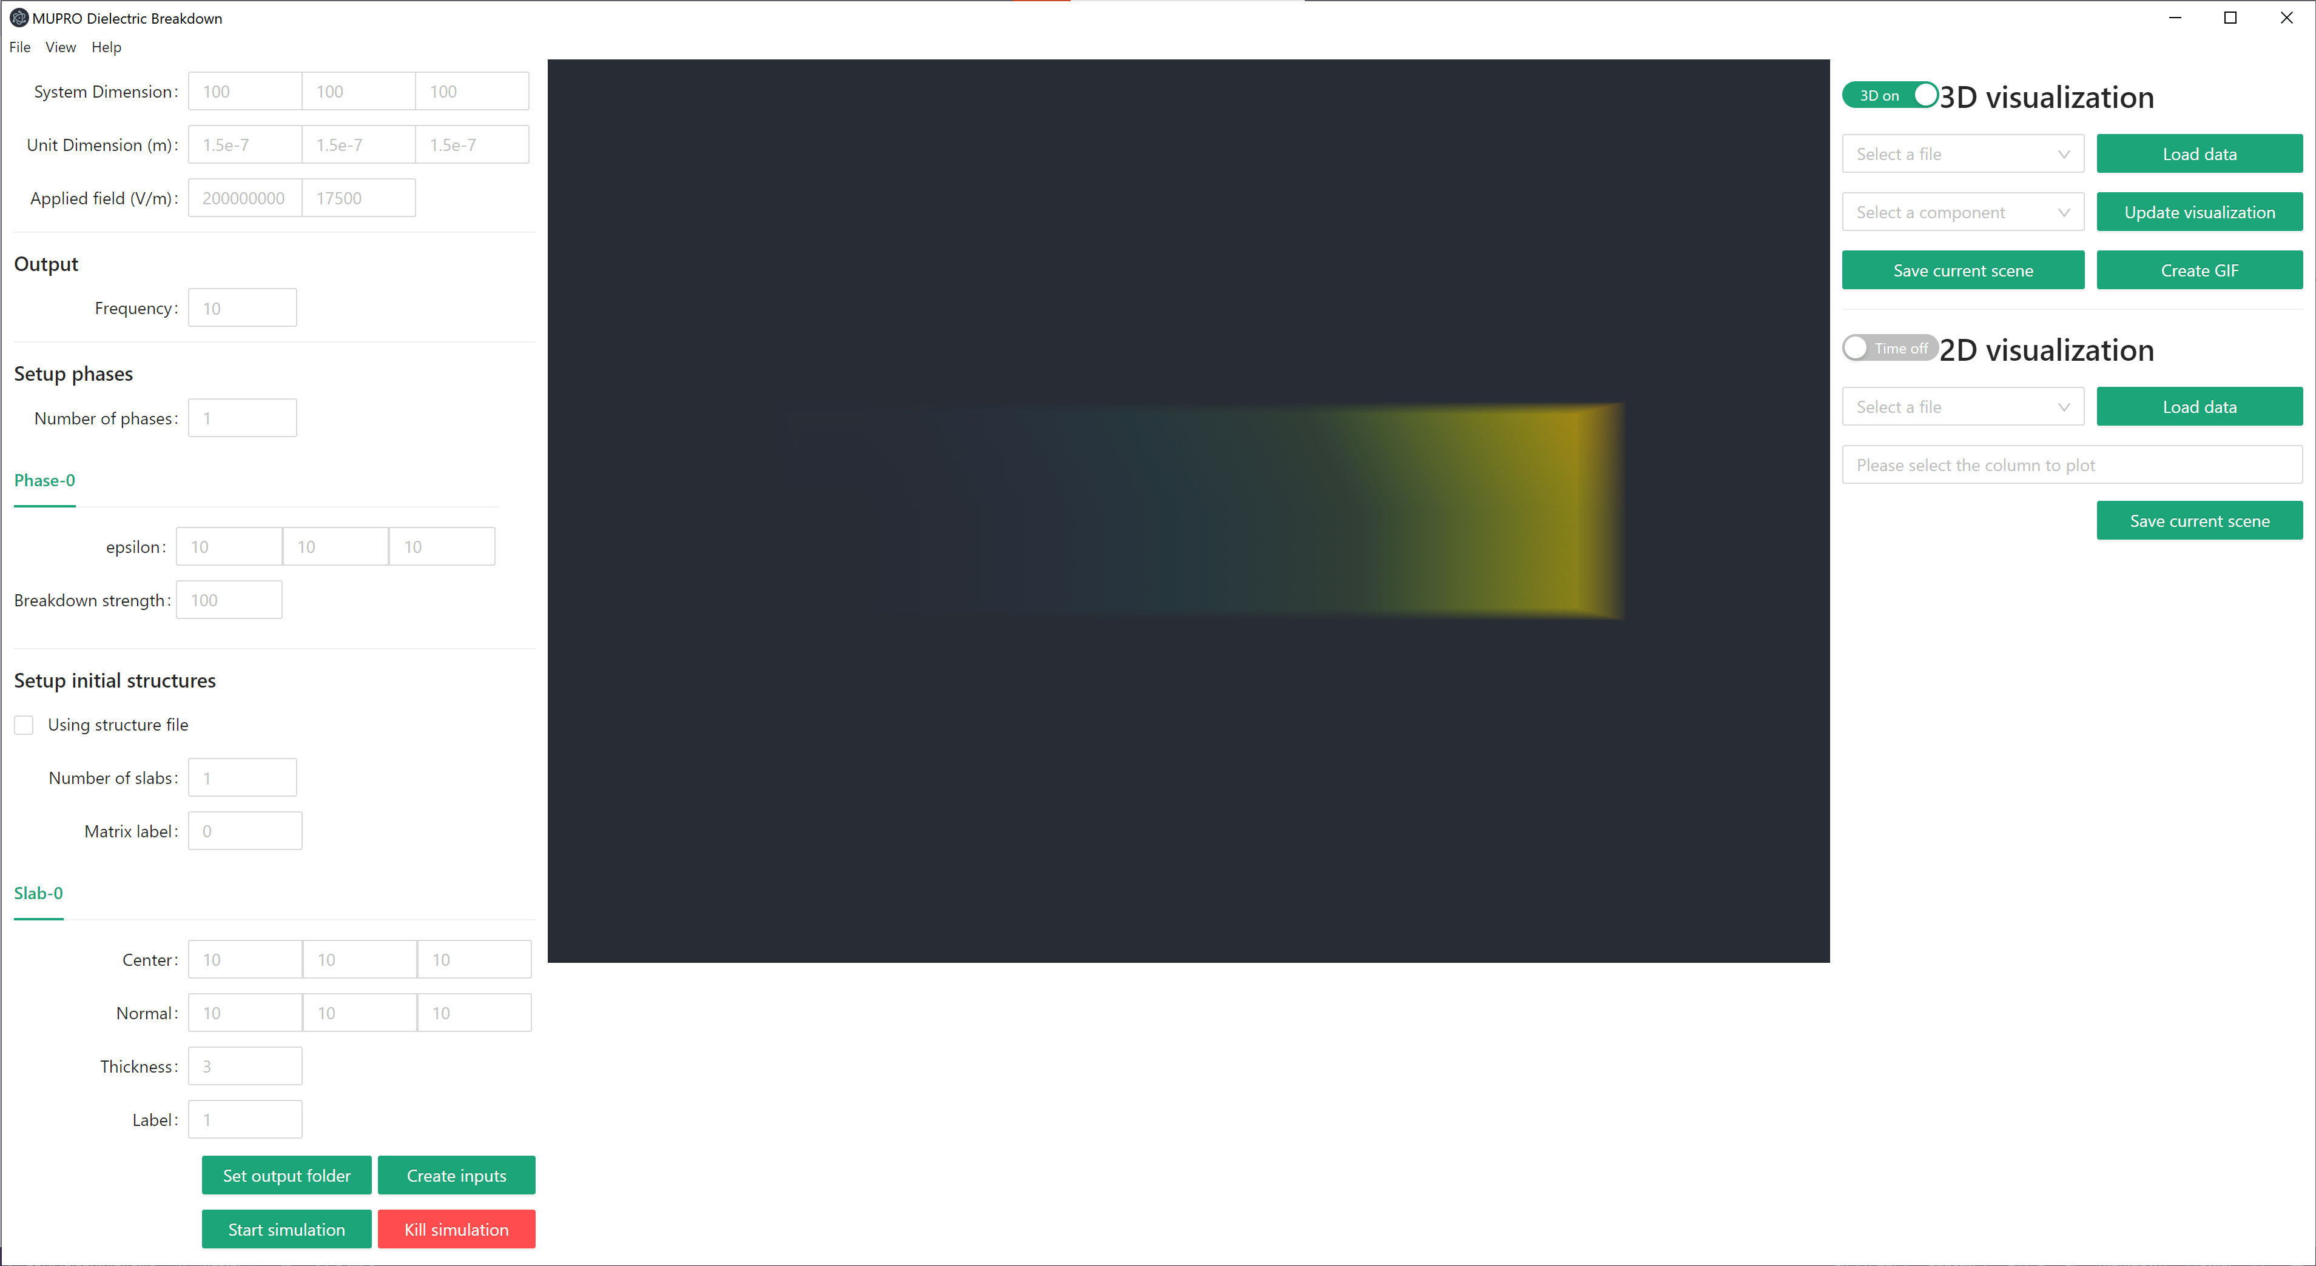
1
2
3
Input
3D/Time series
visualization
Visualization
control
4
Console
output

