Slide 1

The Start of Frontend
Martynas Barzda, Software Engineer
martynas.barzda@nfq.lt

Slide 2
HTML (Hyper Text Markup Language)
Created in '90 at CERN for documents sharing purposes by Tim Barnes-Lee
Specifications maintained by World Wide Web Consortium (W3C) since 1996
HTML5 standardized in late 2014 and it became recommendation
XHTML is extended HTML4 with XML 1.0 specification
Uses .html or .htm for filename extension, MIME: text/html

Slide 3
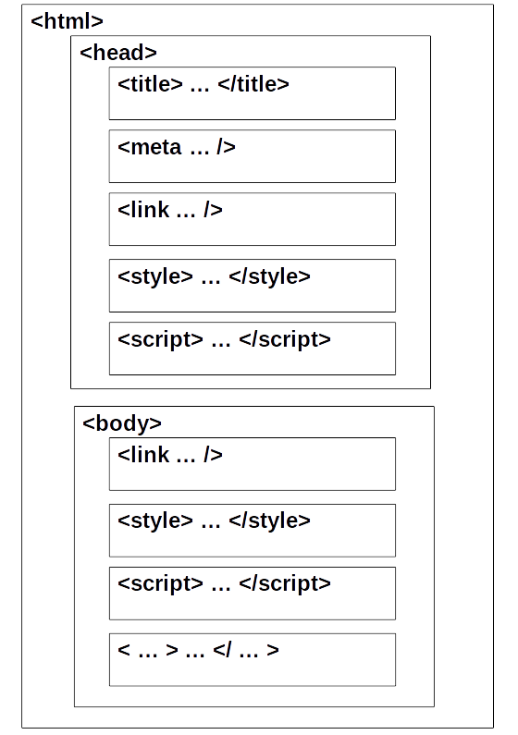
The HTML Concept
html
  head
    title
    meta
    link
    style
    script
  body
    link
    style
    script
    …

Slide 4
The Markup
<!DOCTYPE html>
<html lang=“en“>
<head>
<title>Hello world!</title>
</head>
<body>
<p>Hello world!</p>
</body>
</html>

Slide 5

Semantic Markup
Search-engine spiders are able to rate significance of pieces of text they found in markup, the semantic structures applied to bring out the meaning of published text
Good semantic improves accessibility and screen reader or audio browser can correct ascertain the structure of document
<nav role=“navigation“ aria-label=“main navigation“>
<ul>
<li><a href=”/”>Home</a></li>
<li><a href=”/products”>Products</a></li>
</ul>
</nav>

Slide 6
CSS
V1 released in 1996 by Håkon Wium Lie and Bert Bos;
Specifications maintained by World Wide Web Consortium (W3C) since 1998
CSS2.1 is standard, CSS3 is still working draft, but 4 modules announced as recommendations (media queries, namespaces, selectors level 3, color)
Uses .css for filename extension, MIME: text/css

Slide 7
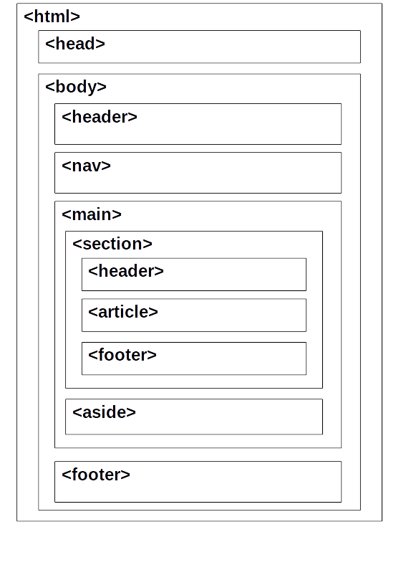
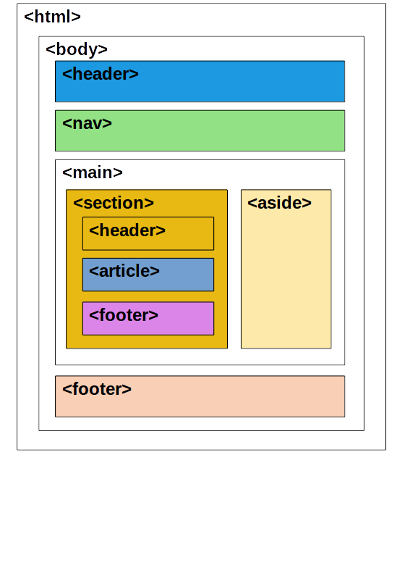
The CSS concept

Slide 8
The CSS syntax
// Rule
selector {
// Declarations block
property: value;
}
selector children {
property: value;
}
// Rule-set
selector1,
selector2 {
property: value;
}
selector:pseudo-class {
property: value;
}

Slide 9
CSS priority scheme
Selector specificity
(body p vs. p)
Importance
(color: red !important;)
Rule order
(last has highest priority)
Inline style
(<div style=”…”></div>)
From parent (inherit)
Media type
(@media or media=”…”)
<style> in HTML
Custom browser default
Browser default

Slide 10
CSS selectors
Selectors are unable to ascend
Selectors can be:
  elements of specific type (p, div, h1, section…)
  elements specified by “id” or “class” attributes (#unique-el, .style-group)
  elements depending on how they are placed relative to others in the document tree (section > article, .wrapper .module strong)
Browser reads selector from right to left

Slide 11
Reading of selectors
.offer
h1
<div class=“ad“>
<h1 class=“ad-title“></h1>
</div>
.offer-title
<article class=“offer“>
<h1 class=“offer-title“></h1>
</article>
<article class=“offer“>
<h1 class=“offer-title“></h1>
</article>

Slide 12
Reading of selectors
.offer
h1
<div class=“ad“>
<h1 class=“ad-title“></h1>
</div>
.offer-title
<article class=“offer“>
<h1 class=“offer-title“></h1>
</article>
<article class=“offer“>
<h1 class=“offer-title“></h1>
</article>

Slide 13
Reading of selectors
.offer
h1
<div class=“ad“>
<h1 class=“ad-title“></h1>
</div>
.offer-title
<article class=“offer“>
<h1 class=“offer-title“></h1>
</article>
<article class=“offer“>
<h1 class=“offer-title“></h1>
</article>

Slide 14
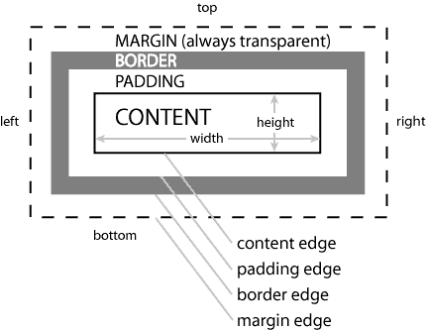
CSS Box Model

Slide 15
JavaScript
Designed by Brendan Eich, shipped in Netscape Navigator in 1995
Multi­-paradigm: scripting, object oriented (prototype­-based), imperative, functional
Standardized as ECMAScript since 1996. Current standard is ECMAScript 5.1
Officially managed by Mozilla Foundation
Uses .js for filename extension, MIME: application/javascript (text/javascript is obsolete by RFC 4329)

Slide 16
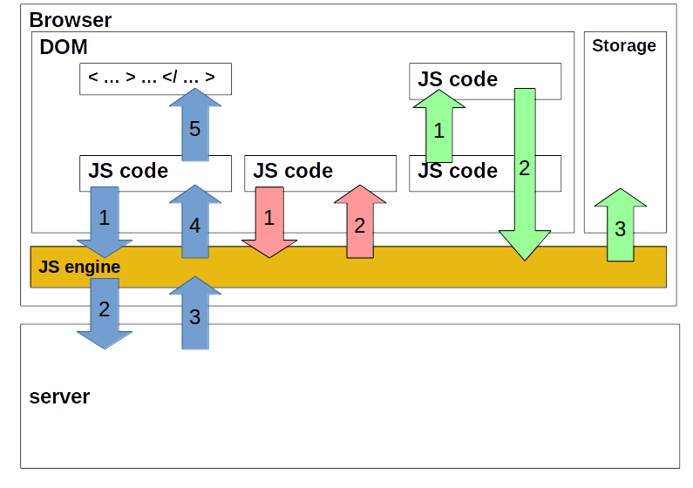
The JavaScript Concept

Slide 17
Types
JS uses 2 kinds of types:
  Primitive – simple data types
  Reference – objects which are references to locations in memory
5 primitive types:
  Boolean – true/false or new Boolean()
  Number – integer or floating-point numeric value or
  new Number()
  String – characters delimited by either single or double quotes or new String()
  Null – null value
  Undefined – undefined value (not initialized variable has undefined value, an ex. var a;)

Slide 18
Reference types
Reference values are instances of reference types and are synonymous with objects (unordered lists of properties consisting of a name and a value)
Reference types do not store the object directly into variable. Variable holds a pointer of object
When assigned a variable with object pointer to another, each variable get a copy of pointer and both reference the same object in memory
var obj1 = new Object();
var obj2 = obj1;
Variable object
obj1
obj2
Memory
Object

Slide 19
Instantiating Built-in Types
Built-in types:
  Array – an ordered list of numerically indexed values;
  new Array() or []
  Date – a date and time; new Date()
  Error – a runtime error; new Error()
  Function – a function; new Function() or function()
  Object – a generic object; new Object() or {}
  RegExp – a regular expresion; new RegExp() or //
  Math - provides properties and methods for manipulating mathematical data. Does not store data

Slide 20
The Logical and Comparison Operators
Data comparison operators - compare operands and return Boolean values:
  == - the left and right operands are equal
  === - the left and right operands are equal and the data types are equal
  != - the left operand is not equal to the right
  > - the left operand is greater than the right
  >= - the left operand is greater than, or equal to, the right
  < - the left operand is less than the right
  <= - the left operand is less than, or equal to, the right
Logical operators - test for more than one condition:
  && - And
  || - Or
  ! - Not

Slide 21
Data Manipulation Operators
JavaScript has a number of operators you can use to manipulate the data:
  + - adds numbers or concatenates strings; 1 + 2 = 3 or
  'a' + 'b' = 'ab'
  - - subtracts the second number from first; 2 – 1 = 1
  * - multiples two numbers; 2 * 2 = 4
  / - divides the first number by the second; 4 / 2 = 2
  % - finds the modulus; 3 % 2 = 1
  -- - decreases the number by 1; var x = 2; x--; (x === 1)
  ++ - increases the number by 1; var x = 2; x++; (x === 3)

Slide 22
Twitter Bootstrap
Developed by Mark Otto and Jacob Thornton, released in 2011
Current The Bootstrap 3 release was announced in 2013
The Bootstrap 3 is mobile first and using flat design
In addition to the regular HTML elements, Bootstrap contains other commonly used interface elements (button groups, drop-downs, tabs, navigation, etc.) implemented as CSS classes
Bootstrap comes with several JS components (Modal, Dropdown, Scrollspy, etc.) in form of jQuery plugins

Slide 23
jQuery
Was originally released in January 2006
Designed to simplify the client-side scripting of HTML
Eliminates cross-browser incompatibilities
The framework is extensible, new events, elements and methods can be easily added and then reused as a plugin
Reserves $ as global variable

Slide 24
Readings
Mark Myers, A Smarter Way to Learn HTML & CSS
Nicholas C. Zakas, The Principles of Object-Oriented JavaScript
Russ Ferguson, Christian Heilmann, Beginning JavaScript with DOM Scripting and Ajax: Second Edition
http://smashingmagazine.com
http://sitepoint.com
http://css-tricks.com
http://html5doctor.com

Slide 25
Resources
http://caniuse.com
http://validator.w3.org
https://jigsaw.w3.org/css-validator/
https://regex101.com/#javascript
https://developer.mozilla.org/en-US/docs/Web
http://getbootstrap.com
http://api.jquery.com
http://docs.emmet.io/cheat-sheet/

Slide 26
Home Work
Create a responsive ready CV (at least for mobile and desktop viewports) with Twitter's Bootstrap. CV should have Table of Contents. Its links should navigate into sections (personal information, working history, education etc.).
Home work should be pushed into Github's public repository. The link of repository should be send via email martynas.barzda@nfq.lt.

